Slide 1
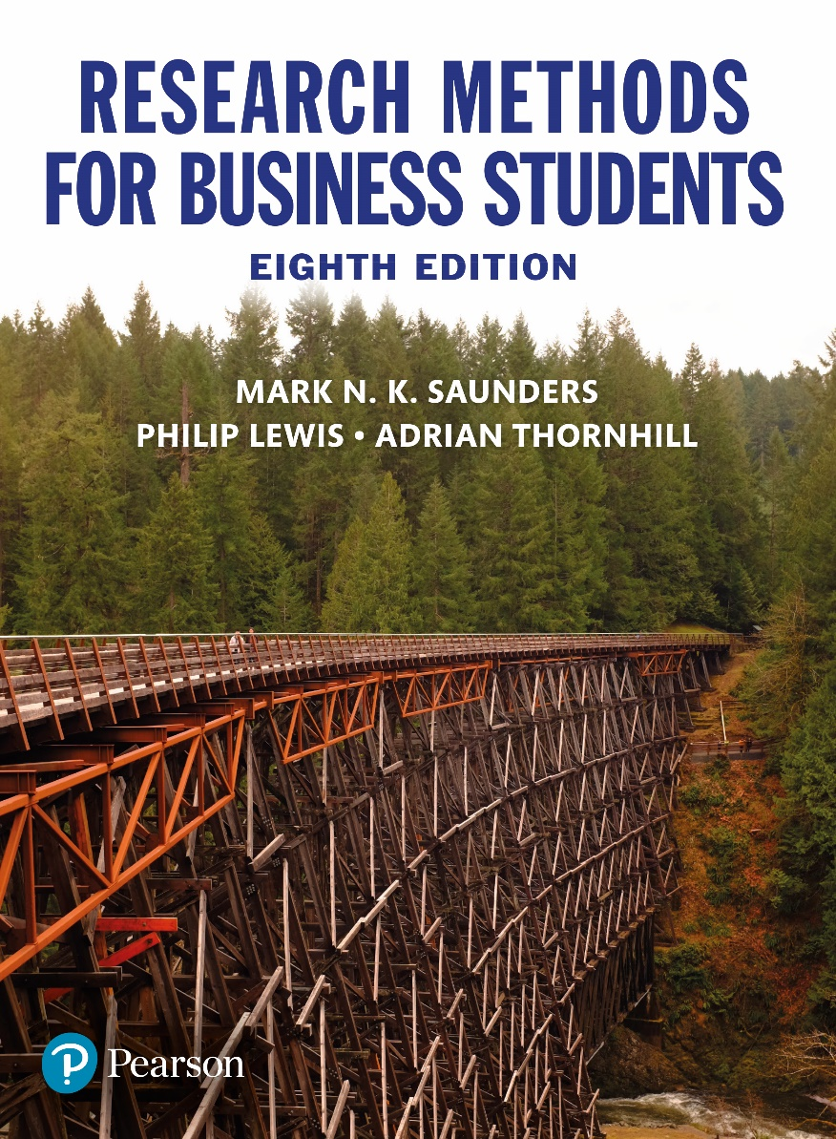
Research Methods for Business Students
8th edition
Chapter 11
Collecting primary data using questionnaires

Slide 2
Learning Objectives (1 of 2)
By the end of this chapter you should:
11.1 understand the advantages and disadvantages of questionnaires as a data collection method;
11.2 be aware of a range of self-completed (Internet, SMS, postal, delivery and collection) and researcher-completed (telephone, face-to-face) questionnaires;
11.3 be aware of the possible need to combine data collection methods within a research project;
11.4 be able to select and justify the use of appropriate questionnaire methods for a variety of research scenarios;

Slide 3
Learning Objectives (2 of 2)
11.5 be able to design, pilot and deliver a questionnaire to answer research questions and to meet objectives;
11.6 be able to take appropriate action to enhance response rates and to ensure the validity and reliability of the data collected;
11.7 be able to apply the knowledge, skills and understanding gained to your own research project.

Slide 4
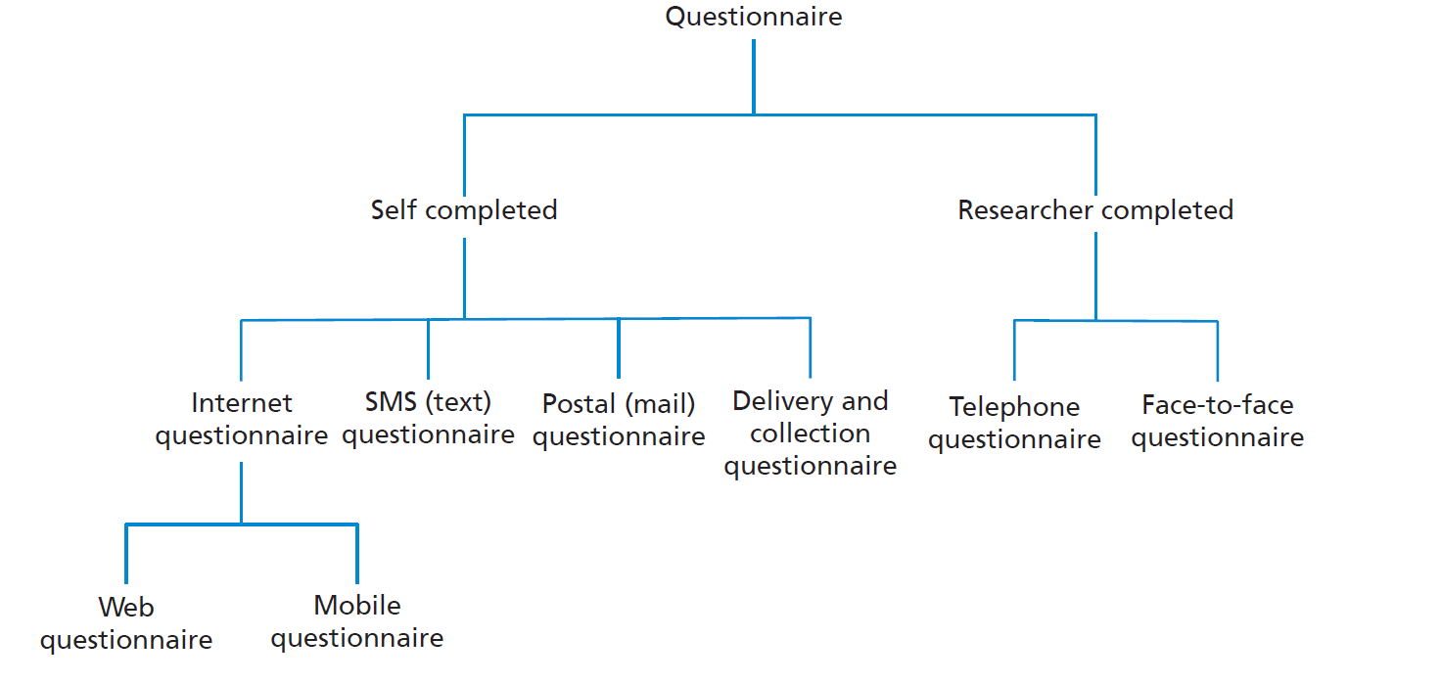
Figure 11.1 Questionnaire modes

Slide 5
Types of data available
Factual or demographic;
Attitudes and opinions;
Behaviours and events.

Slide 6
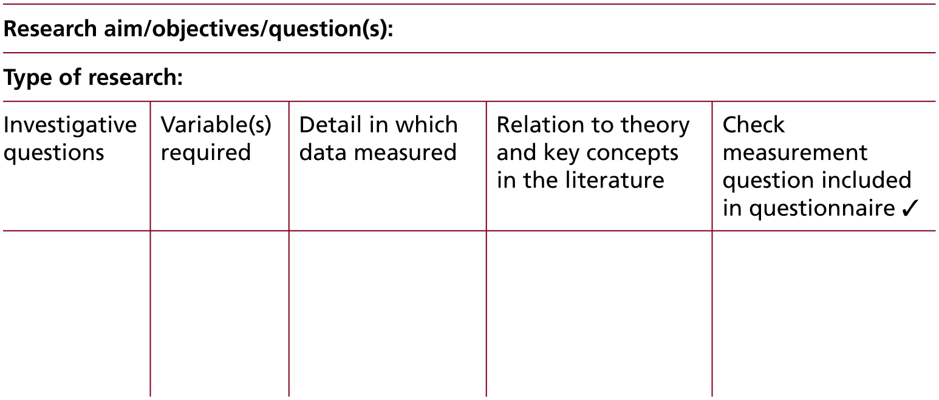
Table 11.2 Data requirements table

Slide 7
Types of closed question
list, where the respondent is offered a list of items, any of which may be selected;
category, where only one response can be selected from a given set of categories;
ranking, where the respondent is asked to place something in order;
rating, in which a rating device is used to record responses;
quantity, to which the response is a number giving the amount;
matrix, where responses to two or more questions can be recorded using the same grid;
creating a scale to measure constructs by combining rating questions.

Slide 8
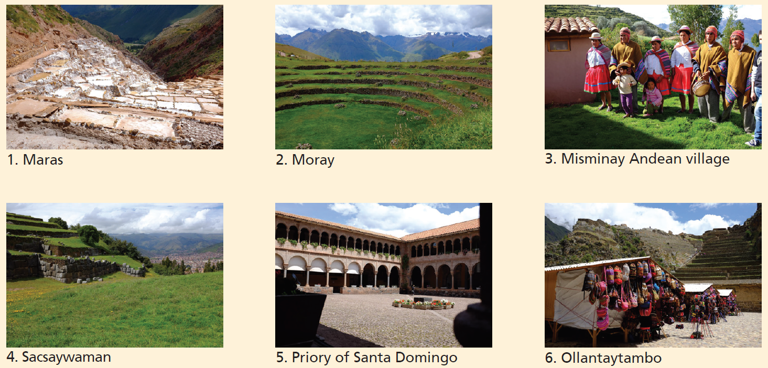
Category question: Which of the following tourist sites did you visit whilst staying in Cusco?
Source: Copyright © 2018 Mark NK Saunders

Slide 9
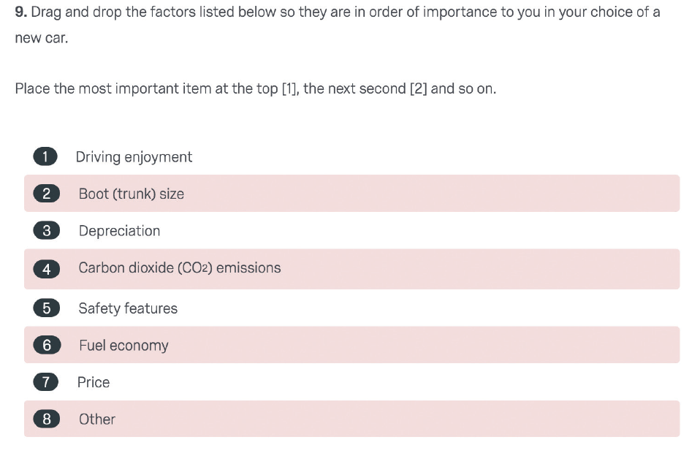
Ranking question

Slide 10
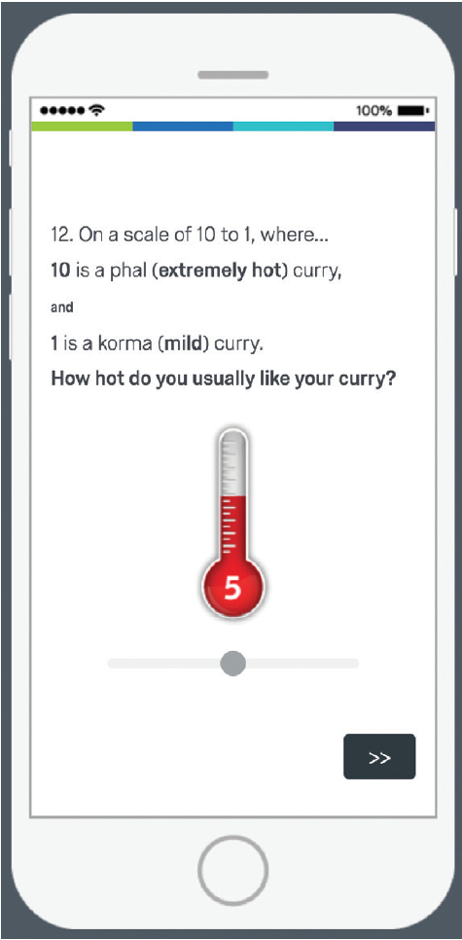
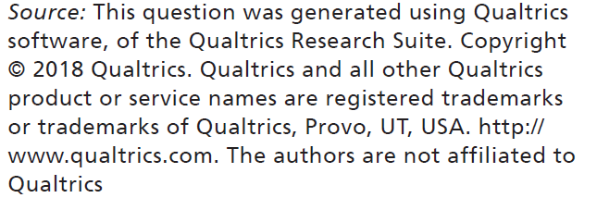
Rating question

Slide 11
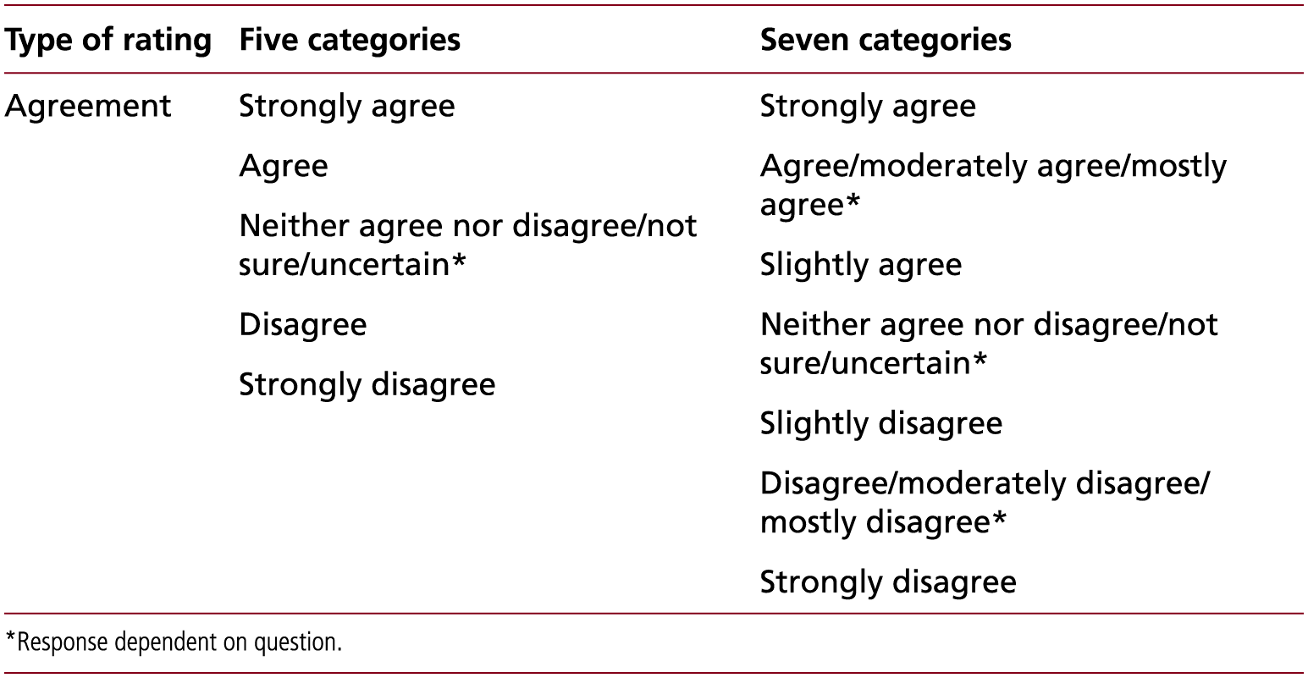
Table 11.3 (1 of 4) Response categories for different types of rating questions: agreement
Source: Developed from Tharenou et al. (2007) and authors' experience

Slide 12
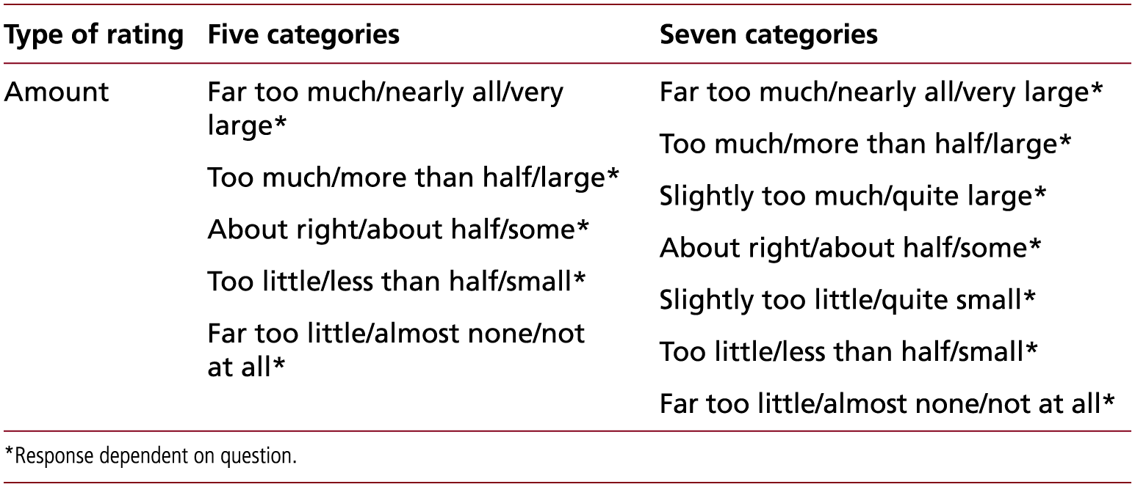
Table 11.3 (2 of 4) Response categories for different types of rating questions: amount
Source: Developed from Tharenou et al. (2007) and authors' experience

Slide 13
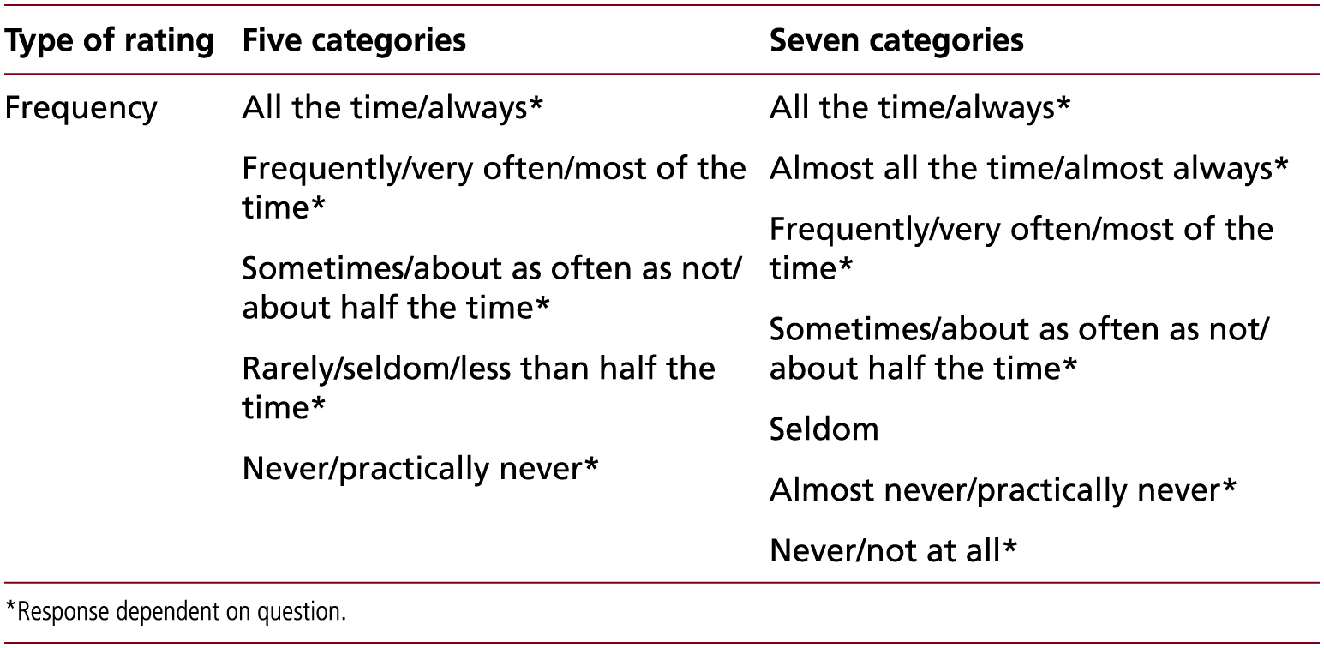
Table 11.3 (3 of 4) Response categories for different types of rating questions: frequency
Source: Developed from Tharenou et al. (2007) and authors' experience

Slide 14
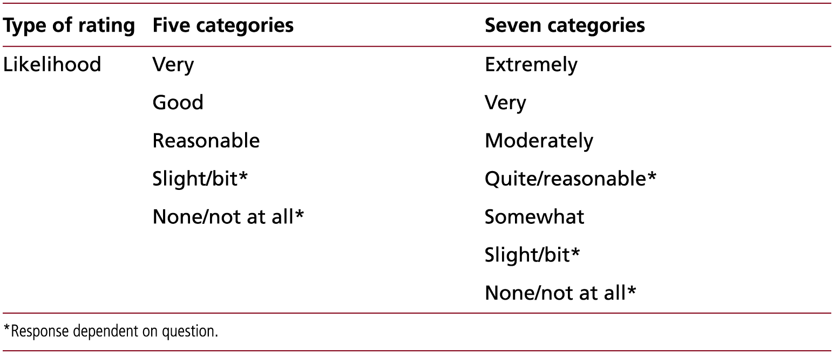
Table 11.3 (4 of 4) Response categories for different types of rating questions: likelihood
Source: Developed from Tharenou et al. (2007) and authors' experience

Slide 15
Quantity question

Slide 16
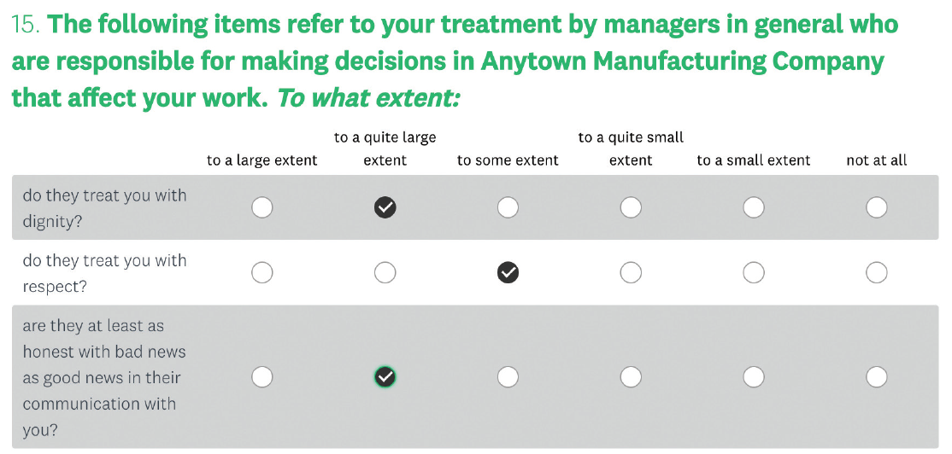
Matrix question
Source: Question created by SurveyMonkey Inc. (2018) San Mateo. Reproduced with permission

Slide 17
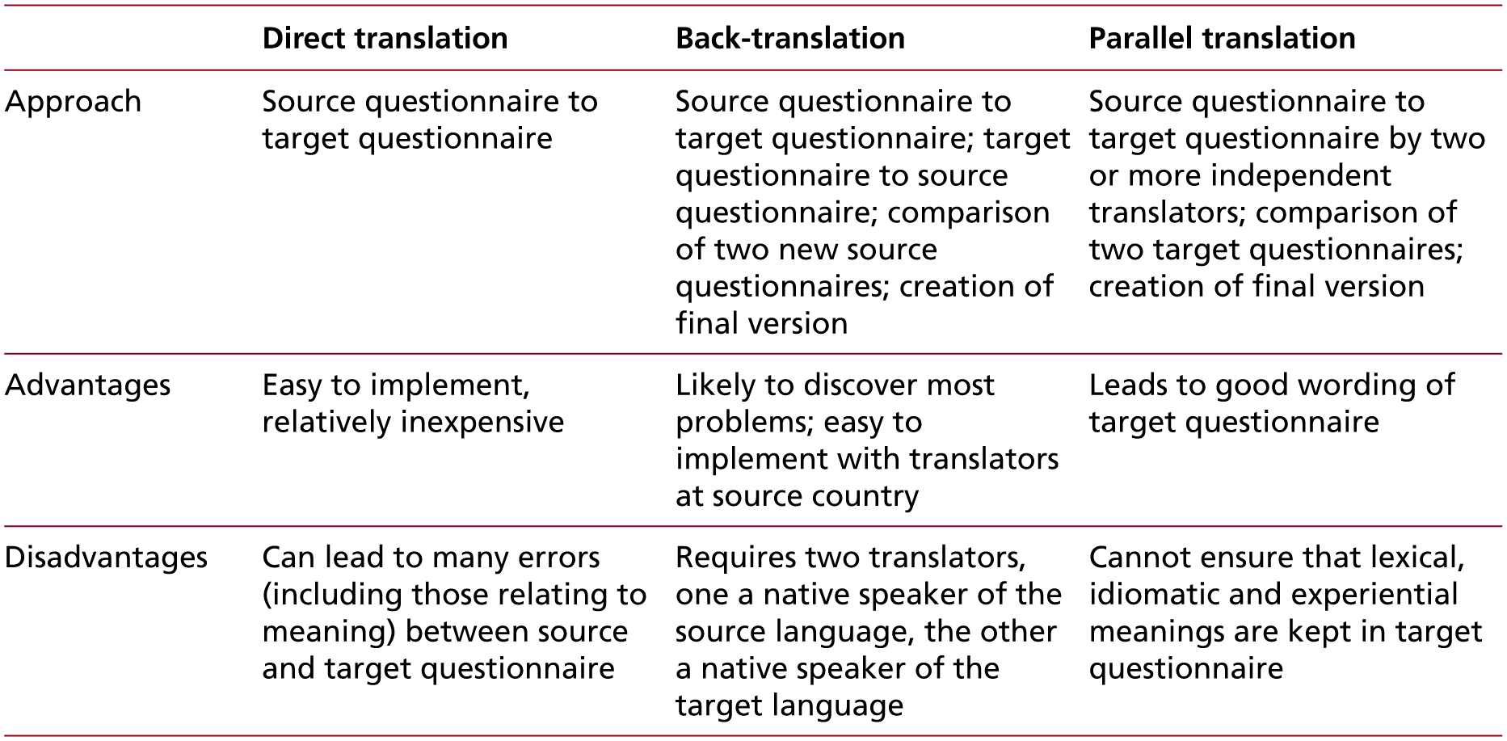
Table 11.4 Translation techniques for questionnaires
Source: Developed from Usunier et al. (2017) ‘Translation techniques for questionnaires’ in International and Cross-Cultural Management Research. Copyright © 2017 Sage Publications, reprinted with permission

Slide 18
Coding questions

Slide 19
Figure 11.2 (1 of 2) Structure of a covering email or letter

Slide 20
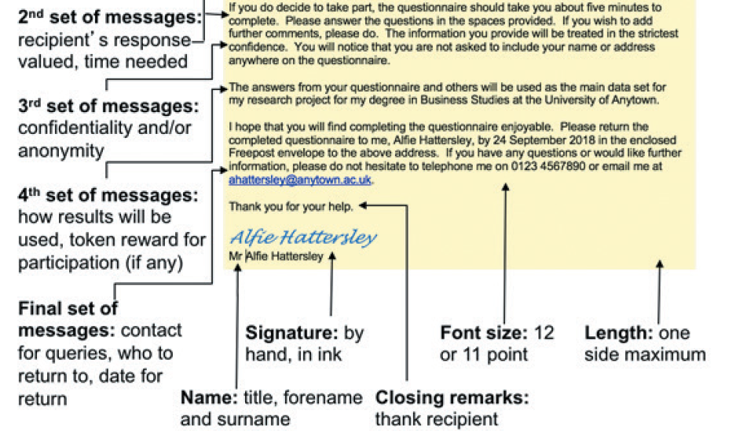
Figure 11.2 (2 of 2) Structure of a covering email or letter

Slide 21
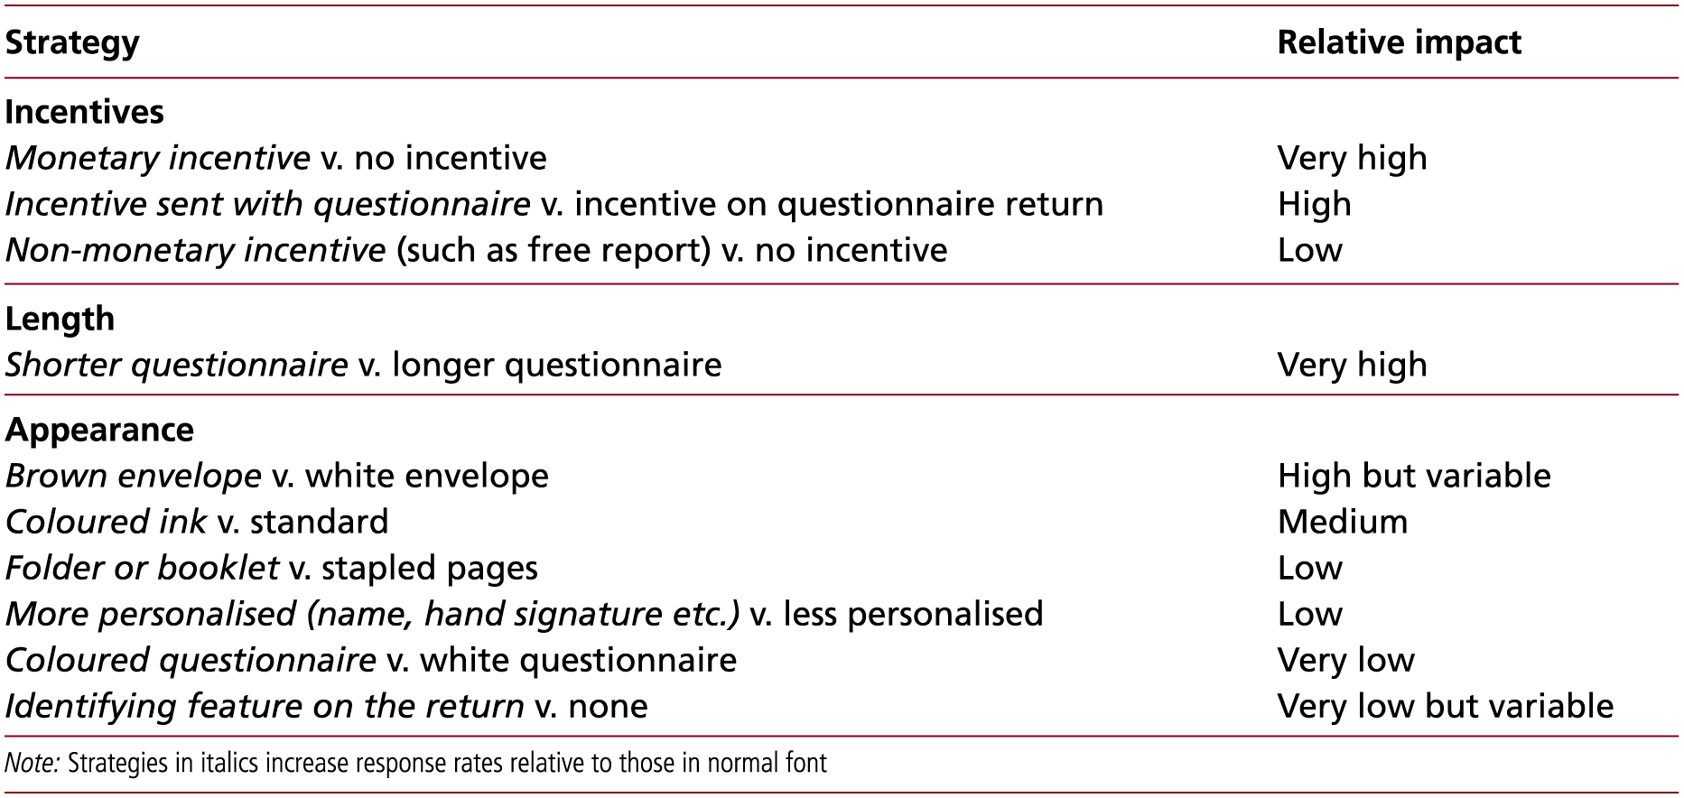
Table 11.5 (1 of 4) Relative impact of strategies for raising postal questionnaire response rates
Source: Developed from Anseel et al. 2010; Edwards et al. 2002; Mellahi and Harris 2016

Slide 22
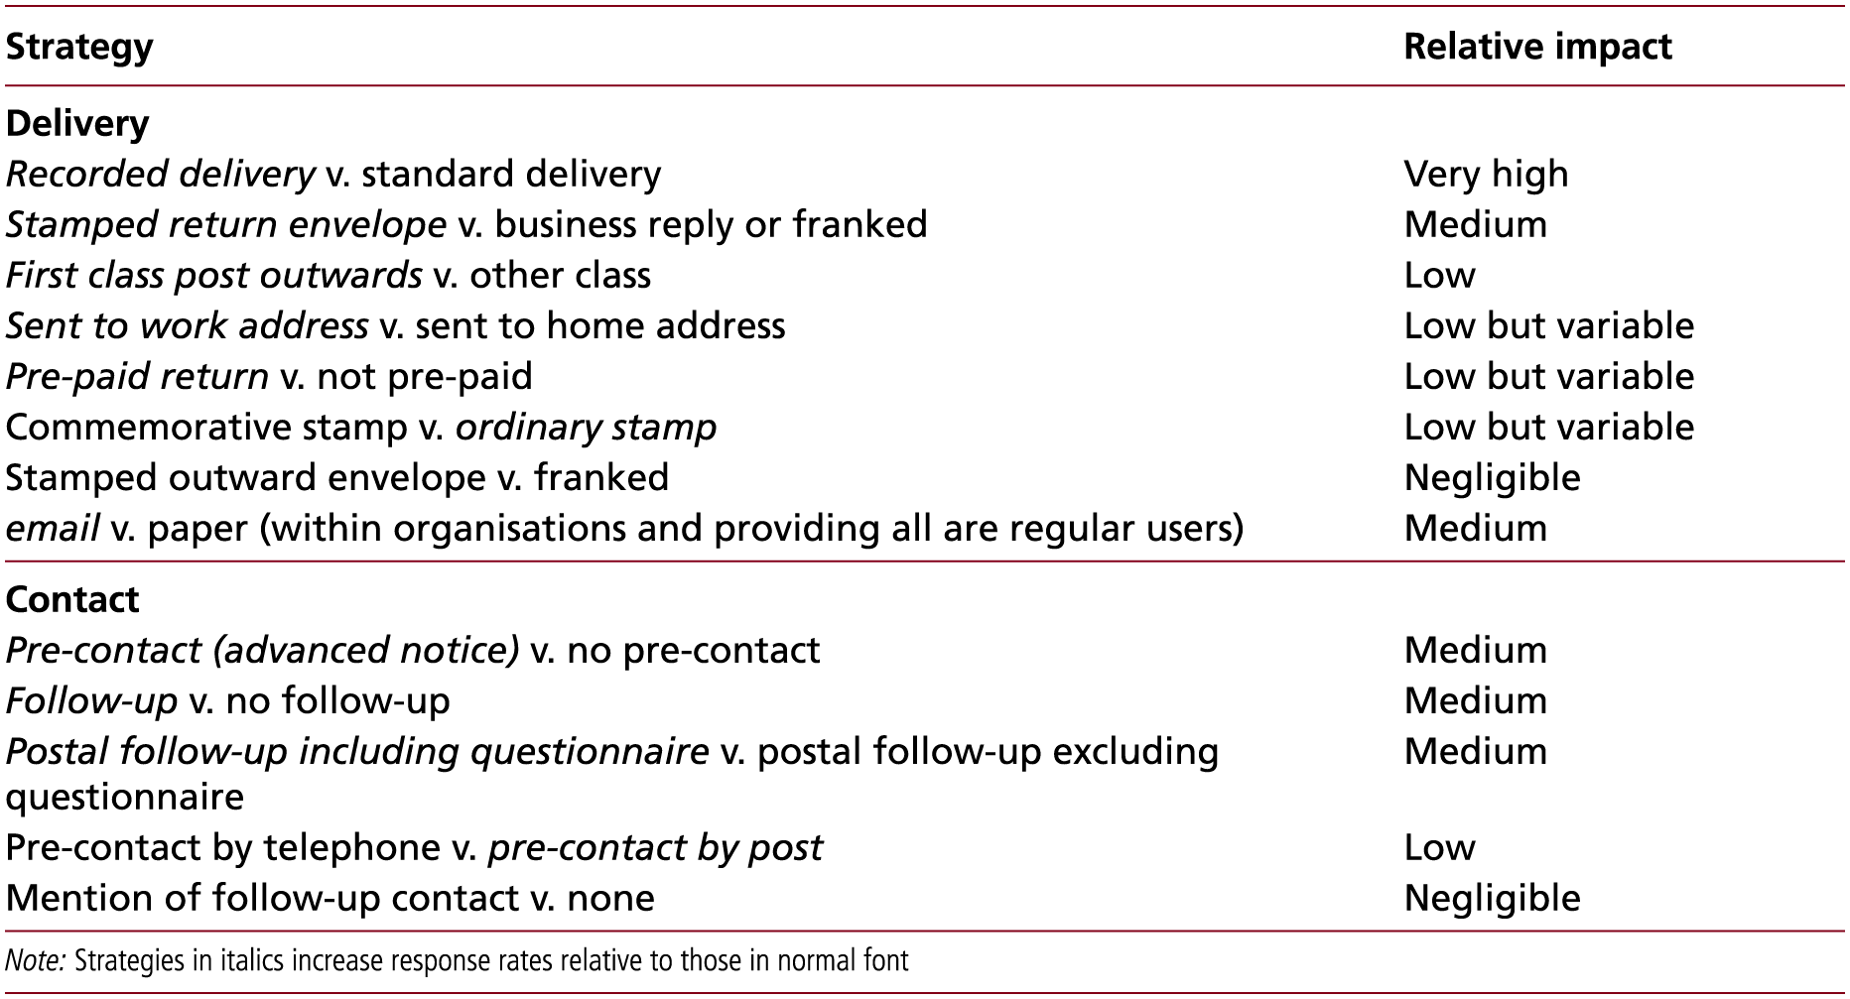
Table 11.5 (2 of 4) Relative impact of strategies for raising postal questionnaire response rates
Source: Developed from Anseel et al. 2010; Edwards et al. 2002; Mellahi and Harris 2016

Slide 23
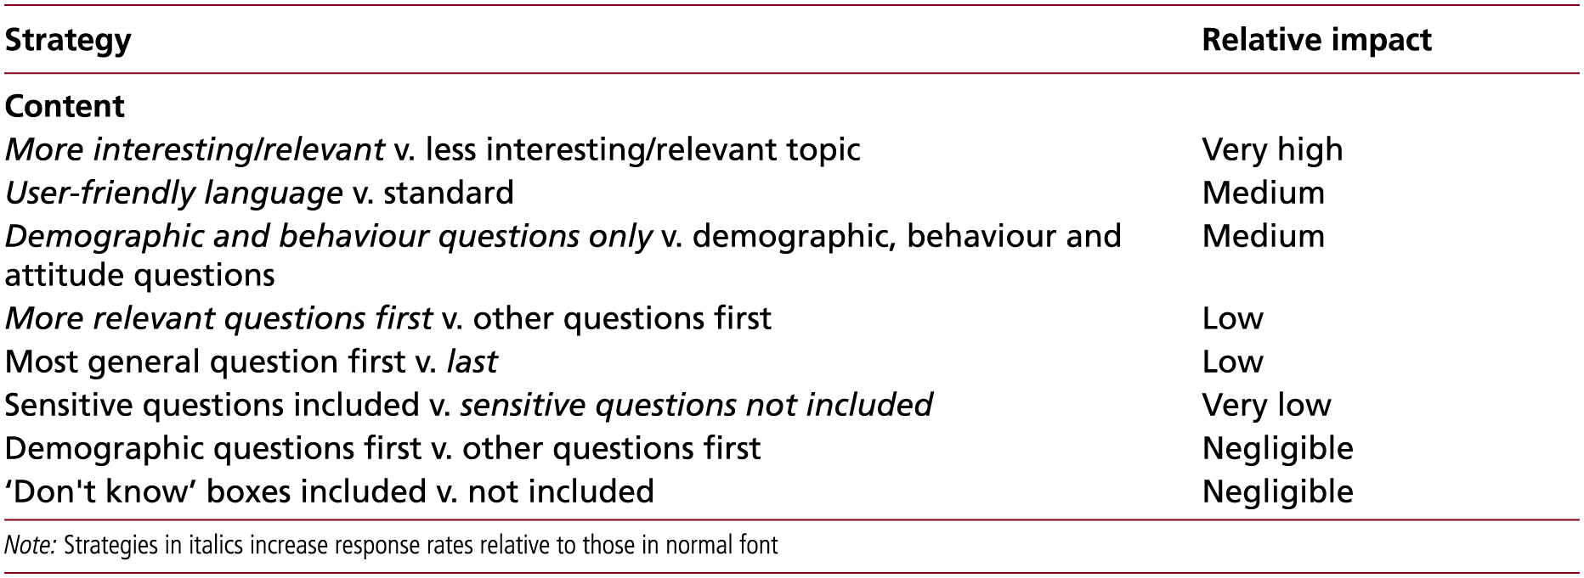
Table 11.5 (3 of 4) Relative impact of strategies for raising postal questionnaire response rates
Source: Developed from Anseel et al. 2010; Edwards et al. 2002; Mellahi and Harris 2016

Slide 24
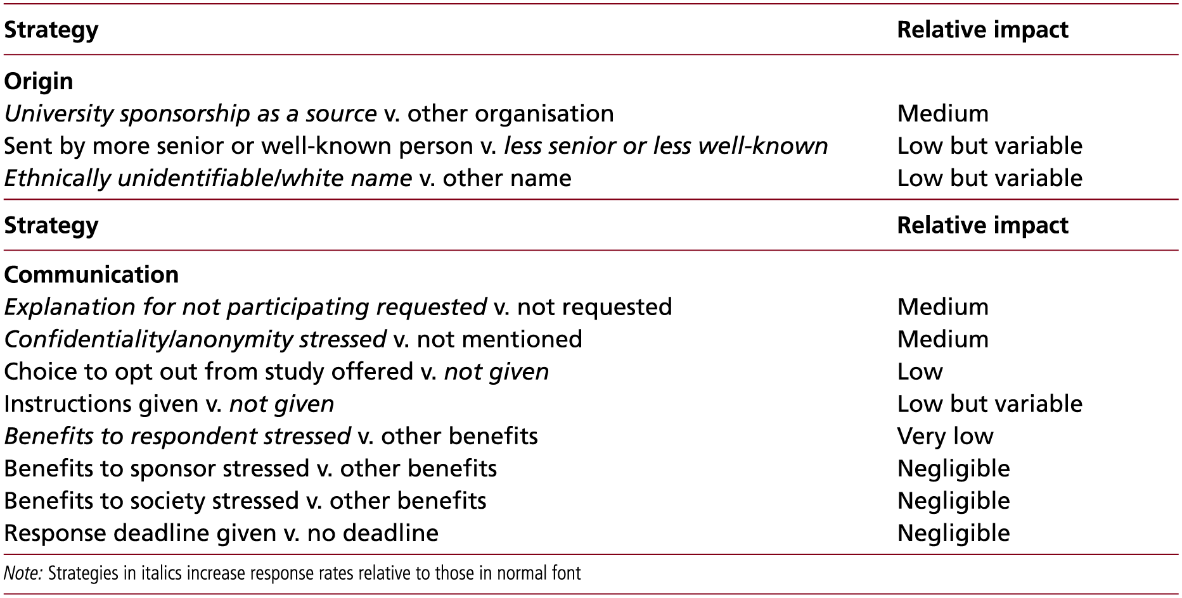
Table 11.5 (4 of 4) Relative impact of strategies for raising postal questionnaire response rates
Source: Developed from Anseel et al. 2010; Edwards et al. 2002; Mellahi and Harris 2016

Slide 25
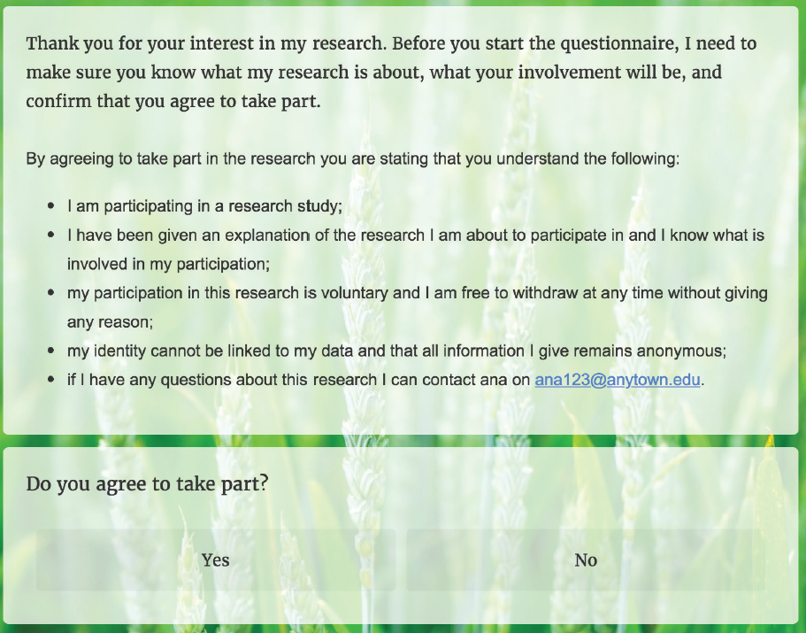
Request for respondent’s consent
Source: This question was generated using Qualtrics software, of the Qualtrics Research Suite. Copyright © 2018
Qualtrics. Qualtrics and all other Qualtrics product or service names are registered trademarks or trademarks of
Qualtrics, Provo, UT, USA. http://www.qualtrics.com . The authors are not affiliated to Qualtrics

Slide 26
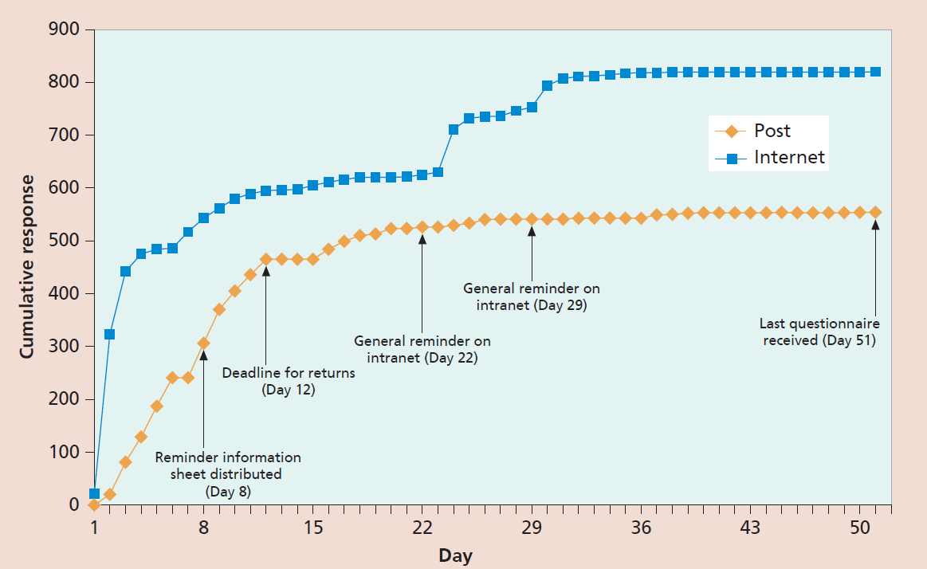
Cumulative questionnaires returned by Internet and post
Source: Unpublished data; details of research from Saunders (2012)

