Slide 1
Research Methods for Business Students
8th edition
Chapter 10
Collecting primary data using research interviews and research diaries

Slide 2
Learning Objectives (1 of 2)
By the end of this chapter you should be:
10.1 able to classify research interviews in order to help you understand the purpose of each type;
10.2 aware of situations favouring the use of particular types of research interview, and the logistical and resource issues that affect their use;
10.3 able to identify potential data quality issues related to the use of research interviews and evaluate how to overcome these;
10.4 able to consider the development of your competence to undertake semi-structured and in-depth research interviews;
10.5 aware of the advantages and disadvantages of using one-to-one and group research interviews, including focus groups, in particular contexts;

Slide 3
Learning Objectives (2 of 2)
10.6 aware of the advantages, disadvantages and mode implications of telephone interviews;
10.7 aware of types of Internet-mediated research interview to be able to evaluate their use;
10.8 aware of the nature of visual interviews and ways to use these;
10.9 able to understand how quantitative and qualitative research diaries may be used to collect primary data;
10.10 aware of the advantages, issues and strategies associated with using research diaries.

Slide 4
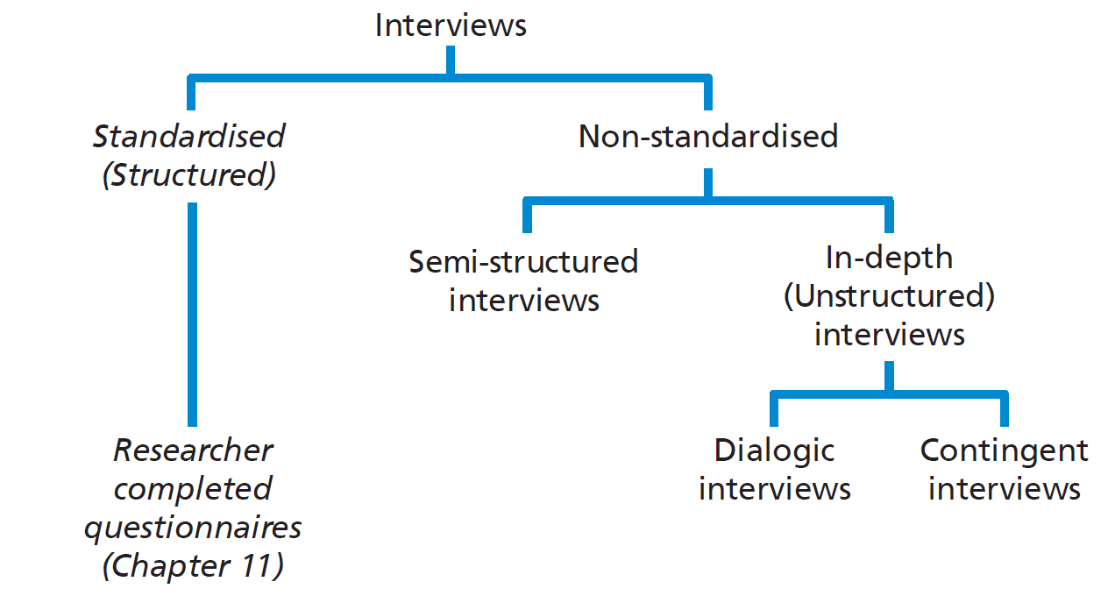
Figure 10.1 Interview structures

Slide 5
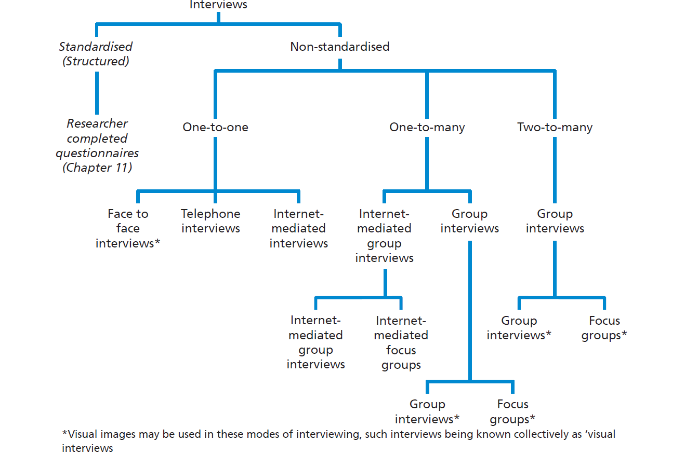
Figure 10.2 Number of participants and interview modes

Slide 6
Table 10.1 Uses of different types of interview for each research purpose

Slide 7
When to use semi-structured and in-depth interviews
Research purpose is exploratory or explanatory.
Establishing personal contact is important.
Questions that need to be asked are:
Complex;
Open-ended;
Large in number;
Likely to need to be varied in the order they are asked.

Slide 8
Aspects to consider when conducting semi-structured and in-depth interviews (1 of 2)
appropriateness of your appearance at the interview;
nature of your comments to open the interview;
approach to questioning;
appropriate use of different types of questions;
nature and impact of your behaviour during the interview;

Slide 9
Aspects to consider when conducting semi-structured and in-depth interviews (2 of 2)
demonstration of attentive listening skills;
scope to summarise and test understanding;
dealing with difficult participants;
approach to recording data.

Slide 10
Types of question
Open questions
Probing questions
Specific questions
Closed questions
Follow-up questions
Reflective questions
Interpretation questions
Extension questions

Slide 11
Table 10.2 Difficulties with interview participants
Recognised difficulty
Participant appears willing only to give monosyllabic answers, these being little more than ‘yes’ or ‘no’
Participant repeatedly provides long answers which digress from the focus of your interview
Participant starts interviewing you
Participant is proud of their status relative to you and wants to show off their knowledge, criticising what you do
Participant becomes noticeably upset during the interview and, perhaps, starts to cry
Source: King (2004); authors’ experiences

Slide 12
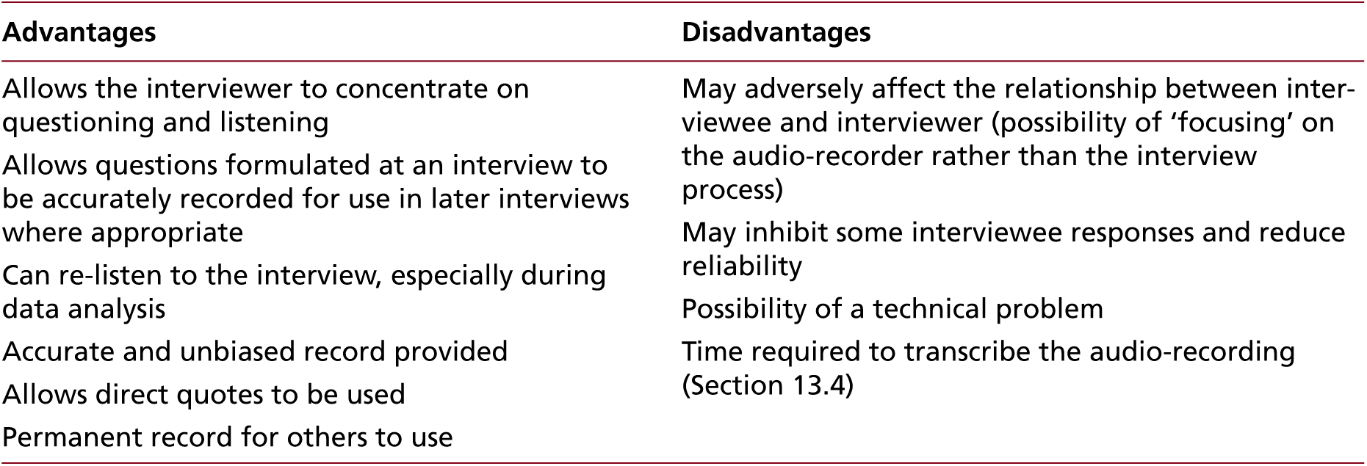
Table 10.3 Advantages and disadvantages of audio-recording the interview
Source: authors’ experiences

Slide 13
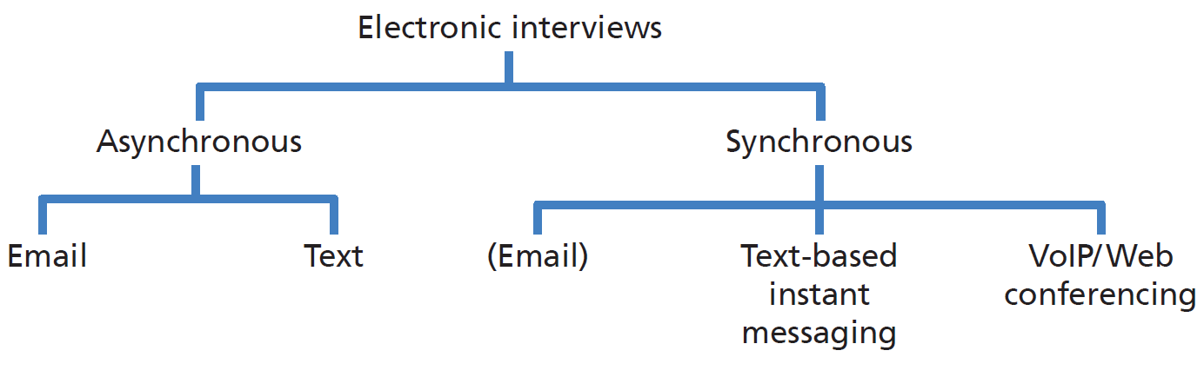
Figure 10.3 Forms of electronic interview

Slide 14
Participant drawing in an interview

