Slide 1
Research Methods for Business Students
8th edition
Chapter 9
Collecting data through observation

Slide 2
Learning Objectives
By the end of this chapter you should be able to:
9.1 appreciate the scope of observation as a data collection method;
9.2 understand the dimensions of observation and the choices to be made when using observational research;
9.3 develop an understanding of participant observation, structured observation and Internet-mediated observation and appreciate how these methods may overlap in practice;
9.4 develop an understanding of the use of videography, audio-recording and static visual images in the collection of observational data;
9.5 identify ethical concerns and quality issues related to the collection of observation data and consider how to avoid or reduce these.

Slide 3
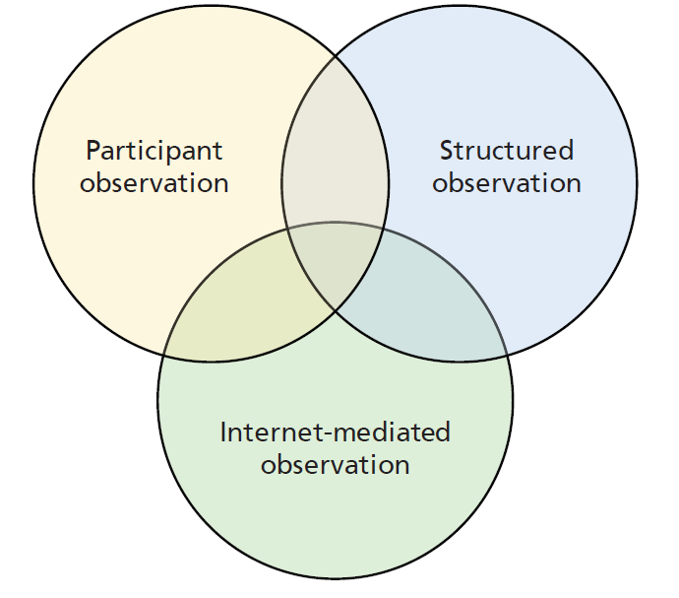
Figure 9.1 Overlap between types of observation

Slide 4
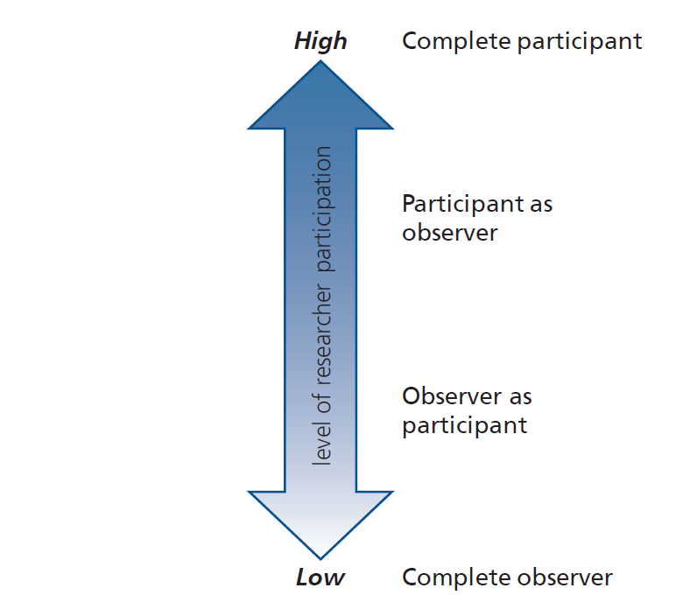
Figure 9.2 Level of participation in classic observation

Slide 5
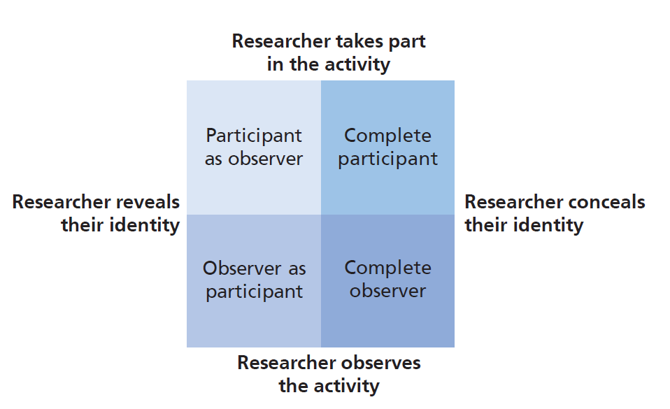
Figure 9.3 Classic observation roles

Slide 6
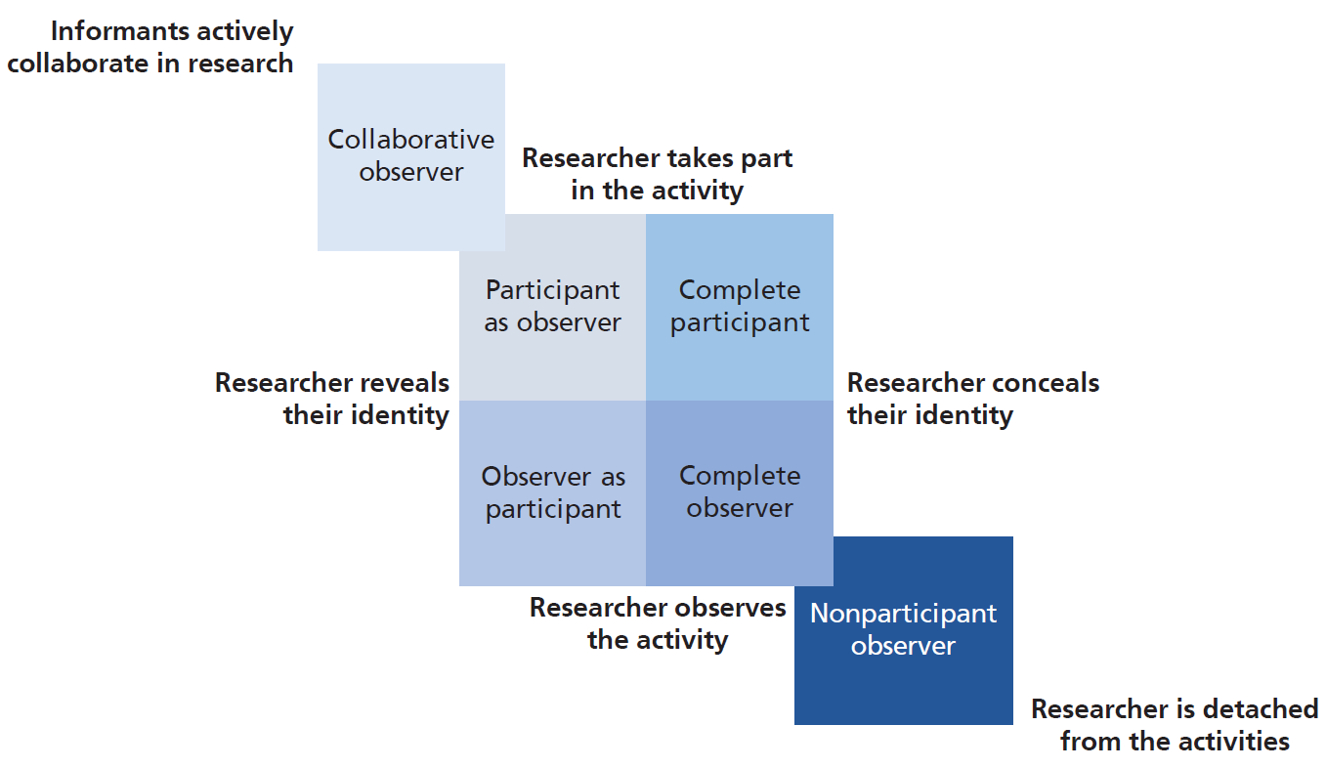
Figure 9.4 Observer roles
Source: © 2018 Mark Saunders, Philip Lewis and Adrian Thornhill

Slide 7
Table 9.1 Aspects to consider in choosing an observer role
Aspect
Ethical concerns
The purpose of your research
Your status in relation to informants in the observational setting
The level of participation you need to demonstrate in the observational setting
The depth of understanding you will need to develop in the observational setting and how much time you have to devote to your research
Observer role preference
Organisational access

Slide 8
Table 9.2 Characteristics of participant observation
Source: Developed from Spradley (2016)

Slide 9
Table 9.3 Types of data generated by participant observation
Data type | Explanation
Observational data | Data created by the participant observer from undertaking observations-in-person or using video or audio recordings, or visual images.
Experiential data | Data created by the participant observer based on her or his experience of undertaking observations, interviews or informal discussions.
Supplementary data | Data created by the participant observer from conducting interviews, informal discussions with informants, or using documentary sources.
Interpretive data | Data created by the participant observer from interpreting observational, experiential or supplementary data, or from informants’ interpretations.
Reflective data | Data created by the participant observer following periods of introspection or reflection about any or all of the other types of data, leading to the creation of further interpretive data that are recorded as self-memos, or in a research journal or diary

Slide 10
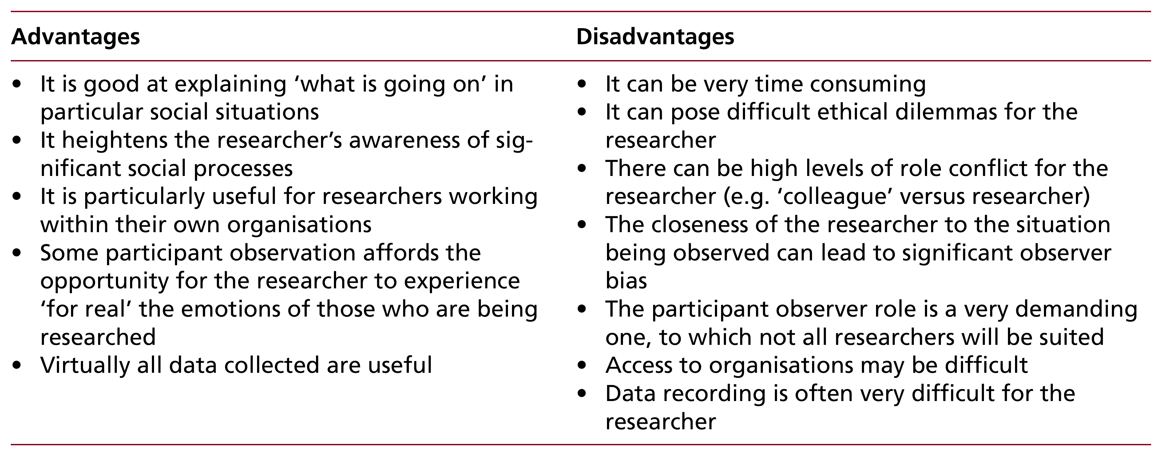
Table 9.4 Advantages and disadvantages of participant observation

Slide 11
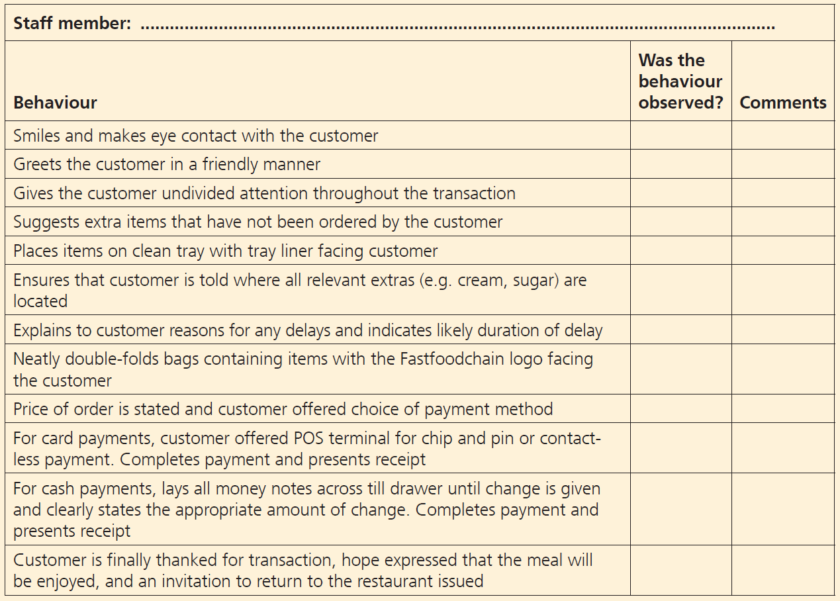
Observational document

Slide 12
Table 9.5 (1 of 2) Advantages and disadvantages of structured observation: advantages
Advantages
It can be used by anyone after suitable training in the use of the measuring instrument It should yield reliable results by virtue of its replicability Structured observation is capable of more than simply observing the frequency of events The method allows the collection of data at the time they occur in their natural setting Structured observation secures data that most informants would ignore because to them these are too mundane or irrelevant

Slide 13
Table 9.5 (2 of 2) Advantages and disadvantages of structured observation: disadvantages
Disadvantages
Unless virtual observation is used, the observer must be in the research setting when the phenomena under study are taking place Behaviours, interactions and events being observed may occur simultaneously or in complex ways While structured observation is helpful in recording the incidence of behaviours, interactions or events, these observations are limited to overt actions or surface indicators Without the prior specification or development of theory, structured observations will be of only limited value for research Not recognising environmental variability within a research setting may invalidate conclusions drawn from structured observation Data may be slow (and expensive) to collect, although this is not always the case

Slide 14
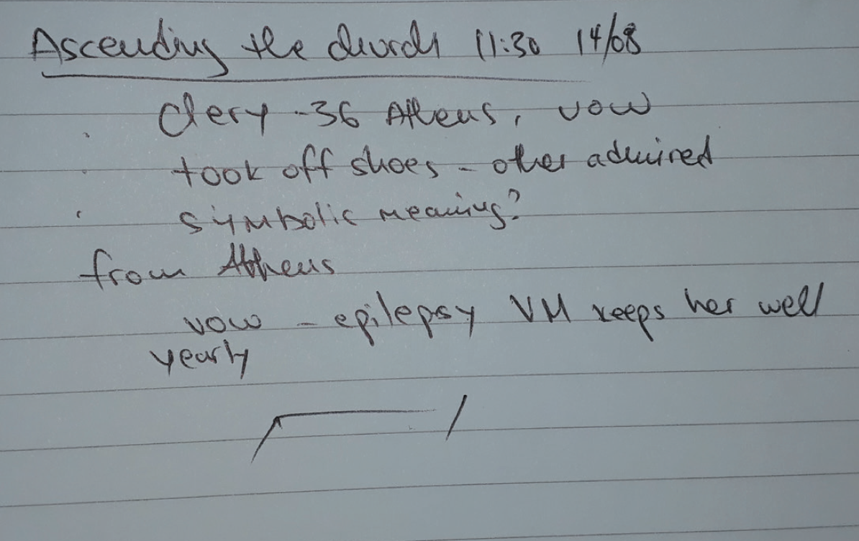
Figure C9.1 Scratch notes

