Slide 1
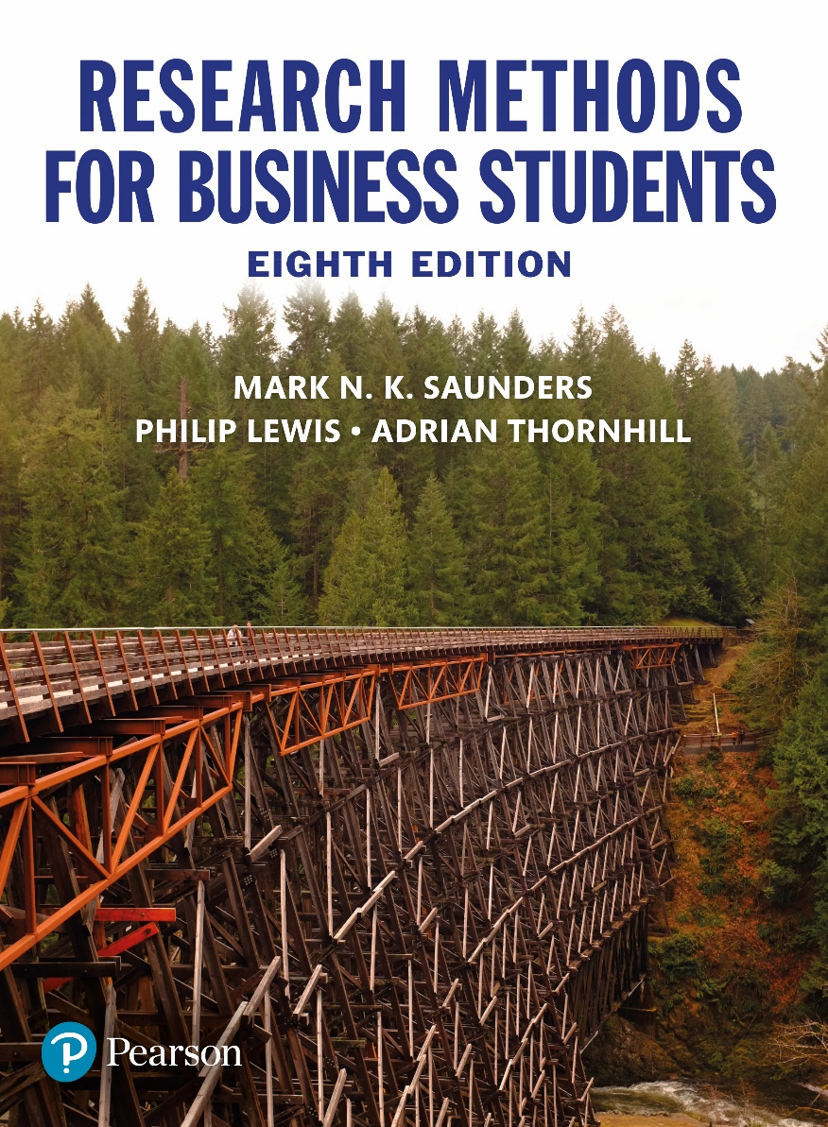
Research Methods for Business Students
8th edition
Chapter 8
Utilising secondary data

Slide 2
Learning Objectives
By the end of this chapter you should be able to:
8.1 identify the variety of types of secondary data that are available;
8.2 appreciate ways in which secondary data can be used to help answer your research question(s) and to meet your objectives;
8.3 understand the advantages and disadvantages of using secondary data in research projects;
8.4 use a range of techniques to search for secondary data;
8.5 evaluate the suitability of secondary data for answering your research question(s) and meeting your objectives in terms of measurement validity, coverage, precise suitability, measurement bias, costs and benefits;
8.6 apply the knowledge, skills and understanding gained to your own research project.

Slide 3
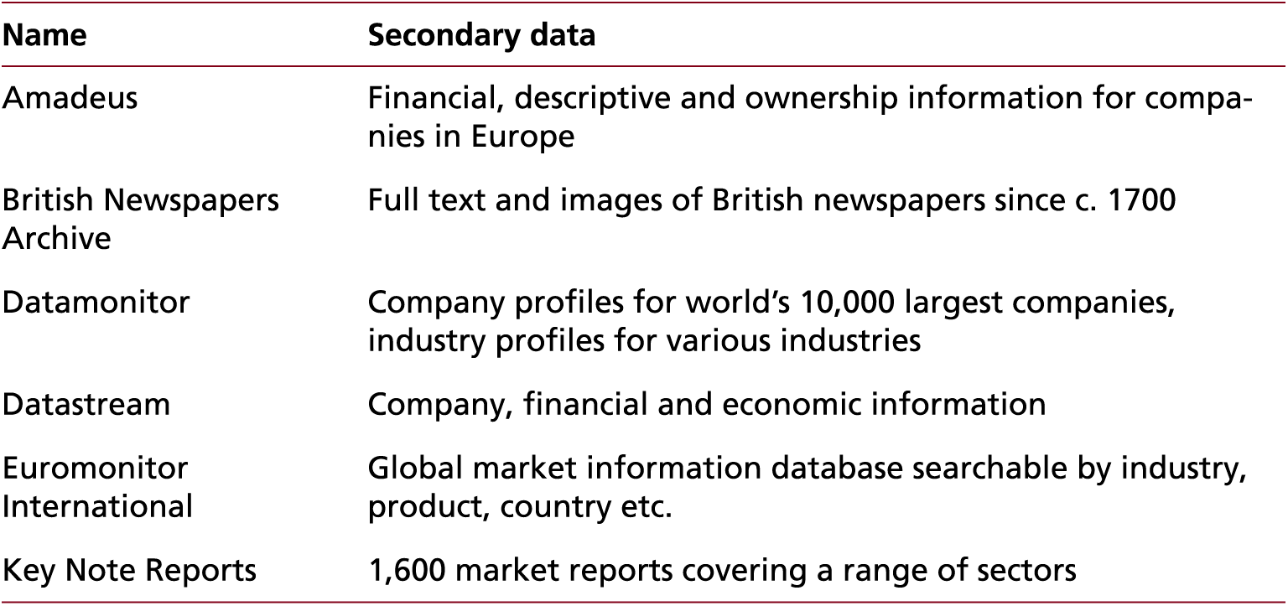
Table 8.1 (1 of 2) Selected online databases with potential secondary data

Slide 4
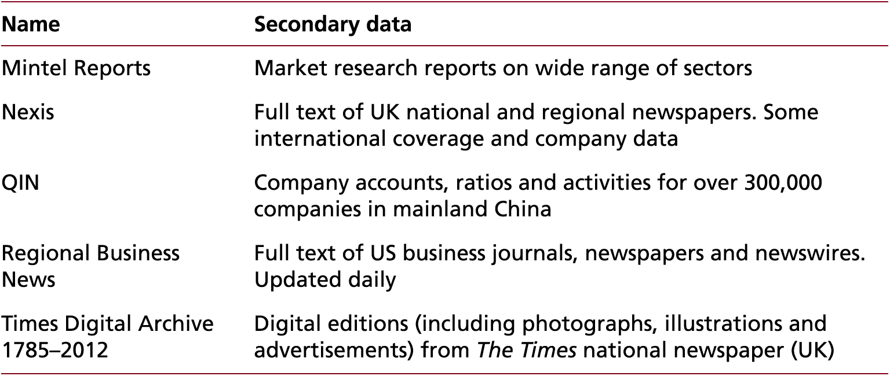
Table 8.1 (2 of 2) Selected online databases with potential secondary data

Slide 5
Figure 8.1 Types and examples of secondary data

Slide 6
Advantages and disadvantages of secondary data
Advantages
May have fewer resource requirements
Unobtrusive
Longitudinal studies may be feasible
Can provide comparative and contextual data
Can result in unforeseen discoveries and insights
Permanence of data
Disadvantages
May be collected for a purpose that does not match your need
Access may be difficult or costly
Aggregations and definitions may
be unsuitable
No real control over data quality
Initial purpose may affect how data are presented

Slide 7
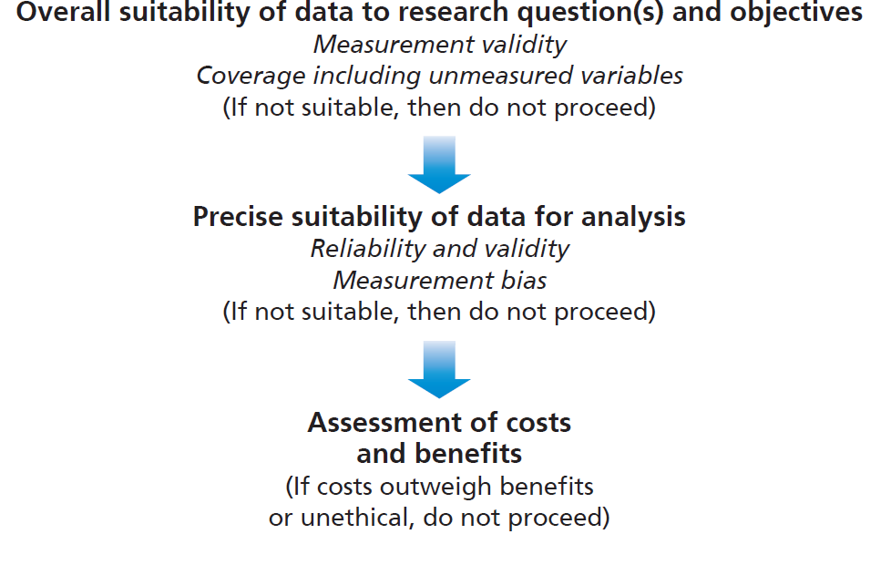
Figure 8.2 Evaluating potential secondary data sources

