Slide 1
Research Methods for Business Students
8th edition
Chapter 7
Selecting samples

Slide 2
Learning Objectives (1 of 2)
By the end of this chapter you should:
7.1 understand the need to select samples in business and management research;
7.2 be aware of a range of probability and non-probability sampling techniques and the possible need to combine techniques within a research project;
7.3 be able to choose appropriate sampling techniques for a variety of research scenarios and justify your choices;

Slide 3
Learning Objectives (2 of 2)
7.4 be able to use a range of sampling techniques;
7.5 be able (where appropriate) to assess the representativeness of the sample selected;
7.6 be able to assess the extent to which it is reasonable to generalise from a sample;
7.7 be able to apply the knowledge, skills and understanding gained to your own research project.

Slide 4
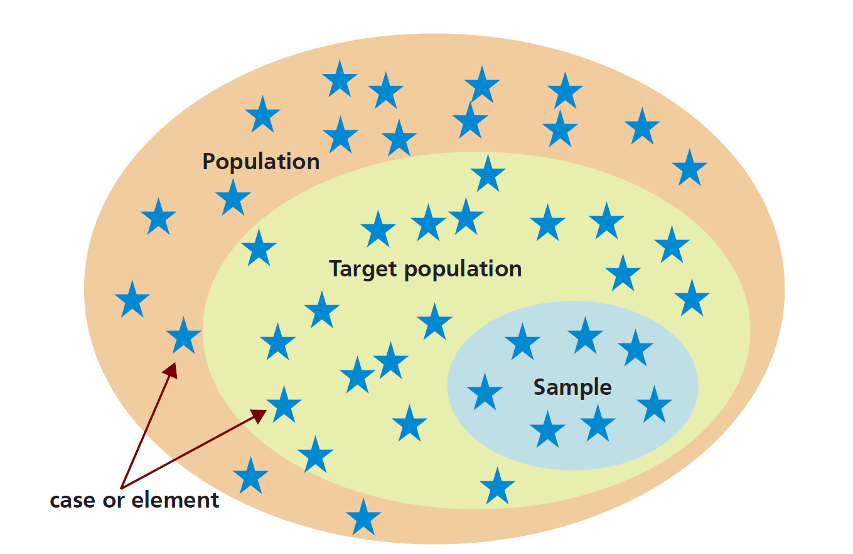
Figure 7.1 Population, target population, sample and individual cases
Notes:
It is helpful for complex images (i.e., charts and graphs) to have descriptive text near the image (perhaps as a caption or in the Notes field). They would still require alt text.

Slide 5
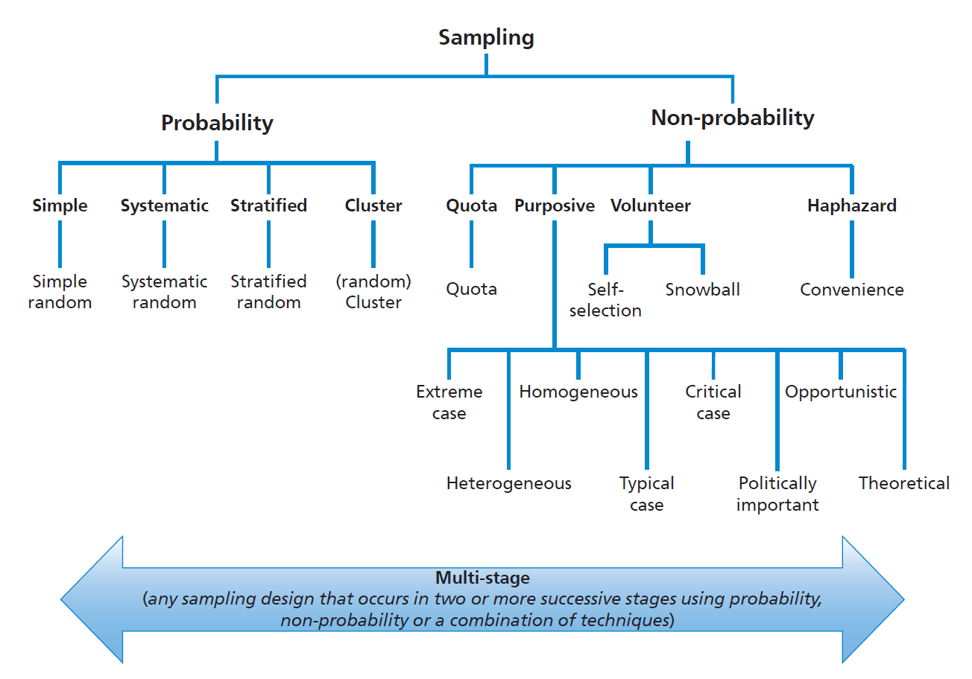
Figure 7.2 Sampling techniques

Slide 6
Table 7.1 Sample sizes for different sizes of target population at a 95 per cent confidence level (assuming data are collected from all cases in the sample)
Target population | Margin of error
 | 5% | 3% | 2% | 1%
50 | 44 | 48 | 49 | 50
100 | 79 | 91 | 96 | 99
250 | 151 | 203 | 226 | 244
500 | 217 | 340 | 414 | 475
1000 | 278 | 516 | 706 | 906
2000 | 322 | 696 | 1091 | 1655
10,000 | 370 | 964 | 1936 | 4899
1,000,000 | 384 | 1066 | 2395 | 9513
10,000,000 | 384 | 1067 | 2400 | 9595

Slide 7
Levels of non-response
Level
Complete refusal
Break-off
Partial response
Complete response
Explanation
none of the questions answered
less than 50 per cent of all questions answered other than by a refusal or no answer (this therefore includes complete refusal)
50 per cent to 80 per cent of all questions answered other than by a refusal or no answer
over 80 per cent of all questions answered other than by a refusal or no answer

Slide 8
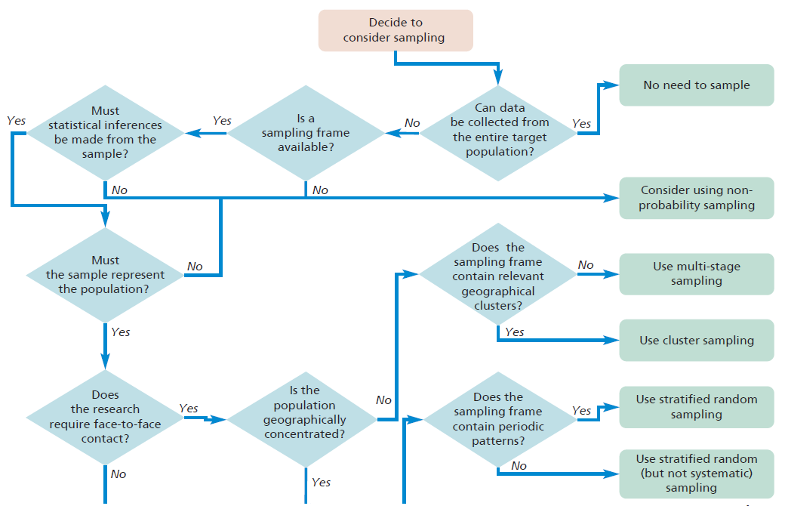
Figure 7.3 (1 of 2) Choosing a probability sampling technique
Note: Simple random sampling ideally requires a sample size of over a few hundred

Slide 9
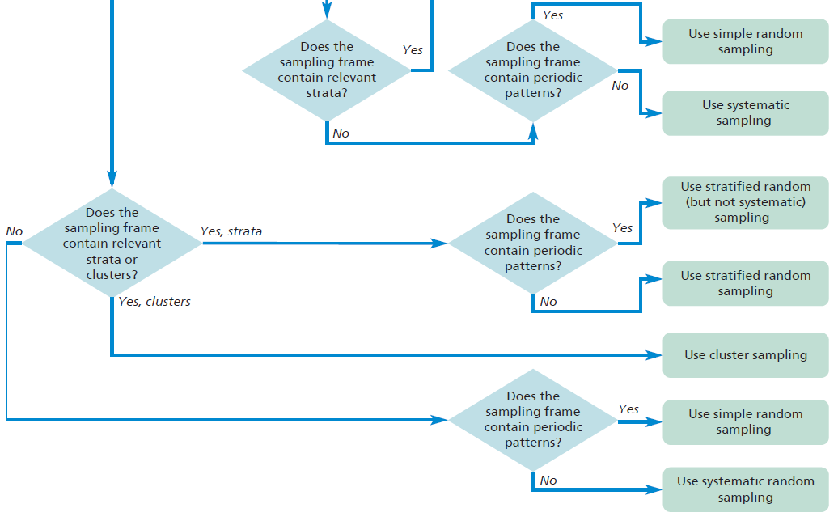
Figure 7.3 (2 of 2) Choosing a probability sampling technique
Note: Simple random sampling ideally requires a sample size of over a few hundred

Slide 10
Table 7.2 (1 of 4) Impact of various factors on choice of probability sampling techniques
Source: © Mark Saunders, Philip Lewis and Adrian Thornhill 2018

Slide 11
Table 7.2 (2 of 4) Impact of various factors on choice of probability sampling techniques
Source: © Mark Saunders, Philip Lewis and Adrian Thornhill 2018

Slide 12
Table 7.2 (3 of 4) Impact of various factors on choice of probability sampling techniques
Source: © Mark Saunders, Philip Lewis and Adrian Thornhill 2018

Slide 13
Table 7.2 (4 of 4) Impact of various factors on choice of probability sampling techniques
Source: © Mark Saunders, Philip Lewis and Adrian Thornhill 2018

Slide 14
Table 7.3 Extract of spreadsheet generated random numbers between 1 and 5011

Slide 15
Table 7.4 The impact of periodic patterns on systematic random sampling
✓ Sample selected if you start with 1. * Sample selected if you start with 2.

Slide 16
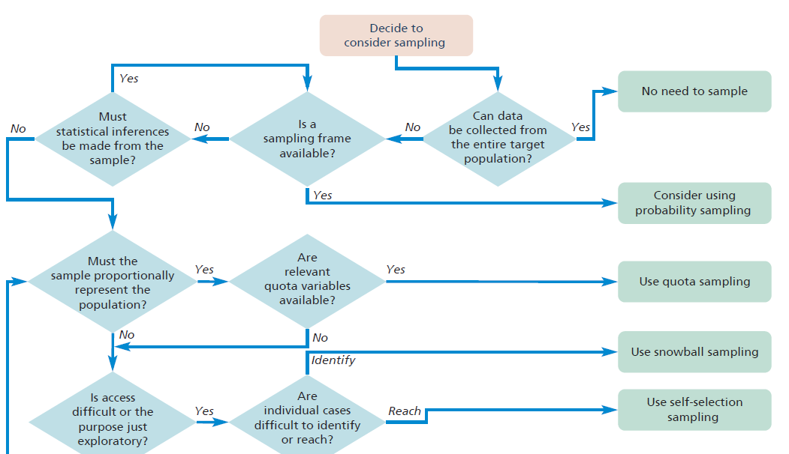
Figure 7.4 (1 of 2) Choosing a non-probability sampling technique

Slide 17
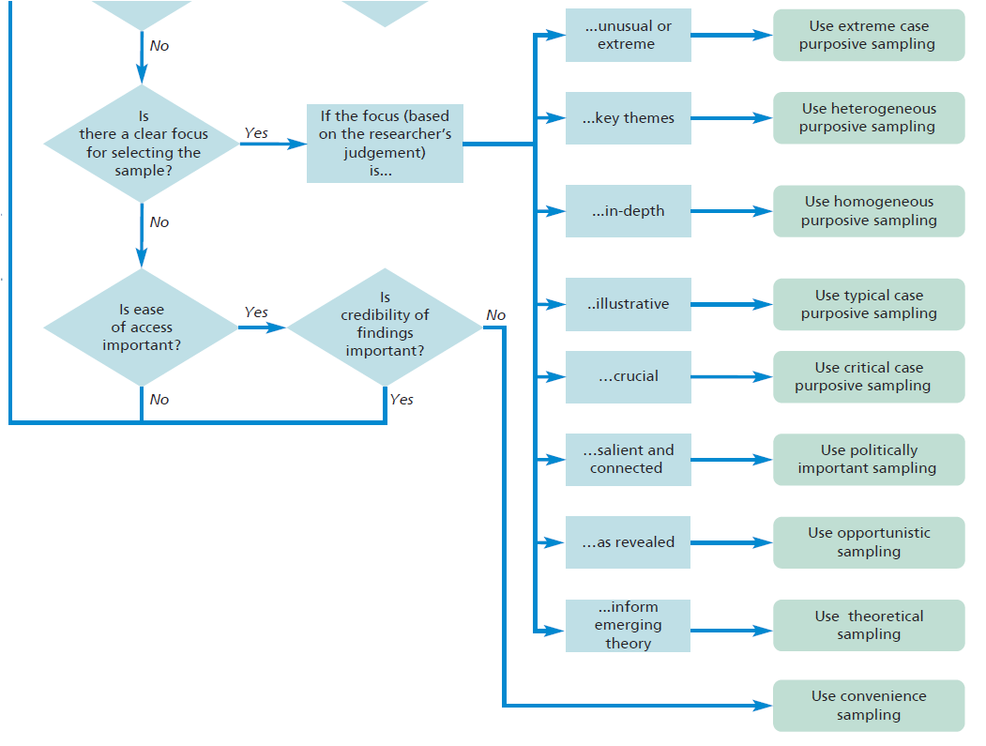
Figure 7.4 (2 of 2) Choosing a non-probability sampling technique

Slide 18
Table 7.5 Non-probability sample size norms when using qualitative interviews
Source: Developed from Saunders and Townsend (2016)

Slide 19
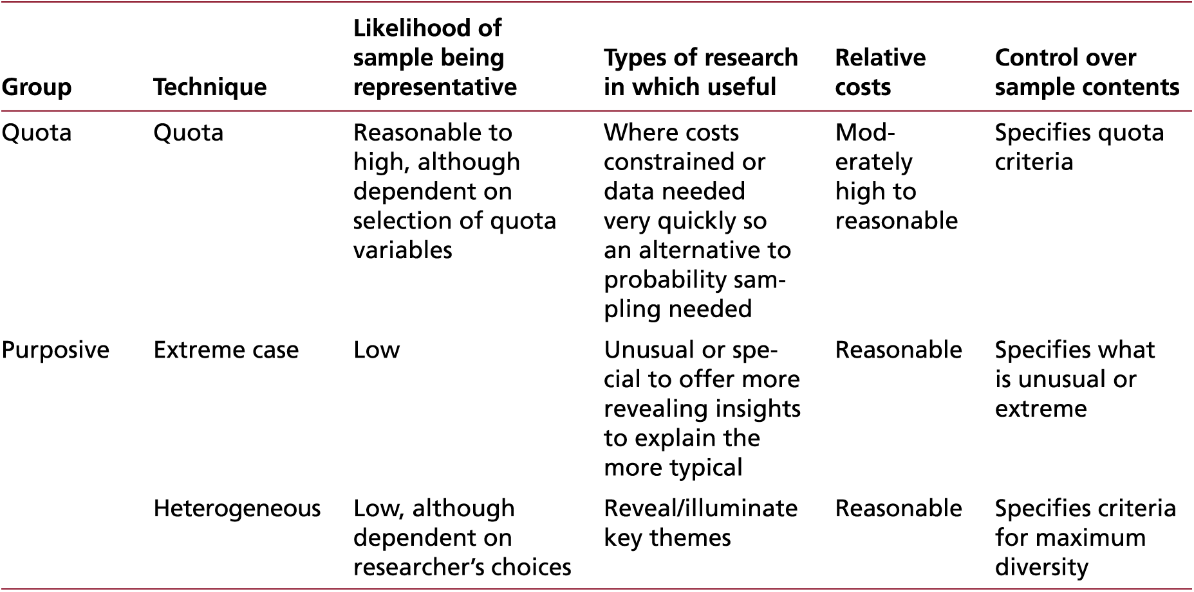
Table 7.6 (1 of 4) Impact of various factors on choice of non-probability sampling techniques
Sources: Developed from Patton (2015); Saunders (2012)

Slide 20
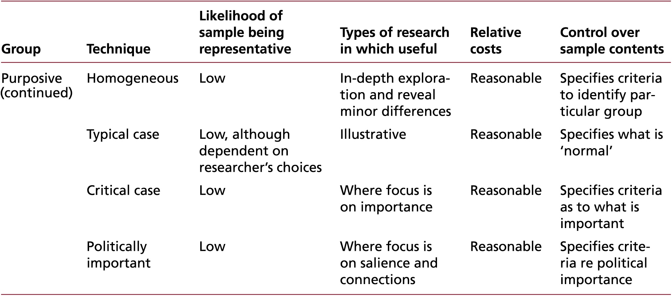
Table 7.6 (2 of 4) Impact of various factors on choice of non-probability sampling techniques
Sources: Developed from Patton (2015); Saunders (2012)

Slide 21
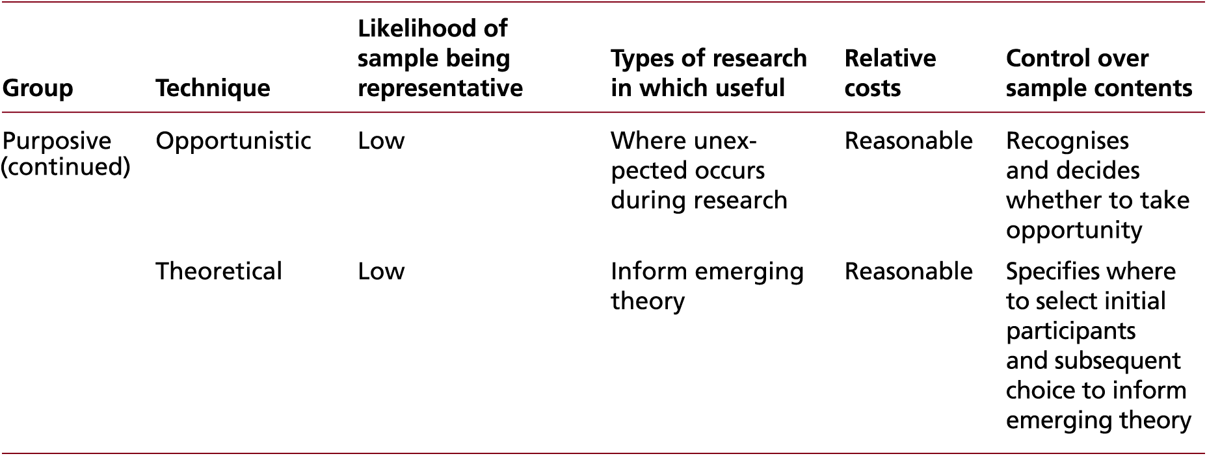
Table 7.6 (3 of 4) Impact of various factors on choice of non-probability sampling techniques
Sources: Developed from Patton (2015); Saunders (2012)

Slide 22
Table 7.6 (4 of 4) Impact of various factors on choice of non-probability sampling techniques
Sources: Developed from Patton (2015); Saunders (2012)

