Slide 1
Research Methods for Business Students
8th edition
Chapter 6
Negotiating access and research ethics

Slide 2
Learning Objectives
By the end of this chapter you should be:
6.1 aware of issues associated with gaining traditional and Internet-mediated access;
6.2 able to evaluate a range of strategies to help you to gain access to organisations and to individual participants; 6.3 aware of the importance of research ethics and the need to act ethically; 6.4 able to anticipate ethical issues at each stage of your research and in relation to particular techniques, and aware of approaches to help you deal with these; 6.5 aware of the principles of data protection and data management.

Slide 3
Table 6.1 (1 of 2) Strategies that may help you to gain access

Slide 4
Table 6.1 (2 of 2) Strategies that may help you to gain access

Slide 5
Table 6.3 Ethical principles and the ethical rationale for and development of each principle (1 of 3)
Ethical principle | Ethical rationale
Integrity, fairness and open-mindedness of the researcher | The quality of research depends in part on the integrity, fairness and open-mindedness of the researcher.
Respect for others | A researcher’s position is based on the development of trust and respect.
Avoidance of harm (non-maleficence) | Any harm to participants must be avoided.

Slide 6
Table 6.3 Ethical principles and the ethical rationale for and development of each principle (2 of 3)
Ethical principle | Ethical rationale
Privacy of those taking part | Privacy is a key principle that links to or underpins several other principles considered here.
Voluntary nature of participation and right to withdraw | The right not to participate in a research project is unchallengeable.
Informed consent of those taking part | The principle of informed consent involves researchers providing sufficient information and assurances about taking part to allow individuals to understand the implications of participation and to reach a fully informed, considered and freely given decision about whether or not to do so, without the exercise of any pressure or coercion.

Slide 7
Table 6.3 Ethical principles and the ethical rationale for and development of each principle (3 of 3)
Ethical principle | Ethical rationale
Ensuring confidentiality of data and maintenance of anonymity of those taking part | Research is designed to answer ‘who’, ‘what’, ‘when’, ‘where’, ‘how’ and ‘why’ questions, not to focus on those who provided the data to answer these.
Responsibility in the analysis of data and reporting of findings | Assurances about privacy, anonymity and confidentiality must be upheld when analysing and reporting data.
Compliance in the management of data | Research is likely to involve the collection of personal data.
Ensuring the safety of the researcher | The safety of researchers is a very important consideration when planning and conducting a research project.
Notes and Sources: The ethical codes and guidelines listed in Table 6.2 were helpful in informing the contents of this table. Table 6.3 seeks to synthesise key points from many different approaches to writing ethical principles. It should not be interpreted as providing completely comprehensive guidance. You are advised to consult the code of ethics defined as being appropriate for your research project. References to legislation in Table 6.3 and elsewhere provide only general indications and should not be interpreted as providing legal advice, or the existence of such types of law in all countries.

Slide 8
Questions to evaluate potential ethical concerns
what is the purpose of asking this question?
what will be the implications of asking it?
what type(s) of data will you need to collect to answer it?
how will you collect these data?
what are the implications for those whom you ask to participate in this research?
how might the research be used and with what consequences?

Slide 9
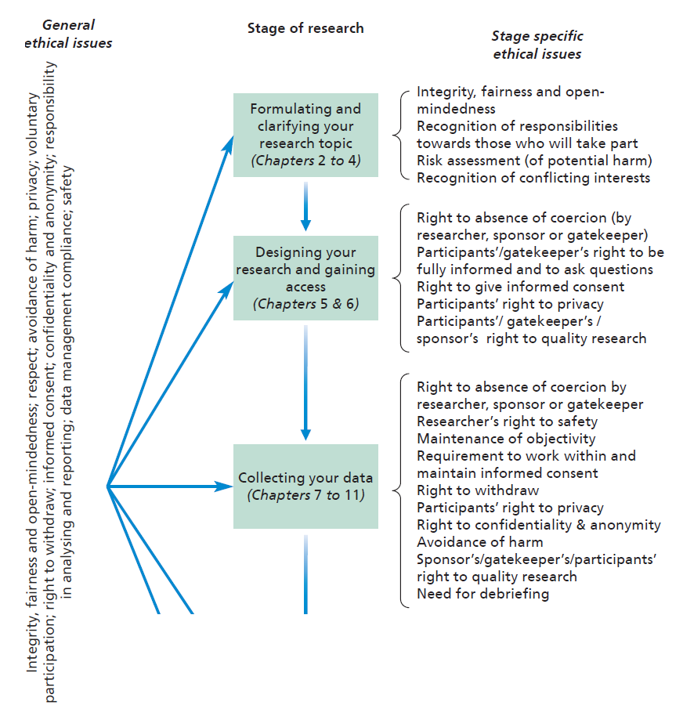
Figure 6.1 (1 of 2) Ethical issues at different stages of research

Slide 10
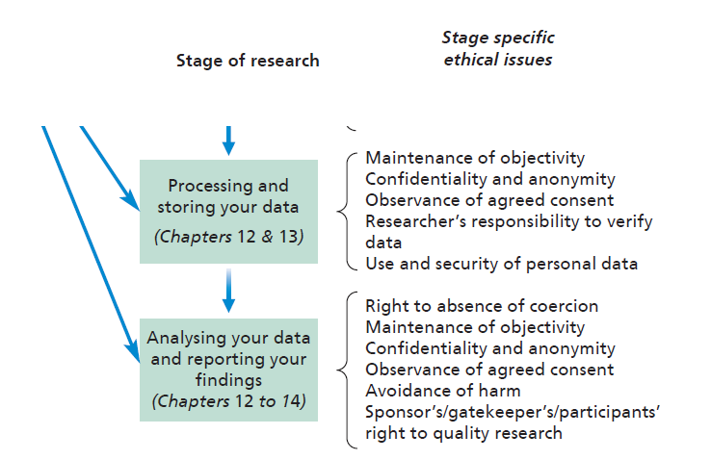
Figure 6.1 (2 of 2) Ethical issues at different stages of research

Slide 11
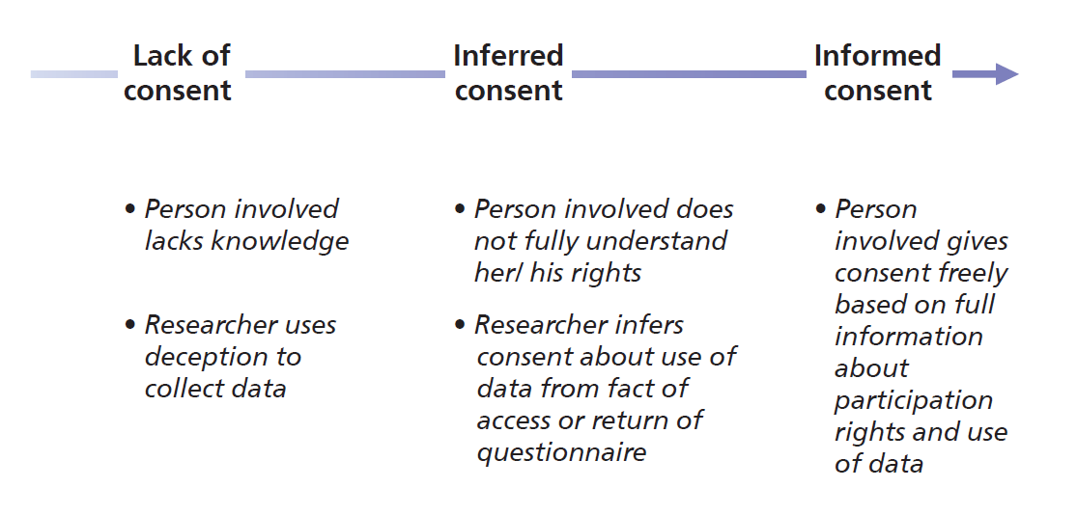
Figure 6.2 The nature of consent

Slide 12
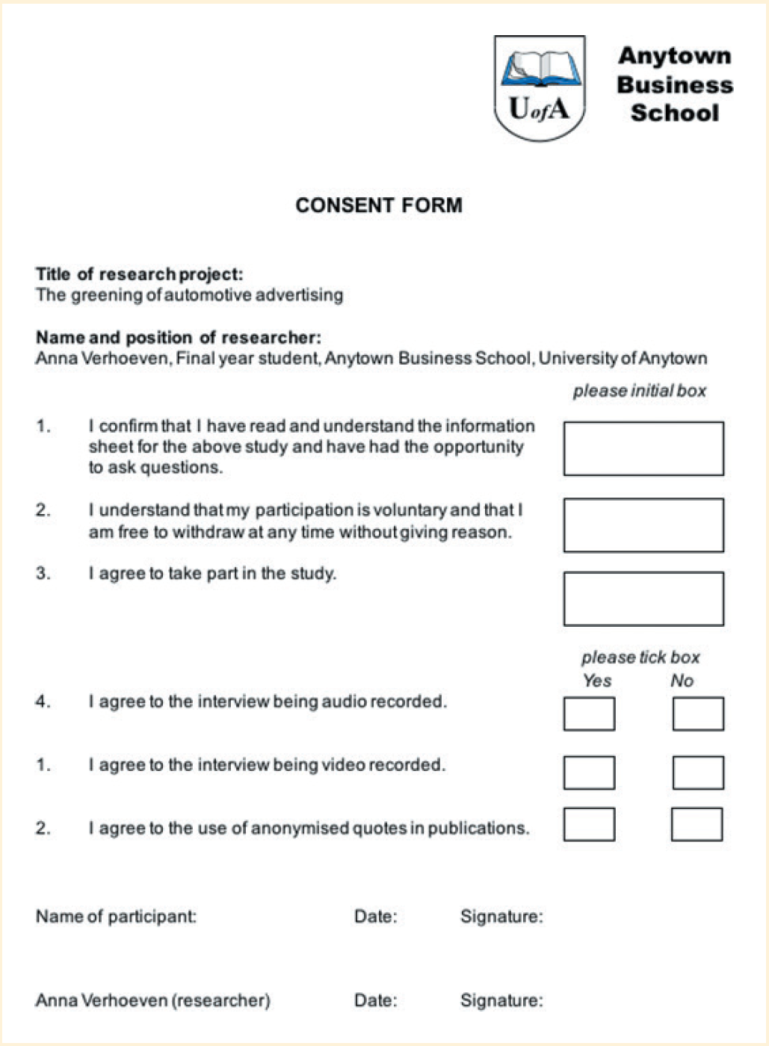
Consent form

Slide 13
Principles for processing personal data (1 of 2)
processed lawfully, fairly and transparently;
obtained for specified, explicit and lawful purposes and not processed further in a manner incompatible with those purposes, while allowing data to be processed further for scientific, historical and statistical research purposes where this is in accordance with Article 89 (1);
adequate, relevant and limited to the purpose for which they are processed;
accurate and, where necessary, kept up to date;
Source: General Data Protection Regulation EU 2016/679 (GDPR)

Slide 14
Principles for processing personal data (2 of 2)
kept in a form that allows identification of data subjects for no longer than is necessary in relation to the purpose for which they are processed, while allowing personal data to be stored for longer periods where this is solely for scientific, historical and statistical research purposes in accordance with Article 89 (1) and subject to measures to safeguard the rights and freedoms of data subjects;
kept securely and protected from wrongful processing and accidental loss or damage;
held responsibly by the person who controls them and compliantly with the points listed above.
Source: General Data Protection Regulation EU 2016/679 (GDPR)

