Slide 1
Research Methods for Business Students
8th edition
Chapter 5
Formulating the research design

Slide 2
Learning Objectives (1 of 2)
By the end of this chapter you should be able to:
5.1 appreciate the importance of your decisions when designing research and the need to achieve methodological coherence throughout your research design;
5.2 understand the differences between quantitative, qualitative and mixed methods research designs and choose between these;
5.3 understand the differences between exploratory, descriptive, explanatory and evaluative research and recognise the purpose(s) of your research design;
5.4 identify the main research strategies and choose from among these to achieve coherence throughout your research design;

Slide 3
Learning Objectives (2 of 2)
5.5 consider the implications of the time frames required for different research designs;
5.6 consider some of the main ethical issues implied by your research design;
5.7 understand criteria to evaluate research quality and consider these when designing your research;
5.8 take into account the constraints of your role as researcher when designing your research.

Slide 4
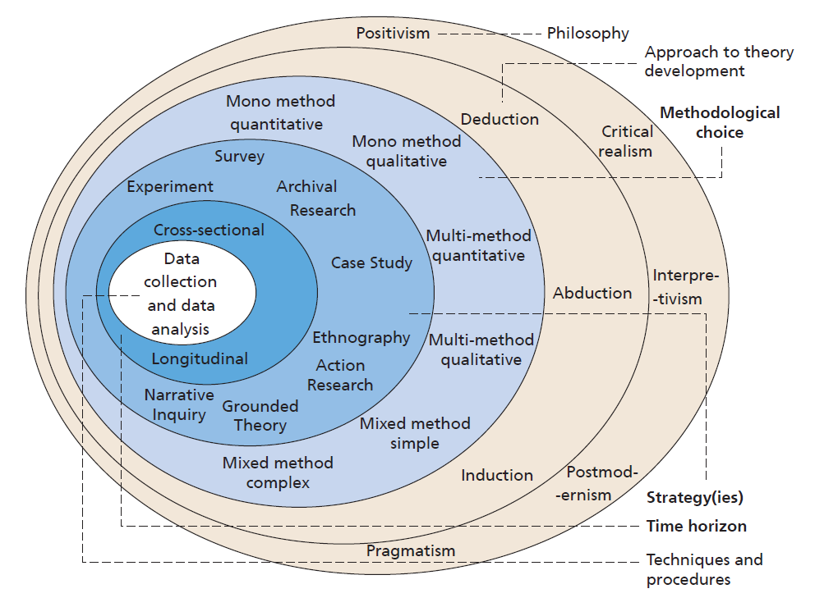
Figure 5.1 The research onion
Source: © 2018 Mark Saunders, Philip Lewis and Adrian Thornhill

Slide 5
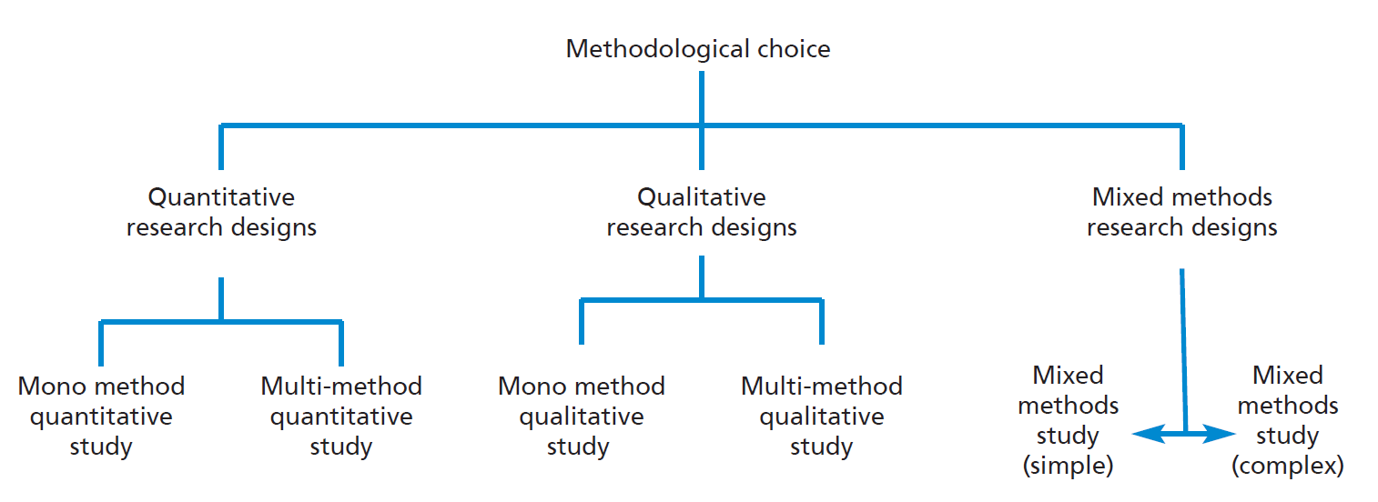
Figure 5.2 Methodological choice

Slide 6
Table 5.1 (1 of 2) Characteristics of quantitative research

Slide 7
Table 5.1 (2 of 2) Characteristics of quantitative research

Slide 8
Table 5.2 (1 of 2) Characteristics of qualitative research

Slide 9
Table 5.2 (2 of 2) Characteristics of quantitative research

Slide 10
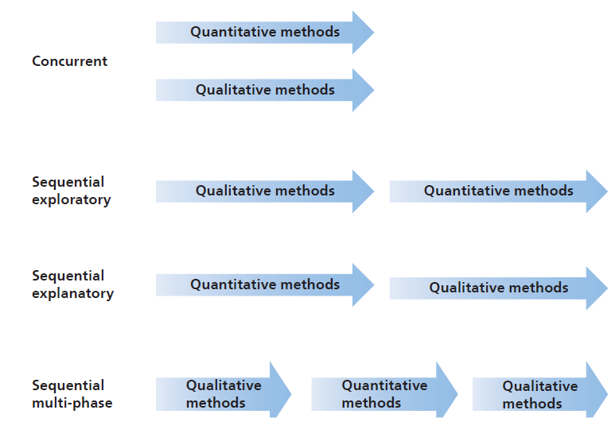
Figure 5.3 Mixed methods research designs

Slide 11
Table 5.3 Reasons for using a mixed methods design
Initiation
Facilitation
Complementarity
Interpretation
Generalisability
Diversity
Problem solving
Focus
Triangulation
Confidence
Source: Developed from Bryman (2006), Greene et al. (1989), Molina-Azorin (2011) and authors’ experience

Slide 12
Different research strategies
Experiment
Survey
Archival and documentary research
Case study
Ethnography
Action Research
Grounded Theory
Narrative Inquiry

Slide 13
Table 5.4 (1 of 2) Types of variable

Slide 14
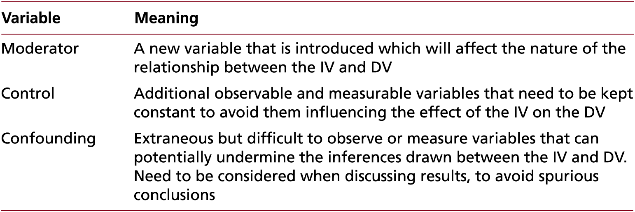
Table 5.4 (2 of 2) Types of variable

Slide 15
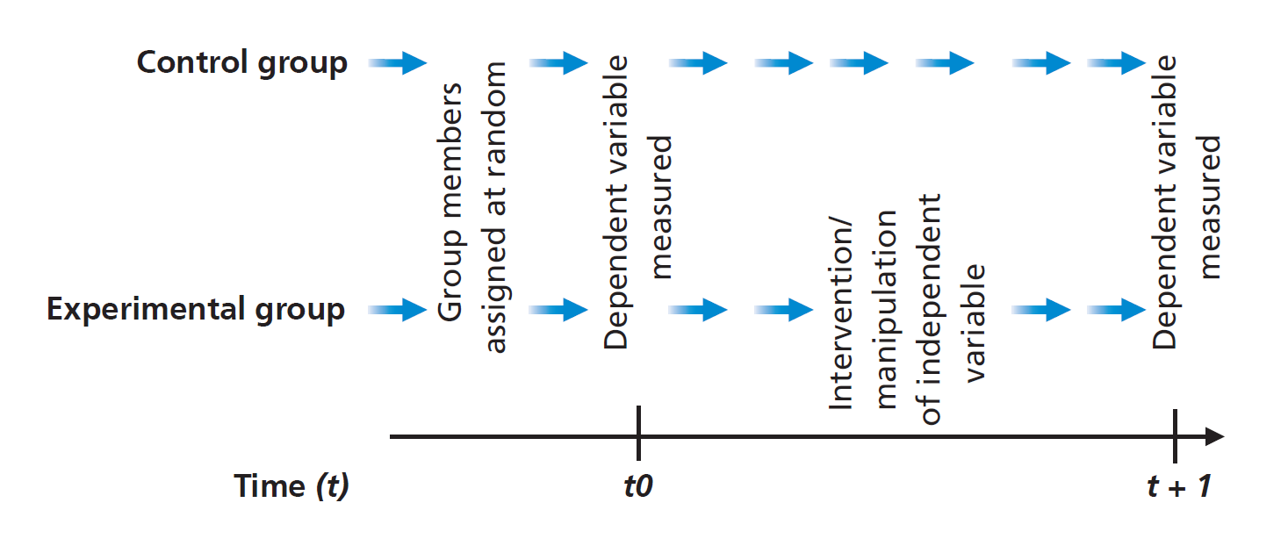
Figure 5.4 A classical experiment strategy

Slide 16
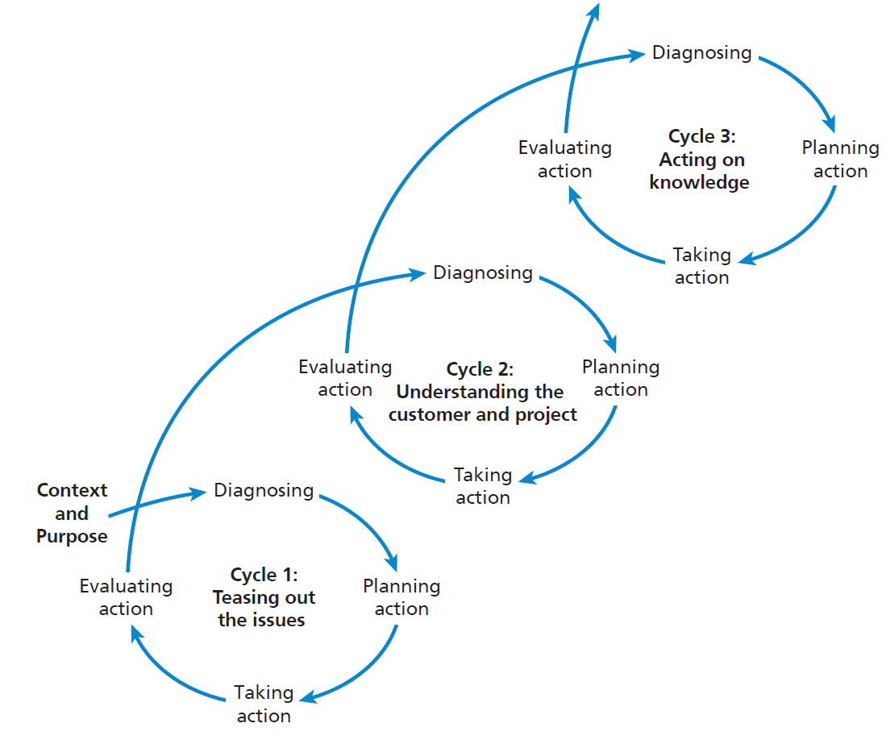
Figure 5.5 The three cycles of the Action Research spiral

Slide 17
Key elements of Grounded Theory strategy (1 of 2)
early commencement of data collection;
concurrent collection and analysis of data;
developing codes and categories from the data as these are collected and analysed;
use of constant comparison and writing of self-memos to develop conceptualisation and build a theory;
use of theoretical sampling and theoretical saturation aimed at building theory rather than achieving (population) representativeness;

Slide 18
Key elements of Grounded Theory strategy (2 of 2)
use of an abductive approach that seeks to gain insights to create new conceptual possibilities which are then examined;
initial use of literature as a complementary source to the categories and concepts emerging in the data, rather than as the source to categorise these data. Later use to review the place of the grounded theory in relation to existing, published theories;
development of a theory that is grounded in the data.

Slide 19
Table 5.5 Threats to reliability
Threat | Definition
Participant error | Any factor which adversely alters the way in which a participant performs.
Participant bias | Any factor which induces a false response.
Researcher error | Any factor which alters the researcher’s interpretation.
Researcher bias | Any factor which induces bias in the researcher’s recording of responses

Slide 20
Table 5.6 Threats to internal validity
Threat | Definition
Past or recent events | An event which changes participants’ perceptions.
Testing | The impact of testing on participants’ views or actions.
Instrumentation | The impact of a change in a research instrument between different stages of a research project affecting the comparability of results.
Mortality | The impact of participants withdrawing from studies.
Maturation | The impact of a change in participants outside of the influence of the study that affects their attitudes or behaviours etc.
Ambiguity about casual direction | Lack of clarity about cause and effect.

Slide 21
Table 5.7 Alternative quality criteria
Criterion | Explanation
Dependability | This is the parallel criterion to reliability.
Credibility | This is the parallel criterion to internal validity.
Transferability | This is the parallel criterion to external validity or generalisability.
Authenticity criteria | These were not conceived as parallel criteria but as criteria that are specifically designed for the nature of constructivist/interpretivist research.
Source: Developed from Guba and Lincoln 1989; Lincoln and Guba 1985; Lincoln et al. 2011

