Slide 1
Research Methods for Business Students
8th edition
Chapter 4
Understanding research philosophy and approaches to theory development

Slide 2
Learning Objectives
By the end of this chapter you should be able to:
4.1 define ontology, epistemology and axiology, and explain their relevance to business research;
4.2 reflect on your own epistemological, ontological and axiological stance;
4.3 understand the main research paradigms that are significant for business research;
4.4 explain the relevance for business research of philosophical positions such as positivism, critical realism, interpretivism, postmodernism and pragmatism;
4.5 reflect on and articulate your own philosophical position in relation to your research;
4.6 distinguish between deductive, inductive, abductive and retroductive approaches to theory development.

Slide 3
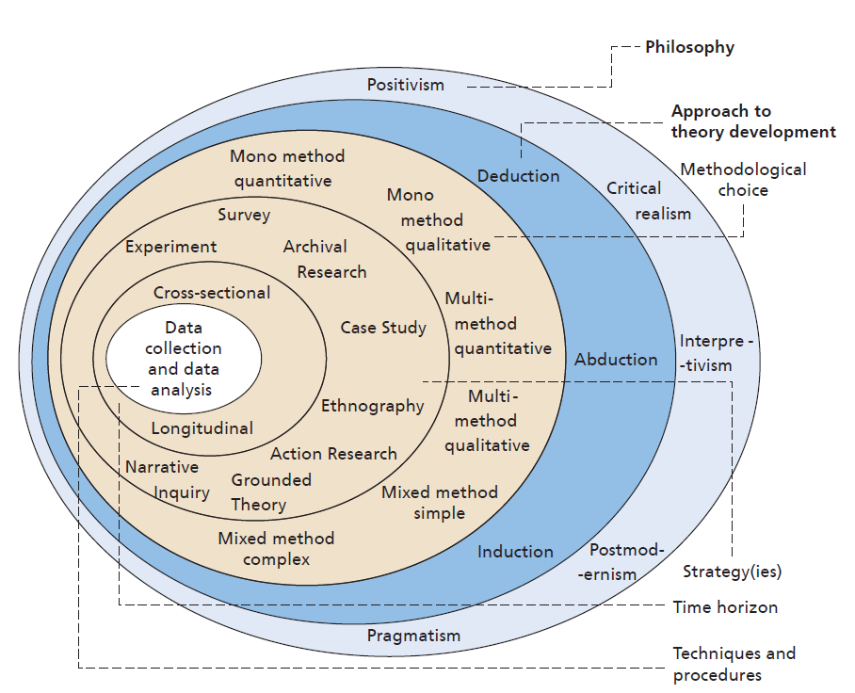
Figure 4.1 The ‘research onion’
Source: ©2018 Mark Saunders, Philip Lewis and Adrian Thornhill

Slide 4
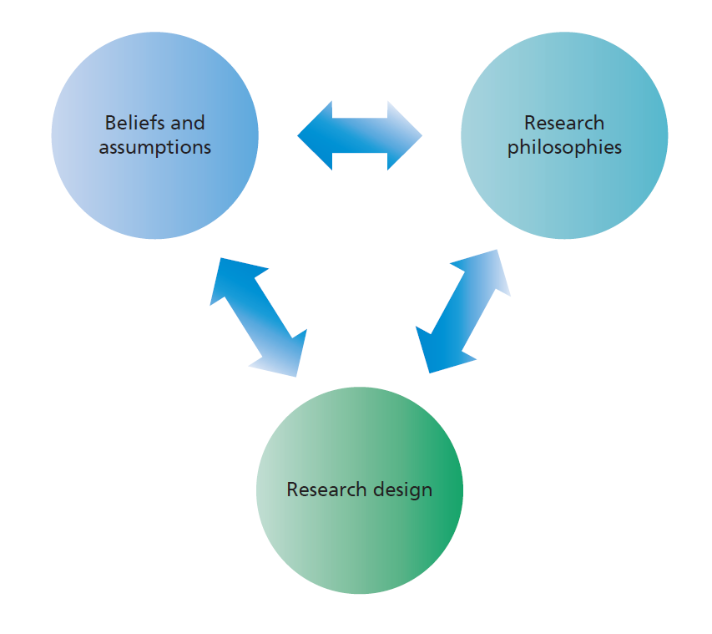
Figure 4.2
Source: ©2018 Alexandra Bristow and Mark Saunders

Slide 5
Table 4.1a Ontological assumptions as a multi-dimensional set of criteria
Questions | Continua with two sets of extreme
 | Objectivism ↔ Subjectivism
What is the nature of reality? What is the world like? For example: What are organisations like? What is it like being in organisations? What is it like being a manager or being managed? | Real | ↔ | Nominal/decided by convention
 | External | ↔ | Socially constructed
 | One true reality (universalism) | ↔ | Multiple realities (relativism)
 | Granular (things) | ↔ | Flowing (processes)
 | Order | ↔ | Chaos

Slide 6
Table 4.1b Epistemological assumptions as a multi-dimensional set of criteria
Questions | Continua with two sets of extreme
 | Objectivism ↔ Subjectivism
How can we know what we know What is considered acceptable knowledge? What constitutes good-quality data? What kinds of contribution to knowledge can be made? | Adopt assumptions of the natural scientist | ↔ | Adopt the assumptions of the arts and humanities
 | Facts | ↔ | Opinions
 | Numbers | ↔ | Written, spoken and visual accounts
 | Observable phenomena | ↔ | Attributed meanings
 | Law-like generalisations | ↔ | Individuals and contexts, specifics

Slide 7
Table 4.1c Axiological assumptions as a multi-dimensional set of criteria
Questions | Continua with two sets of extreme
 | Objectivism ↔ Subjectivism
What is the role of values in research? Should we try to be morally-neutral when we do research, or should we let our values shape research? How should we deal with the values of research participants? | Value-free | ↔ | Value-bound
 | Detachment | ↔ | Integral and reflexive

Slide 8
Table 4.2 The regulation-radical change dimension
Source: Developed from Burrell and Morgan (2016)

Slide 9
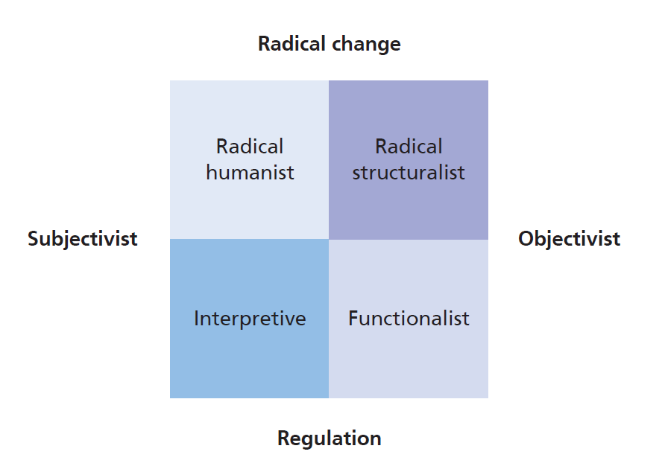
Figure 4.3 Four paradigms for organisational analysis
Source: Developed from Burrell and Morgan (2016) Social Paradigms and Organisational Analysis

Slide 10
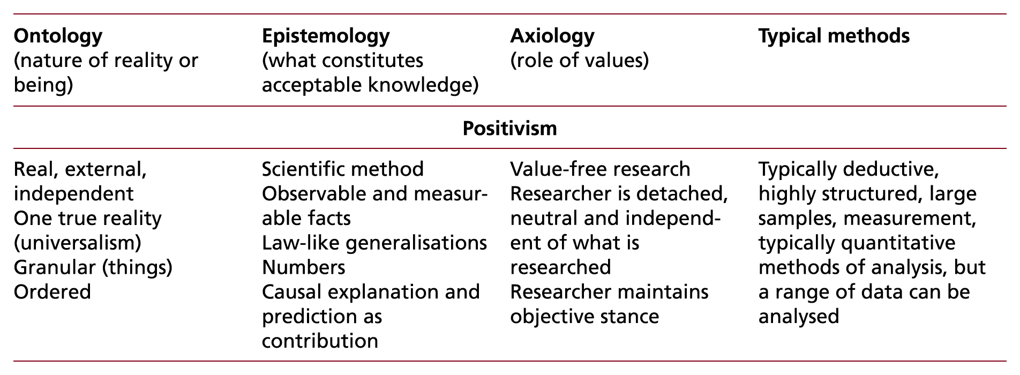
Table 4.3 (1 of 5) Comparison of five research philosophical positions in business and management research

Slide 11
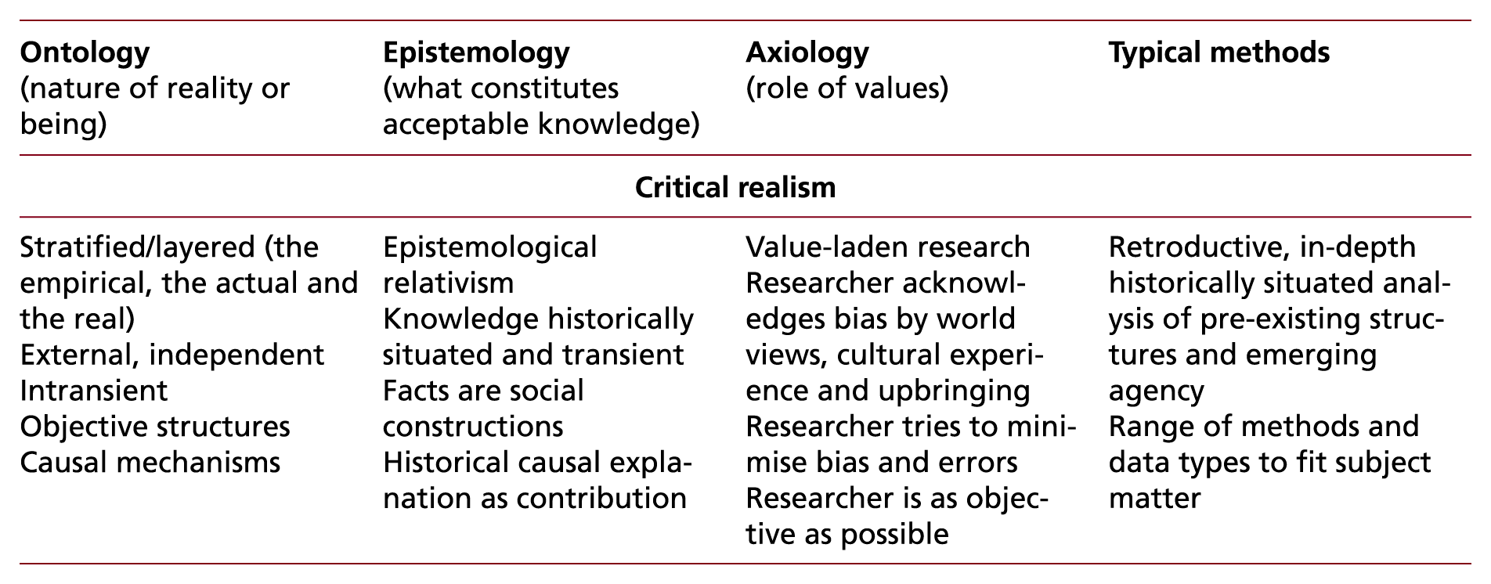
Table 4.3 (2 of 5) Comparison of five research philosophical positions in business and management research

Slide 12
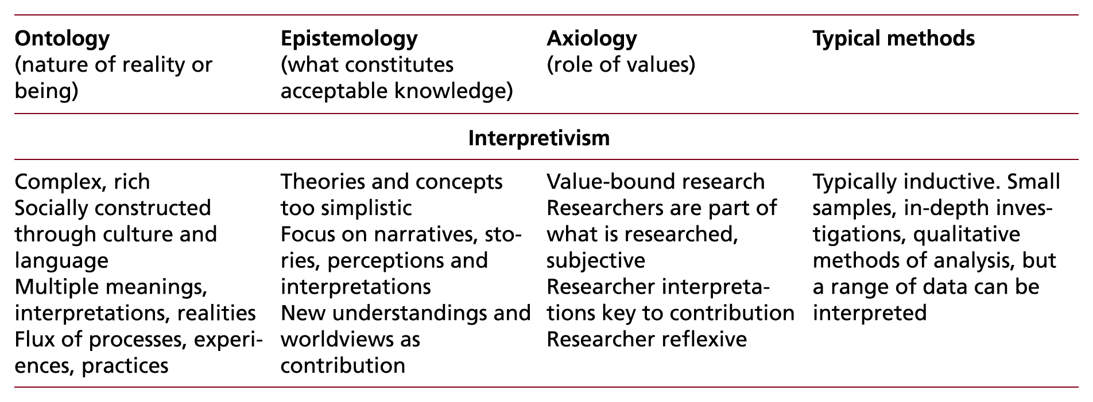
Table 4.3 (3 of 5) Comparison of five research philosophical positions in business and management research

Slide 13
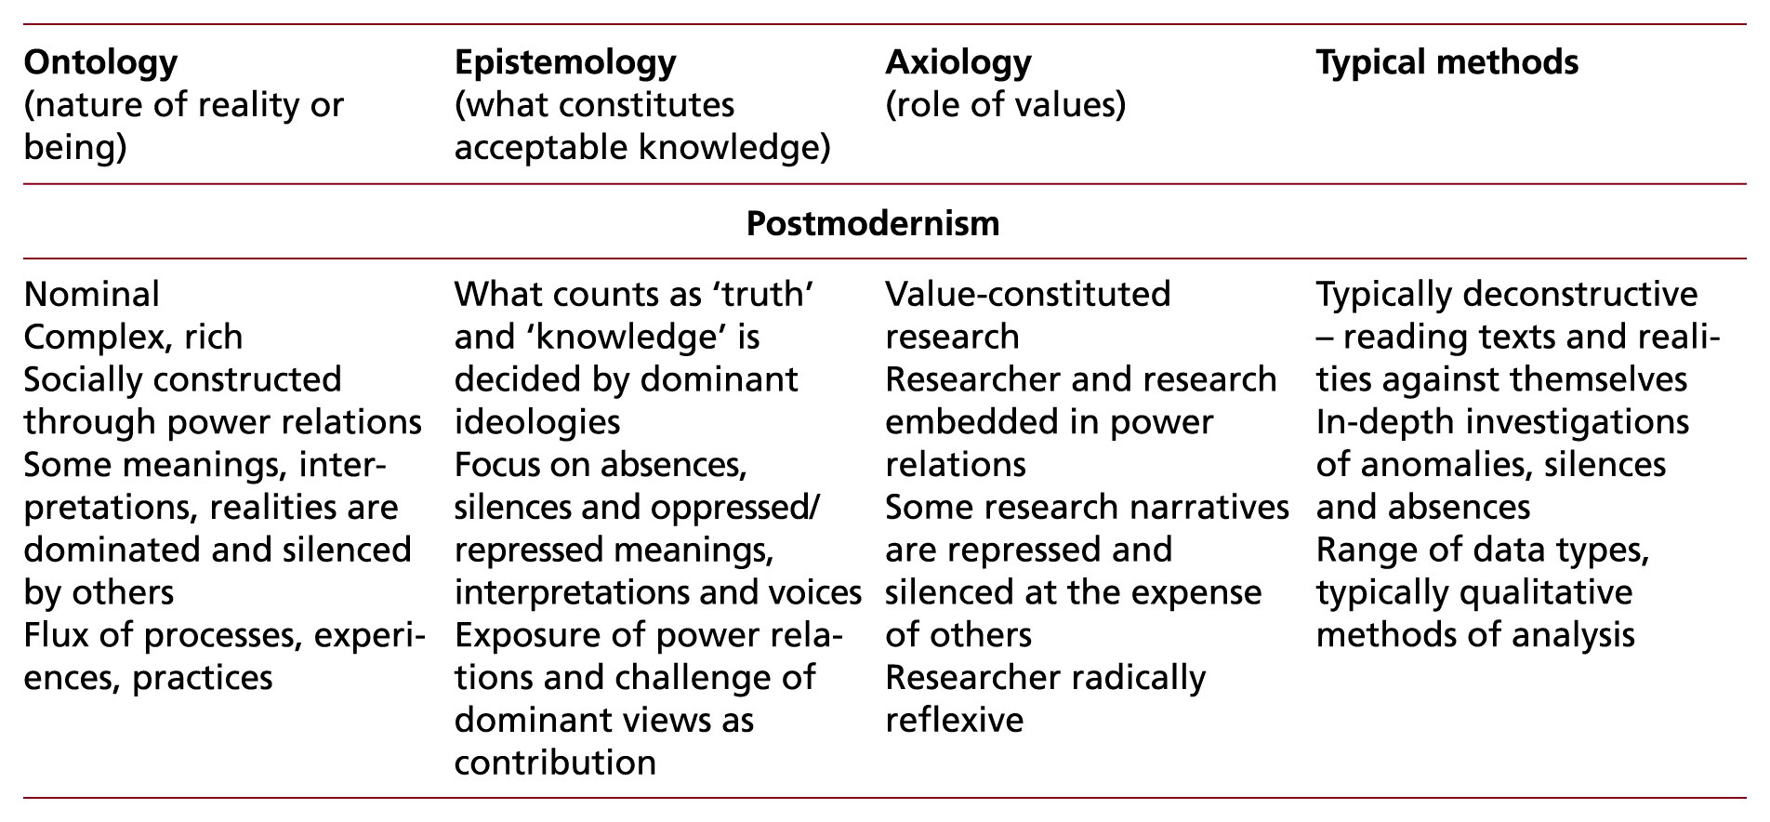
Table 4.3 (4 of 5) Comparison of five research philosophical positions in business and management research

Slide 14
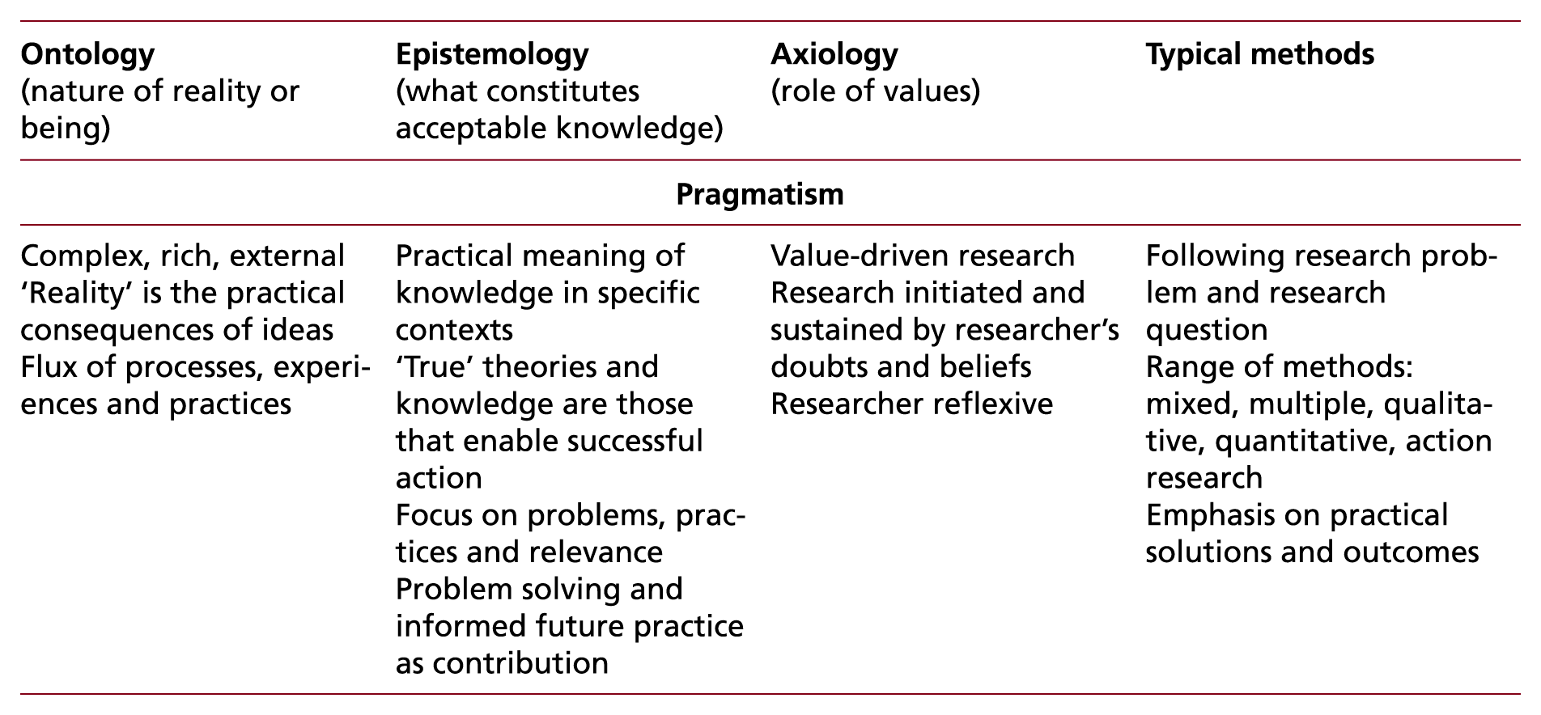
Table 4.3 (5 of 5) Comparison of five research philosophical positions in business and management research

Slide 15
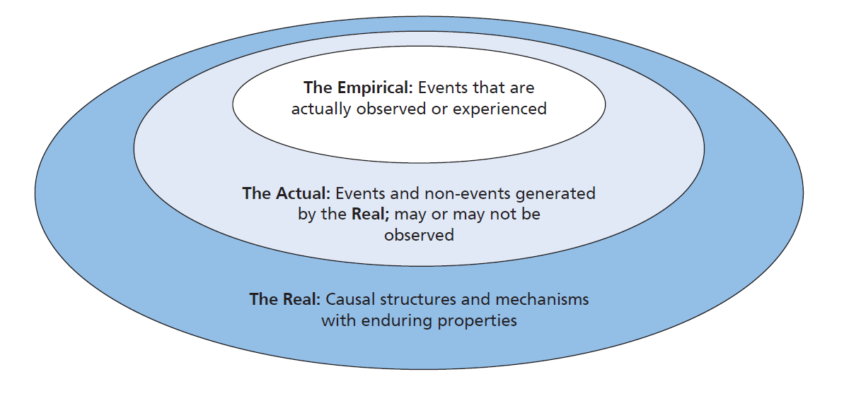
Figure 4.4 Critical realist stratified ontology
Source: Developed from Bhaskar (2008)

Slide 16
Table 4.4 (1 of 2) Deduction, induction and abduction: from reason to research

Slide 17
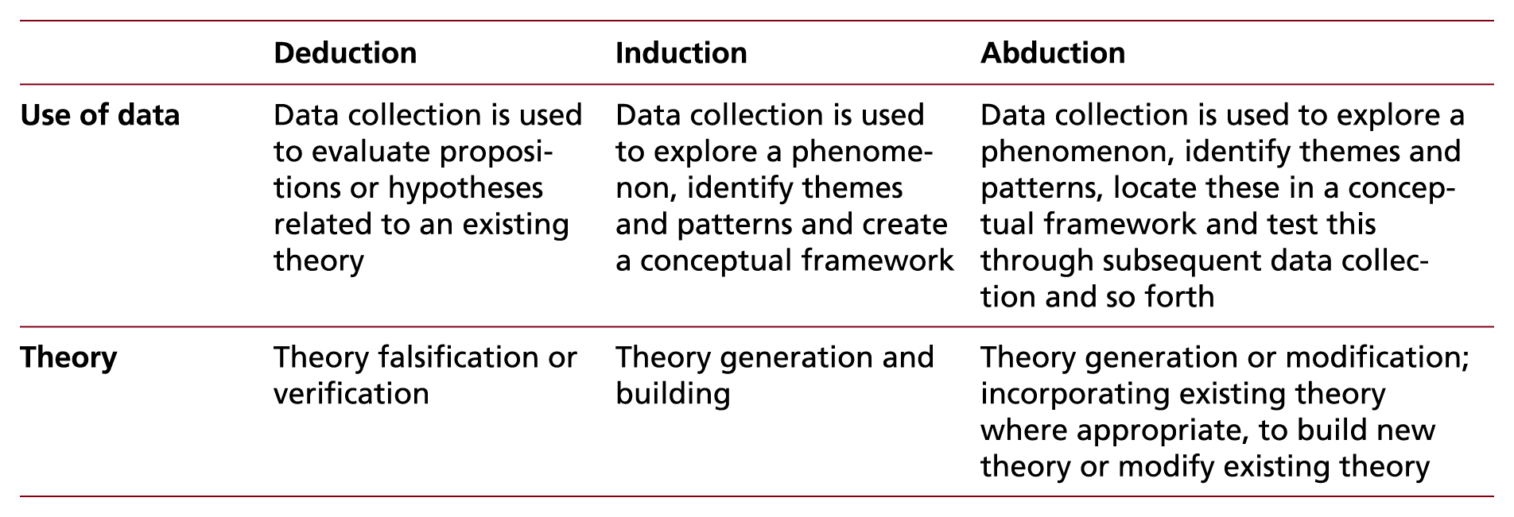
Table 4.4 (2 of 2) Deduction, induction and abduction: from reason to research

Slide 18
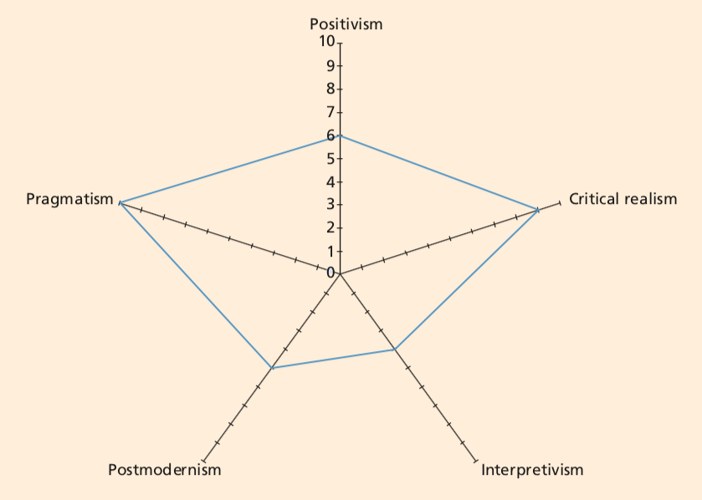
Figure C4.1 Radar Graph of HARP Scores

