Slide 1
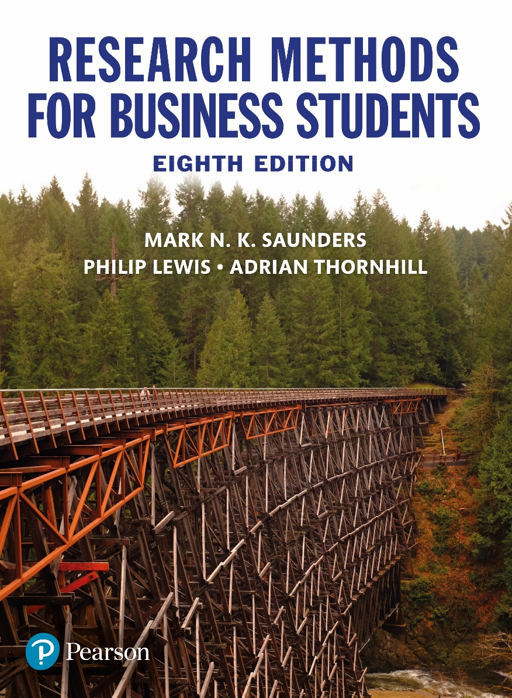
Research Methods for Business Students
8th edition
Chapter 3
Critically reviewing the literature

Slide 2
Learning Objectives (1 of 2)
By the end of this chapter you should:
3.1 understand what is meant by being critical when reviewing the literature;
3.2 understand the purpose of the critical literature review and its different forms;
3.3 be clear about the content of a critical literature review and possible ways to structure it;
3.4 be aware of types of literature available;
3.5 be able to plan literature search strategy and undertake searches;
3.6 be able to evaluate the relevance, value and sufficiency of potentially relevant literature;

Slide 3
Learning Objectives (2 of 2)
3.7 be able to reference the literature accurately;
3.8 understand the process of systematic review;
3.9 be able to draft a critical literature review;
3.10 understand why you must acknowledge others’ work or ideas and avoid plagiarism;
3.11 be able to apply knowledge, skills and understanding gained to your own research project.

Slide 4
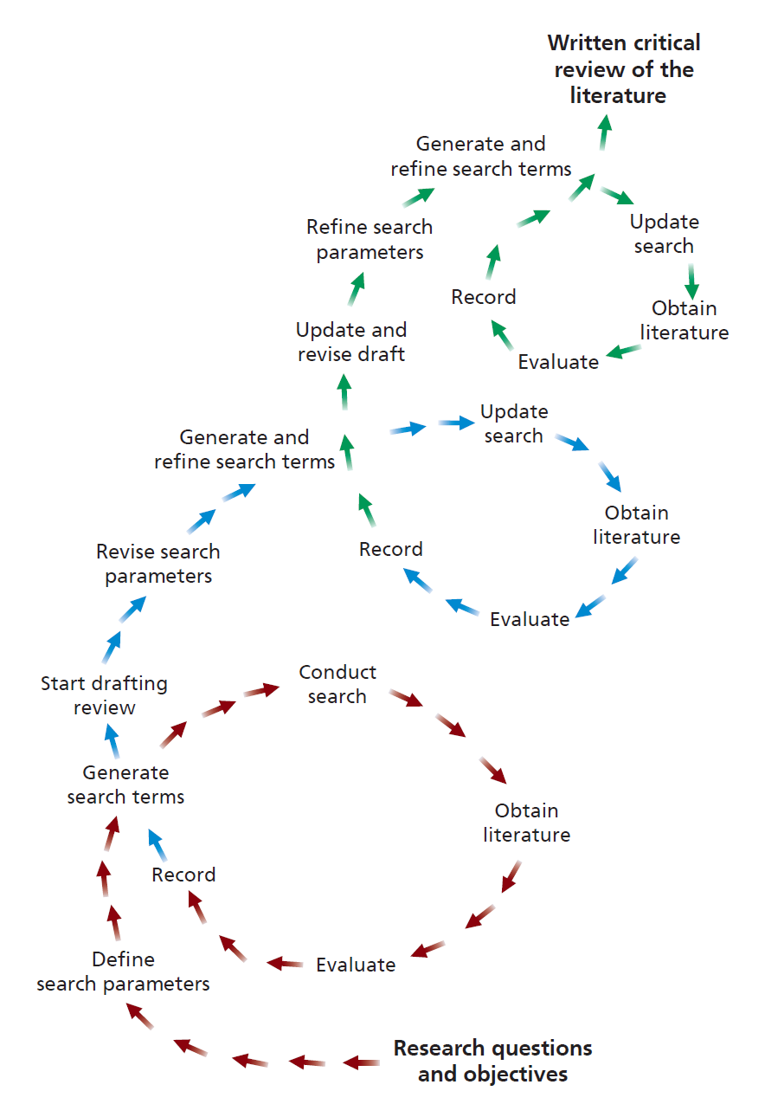
Figure 3.1 The literature review process

Slide 5
Aspects of critical approach
Critique of rhetoric;
Critique of tradition;
Critique of authority;
Critique of objectivity.

Slide 6
Forms of critical review
Integrative review;
Theoretical review;
Historical review;
Methodological review;
Systematic review.

Slide 7
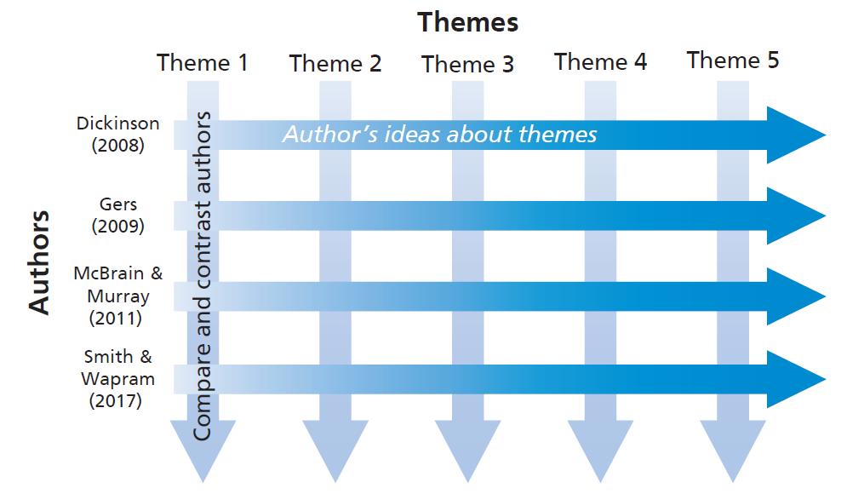
Figure 3.2 Literature review structure

Slide 8
Table 3.1 (1 of 2) Main literature sources
Source | Content
Referenced (peer-reviewed) academic journal | Detailed reports of research. Written by experts and evaluated by other experts to assess quality and suitability for publication. Rigorous attention paid to detail and verification.
Non-referenced academic journal | May contain detailed reports of research. Selected by editor or editorial board with subject knowledge.
Professional Journals | Mix of news items and practical detailed accounts. Sometimes include summaries of research.
Trade journals/magazines | Mix of news items and practical detailed accounts.
Source: © Mark Saunders, Phillip Lewis and Adrian Thornhill 2018

Slide 9
Table 3.1 (2 of 2) Main literature sources
Source | Content
Books and e-books | Written for specific audiences. Usually in an ordered and relatively accessible format. Often draw on wide range of sources
Newspapers | Written for a particular market segment. Filtered dependant on events. May be written from particular viewpoint.
Conference proceedings | Selected papers presented at a conference.
Reports | Topic specific. Written by academics and organisations. Those from established organisations often of high quality.
Theses | Often most up-to-date research but very specific.
Source: © Mark Saunders, Phillip Lewis and Adrian Thornhill 2018

Slide 10
Planning your literature search
The parameters of your search;
The search terms and phrases you intend to use;
The online databases and search engines you intend to use;
The criteria you intend to use to select the relevant and useful studies from all the items you find.

Slide 11
Conducting your literature search
Searching using online databases;
Obtaining relevant literature referenced in books and journal articles you have already read;
Browsing and scanning secondary literature in your library;
General online searching.

Slide 12
Table 3.4 Selected online search tools and their coverage
Name | Internet address
General search engines Bing Google Google UK | www.bing.com www.google.com www.google.co.uk
Specialised search engines Google Scholar UK government | www.scholar.google.com www.gov.uk
Information gateways Publishers’ catalogues homepage | www.lights.ca/publisher/
Subject directories Dotdash ipl2 | www.dotdash.com www.ipl.org

Slide 13
Five questions to employ in critical reading
Why am I reading this?
What is the author trying to do in writing this?
What is the writer saying that is relevant to what I want to find out?
How convincing is what the author is saying?
What use can I make of the reading?

Slide 14
Table 3.5 (1 of 2) Bibliographic details required

Slide 15
Table 3.5 (2 of 2) Bibliographic details required

Slide 16
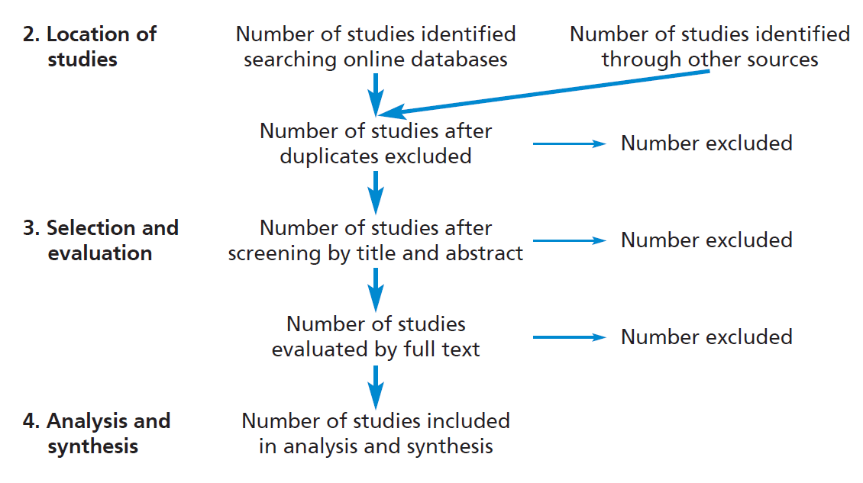
Figure 3.3 Reporting a Systematic Review
Source: Developed from Moher et al. 2009

Slide 17
Common forms of plagiarism (1 of 2)
Quoting someone else’s work, word for word, without acknowledgement.
Cutting and pasting text, diagrams or any other material from the Internet without acknowledgement.
Paraphrasing someone else’s work by altering a few words or changing their order or closely following the structure of their argument without acknowledgement.
Collaborating with others (unless expressly asked to do so such as in group work) and not attributing the assistance received.

Slide 18
Common forms of plagiarism (2 of 2)
Inaccurately referencing, within the text and list of references, the source of a quoted passage. This often occurs when students pretend to have read an original source, when their knowledge is derived from a secondary source.
Failing to acknowledge assistance that leads to substantive changes in the content or approach.
Using materials written by others such as professional essay writing services, or friends, even with the consent of those who have written it.
Auto or self-plagiarising, that is submitting work that you have already submitted (either in part or fully) for another assessment. However, it is usually acceptable to cite earlier work you have had published.

