Slide 1
Research Methods for Business Students
8th edition
Chapter 2
Choosing a research topic and developing your research proposal

Slide 2
Learning Objectives
By the end of this chapter you should be able to:
2.1 identify the characteristics of a good research topic;
2.2 generate and refine ideas to choose a suitable research topic;
2.3 express your research topic as a clear research question(s), and as an aim and objectives;
2.4 understand the relationship between the research question(s), research aim and research objectives;
2.5 recognise the role of theory in developing the research question(s), research aim and research objectives;
2.6 develop a written research proposal that outlines your proposed research project.

Slide 3
Table 2.1 More frequently used techniques for generating and refining research ideas

Slide 4
Brainstorming
Defining the problem. This will focus on the sorts of ideas you are interested in – as precisely as possible. In the early stages of formulating a topic this may be as vague as, ‘I am interested in marketing but don’t know what to do for my research topic’.
Asking for suggestions. These will relate to the problem.
Recording suggestions. As you record these you will need to observe the following rules:
No suggestion should be criticised or evaluated in any way before all ideas have been considered.
All suggestions, however wild, should be recorded and considered.
As many suggestions as possible should be recorded.
Reviewing suggestions. You will seek to explore what is meant by each as you review these.
Analysing suggestions. Work through the list of ideas and decide which appeal to you most as research ideas and why.

Slide 5
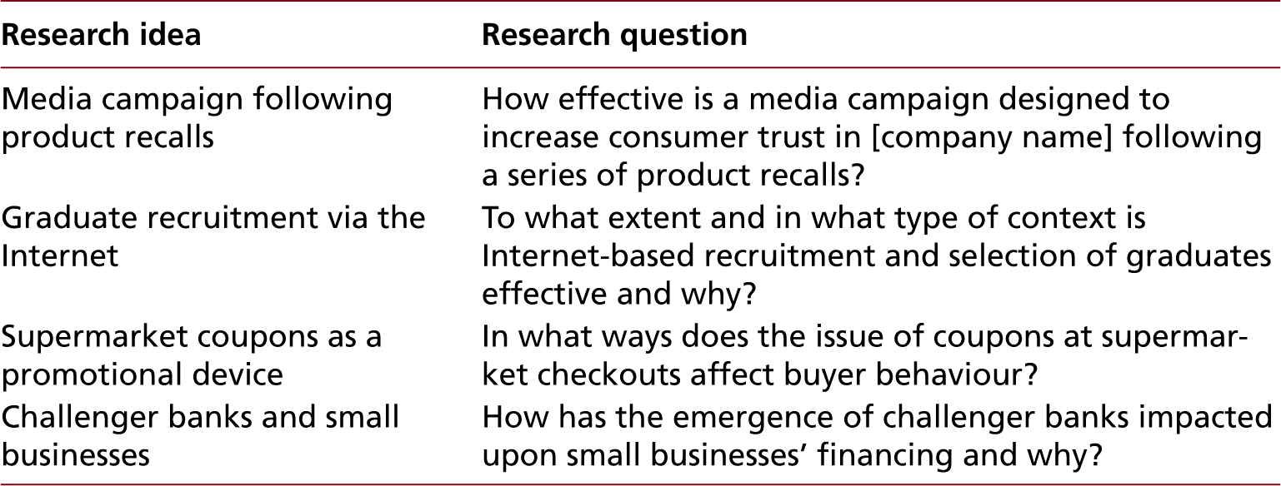
Table 2.2 Examples of research ideas and resulting general focus research questions

Slide 6
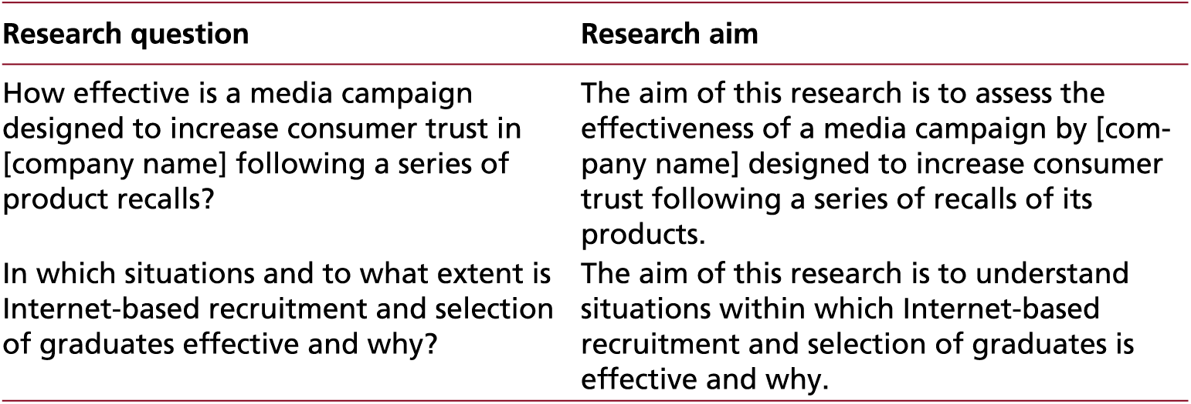
Table 2.3 Examples of research questions and related research aims (1 of 2)

Slide 7
Table 2.3 Examples of research questions and related research aims (2 of 2)

Slide 8
Table 2.4 Criteria to devise useful research objectives
Criterion
Transparency (What does it mean?)
Specificity (What am I going to do?)
Relevance (Why I am going to do this?)
Interconnectivity (How will it help to complete the research project?)
Answerability (Will this be possible?) (Where shall I obtain data?)
Measurability (When will it be done?)

Slide 9
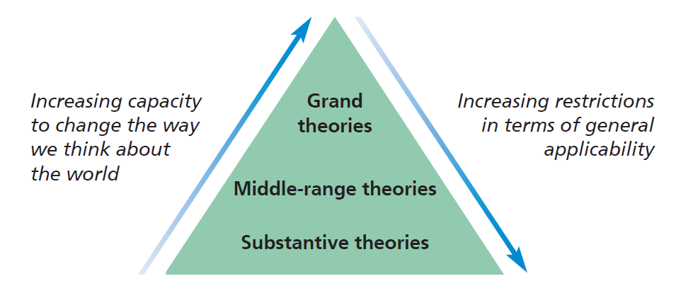
Figure 2.1 Grand, middle range and substantive theories

Slide 10
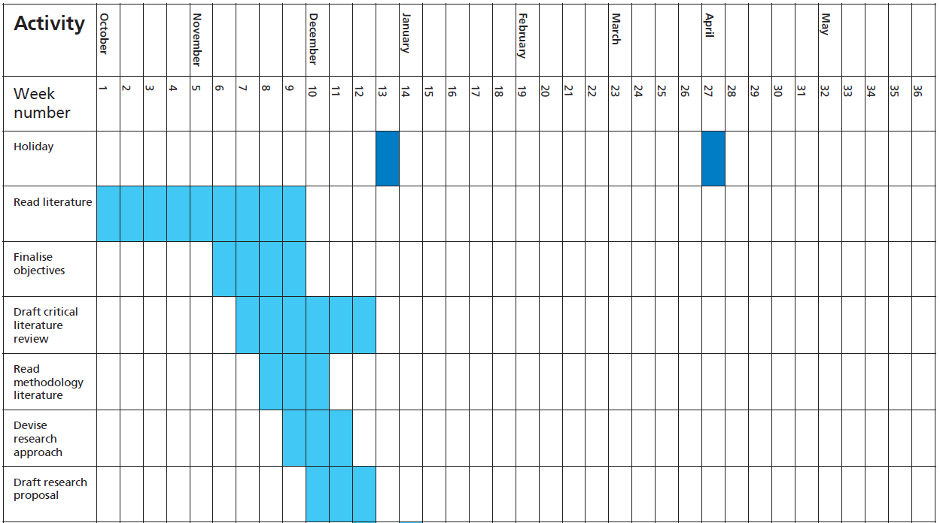
Figure 2.2 Gantt chart for a student’s research project (part)

