Slide 1
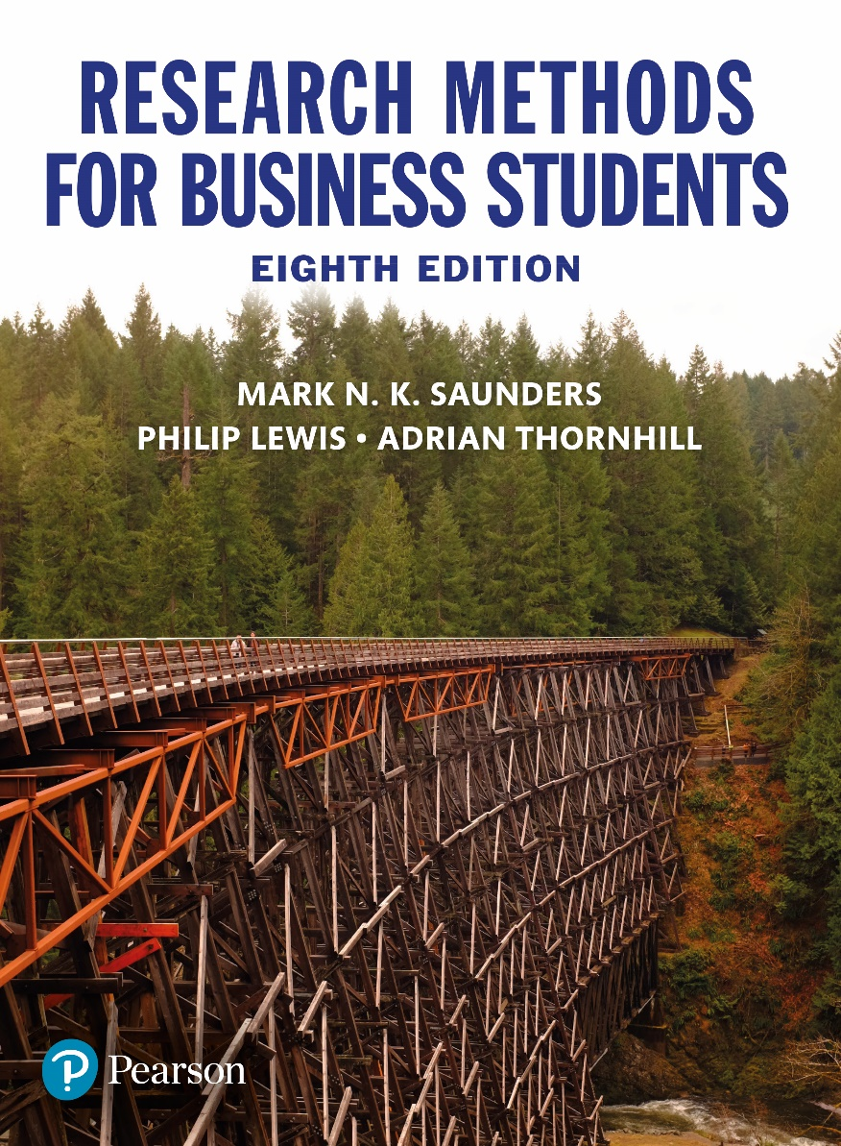
Research Methods for Business Students
8th edition
Chapter 1
Business and management research, reflective diaries and the purpose of this book

Slide 2
Learning Objectives
By the end of this chapter you should:
1.1 be able to explain the nature of research;
1.2 be able to outline the features of business and management research;
1.3 be able to place your research project on a basic–applied research continuum according to its purpose and context;
1.4 understand the usefulness and importance of keeping a reflective diary;
1.5 understand the stages you will need to complete (and revisit) as part of your research process;
1.6 have an overview of this book’s purpose, structure and features;
1.7 be aware of some of the ways you can use this book.

Slide 3
Table 1.1 A taxonomy for considering the ‘relevance gap’ in relation to managerial knowledge
Source: Developed from Hodgkinson et al. (2001)

Slide 4
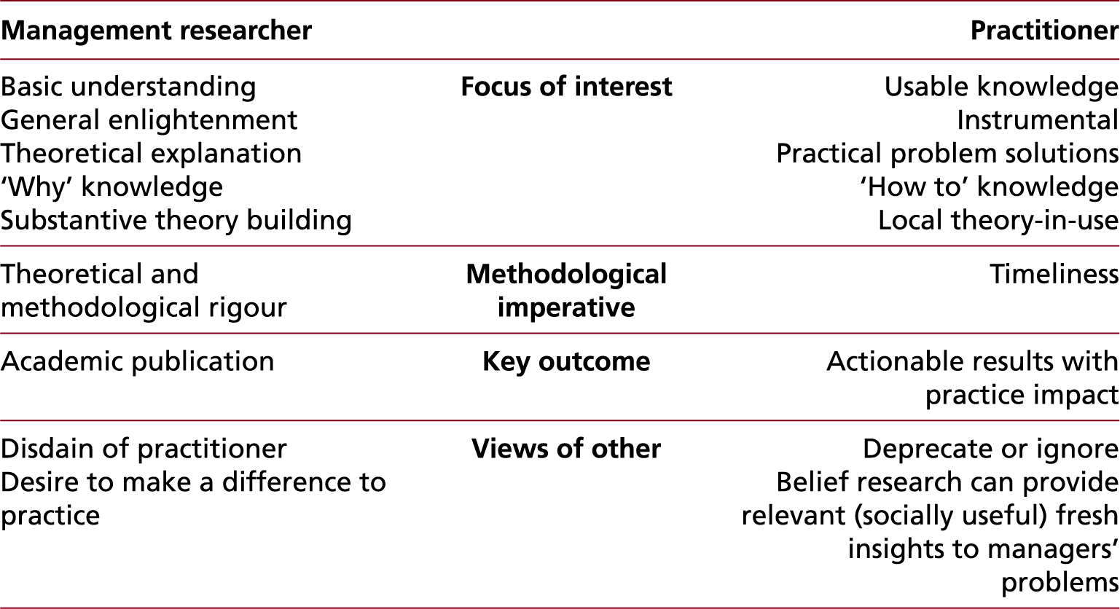
Table 1.2 Practitioner and management researcher orientations
Source: Developed from Saunders (2011)

Slide 5
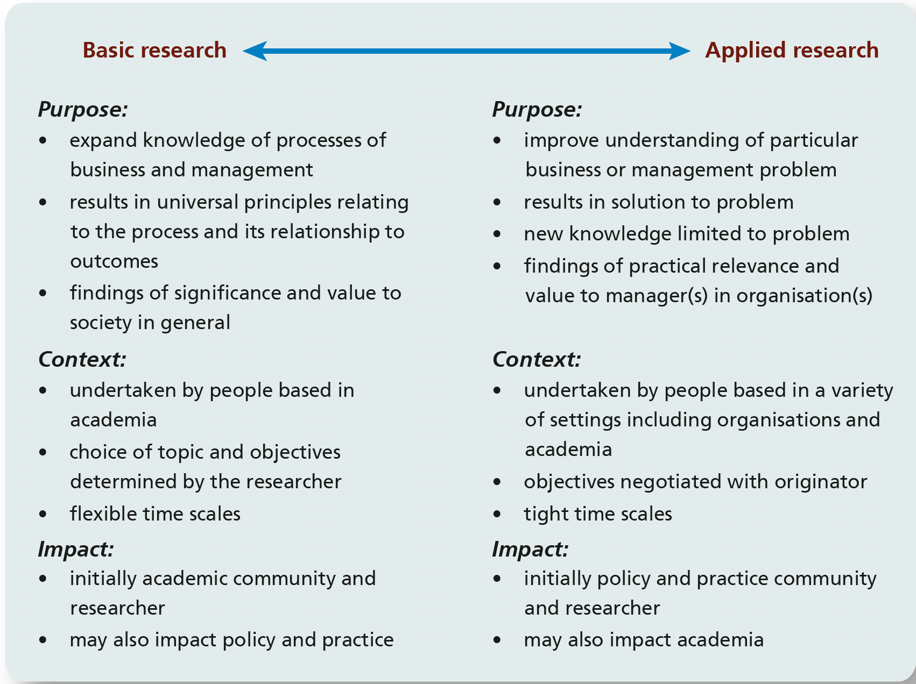
Figure 1.1 Basic and applied research
Sources: Authors’ experience; Easterby-Smith et al. (2012) ; Hedrick et al. (1993), MacIntosh et al. (2017)

Slide 6
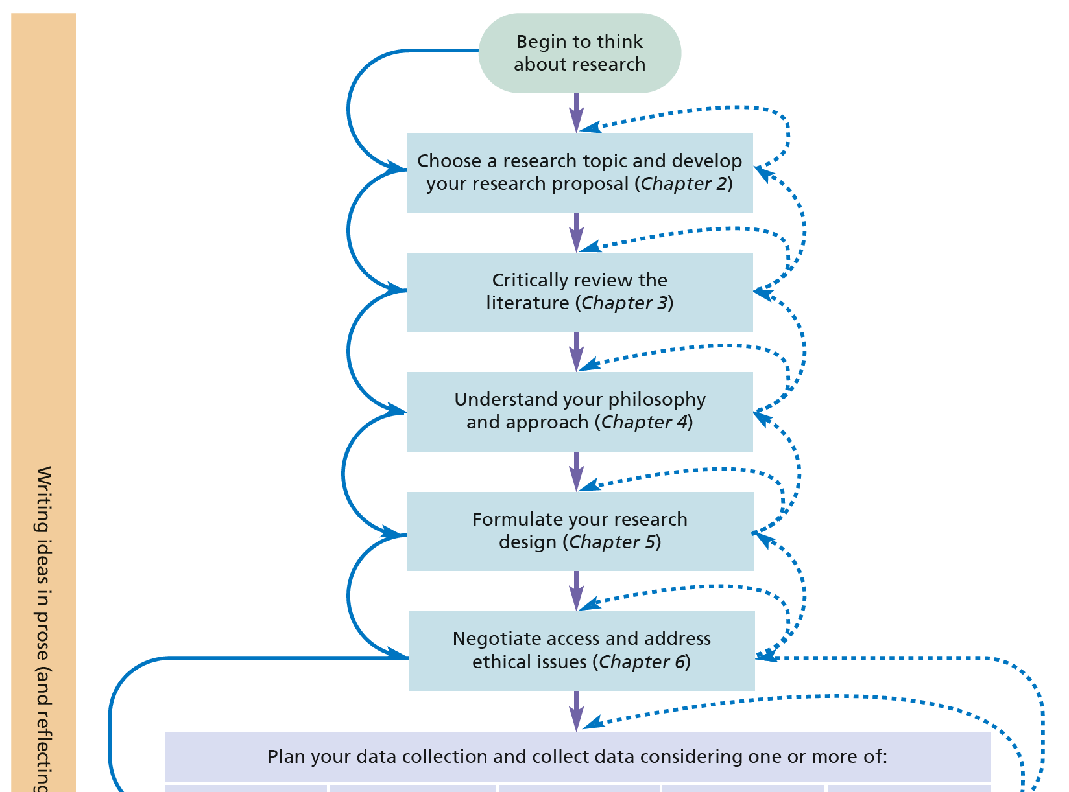
Figure 1.2 The research process (1 of 2)
Source: © Mark Saunders, Philip Lewis and Adrian Thornhill 2018

Slide 7
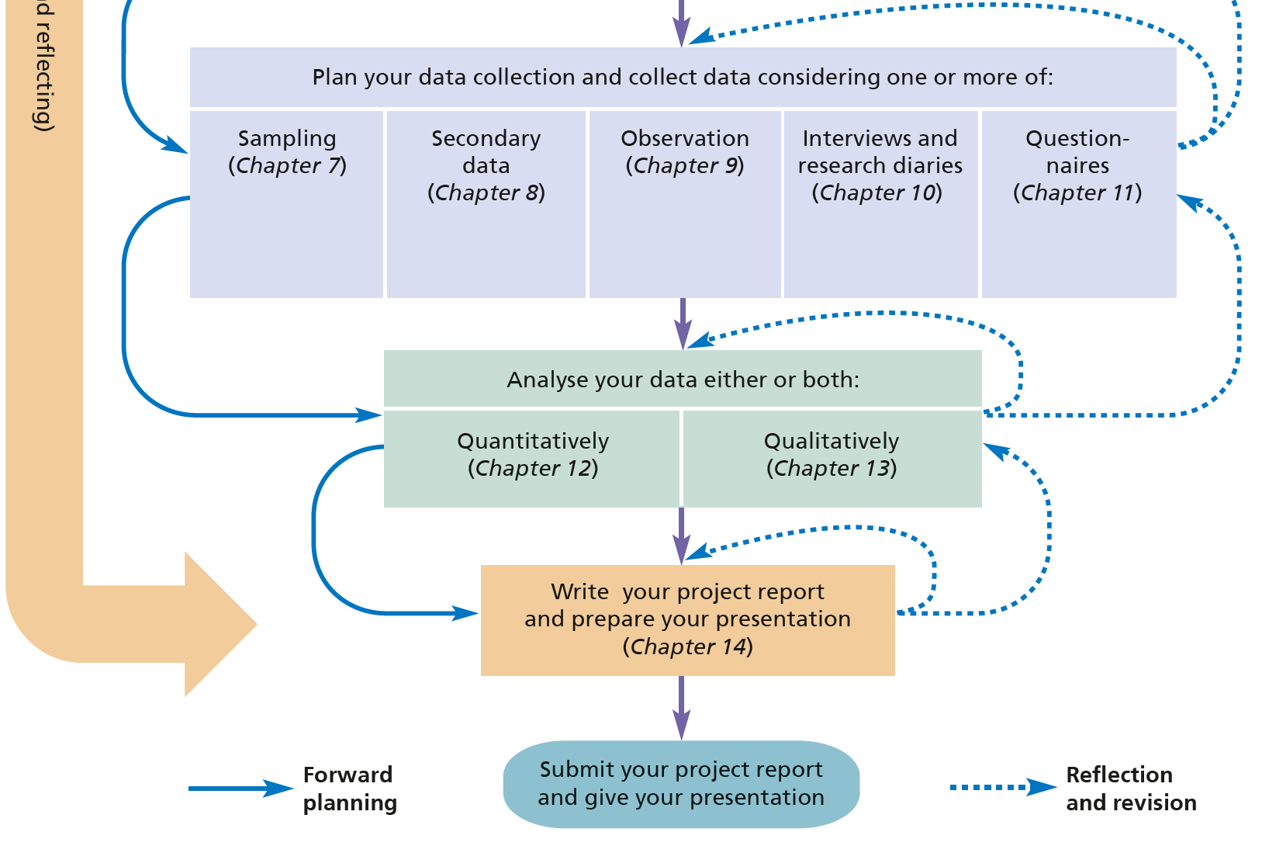
Figure 1.2 The research process (2 of 2)
Source: © Mark Saunders, Philip Lewis and Adrian Thornhill 2018

