Slide 1
CLS 223
Reem Alkhamis
Email: ralkhamis@ksu.edu.sa
3rd floor/ office # 125

Slide 2
Lecture # 9
Disturbances of Growth

Slide 3
Disturbance of growth are divided into
Congenital anomalies (Developmental disorders)
Atrophy
Hypertrophy
Hyperplasia
Metaplasia
Dyslasia
Neoplasia

Slide 4
Cellular response to stress
Cellular response to stress may be adaptive or non adaptive.
Adaptive | Non-adaptive (cell injury-----cell death)
hypertrophy | Dysplasia
hyperplasia | neoplasia
Atrophy | Degeneration
Metaplasia | Necrosis, apoptosis & gangrene
Reversible | Reversible* / Irreversible
1) Change in cell number, size, type
2) Inflammation and repair
3) Immune response
*to a certain limit

Slide 5
1) Congenital anomalies :
Causes:
-Genetics.
-Environmental: Exposure of the mother during pregnancy to X-ray, Drugs, toxins..ect
Examples of Congenital anomalies :
Agenesis or Aplasia: Complete failure of an organ or tissue to develop. The organ is totally absent.
Hypoplasia: Failure of an organ to achieve the full size.
Notes:
Agenesis, aplasia and hypoplasia can occur in any tissue or organ.

Slide 6
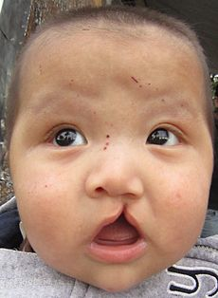
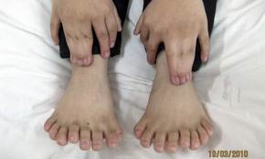
Failure to fuse (E.g. Cleft palate, cleft lip)
Failure to separate (In toes or fingers)
Supernumerary organs (E.g. more than 5 toes)
Failure to canalize (E.g. esophagus)
Notes:
Cleft palate: abnormal facial development
Supernumerary organs (3 nipples..)

Slide 7
6) Dysplasia
Disordered epithelial cell growth leading to formation of tissue with various size, shape and appearance.
The Variation in caused by:
1- Chronic irritation.
2- Chronic inflammation.
It might lead to neoplasia (tumors) (malignancy).
Notes:
Mild dysplasia is commonly reversible when the irritation is removed. Severe dysplasia is considered a preinvasive neoplasm (cancinoma in situ)

Slide 8
7)Neoplasia (tumors)
Definition: Self-controlling growth formed by the unlimited multiplication of abnormal cells in one of the body tissues or organs.
General characters of tumors:
The growth is unlimited and independent of the normal process of body growth.
2)Cells of tumor have supporting stroma of fibrous tissue and blood supply derived from the host.
3)The tumor mainly forms a mass which has no useful function. The activity of the tumor is spent mainly in multiplication. However, functional activity might be present e.g. in tumors of endocrine glands. This functional activity is not needed and harmful.
4)Tumors are classified according to their behavior into benign and malignant.
Notes:
Independent of the normal process of body growth: lipoma continues to grow even when the body is starving.

Slide 9
Tumor = Swelling.
It ends with (oma)
e.g. Retinoblastoma, lipoma, carcinoma
Oncology: is the study of neoplasms and their treatment.

Slide 10
Characteristics: | Benign tumors | Malignant tumors
mass | Small size, spherical shape, with sharply defined margin | Reach large size within short time, different shapes, irregular margin
Fibrous Capsule: formed by normal tissue around the tumor | Present | Absent
Cells type and arrangement | Cells resemble the tissue of origin regarding cell type and arrangement (differentiation) | Fail to reproduce the exact type and pattern of parent tissue (Loss of differentiation)
Cell size | Cells are usually small and similar in size and shape. | Pleomorphism ( change in size and shape of the cells)
BV | Few blood vessels. | More blood vessels involved

Slide 11
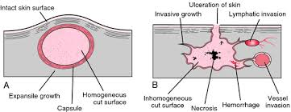
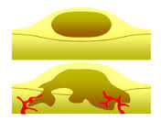
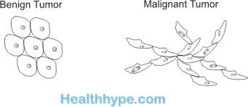

Slide 12
Behavior: | Benign tumors | Malignant tumors
Rate of growth: | Slow | Rapid
Mode of growth and Effect on the host | By expansion, Compress on the surrounding tissue to form room for itself without destroying the surrounding tissue, so it isn’t dangerous except when it compresses vital structures as the brain, spinal cord, heart... | By Infiltration and destruction of all the surrounding tissues. Malignant cells push themselves in between surrounding normal cells in all directions and take most of their nutrients, so normal cells undergo necrosis which usually kills the patient even if it was in the skin
localization | Localized at the site of origin. | Not localized at site of origin but metastasis occurs.
Recurrence | If well removed, there is no recurrence (Good prognosis) | Even after surgical removal it often reoccurs (bad prognosis)

Slide 13
Malignant tumor
 | Carcinoma | sarcoma
Definition | Tumor of epithelial tissue | Tumor of mesenchymal tissue: made of bone, cartilage, fat, muscle, vascular, or blood tissue
Incidence | More common | Less common
Age | Middle and old age (40-60ys) | Adolescent and early adult life (10-20ys)
Rate of growth | Slower than sarcoma | More rapid than carcinoma
Mode of growth | More by infiltration than by expansion | Is by expansion and by infiltration.
Gross picture | Hard mass | Soft mass
Microscopic picture | Carcinoma cells are arranged in groups, separated by fibrous stroma, with less numerous blood vessels. | Sarcoma cells are arranged singly, separated by scanty amount of fibrous stroma with numerous blood vessels.
Notes:
Carcinoma:
Sarcoma:

Slide 14
Factors causing cancer
Cancer is a complex disease with many possible causes.
1) Hereditary: E.g. breast cancer
2)Organisms: mostly viruses can lead to cancer e.g. Human papilloma virus (HVP) is strongly linked to cervical cancer.
3)Carcinogens: Agents natural or synthetic capable of causing cancer
E.g. Smoking can lead to lung cancer. Radiation exposure..
Notes:
Hereditary: Some cancers run in certain families more than others
Lifestyle: alchol consumption, obisity,
Exposure to the sun UV rays

Slide 15
Effects of cancer growth on body function
1) Destruction & replacement of normal tissue by neoplastic growth lead to altered function of that tissue.
2) Compression on BV lead to ischemia, necrosis. Compression on surrounding hollow viscera can lead to their obstruction.
3) Inappropriate production of hormones (in case of cancer in any of the endocrine glands).
4) In some tumors, there is abnormal production of coagulation factors and this increase the risk of thrombosis.
5) In some tumors, there is bleeding and/or decrease in RBC production, and leads to anemia.
6) Metastatic invasion of bone that occurs in advanced stages of the tumors leads to bone destruction.
7) Pain occurs in some tumors due to compression on nerve ends or liberation of pain mediators.

Slide 16
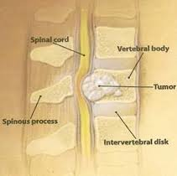

Slide 17
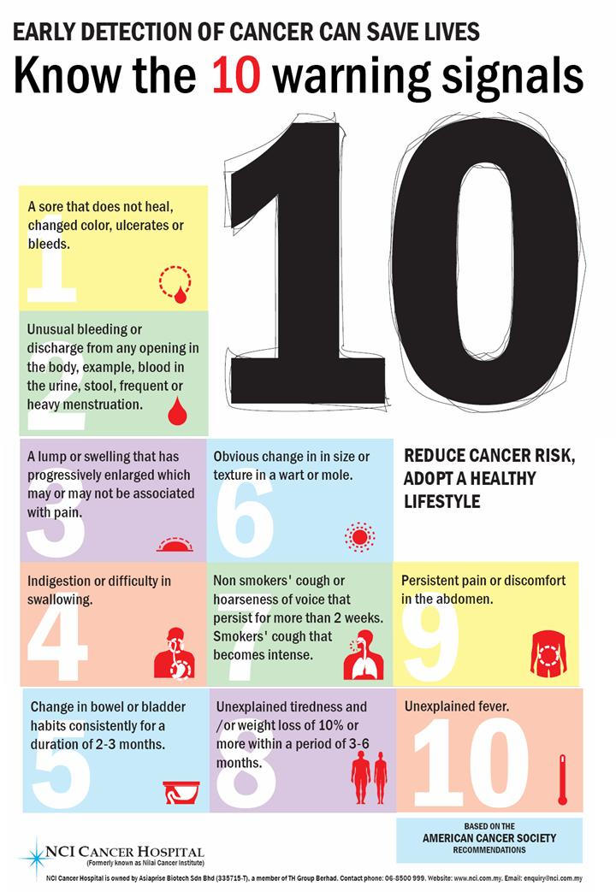
Diagnosis of cancer

Slide 18
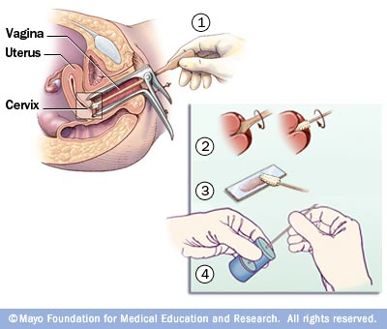
2. Pap smear (cervical smear): obtaining superficial cells from the cervix and examining them to detect abnormality.

Slide 19
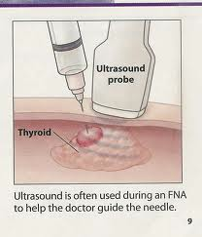
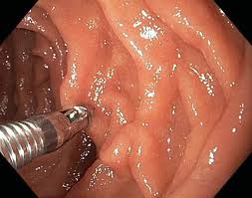
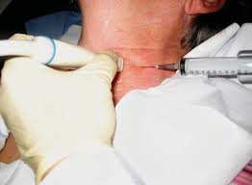
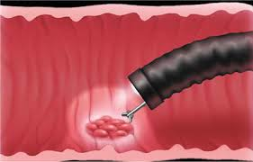
3. Biopsy: obtaining deep cells:
-needle aspiration
-Using endoscope
4. Others as x-ray, blood film

