Slide 1
The effect of inhibitor (Inorganic phosphate & Sodium fluoride) on the rate of an enzyme catalyzed reaction

Slide 2
Type of Inhibitors
There exist a number of molecular species which, in the presence of an enzyme and its substrate, have the effect of binding to the enzyme (or to the enzyme-substrate complex) and totally or partially inhibiting the reaction.
In those cases where the binding is irreversibly, the reaction is inalterably inhibited and not subject to kinetic analysis.
If the binding is reversible, however, the specific type of inhibition can be determined by kinetic analysis.

Slide 3
Types of reversible Enzyme inhibitors
The three types of revisable inhibitors that can be clearly distinguished in this manner are :
competitive, noncompetitive, and uncompetitive.
Experimentally, these are distinguished by amount of the inhibitor at ever-increasing concentrations of the substrate.
When the inhibited reaction is compared with the normal reaction using the graphic analyses of Michaelis and Menten or Lineweaver and Burke, the type of inhibition is clearly indicated.

Slide 4
1-Competitive inhibitor
In the case of competitive inhibition, high substrate concentrations wipe out the inhibitory effect and the V_{MAX} for the inhibited reaction is identical to that for the uninhibited reaction
The K_{M} of the inhibited reaction (K_{M}) is significantly higher than that of the reaction run in the absence of inhibitor, which indicates an apparent decrease I the affinity of the enzyme for its substrate
Competitive inhibitor and substrate compete for the same active site. Only ES complex leads to production on formation

Slide 5
In competitive inhibition , the substrate and inhibitor cannot bind to the enzyme at the same time, This usually results from the inhibitor having an affinity for the active site of an enzyme where the substrate also binds; the substrate and inhibitor compete for access to the enzyme's active site.
This type of inhibition can be overcome by sufficiently high concentrations of substrate (V max remains constant), i.e., by out-competing the inhibitor. However, the apparent Km will increase as it takes a higher concentration of the substrate to reach the Km point, or half the V max. Competitive inhibitors are often similar in structure to the real substrate

Slide 6
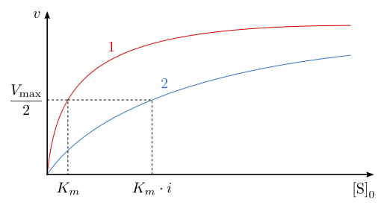
1-Competitive inhibition

Slide 7
2- Noncompetitive inhibition
Noncompetitive inhibition yields the curve indicated, with a lower V_{MAX} and a K_{M} identical to the reaction in the absence of inhibitor.
The inhibitor bind to the free enzyme or enzyme-substrate complex and reduces Enzyme activity ,but does not affect the binding of substrate
V max will decrease due to the inability for the reaction to proceed as efficiently, but Km will remain the same as the actual binding of the substrate, by definition, will still function properly
Noncompetitive inhibitor binds to a site other than the active site or the ES complex. The (ESI) complex does not lead to product.

Slide 8
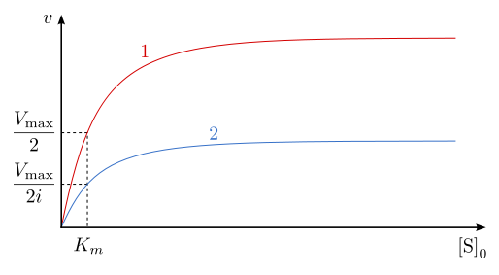
2-Non-competitive inhibition

Slide 9
3-Uncompetitive inhibition
Uncompetitive inhibition is characterized by a low V_{MAX}, a lower K_{M} and a Michaelis-Menten curve similar to that of noncompetitive inhibition. The best way to distinguish the three types of inhibition graphically is to use the Lineweaver-Burk plot
Notice that in the case of uncompetitive inhibition the slope of the inhibited curve (K_{M}/ V_{MAX}) is the same as that of the noninhibited curve, whereas in the other two types of inhibition, the slope of the inhibited plot is greater

Slide 10
In uncompetitive inhibition, the inhibitor binds only to the substrate-enzyme complex; it should not be confused with non-competitive inhibitors. This type of inhibition causes V max to decrease (maximum velocity decreases as a result of removing activated complex) and Km to decrease (due to better binding efficiency thus decreasing the Km which indicates a higher binding affinity).
Uncompetitive inhibitor binds only to the ES complex. The (ESI) complex does not lead to product.

Slide 11
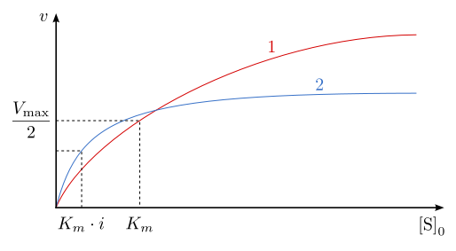
3-Uncompetitive inhibition

Slide 12
summary
In summary, it is relatively simple to distinguish the three types of reversible inhibition by comparing the Michaelis-Menten and Lineweaver-Burke kinetics in the presence and absence of the inhibitor

Slide 13
Inhibitors for Acid phosphatase
The inhibition of acid phosphatase by inorganic phosphate.
The inhibition of acid phosphatase by Sodium Floride.

Slide 14
Inorganic phosphate (Pi) and sodium fluoride are inhibitors of acid phosphatase and it is your task to determine whether they are competitive, noncompetitive, or uncompetitive inhibitor.
The kinetics for the uninhibited reactions must be compared with those of reactions run in the presence of the inhibitor.
The setup is basically the same as in the experiment for the effect of substrate concentration on reaction velocity, except that a constant amount of inhibitor is added.

Slide 15
phosphate (1.0 mM K₂HPO₄) or sodium fluoride (NaF 5mM) will be present in each reaction tube. Run the reactions as before and compare Michaelis-Menten and Lineweaver-Burke plots in the presence and absence .
Determinations of V_{MAX} and K_{M} will help you to determine the specific mode of inhibition

Slide 16
Materials:
1.0M Sodium acetate buffer
0.1M Magnesium chloride
0.05M para-nitrophenyl phosphate
0.5M Potassium hydroxide
0.005M Potassium hydrogen phosphate
5mM Sodium fluoride
phosphate (1.0 mM K₂HPO₄)
Stock solution of crude/purified wheat germ Acid Phosphatase
Equipments:
pH meter
Waterbath
Spectrophotometer
Glassware:
Test tubes
Pipetts

Slide 17
Method:
Use the same set of substrate dilutions prepared for the experiment on effect of substrate concentration on rate of enzyme catalyzed reaction.(0 to 0.05 M p-nitrophenyl phosphate).
Prepare 16 reaction tubes labeled in accordance with substrate concentrations to be used. To each tube add 0.5 ml of 1.0 M sodium acetate buffer (pH 5.7), 0.5 ml of 0.1M MgCl₂, 4ml of distilled water, and 1.0ml of 0.005M K₂HPO₄ or 5mM Sodium fluoride .
To each tube add 0.5ml of the appropriate diluted substrate (p-nitrophenyl phosphate). Note that each tube contains a different substrate concentration and the identical inhibitor concentration.
Place the tubes in a 37 ºC water bath for 5 minutes.
Begin the reaction in each assay tube at 2-minute intervals by adding 0.5 ml of the enzyme, let the reaction proceed for 5 minutes, and then stop them by adding 0.5ml of 0.5M KOH.
Determine the absorbance at 405 nm for each sample, using the first tube as the blank.

Slide 18
Results: I) Absorbance
Tube | Concentration of dilute PNPP (M) | Absorbance at 405nm
 |  | Without inhibitor | With inorganic phosphate as inhibitor | With sodium fluoride as inhibitor
A | 0
B | 0.0005
C | 0.0010
D | 0.0025
E | 0.005
F | 0.010
G | 0.025
H | 0.050

Slide 19
Results: II)-A In Michaelis and Menten Manner without Inhibitor
Tube | Concentration of dilute PNPP (M) [S] | Velocity (µmoles of p-nitrophenol/minute)
A | 0
B | 0.0005
C | 0.0010
D | 0.0025
E | 0.005
F | 0.010
G | 0.025
H | 0.050

Slide 20
Results: II)-B In Michaelis and Menten Manner with Inhibitor
Tube | Concentration of dilute PNPP (M) [S] | Velocity (µmoles of p-nitrophenol/minute)
A | 0
B | 0.0005
C | 0.0010
D | 0.0025
E | 0.005
F | 0.010
G | 0.025
H | 0.050

Slide 21
Results: III)-A In Lineweaver-Burke Manner without Inhibitor
Tube | Concentration of dilute PNPP (M) | (1/[S]) | Velocity (µmoles of p-nitrophenol/minute) | (1/v)
A | 0
B | 0.0005
C | 0.0010
D | 0.0025
E | 0.005
F | 0.010
G | 0.025
H | 0.050

Slide 22
Results: III)-B In Lineweaver-Burke Manner with Inhibitor
Tube | Concentration of dilute PNPP (M) | (1/[S]) | Velocity (µmoles of p-nitrophenol/minute) In presence of Pi or NaF | (1/v) In presence of Pi or NaF
A | 0
B | 0.0005
C | 0.0010
D | 0.0025
E | 0.005
F | 0.010
G | 0.025
H | 0.050

Slide 23
Results:
Determine the amount of conc. p-nitrophenol produced in 5 minutes for each substrate concentration.
Calculate the velocity (µmoles of p-nitrophenol/minute) for each substrate dilution.
Plot velocity against substrate concentration (mmoles p-nitrophenyl phosphate) in the standard manner of Michaelis and Menten . Determine V_{MAX} and K_{M} for acid phosphatase in both of them.
Calculate the reciprocals of velocity (1/v) and substrate concentration (1/[S]) and present these data as a table.
Prepare the double-reciprocal plot of Lineweaver and Burk and determine the V_{MAX} and K_{M} from the x and y intercepts.

Slide 24
Discussion :
Prepare Michaelis-Menten and Lineweaver-Burke plots that compare the inhibited reaction with the uninhibited reaction.
Determine the K_{M} and V_{MAX} in the presence of phosphate and sodium fluoride.

Slide 25
Thank You
&
Good Luck

