Slide 1
Information Hiding Revisited
Ch6.5

Slide 2
Information Hiding Revisited
Privacy Leaks
Instance variable of a class type contain address where that object is stored
Assignment of class variables results in two variables pointing to same object
  Use of method to change either variable, changes the actual object itself
View insecure class, listing 6.18
class petPair

Slide 3
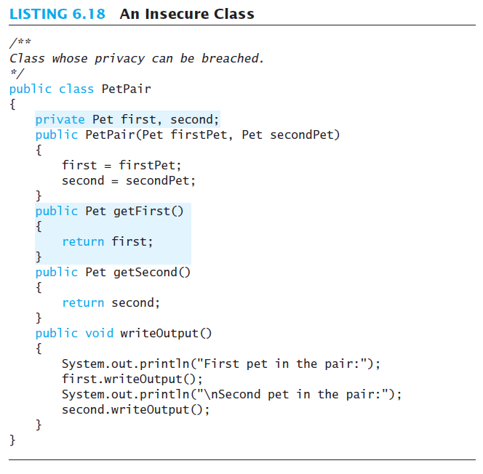

Slide 4
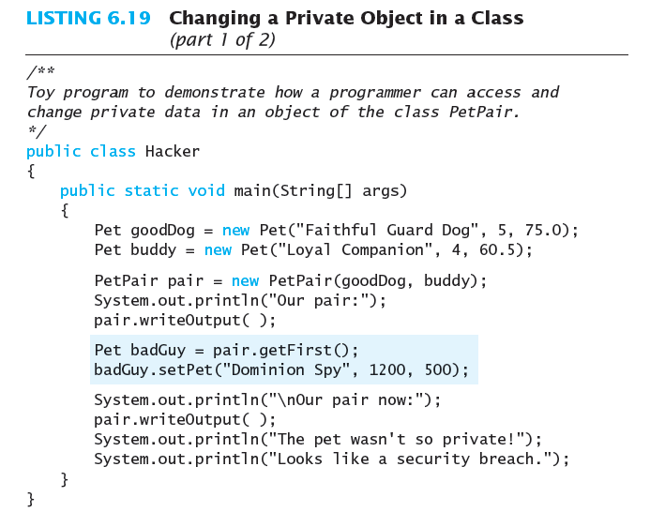
Sequence of execution:
goodDog 100 200
buddy 110 300
pair 120 500
badGuy 130 200
200 Faithful..
5, 75.0
300 Loyal..
4, 60.5
500 P1:200,
P2:300
?
?
?
?
What will this do now?

Slide 5
Sequence of execution:
goodDog 100 200
buddy 110 300
pair 120 500
badGuy 130 200
200 Dominion Spy
1200, 500
300 Loyal..
4, 60.5
500 P1:200,
P2:300

Slide 6
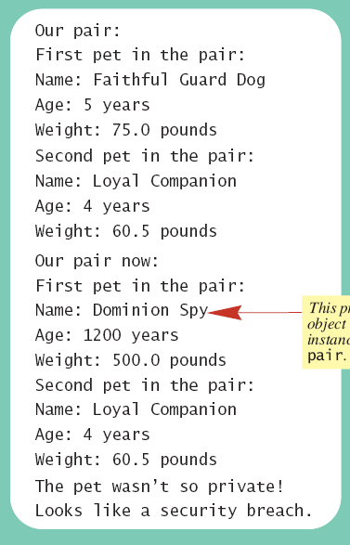

Sample
screen output

Slide 7
Summary
Constructor method creates, initializes object of a class
Default constructor has no parameters
A static variable shared by all objects of the class
Divide method tasks into subtasks
Test all methods individually
Methods with same name, different signatures are overloaded methods

