Slide 1
Predefined Methods
From “Java Programming...” D.S. Malik – Ch7

Slide 2
Outline
Introduction
Mathematical Methods
Character Manipulation Methods
import static Statements
Parsing Methods

Slide 3
Pre-defined methods
A predefined method is an existing method that is written and provided by Java.
In Java, predefined methods are organized as a collection of classes, called class libraries.
Class libraries are stored in packages.
The programmer can use a predefined method immediately after importing the relevant package.
Example:
  nextInt(), nextDouble(), etc… with Scanners
  equals(…), toUpperCase(), etc… with Strings

Slide 4
Pre-defined methods
We have seen methods like these
  nextInt(), nextDouble(), etc… with Scanners
  equals(…), toUpperCase(), etc… with Strings ,
They were used with objects of those classes
Syntax of a call:
objectName.methodName(parameters)

Slide 5
Pre-defined methods
We will see methods like these
  pow(3,2), cos(theta), etc… for class Math
  isDigit(ch), toUpperCase(ch), etc… for class Character
These do NOT need an object of those classes
Syntax of a call:
className.methodName(parameters)

Slide 6
import statements
All methods in this lecture belong to the package java.lang
You have seen import statements like this:
import java.util.*;
We can have import statements like this:
import java.lang.Math.*;
But we will also see statements like this:
import static java.lang.Math.* ;

Slide 7
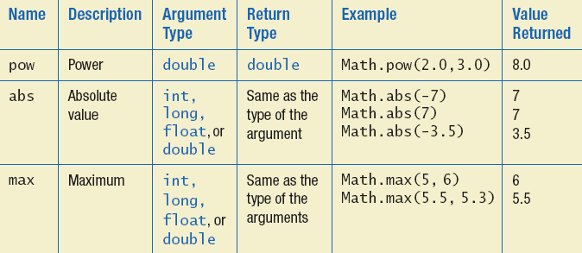
The Math Class
Provides many standard mathematical constants and methods:
  double E = 2.7182818283590455;
  double PI = 3.141592653689793;

Slide 8
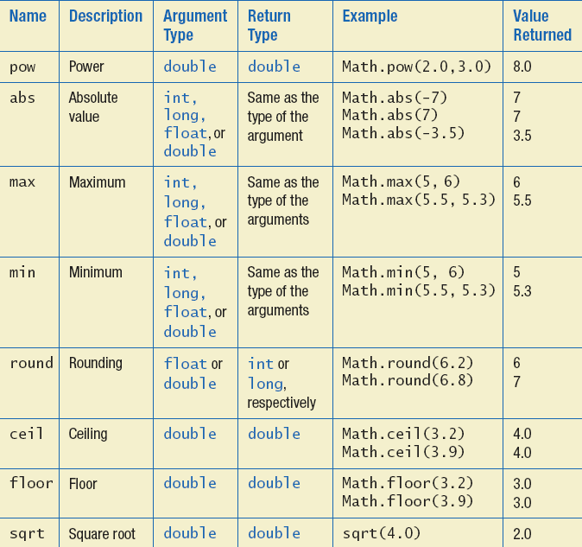
The Math Class
Notes:
What will happen if you round / ceil / floor a negative number ?
ceil(-3.2)= -3.0
round(-3.2)= -3
round(-3.7)= -4
ceil( 3.2)= 4.0
round( 3.2)= 3
round( 3.7)= 4

Slide 9
The Math Class
Value returned | Example | Return Type | Argument Type | Description | Name
1.0 | Math.cos(0.0) | double | double | Returns the cosine of x (x is in radians) | cos(x)
0.0 | Math.sin(0.0) | double | double | Returns the sine of x (x is in radians) | sin(x)
0.0 | Math.tan(0.0) | double | double | Returns the tangent of x (x is in radians) | tan(x)
20.086 | Math.exp(3.0); | double | double | Returns the value of e^{x}; where e is approximately 2.718. | exp(x)
0.693 | Math.log( 2.00) | double | double | Returns the natural logarithm (base E) of x | log(x)
3.00 | Math.log10 (1000.00) | double | double | Returns the base 10 logarithm of x | log10(x)

Slide 10
The Math.random() method
Math.random()returns a random double that is greater than or equal to zero and less than 1, i.e., [0,1[
You can scale the result using addition and multiplication
Example:
  the following simulates rolling a six sided die
  int die = (int) (6.0 * Math.random())+1;

Slide 11
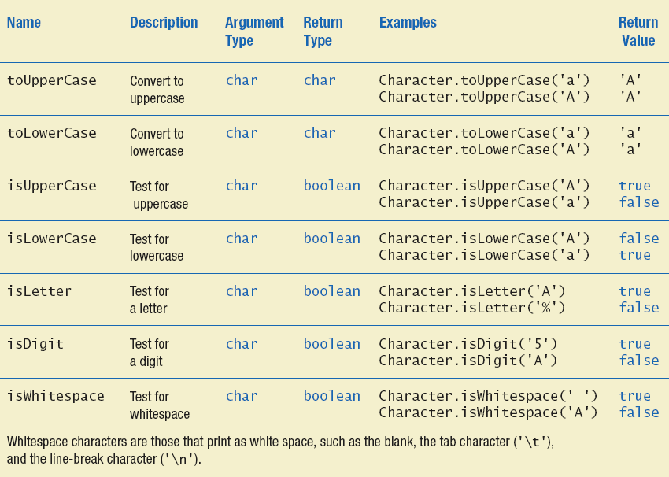
The Character Class

Slide 12
Example 1
// assume you did: import java.lang.Character.*;
String str = "I got\t30 cats.\n";
char oneChar;
int i, ws=0, digits=0;
for(i=0; i < str.length(); i++)
{ oneChar = str.charAt(i);
if (Character.isWhitespace(oneChar))
ws++;
else if (Character.isDigit(oneChar))
digits++;
}
System.out.println("the string: \"" + str +"\" has ws= " +
ws + " digits= " + digits);
System.out.println(Character.toUpperCase(str.charAt(2)));
System.out.println(str.toUpperCase());

Slide 13

Example 2
Write a complete program that computes the length of a side of a triangle using the following formula: $a2=b2+c2−2bc cosθ$
The lengths of the sides b and c are given in cm.
The angle $θ is given in degrees.$

Slide 14
import static Statement
For simplification, Java 5.0 introduces the following import statement:
  import static java.packageName.ClassName.*;
After you include this statement in the program, you can omit the name of the class and the dot operator when calling a method.

Slide 15
import static Statement
For example:
  If you include:
  import static java.lang.Math.*;
  you can simply call abs(x)
  instead of Math.abs(x)
  If you include:
  import static java.lang.Character.*;
  you can simply call toLowerCase(ch)
  instead of Character.toLowerCase(ch)

Slide 16
import vs import static
0 - 9
1
2
3
4
5
6
7
8
import java.lang.Math.*; //java.lang is the package;
//Math is the class
public class MathTest1
{ public static void main (String[] args) {
int rand = (int)(Math.random()*10);
double c60 = Math.cos(Math.PI/3);
System.out.printf (“Random = %d and cos(60)= %f”, rand, c60);
}}
What is the range produced?
import static means you may omit
class Name and dot
1
2
3
4
5
6
7
8
import static java.lang.Math.*; //java.lang is the package;
// Math is the class
public class MathTest2
{ public static void main (String[] args) {
double rand = (int)(random()*10);
double c60 = cos(PI/3);
System.out.printf (“Random = %d and cos(60)= %f”, rand, c60);
}}

Slide 17
3. PARSING NUMERIC STRINGS
A string that consists of only an integer or a floating-point number is called a numeric string.
A numeric string can contain a minus sign.
Examples of numeric strings include:
  “2015”
  “-20”
  “144.45”
  “-53.99”
In order to process numeric strings as numbers (addition, multiplication, etc…), they must be converted first into numbers.

Slide 18
3. PARSING NUMERIC STRINGS
Assume we have:
String strExp1 = “2015”, strExp2 = “-20”, strExp3 = “144.45”;
Integer.parseInt (strExpression) converts a numeric string to an int.
  Integer.parseInt (strExp1) ➔ 2015
  Integer.parseInt (strExp2) ➔ -20
Float.parseFloat (strExpression) converts a numeric string to a float.
  Float.parseFloat (strExp2) ➔ -20.0 (as a float)
  Float.parseFloat (strExp3) ➔ 144.45 (as a float)
Double.parseDouble (strExpression) converts a numeric string to a double.
  Double.parseDouble (strExp2) ➔ -20.0 (as a double)
  Double.parseDouble (strExp3) ➔ 144.45 (as a double)

Slide 19
Parsing Example
In this example we will read a line from the user in the format: name age height and then divide the whole string into three variables:
name of type String,
age of type Integer,
and height of type double.

Slide 20
Parsing Example
import java.util.*;
public class HelloWorld {
public static void main(String []args){
Scanner input = new Scanner(System.in);
System.out.println(“Enter your name, age, and height: “);
String str = input.nextLine();
int first_space = str.indexOf(" ");
int second_space = str.indexOf(" ",first_space+1);
String name = str.substring(0,first_space);
int year =
Integer.parseInt(str.substring(first_space+1,second_space));
double height =
Double.parseDouble(str.substring(second_space+1));
System.out.println(name + " will be " + (height+2.0)+
" tall when he turns " +(year+1));
} // end main
} // end class

Slide 21
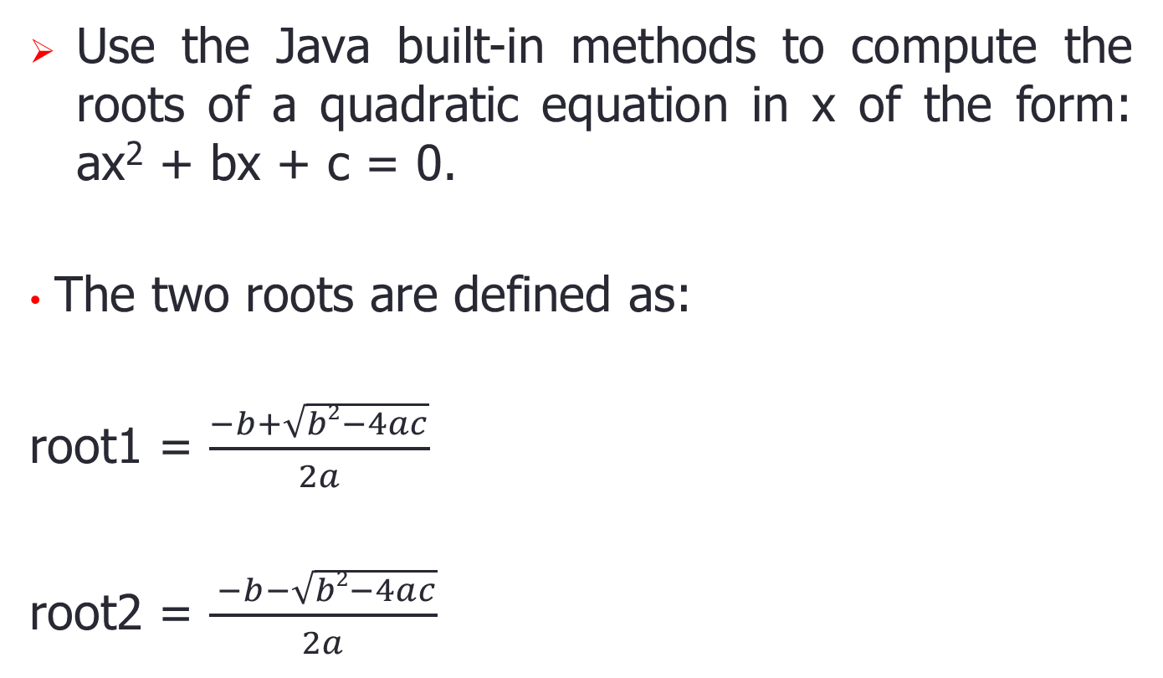
Self-Check Exercises
Use the Java built-in methods to compute the roots of a quadratic equation in x of the form: ax² + bx + c = 0.
The two roots are defined as:
root1 = $\frac{−b+\sqrt{b2−4ac}}{2a}$
root2 = $\frac{ −b−\sqrt{b2−4ac}}{2a}$

