Slide 1
File and Streams
Binhadba Edit

Slide 2
What is a File
Up until now, any stored data within a program is lost when the program closes.
A file is a permanent way to store data

Slide 3
Types of Files
File - block of information stored on disk or another media.
Text file - file that contains lines of written information that can be sent directly to the screen or printer.
Binary file - file that contains bits that do not necessarily represent printable text Examples: Word file, machine language file.

Slide 4
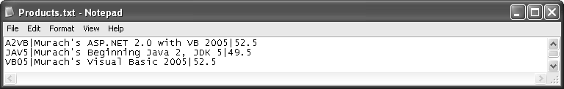

Files and Streams in VB.net
In VB.net environment:
  System.IO classes are used to work with files and streams.
  You can work with two kinds of files:
    text files (containing only characters)
    binary files
Displayed in text editor

Slide 5
Introduction to Processing Textual Data
One way to process textual files is from beginning to end using sequential access .This type of file is called a sequential file
Sequential files are useful for:
Storing text.
Easy implementation in programs.
Where real-time editing of file(s) is not required.

Slide 6
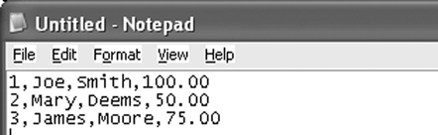
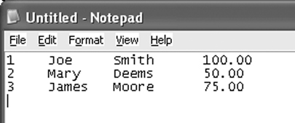
Introduction to Processing Textual Data
Sequential files can be categorized into roughly three types
  Free-form files have no particular format
  Fields in a delimited file are separated with a special character called a delimiter
  In a fixed-field file, each field occupies the same character positions in every record

Slide 7
Introduction to Processing Textual Data
Sequential files can be read one character at a time, one line at a time, or the entire file can be read at once
Sequential files are typically read into a string or an array

Slide 8
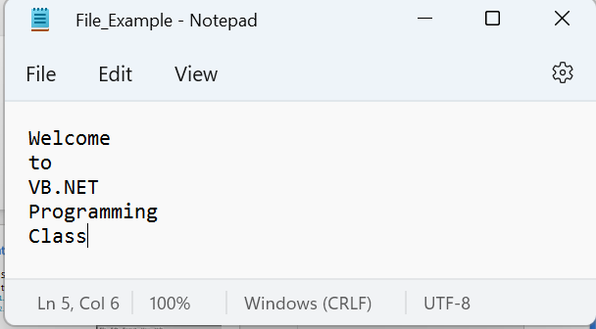
Introduction to Processing Textual Data
Each file stored in your machine has a location that is identified by a path. E.g. the file “File_Example.txt”
Has the following path:
File Path
C:\Users\ghada\OneDrive\Documents\File_Example.txt
Directory Path

Slide 9
Directory Path Vs File Path
File Path
Directory path represent the folder in which the file resides.
The file path represents the actual file and where it resides.
C:\Users\ghada\OneDrive\Documents\File_Example.txt
Directory Path

Slide 10
System.IO namespaces
In the .NET Framework, the System.IO namespace defines classes for reading and writing files and data streams*. Including:
  Directory Class
  File Class
  Stream Classes:
    FileStream
    StreamReader
    StreamWriter
    BinaryReader
    BinaryWriter
Hence, the System.IO MUST be referenced wherever file processing is carried out.
*System I/O and Streams in VB.NET: Part 1 (dotnetheaven.com)

Slide 11
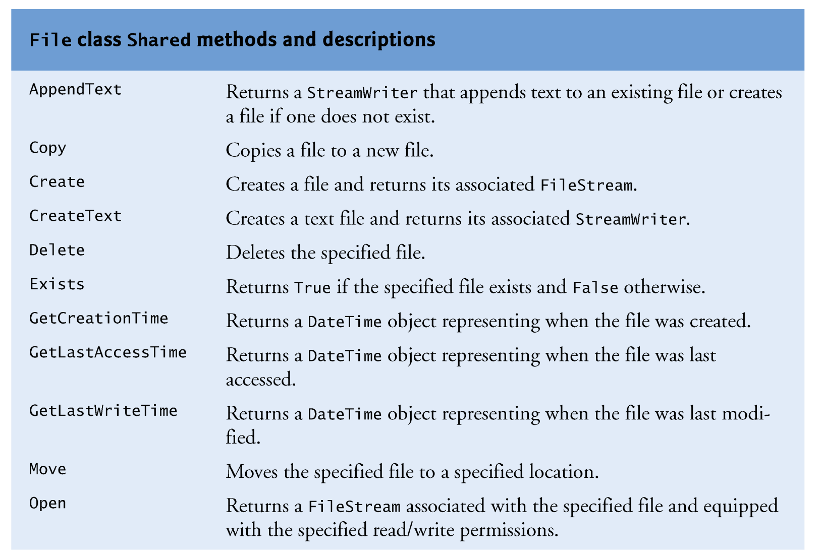
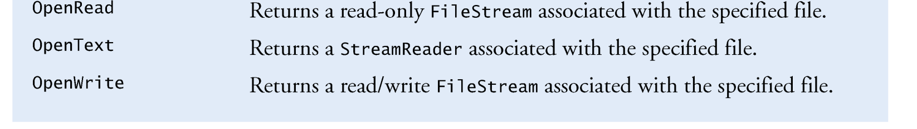
File Class

Slide 12
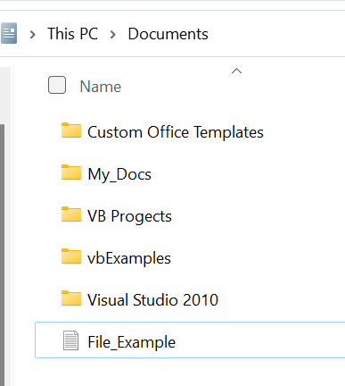
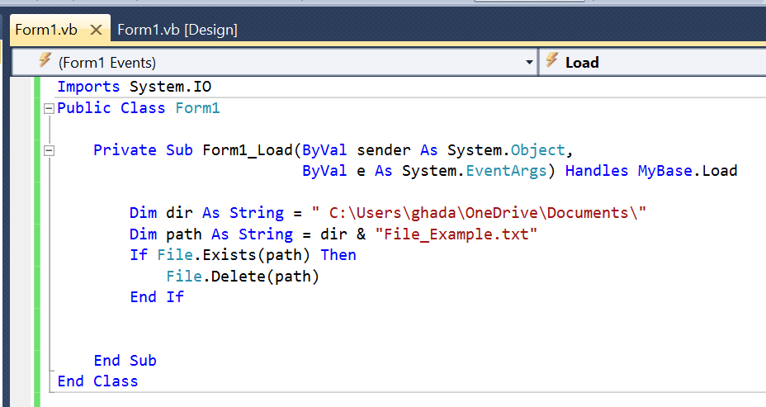
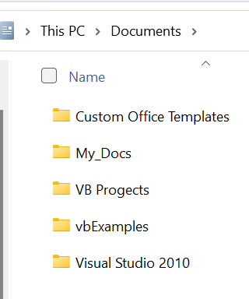





File Class: Example
Before
After

Slide 13
Files Manipulation
Files are manipulated in 3 stages:
File Open : If the file does not exist it is created and then opened by the operating system. A portion of memory (RAM) is reserved by the Operating System.
Process File : When a file is open it can be written to or read from.
Close File : When a file has been opened and processed it must then be closed. The Operating system will then release the memory.

Slide 14
The Stream-File Connection
To perform file processing in Visual Basic, requires creating objects of the following stream classes.
  FileStream: used to read from, write to, open and to close file any location within a file system.*
  StreamReader: used to read data only from a text file.*
  StreamWriter: used to write data only to a text file.
  BinaryReader: used to read data only from a binary file.
  BinaryWriter: used to write data only to a binary file
FileStream class and StreamReader class in VB.NET (dotnetheaven.com)

Slide 15
The StreamReader Class
The StreamReader constructor accepts one argument – the path and filename of the sequential file to read.
The StreamReader has the following reading methods:
  The Read method reads a single character or many characters. Without arguments, the Read method returns the Integer code point (ASCII code) of the character read
  The ReadLine method reads a record. The carriage return at the end of the record is discarded. The method returns a String containing the characters read.
  The ReadToEnd method reads from the current file position to the end of the file. The method returns a String containing the characters read

Slide 16
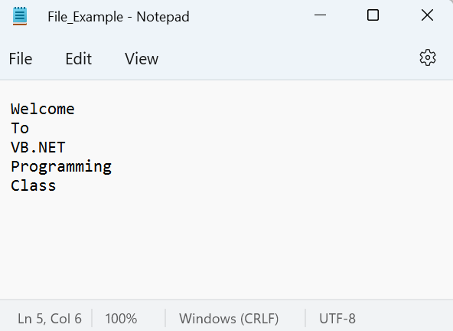
The StreamReader Class: Example
Consider the following text file:
That resides on the following path:
"C:\Users\ghada\OneDrive\Documents\File_Example.txt"

Slide 17
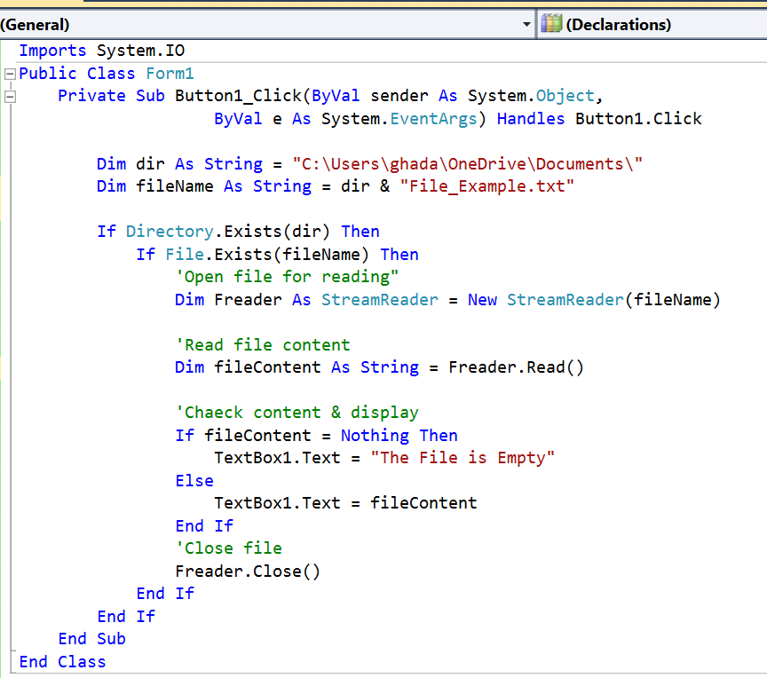
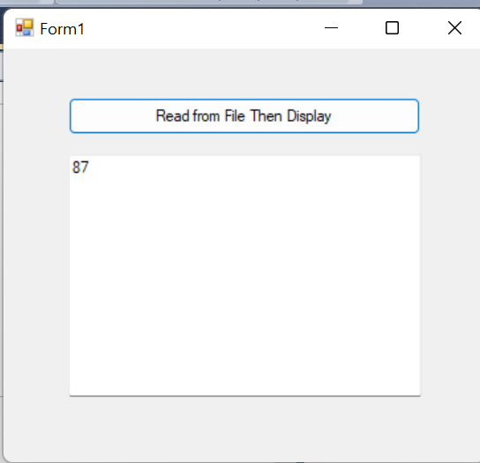



The StreamReader Class: Example (Read)

Slide 18
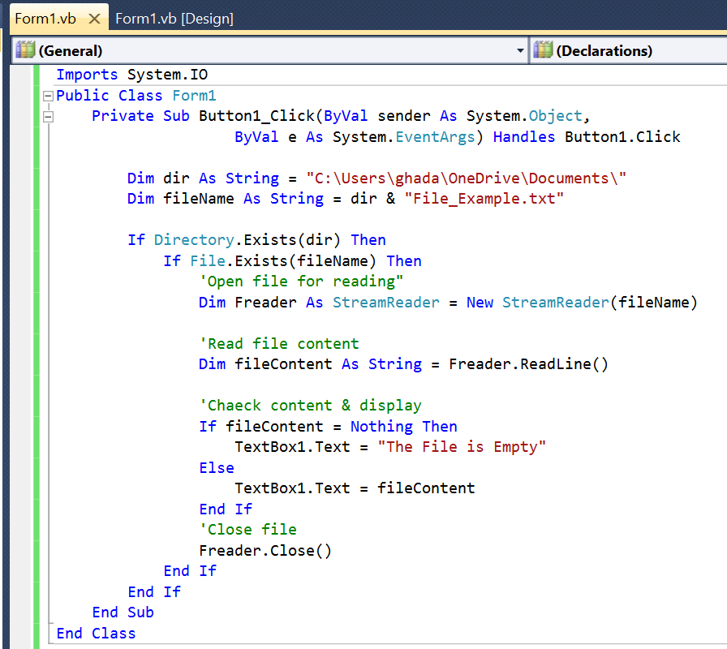
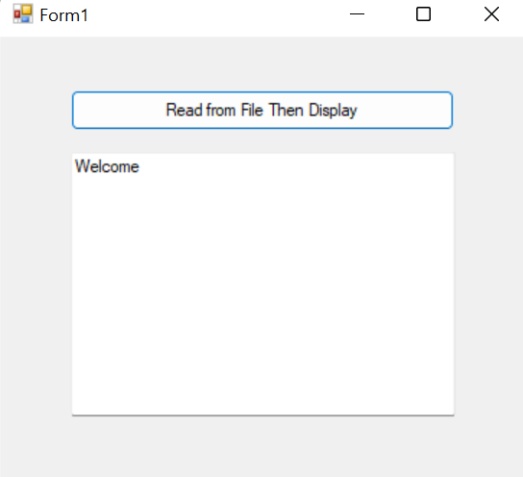



The StreamReader Class: Example (ReadLine)

Slide 19
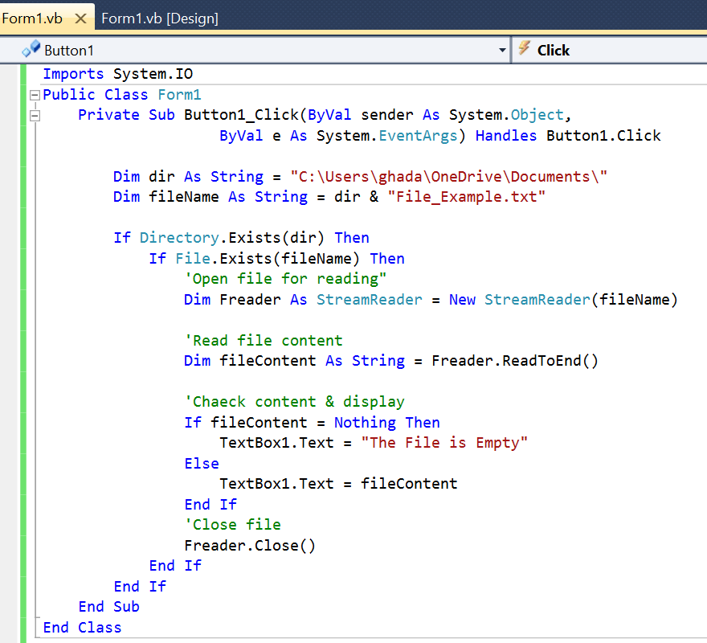
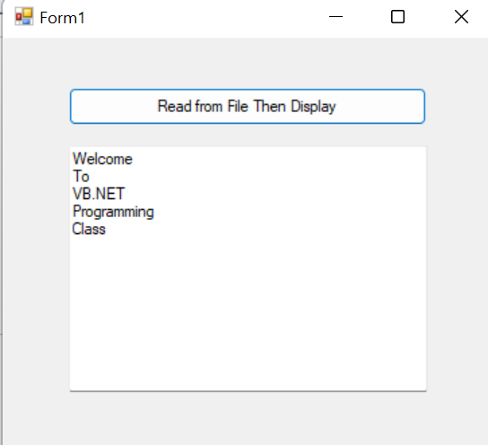


The StreamReader Class: Example (ReadToEnd)

Slide 20
The StreamWriter Class
The StreamWriter constructor accepts one argument – the path and filename of the sequential file to read.
The StreamWriter has the following writing methods:
  The NewLine property contains the character(s) that mark the end of the line.
  The Write method writes a character or array of characters.
  The WriteLine method writes data terminated by the character(s) stored in the NewLine property.
  If the data type passed to Write or WriteLine is not a string, these methods will implicitly call toString.

Slide 21
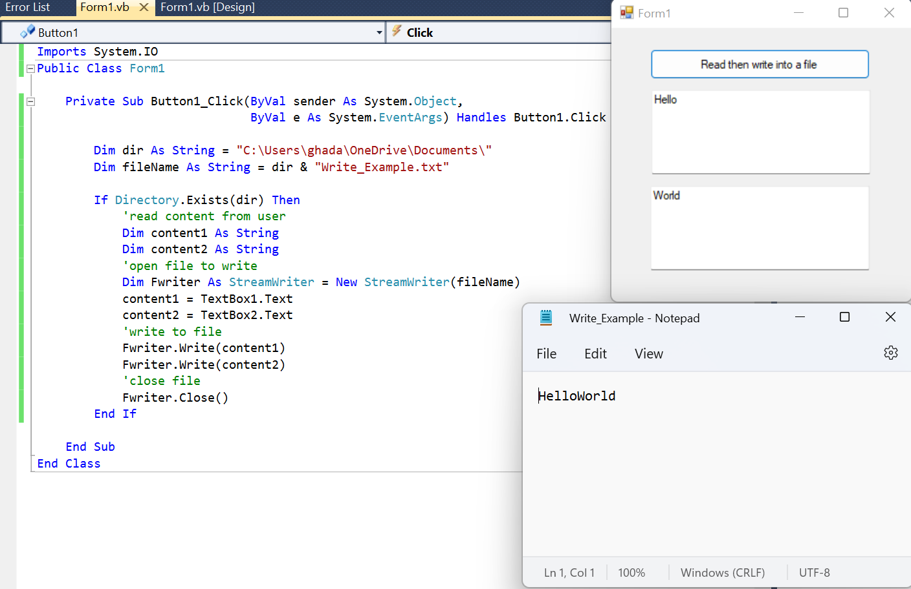


The StreamWriter Class: Example (Write)

Slide 22
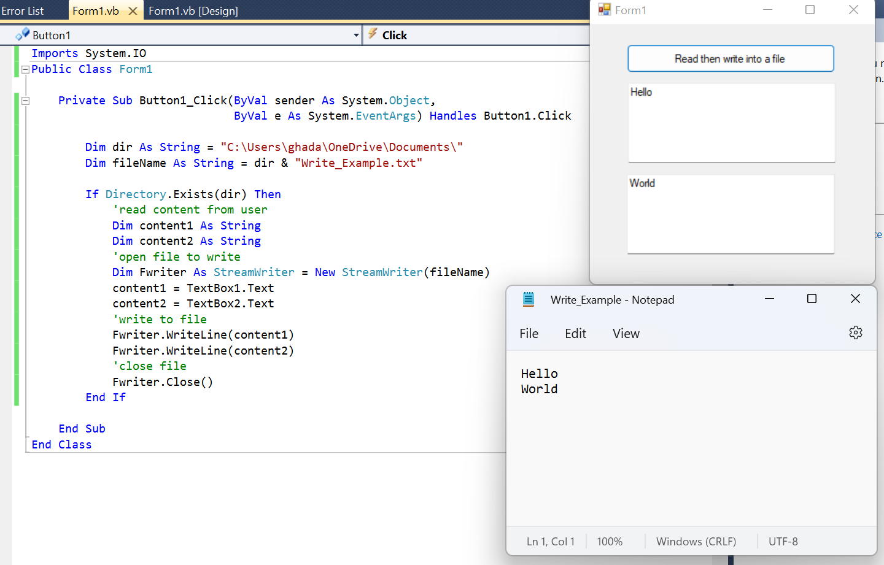
The StreamWriter Class: Example (writeLine)

