Slide 1
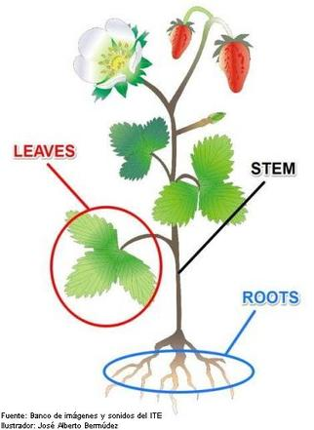
Shoot system
(Stem + Associated Leaves)
Functions:
Support for and the elevation of leaves, flowers and fruits.
The stems keep the leaves in the light and provide a place for the plant to keep its flowers and fruits.
Transport of fluids between the roots and the shoots in the xylem and phloem

Slide 2
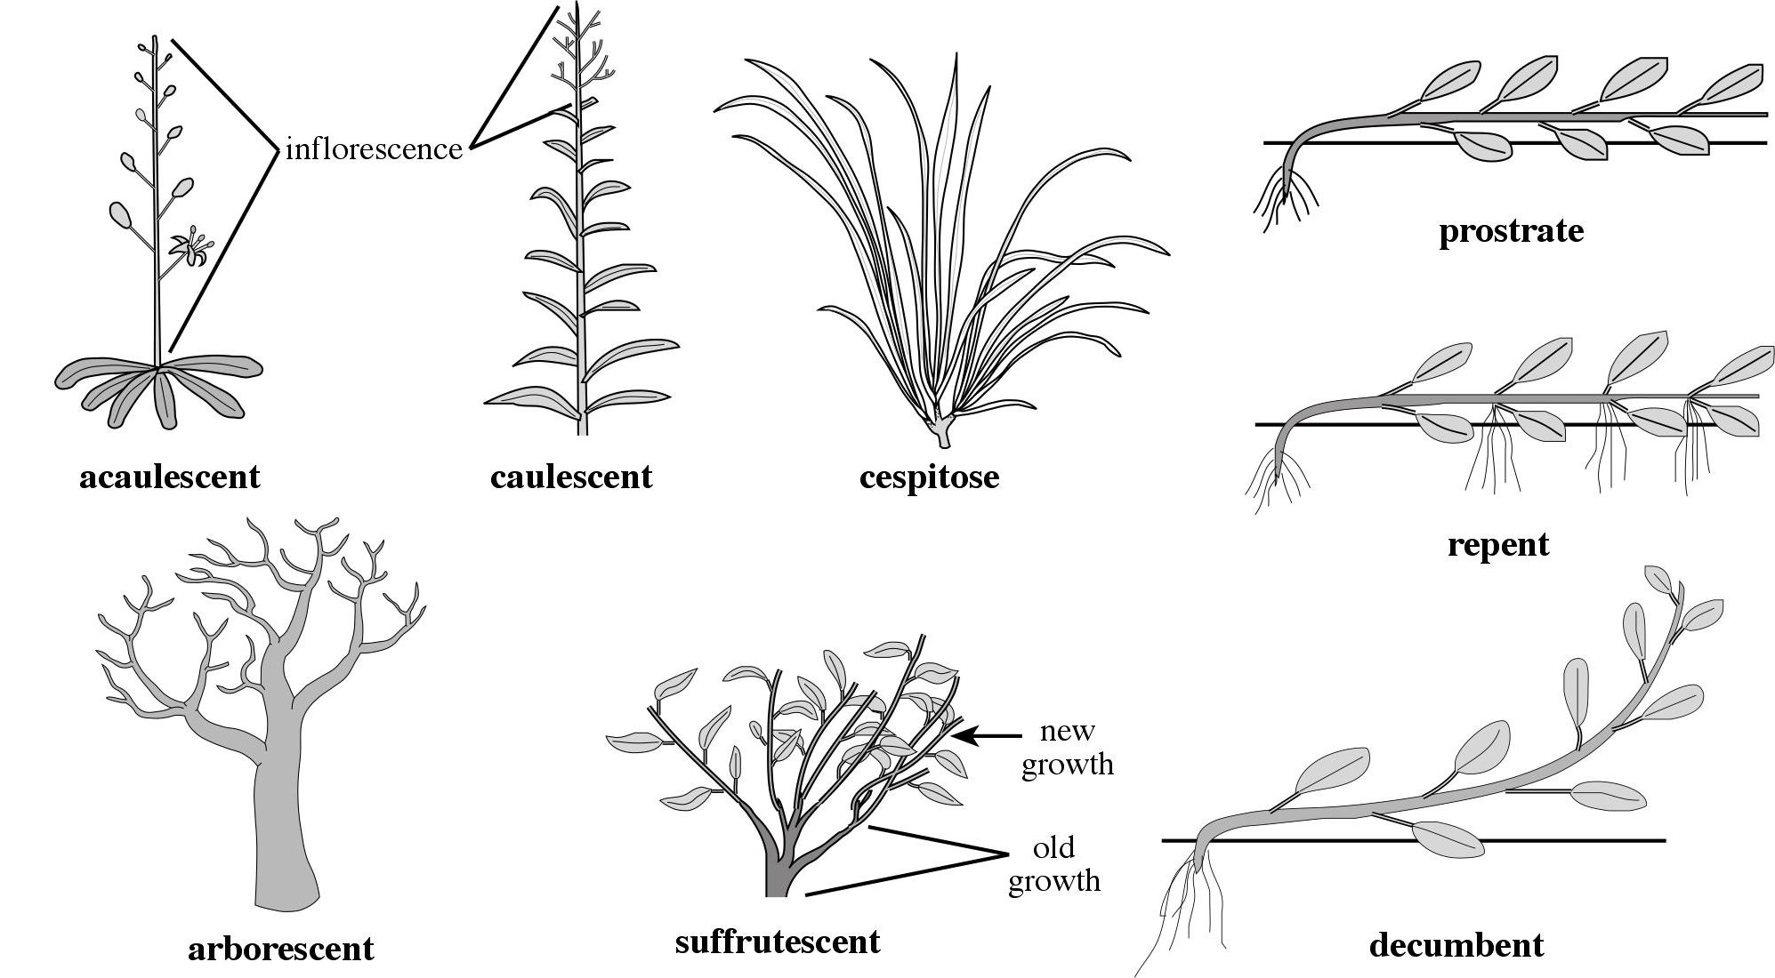
Stem Habit
=relative position of stem (+ growth, structure)
prostrate
نبات ذو ساق زاحف او مفترش
acaulescent
caulescent
cespitose
نبات عديم الساق
نبات ذو ساق
نبات ذو ساق خصلي (ذو خصل)
repent
ساق زاحف او مفترش
arborescent
suffrutescent
decumbent
ساق شجري
ساق متخشبة القاعدة
ساق منبطح

Slide 3
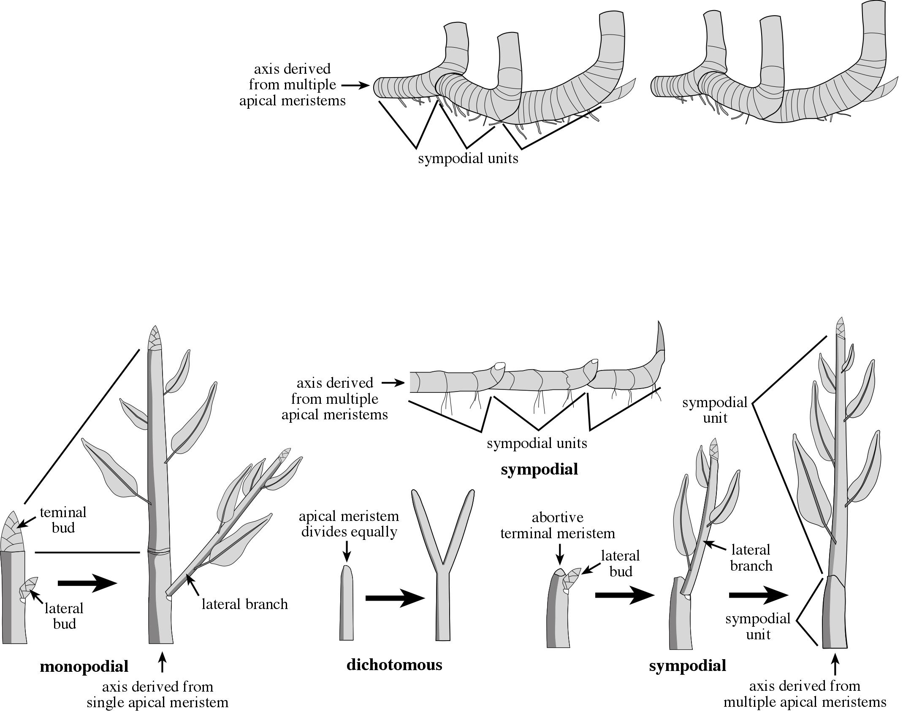
lateral branching
التفرع الجانبى
Stem Branchingتفرع الساق
Dichotomous Branching
ثنائي التشعب (قمي)
lateral branching
التفرع الجانبى
Monopodial Branching
تفرع صادق المحور
Sympodial Branching
تفرع كاذب المحور
Dichotomous Branching
ثنائي التشعب (قمي)

Slide 4
Apical Dominanceالسيادة القمية
Usually the growing terminal bud inhibits the development of the lateral buds, a phenomenon known as apical dominance – as the influence of the apical meristem lessens the growth of the lateral buds which proceed with their development.
عادة نمو البرعم القمي يثبط نمو وتطور البراعم الجانبية، وتعرف هذه الظاهرة باسم السيادة القمية.

Slide 5
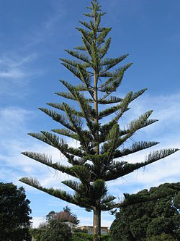
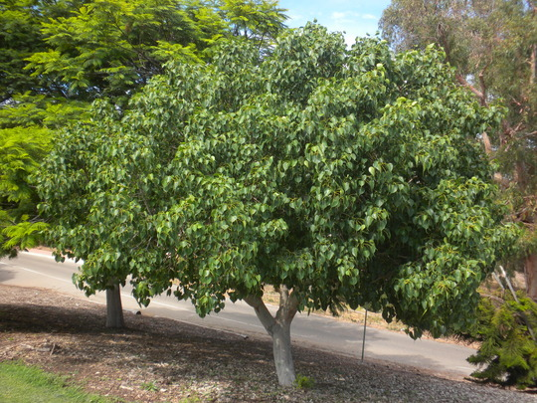
Apical Dominance
السيادة القمية
Apical dominance is the phenomenon whereby the main, central stem of the plant grows more than other side stems.

Slide 6
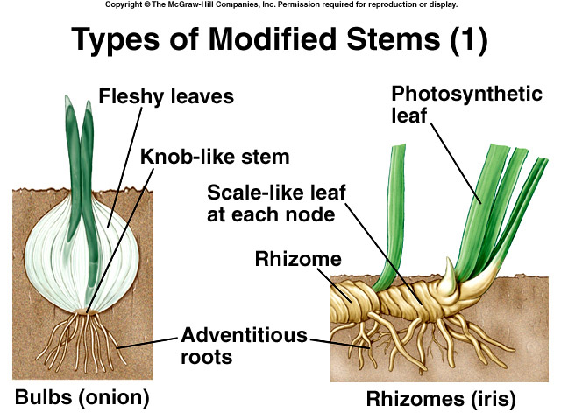
Stem (Shoot) Types & Modificationsأنواع وتحور السيقان
اوراق شحمية
اوراق حرشفية عند كل عقدة
ريزومه
جذور عرضية
ساق نبات البصل (بصيلة)
ساق نبات السوسن
ريزومية

Slide 7
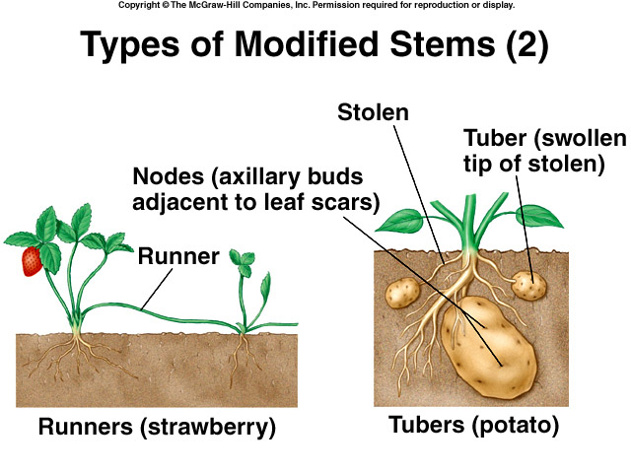
مداد
درنة (قمة مداد منتفخ)
stolon (مداد) ساق جارية
ساق جارية فراولة
ساق درنات

Slide 8
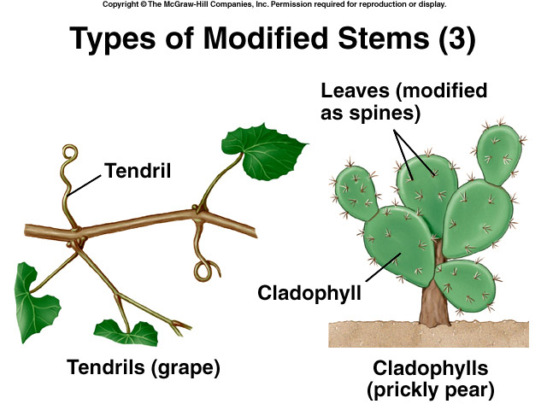
اوراق متحورة لأشواك
محلاق
عنب
ساق ورقية
التين الشوكي
ساق محلاقية

Slide 9
Onion Bulb

Slide 10
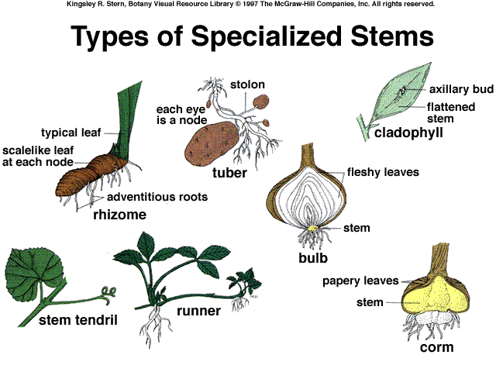

Slide 11
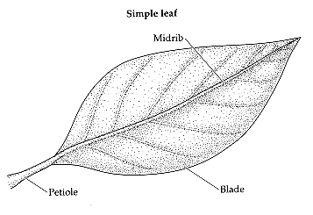
Leaves
The leaf- Is the main photosynthetic organ of most vascular plants
Leaves generally consist of a flattened blade and a petiole, which joins the leaf to a node of the stem
Leaves may appear different based on whether they grow in shade or full sun
Some plant species have evolved modified leaves that serve various functions
Climbing, pollinator attraction, storage, digestion, prevention of water loss, etc.
External Parts of the Leaf:
Petioleعنق
Leaf stalk or part that connects
the leaf to the stem.
Bladeنصل
The large, flat part of a leaf.
Midribعرق وسطي
The large center vein.

Slide 12
Leaf Types
وريقات
العرق الوسطي
محور
النصل
عروق ثانوية
ورقة مركبة ريشية فردية
برعم
العرق الوسطي في الوريقة
عنق الورقة
عنق الوريقة
محور الوريقة المركبة
اذينات
أذينات
ورقة بسيطة
ورقة مركبة ريشية
ورقة مركبة ريشية زوجية
الورقة مركبة ريشية مزدوجة
(b) Compound leaf (Pinnate). ورقة مركبة ريشية
In a compound leaf, the blade consists of multiple leaflets. Note that a leaflet has no axillary bud at its base.
(c) Doubly compound leaf (Bi-pinnate).
ورقة مركبة ريشية مزدوجة
In a doubly compound leaf, each leaflet is divided into smaller leaflets.
(a) Simple leaf.
ورقة بسيطة
A simple leaf is a single, undivided blade.

Slide 13
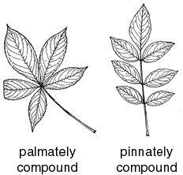
Compound Leaves
ورقة مركبة ريشية مزدوجة
ورقة راحية مركبة
ورقة ريشية مركبة

Slide 14
Leaf Venationتعرق الورقة
متوازي تعرق
Parallel-veins extend the entire length of the leaf with little or no cross-linking
ريشي تعرق
Pinnate-leaves have one major vein from which others branch
راحي تعرق
Palmate-leaves have several veins which branch
Reticulate
شبكي
Parallel
متوازي

Slide 15
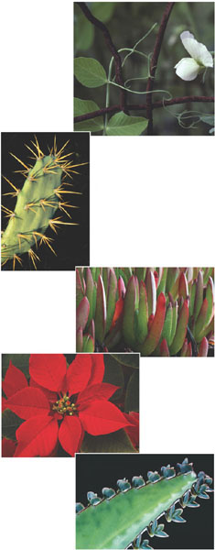
Leaf Adaptations/ Modifications
(a) Tendrils. The tendrils by which this pea plant clings to a support are modified leaves. After it has “lassoed” a support, a tendril forms a coil that brings the plant closer to the support. Tendrils are typically modified leaves, but some tendrils are modified stems, as in grapevines.
Some plant species have evolved modified leaves to serve various functions.
(b) Spines. The spines of cacti, such as this prickly pear, are actually leaves, and photosynthesis is carried out mainly by the fleshy green stems.
(c) Storage leaves. Most succulents, such as this ice plant, have leaves modified for storing water.
(d) Bracts. Red parts of the poinsettia are often mistaken for petals but are actually modified leaves called bracts that surround a group of flowers. Such brightly colored leaves attract pollinators.
(e) Reproductive leaves. The leaves of some succulents, such as Kalanchoe daigremontiana, produce adventitious plantlets, which fall off the leaf and take root in the soil.

Slide 16
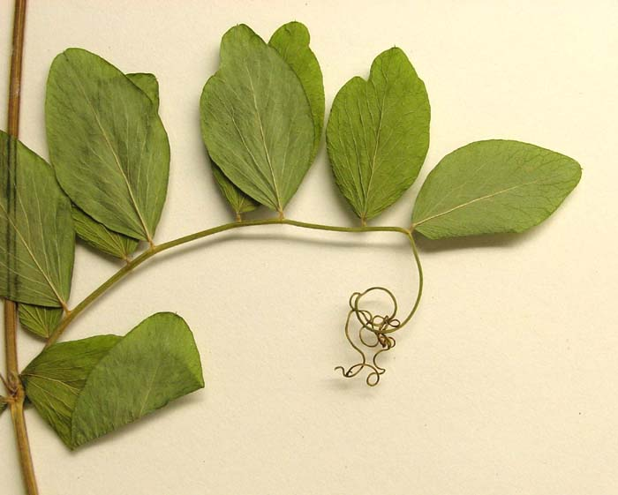
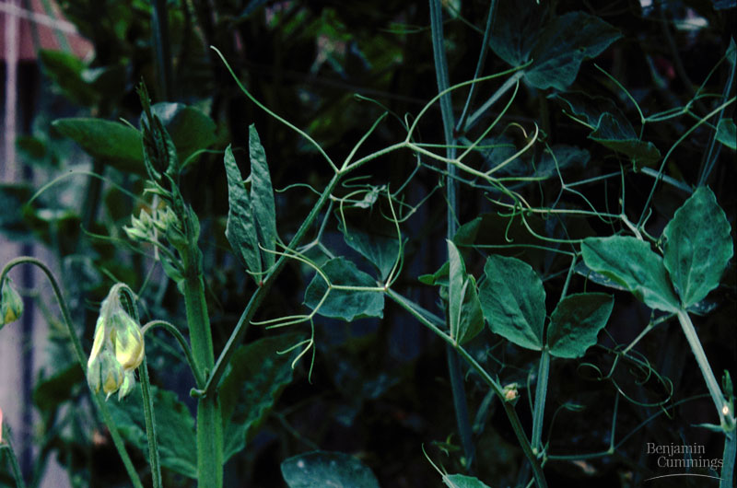
Tendril

Slide 17
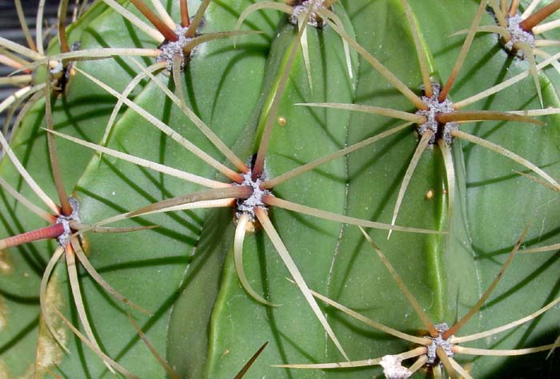
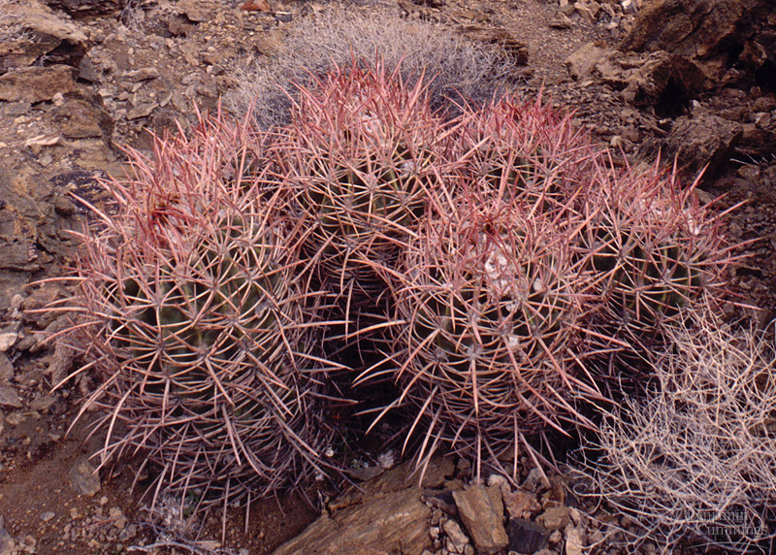
Spiny leaf- Cacti spines

Slide 18
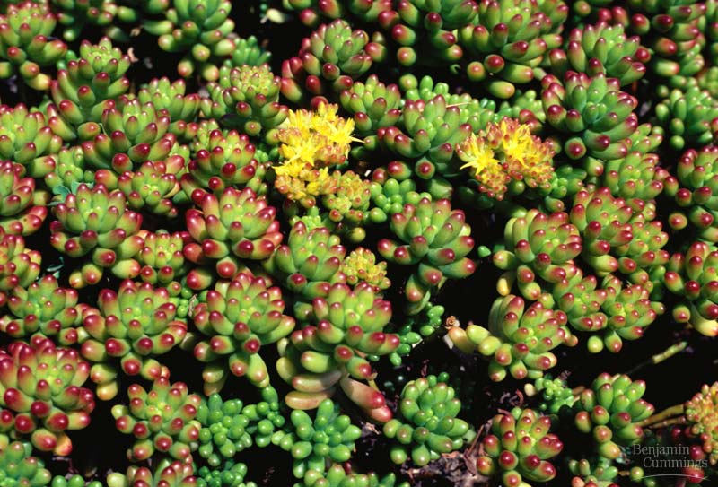
Succulent leaves

Slide 19
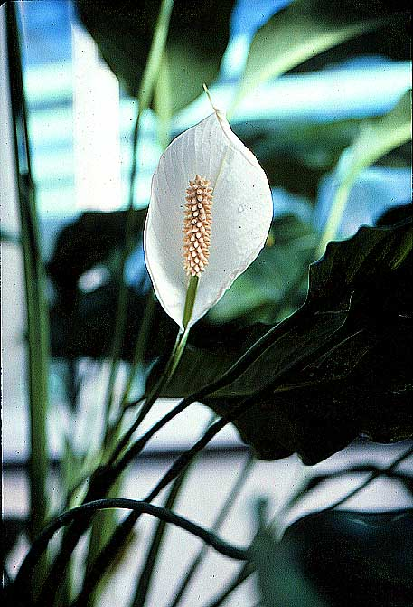
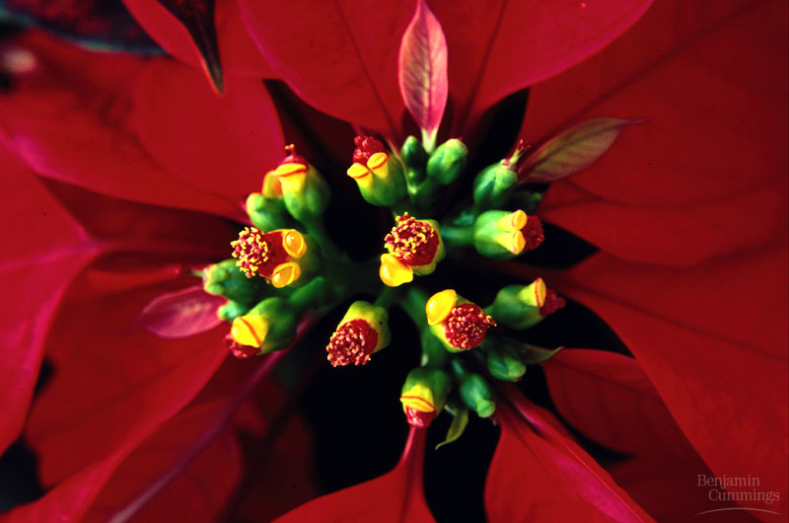
Brightly-colored leaves- to attract pollinators

Slide 20
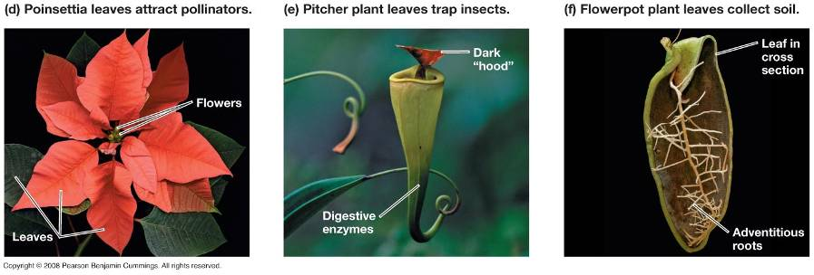
Leaf Modifications

Slide 21
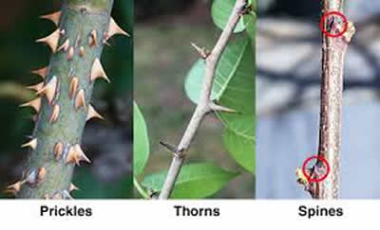
Modified into Sharp structure for protection
Thorn – Hard, long, sharp-pointed
Spine - Hard, rigid extensions of leaves
Prickle – Hard, sharp pointed

Slide 22
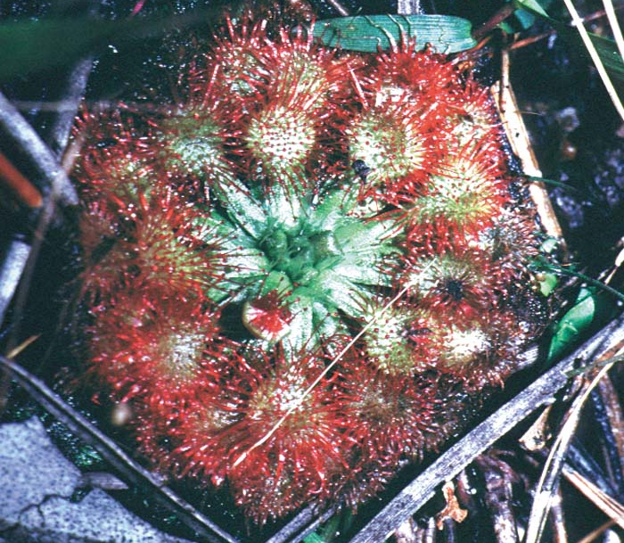
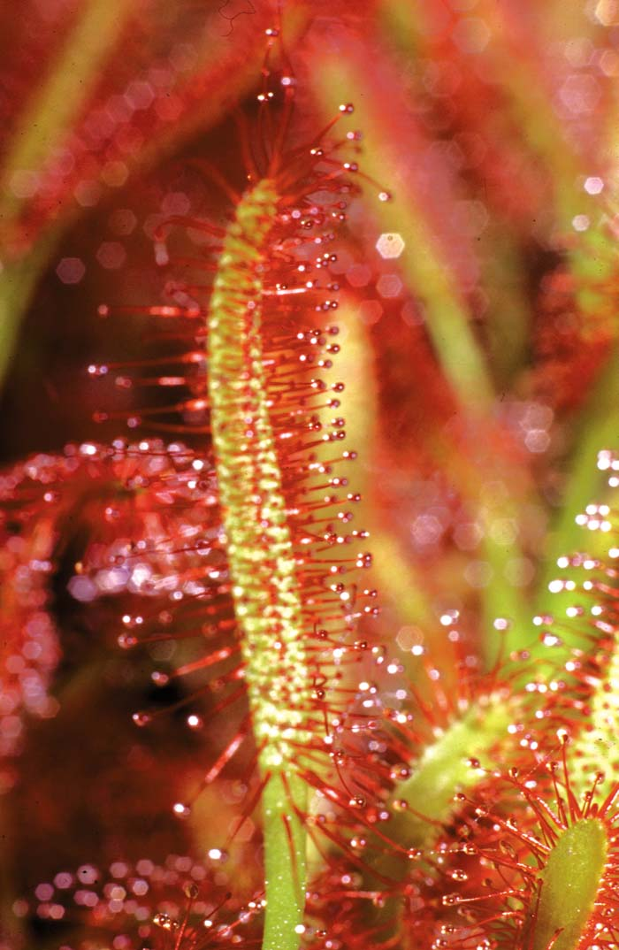
Tentacular Leaf
A leaf bearing numerous, sticky, glandular hairs or bristles that function in capturing and digesting small animals, e.g. Drosera
Tentacular Leaf - Drosera spp (Droseraceae)

Slide 23
Carnivorus plants
Insect-Trapping Leaves in areas with low soil Nitrogen
Insect digested by enzymes to release Nitrogen from proteins
Trap Leaf of Dionaea muscipula capturing fly

Slide 24
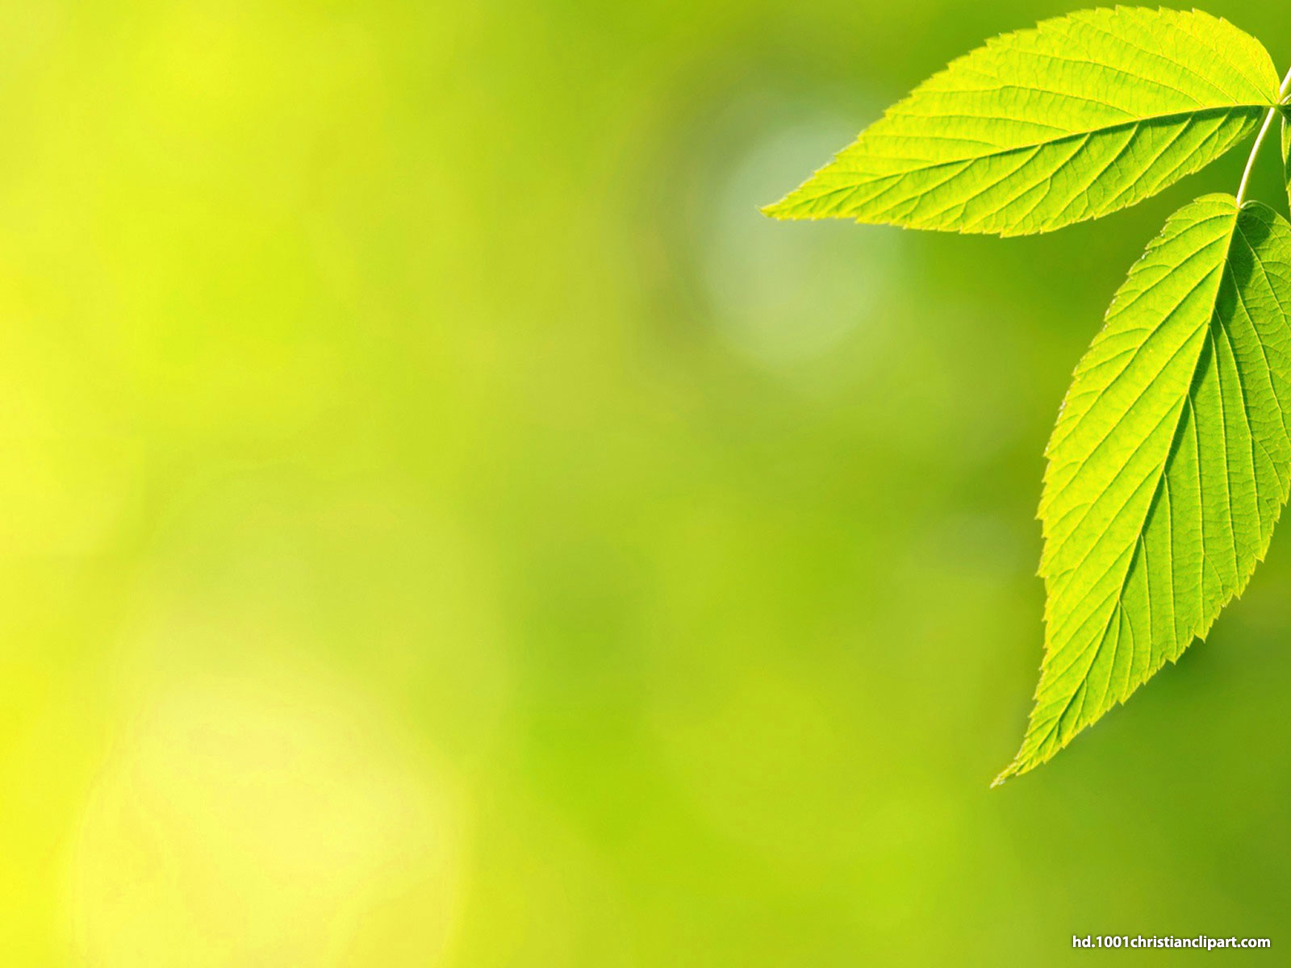
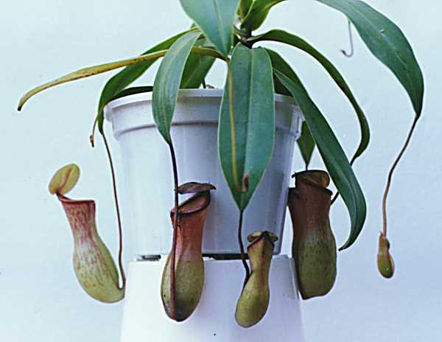
Leaf modification
(Pitcher plant leaf)

Slide 25
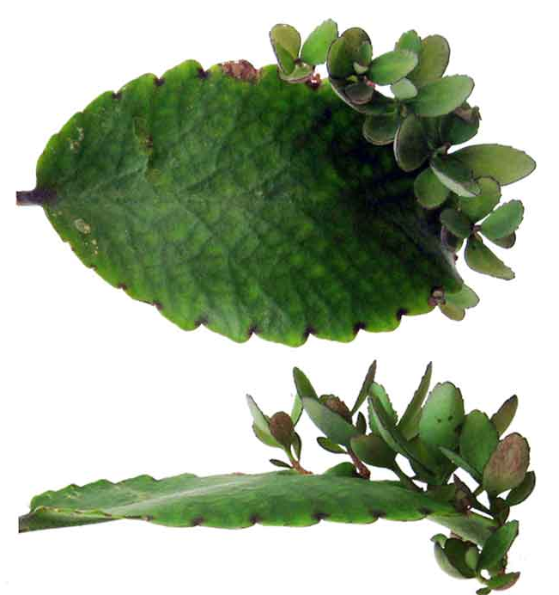
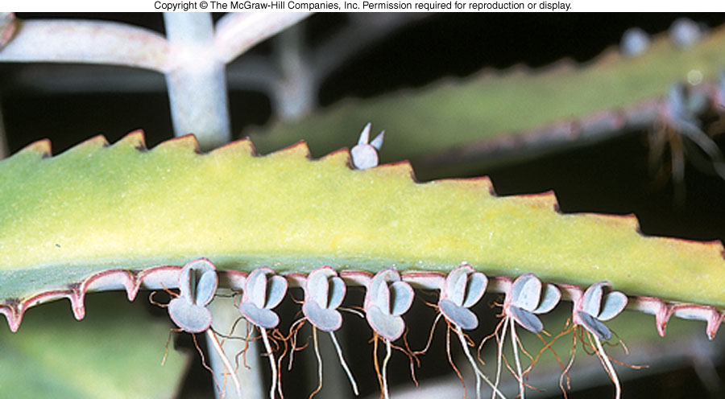
Modification of leaves:
Reproductive Leaves - development of a new plants at tip of the leaf.

Slide 26
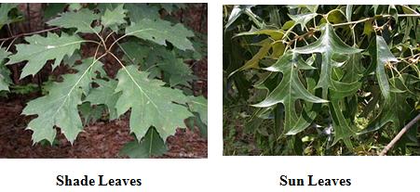
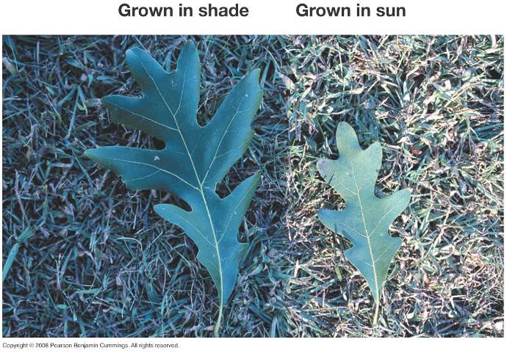
Sun and Shade Leaves

