Slide 1
MARIE: An Introduction to a Simple Computer

Slide 2
Lecture Overview
MARIE
Introduction
The Architecture
Registers and Buses
The Instruction Set Architecture
Register Transfer Notation
Instruction processing

Slide 3
MARIE – Introduction (1/1)
MARIE
We are now familiar with computer components but how these are connected together? How these work together?
Leonardo Da Vinci once said:
“When you wish to produce a result by means of an instrument, do not allow yourself to complicate it”
In this part we will use a MARIE, A Machine Architecture that is Really Intuitive and Easy.
MARIE will help us to understand how computer functions (even the more complex computers)

Slide 4
The Architecture (1/1)
MARIE
The MARIE architecture has the following characteristics:
Binary, two's complement data representation.
Stored program, fixed word length data and instructions.
4K x 16 word-addressable main memory.
16-bit instructions: 4 bits for the opcode, 12 bits for the address.
A 16-bit arithmetic logic unit (ALU).
Seven registers for control and data movement.

Slide 5
Registers and Buses (1/5)
MARIE
MARIE’s seven registers are:
AC: Accumulator, a 16-bit register that holds a conditional operator (e.g., "less than") or one operand of a two-operand instruction.
MAR: Memory address register, a 12-bit register that holds the memory address of an instruction or an operand of an instruction.
MBR: Memory buffer register, a 16-bit register that holds the data after its retrieval from, or before its placement in memory.

Slide 6
Registers and Buses (2/5)
MARIE
MARIE’s seven registers are:
PC: Program counter, a 12-bit register that holds the address of the next program instruction to be executed.
IR: Instruction register, a 16-bit register that holds an instruction immediately preceding its execution.
InREG: Input register, an 8-bit register that holds data read from an input device.
OutREG: Output register, an 8-bit register that holds data that is ready for the output device.

Slide 7
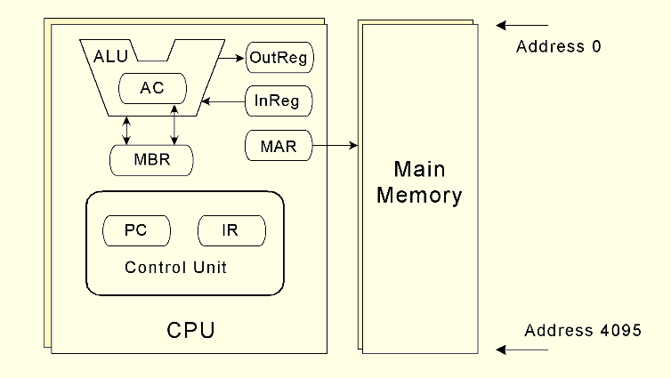
Registers and Buses (3/5)
MARIE
The MARIE architecture is shown in the figure below:

Slide 8
Registers and Buses (4/5)
MARIE
MARIE cannot transfer data or instructions into or out of registers without a bus.
In MARIE, we assume a common bus scheme
Each device on the bus is identified by a unique number.
If the device is required to use the common bus, Its number is set on the control lines.
Some direct pathways (without using the common bus) are also available to speed up execution
MAR – Memory ; AC – ALU ; AC – MBR ; MBR – ALU.

Slide 9
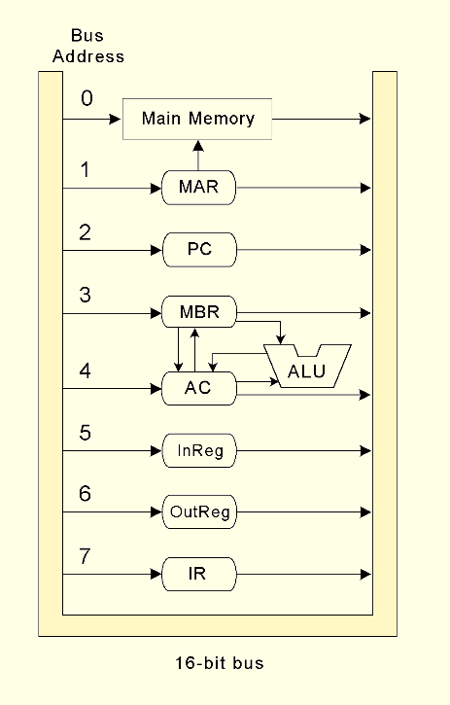
Registers and Buses (5/5)
MARIE
The Data path in MARIE is shown in this figure
Note that a data word (that is an instruction) in the main memory travels a relatively long path before achieving the IR!

Slide 10
Lecture Overview
Introduction
MARIE
Introduction
The Architecture
Registers and Buses
The Instruction Set Architecture
Register Transfer Notation
Instruction processing

Slide 11
The Instruction Set Architecture (1/7)
MARIE
MARIE has a very simple, yet powerful, instruction set.
The Instruction Set Architecture (ISA) specifies the format of its instructions and the primitive operations that the machine can perform.
The ISA is an interface between a computer’s hardware and its software.
Some ISAs include hundreds of different instructions for processing data and controlling program execution.

Slide 12
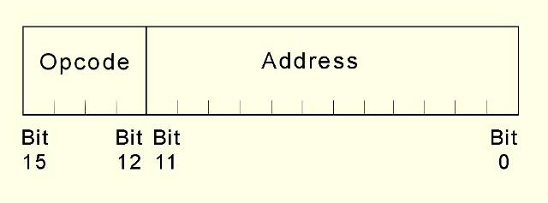
The Instruction Set Architecture (2/7)
MARIE
For MARIE, each instruction consists of 16 bits
These bits are organized as follows:
Opcode: 4 bits (bits 12 to 15), specifies the instruction to be executed (which allows for a total of 2⁴=16 instructions, but only 13 are used)
Address: 12-bits (bits 0 to 11), forms an address.
An instruction word

Slide 13
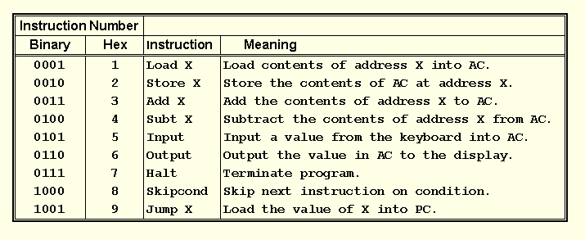
The Instruction Set Architecture (3/7)
MARIE
The fundamental MARIE instructions are:

Slide 14
The Instruction Set Architecture (4/7)
MARIE
Example: Consider the following binary instruction: 0001000000000011. What is the job of this instruction?
Solution:
The first four MSB forms the opcode “0001”. It corresponds to a LOAD instruction.
The remaining 12 bits indicate the address of the value we are loading, which is address 3 in main memory.
This instruction causes the data value found in main memory, address 3, to be copied into the AC

Slide 15
The Instruction Set Architecture (5/7)
MARIE
One important instruction is “SKIPCOND”
When the Skipcond instruction is executed, the value stored in the AC must be inspected.
The next instruction is skipped (resp. not skipped), if the condition tested is True (resp. False).
Bits 11 and 10 (say b₁₁b₁₀) in the AC specify the condition to be tested, if:
b₁₁b₁₀ = 00: The CPU tests if AC < 0
b₁₁b₁₀ = 01: The CPU tests if AC = 0
b₁₁b₁₀ = 10: The CPU tests if AC > 0

Slide 16
The Instruction Set Architecture (6/7)
MARIE
Example: Consider the following binary instruction: 1000100000000000. What is the job of this instruction?
Solution:
The opcode “1000” corresponds to a “skipcond”
b₁₁b₁₀ = 10, so the instructions’ job is to skip the next instruction if AC > 0.

Slide 17
The Instruction Set Architecture (7/7)
MARIE
In general we use:
SKIPCOND 000 which means skip the next instruction if the AC <0.
SKIPCOND 400 which means skip the next instruction if the AC =0.
SKIPCOND 800 which means skip the next instruction if the AC >0.
Note that 000, 400 and 800 are in base 16, They are equivalent to 12bits (Address part)!

Slide 18
Lecture Overview
Introduction
MARIE
Introduction
The Architecture
Registers and Buses
The Instruction Set Architecture
Register Transfer Notation
Instruction processing

Slide 19
Register Transfer Notation (1/7)
MARIE
MARIE instruction appears to be very simplistic
Actually, at the component level, each instruction involves multiple operations called “microoperations”
Register Transfer Language (RTL), or Register Transfer Notation (RTN) specifies the exact sequence of microoperations that are carried out by an instruction.

Slide 20
Register Transfer Notation (2/7)
MARIE
In the MARIE RTL we will use the following :
M[X]: to indicate the actual data value stored in memory location X
←: to indicate the transfer of bytes to a register or memory location
In the following few slides we will present the RTL for each of the instructions in the ISA for MARIE

Slide 21
Register Transfer Notation (3/7)
MARIE
Load X (loads the contents of memory location X into the AC)
MAR← X Place the address X in MAR;
MBR← M[MAR] The data M[MAR] at location address MAR
is moved into the MBR;
AC← MBR The content of MBR is placed in the AC.
Store X (stores the contents of AC into the memory location X)
MAR← X Place the address X in MAR;
MBR← AC Place the content of AC in MBR
M[MAR]← MBR Place the content of MBR in the memory
location MAR (M[MAR] is replaced by MBR)

Slide 22
Register Transfer Notation (4/7)
MARIE
Add X (The data value stored at address X is added to the AC).
MAR← X Place the address X in MAR;
MBR← M[MAR] Place the data M[MAR] at location address
MAR in MBR;
AC← AC + MBR Place the sum AC + MBR in AC
Subt X (The data value stored at address X is subtracted from AC).
MAR← X Place the address X in MAR;
MBR← M[MAR] Place the data M[MAR] at location address
MAR in MBR;
AC← AC - MBR Place AC - MBR in AC

Slide 23
Register Transfer Notation (5/7)
MARIE
Input (Inputs a value from the keyboard into AC)
AC← InREG Place the content of InREG (contains the input) in the
AC.
Output (Output the value in AC to the display)
OutREG← AC Place the content of AC (contains the output) in the
OutREG (to sent data to the display)
Halt (Terminate the program)
no need for any RTL!
Jump X (unconditional branch to the given address, X)
PC← X Load X into the PC

Slide 24
Register Transfer Notation (6/7)
MARIE
Skipcond
if IR[11–10] = 00 then {if bits 10 and 11 in the IR are both 0}
if AC < 0 then PC ← PC+1
else if IR[11–10] = 01 then {if bit 11 = 0 and bit 10 = 1}
if AC = 0 then PC ← PC + 1
else if IR[11–10] = 10 then {if bit 11 = 1 and bit 10 = 0}
if AC > 0 then PC ← PC + 1

Slide 25
Register Transfer Notation (7/7)
MARIE
Important Notes
Any instruction is firstly placed into the instruction register IR where:
IR[15-12] contains the opcode
IR[11-0] contains the operand (address)
In all the previous RTL, X can be replaced by IR[11-0]!
Example:
The RTL for Jump X can be written as follows:
PC← IR[11-0]

Slide 26
Lecture Overview
Introduction
MARIE
Instruction processing
The Fetch-Decode-Execute cycle
Interrupts

Slide 27
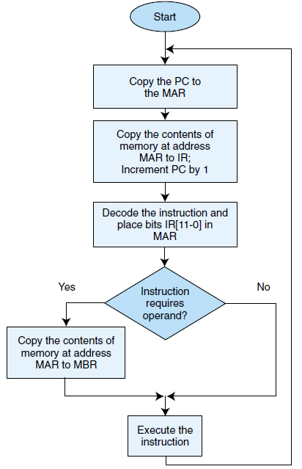
The Fetch-Decode-Execute cycle (1/1)
Instruction processing
MARIE, like any other computer architecture, follow the basic machine cycle:
the fetch, decode, and execute cycle
Fetch
Decode
Execute

Slide 28
Interrupts (1/3)
Instruction processing
An important issue (that is not covered here for MARIE) is interrupt handling
Most computers provide a way of interrupting a running program
Examples of interrupts:
A user break is issued (e.g., Ctrl+C)
I/O is requested by the user or a program
A critical error occurs
Practically, when an interrupt occurs a special bit in the “status register” or “flag register” of the CPU is set.

Slide 29
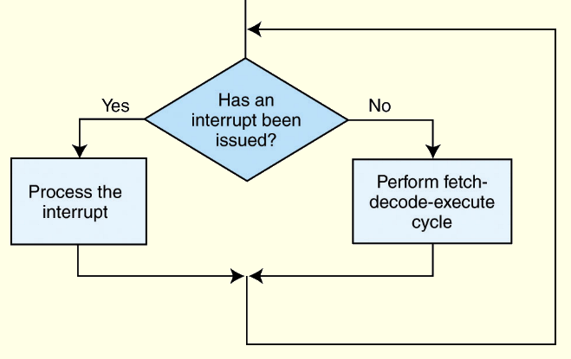
Interrupts (2/3)
Instruction processing
The CPU checks this bit at the beginning of every machine cycle
If the bit is set, the CPU processes an interrupt as follows:
Pause the execution of the current program
Run the interrupt’s appropriate routine
Continue the execution of the previously paused program (after finishing the interrupt’s routine)
If the bit is not set, the CPU performs a normal new fetch, decode, execute cycle of the program currently being executed.

Slide 30
Interrupts (3/3)
Instruction processing
When the CPU finishes the interrupt’s routine, it must return to the exact point at which it was running in the original program.
Before the CPU switches to the interrupt service routine, it must save:
The contents of the PC
The contents of all other registers in the CPU
Any status conditions that exist for the original program.

