Slide 1
Kirby-Bauer test
Lab# 8
BCH462 [practical]

Slide 2
Objective:
To test the ability of antimicrobial agents to inhibit the growth of microorganisms. Using Kirby-Bauer test method.

Slide 3
Zone of inhibition [Kirby-Bauer test method]:
Zone of Inhibition test method is designed to test the ability of antimicrobial agents to inhibit the growth of microorganisms over an 18-24 hour period of contact.
Summary of Test:
-A microbial suspension is spread by a sterile swab, evenly, over the face of a sterile
agar plate.
-The antimicrobial agent is applied to the center of the agar plate and incubated.
-If substantial antimicrobial activity is present, then a zone of inhibition appears around the test product. The zone of inhibition, is simply the area on the agar plate that remains free from microbial growth.
-The size of the zone of inhibition is usually related to the level of antimicrobial activity present in the sample or product - a larger zone of inhibition usually means that the antimicrobial is more potent-.

Slide 4
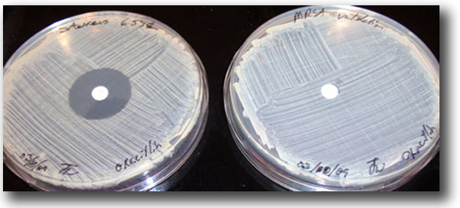
A zone of Inhibition is evident around the oxacillin disk for S. aureus, left, but not for Methicillin-resistant S. aureus (MRSA), right.

Slide 5
Tests for sensitivity and resistance to antibiotics.
The size of the zones of inhibition of microbial growth surrounding the antibiotic disks on the plate are an indication of microbial susceptibility to the antibiotic.

