Slide 1
Beer's- Lambert Law and Standard Curves
BCH 312 [practical]

Slide 2
Objectives:
-Getting familiar with standard curve.
-Determination of an unknown concentration for a solution.

Slide 3
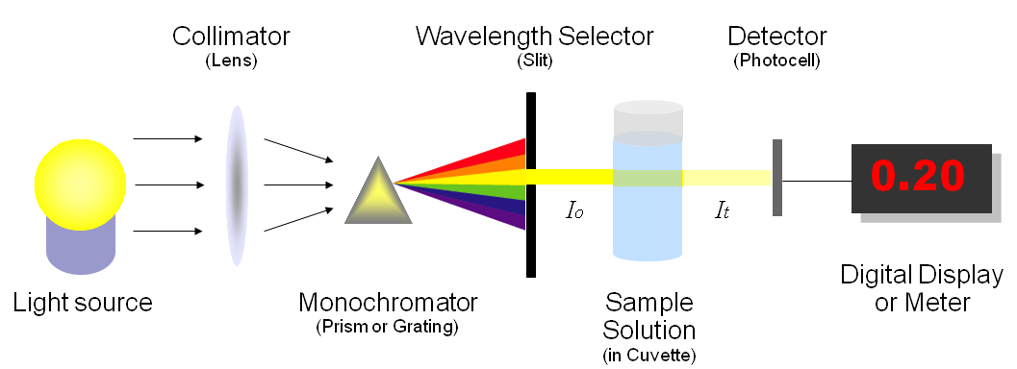
How a spectrophotometer works

Slide 4
The spectrophotometer: it can be used to measure the amount of light absorbed by a solution. How?
-it consist of two part spectrometer and photometer.
-By using the spectrophotometer, we can quantitatively measure absorbance, and this information can be used to determine the concentration of the absorbing molecule.
-More concentrated solution will absorb more light and transmits less.[why?]
So, the more concentrated solution → high absorbance value.
And Less concentrated solution → less absorbance value.

Slide 5
Wavelength in this instrument divided into: Visible range and ultraviolet rang.
- The blank contain every thing expect the substance that we want to measure.

Slide 6
Beer-Lambert law:
Principle:
The absorption of light by a solution is described by the Beer-Lambert law as:
There is linear relationship between absorbance and concentration of an absorbing species.
A = a_{m} x c x l
A= is the absorbance of the solution [Ab].
a_{m} = the molar extinction(absorption) coefficient.
l = length of the light path through the solution.
c = concentration of the absorbing substance.

Slide 7
From this law we observe :
1- There are direct proportional between C and Ab.
2- Also There are direct proportional between l and Ab.
So, what does standard curve of concentrations mean?

Slide 8
A standard curve for concentrations:
- It is a graph that shows the relationship between different known concentrations of a substance and the absorbance at a specific wave length.
-Standard curve are most commonly used to determine the concentration of a substance, using serial dilution of solutions of known concentrations.
-So, what is the principle of a standard curve???
Wait….. what is standard solutions???
Standard solution:
is a solution containing a precisely known concentration of an element or a substance.
- a series of known standard solutions can be Prepare by diluting the stock known solution.

Slide 9
-We should calculate the concentration of mixture after diluted by the formula:
C1 X V1 = C2 X V2

Slide 10
Notes:
1- The Ab of solution with “unknown concentration” preferred to be lower that highest Ab value in standard Curve.
[ the absorbance of solution with “unknown concentration”, is within the rang of absorbance values of solution with “known concentration solutions”].
2- If your unknown sample had an absorbance higher the highest absorbance recorded by standard [out of the rang], how will you determine its concentration correctly ?
I have two choice :
1- Increase the concentration of standard solution.
2- Dilute the solution with “unknown concentration” →measure the Ab → After dilution then determine its concentration from the curve →then multiply the value by Dilution factor.

Slide 11
How to determine unknown concentration
of a solution with known absorbance value?

Slide 12
If the unknown concentration of a solution has absorbance value =0.45,
the conc. From the curve will be ......??
Absorbance of the
” solution with unknown concentration”
Concentration of the
” solution with unknown concentration”

Slide 13
To determine the concentration of a solution with “an unknown concentration”:
From standard curve:
-Measure the absorbance of the “solution with unknown concentration” in order to determine the concentration.
Beer-Lambert law:
Using available information of any standard solution to determine the “ε”,
then using these information to get the unknown concentration. Using:A = εlc
Note: “ε” will changed when the weave length changed.

Slide 14


Spectrophotometry Introduction:
http://www.youtube.com/watch?v=qbCZbP6_j48
Spectrophotometry Example
http://www.youtube.com/watch?v=VqAa_cmZ7OY&feature=relmfu

