Slide 1
chapter 9
chapter
9
B Vitamins Important in Energy Metabolism
B Vitamins Important in Energy Metabolism
Prof Jennifer Broxterman, RD, MSc
FN3373: Nutrition for Physical Activity
Lecture 8
Author name here for Edited books

Slide 2
The B Vitamins

Slide 3
The B Vitamins
B vitamins:
Thiamin (B1)
Riboflavin (B2)
Niacin (B3) energy metabolism
Vitamin B6
Pantothenic acid
Biotin
Folate blood formation
Vitamin B12

Slide 4
Guidelines for Recommending Vitamins Supplements
Is current dietary intake of the vitamin adequate?
Is there any indication for increased need?
Is the amount recommended below the toxic level?
Are any nutrient-nutrient or drug-nutrient interactions indicated?
Why does the athlete want to supplement?
Is the athlete willing to make dietary changes that would improve vitamin intake?
Can the nutrient easily be obtained from food by means of simple dietary changes that are acceptable to the athlete?

Slide 5
Exercise-Related Functions and Dietary Requirements

Slide 6
Figure 9.1

Slide 7
Thiamin
Thiamin is an essential cofactor for important enzymes involved in the metabolism of CHO, protein, and fat
Branched-chain amino acids (BCAAs)
Active form: thiamin disphosphate (TDP)
Coenzyme for the pyruvate dehydrogenase complex
Cofactor for α-ketoglutarate decarboxylase
Required for transketolase
Thiamin RDA: 1.2 mg/d (men), 1.1 mg/d (women)

Slide 8
Riboflavin
Riboflavin is involved with the metabolism of glucose, fatty acids, glycerol, and amino acids for energy
Necessary for the synthesis of 2 important coenzymes in the body:
Flavin mononucleotide (FMN)
Flavin adenine dinucleotide (FAD)
Involved in the conversion of pyridoxine (Vitamin B6) and folate to their coenzyme forms
Hypothesized that riboflavin requirements are higher in people who exercise
Riboflavin RDA: 1.3 mg/d (men), 1.1 mg/d (women)

Slide 9
Vitamin B6
Vitamin B6 plays a major role in metabolic pathways required during exercise
Required in the metabolism of protein & aa’s and release of glucose from stored glycogen
Active form: pyridoxal-5’-phosphate (PLP)
Vitamin B6 RDA: 1.3 mg/d (both men & women)

Slide 10
Niacin
Niacin (also called nicotinic acid and nicotinamide):
Precursor for 2 coenzymes:
Nicotinamide adenine dinucleotide (NAD)
NAD phosphate (NADP)
Niacin can come from 2 sources:
Directly from the diet
Made from the essential aa tryptophan
Niacin RDA: 16 NE/d (men), 14 NE/d (women)

Slide 11
Pantothenic Acid
Pantothenic acid is involved in many energy-producing metabolic pathways
Active forms: coenzyme A (CoA) & acyl carrier protein (ACP)
Involved in glycolysis, β-oxidation, TCA cycle, gluconeogenesis, protein degradation and aa synthesis, and the synthesis of steroid hormones, acetylcholine, fatty acids, and membrane phospholipids
Pantothenic acid AI: 5 mg/d (men & women)

Slide 12
Biotin
Biotin is involved in the metabolism of glucose, fat, and protein:
Gluconeogenesis
Fatty acid synthesis
Required for the degradation of some aa’s (isoleucine, valine, methionine, and leucine) and odd-carbon fatty acids
Biotin AI: 30mg/d (men & women)

Slide 13
Table 9.1

Slide 14
B Vitamins: Pharmacological Effects & Toxic Levels
Thiamin
No evidence of toxicity from oral supplementation
Riboflavin
No evidence of toxicity from food or supplements
Vitamin B6
Chronic high doses may cause neurotoxicity

Slide 15
B Vitamins: Pharmacological Effects & Toxic Levels
Niacin
Can cause flushing of the skin, hyperuricemia, abnormal liver function, low BG levels
UL = 35 mg/d
Pantothenic Acid
No UL
Biotin
No UL

Slide 16
Rationale for Increased Need for Active Individuals

Slide 17
Exercise & The B Vitamins
Theoretically, exercise could increase the need for B vitamins:
Altered absorption of the nutrient due to decreased transit time
Increased turnover, metabolism, or loss of the nutrient in urine or sweat
Increased need due to the biochemical adaptations associated with training

Slide 18
Exercise & The B Vitamins
Theoretically, exercise could increase the need for B vitamins:
Increased mitochondrial enzymes that require the nutrients are cofactors
Increased need for the nutrient for tissue maintenance and repair
Increased need due to biochemical adaptations associated with changes in the composition of the diet (higher intakes of CHO or protein or both)

Slide 19
Dietary Intakes of Active Individuals

Slide 20
Active Males and B Vitamins
Studies examining the dietary intakes of B vitamins in active males indicate:
Adequate intakes of thiamin, riboflavin, vitamin B6, and niacin
Attributed to the relatively high energy intakes in active males

Slide 21
Active Females and B Vitamins
Studies examining the dietary intakes of B vitamins in active males indicate:
Intakes are generally lower in active females as compared to active males
Most studies indicate adequate intakes for thiamin, riboflavin, and niacin
Populations at risk: amenorrheic runners, athletes at the end of their season at peak competition, those consuming < 1900 kcal/day

Slide 22
Dietary Sources
of B Vitamins

Slide 23
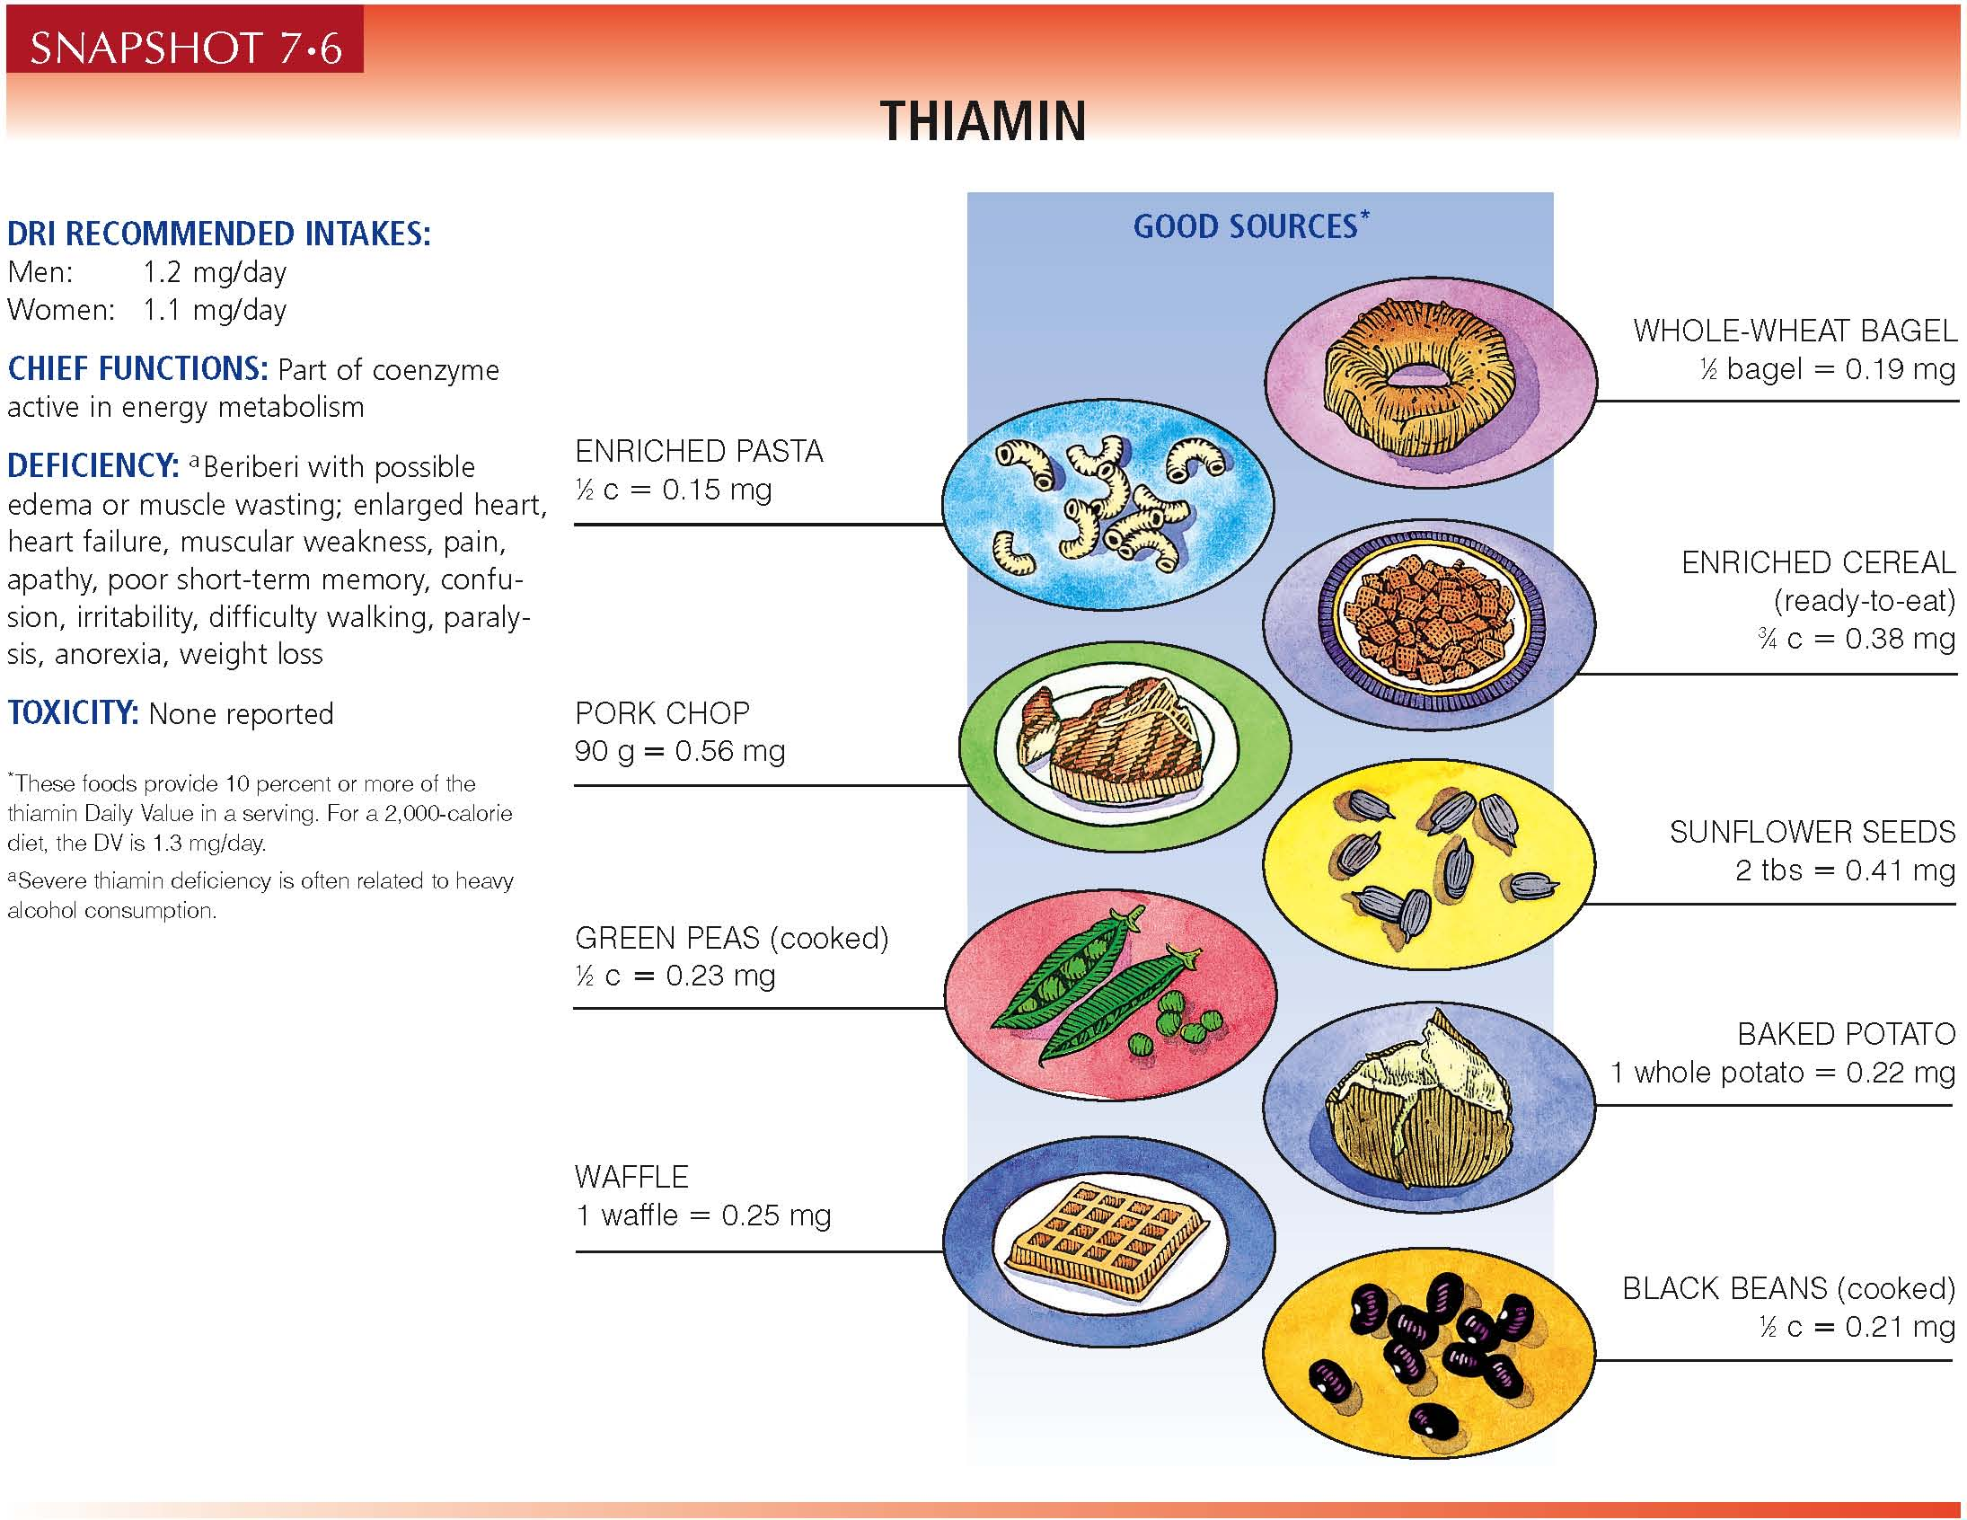

Slide 24
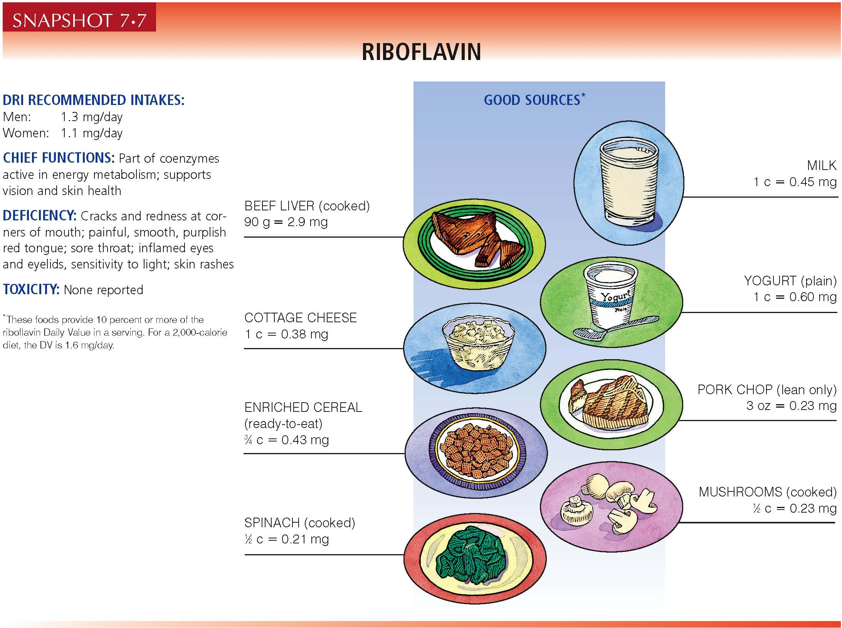

Slide 25
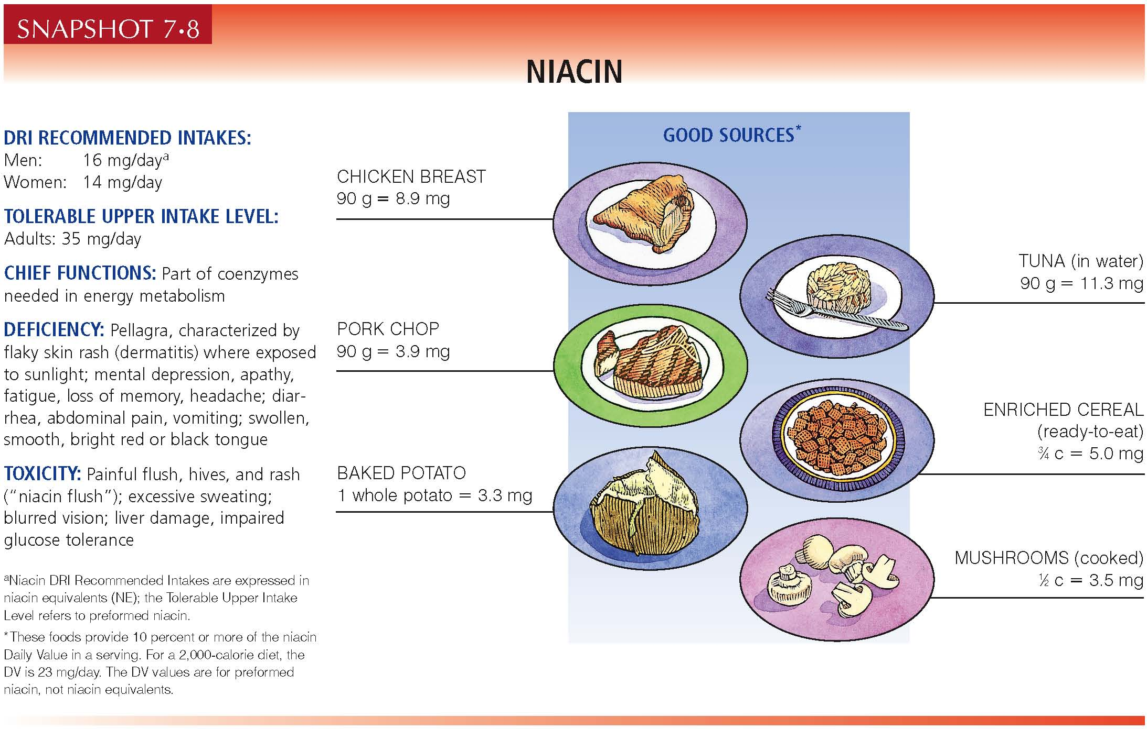

Slide 26
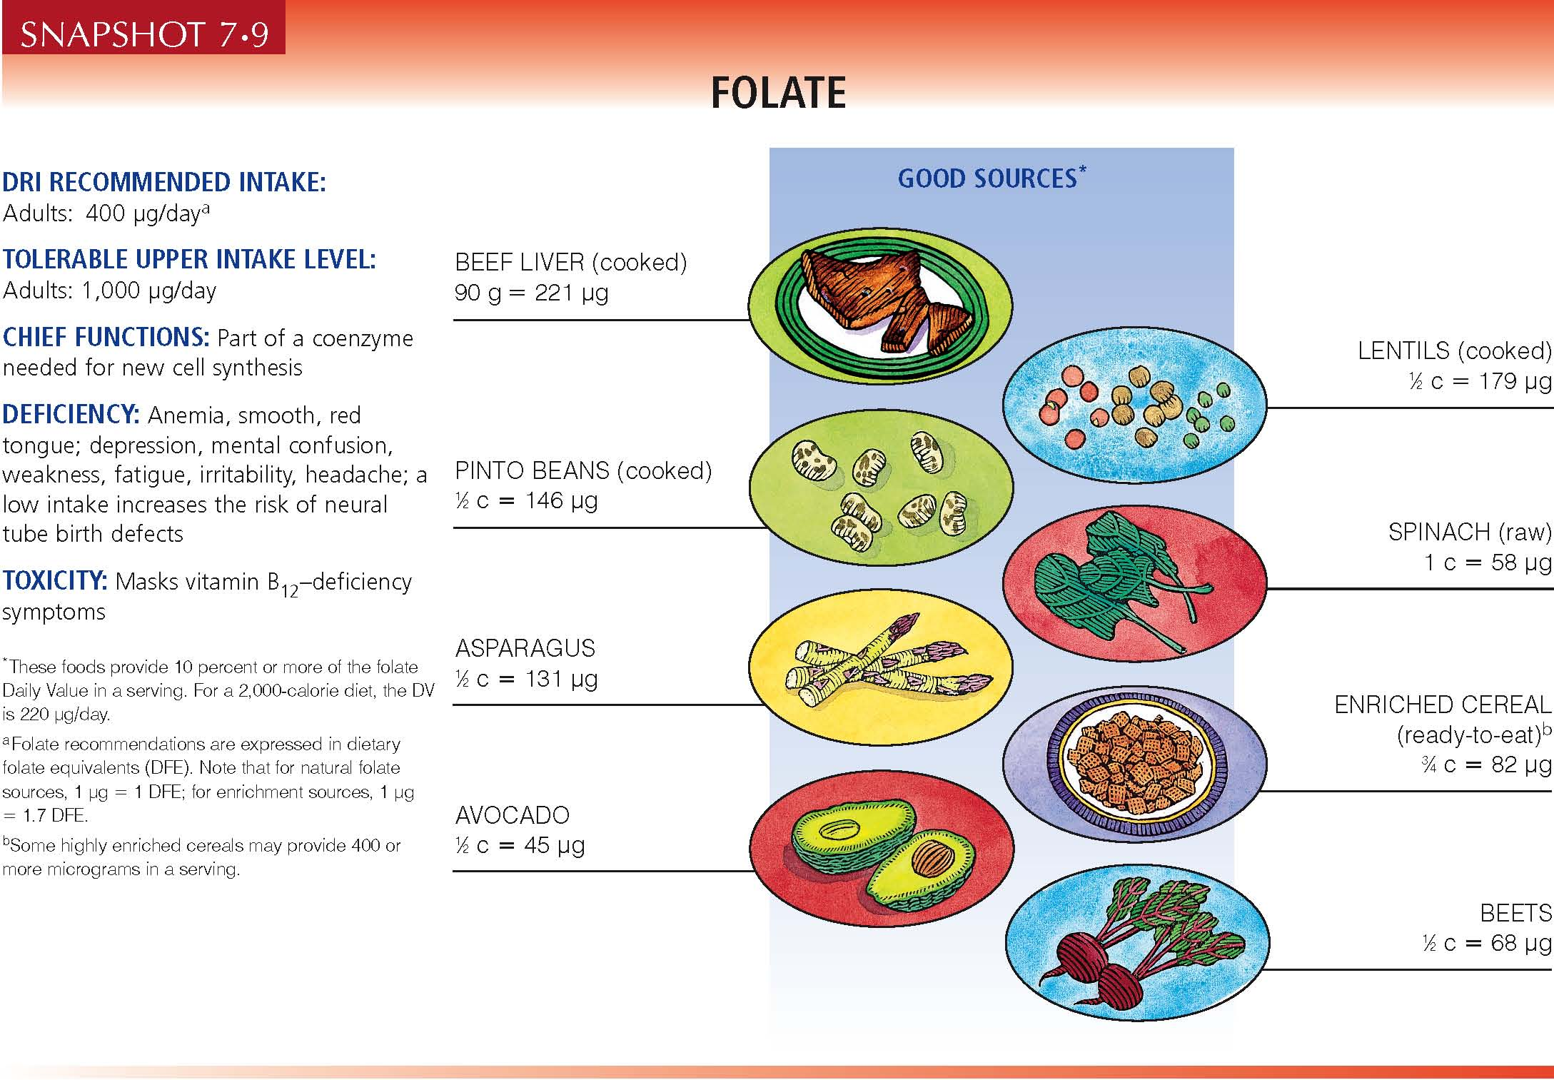

Slide 27
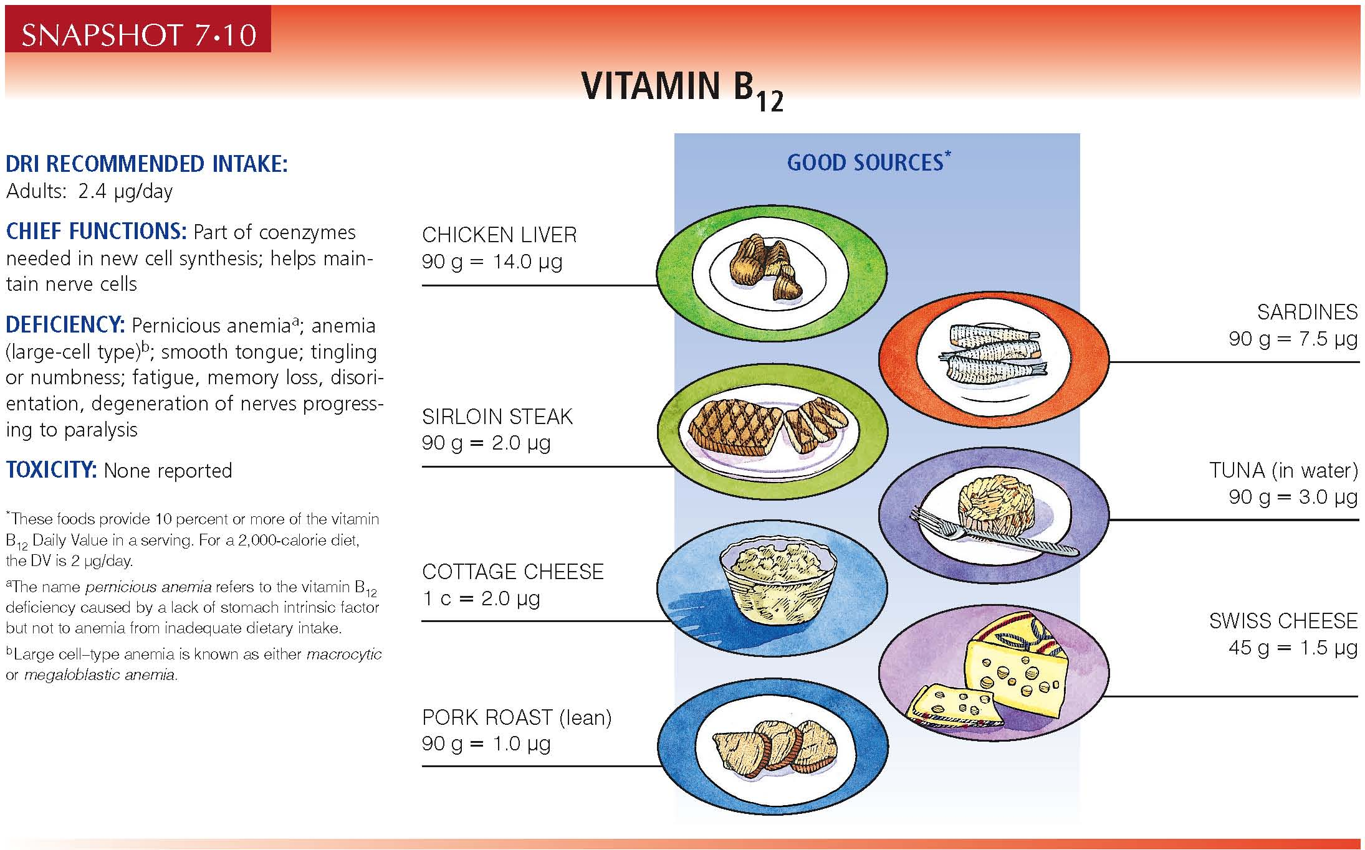

Slide 28
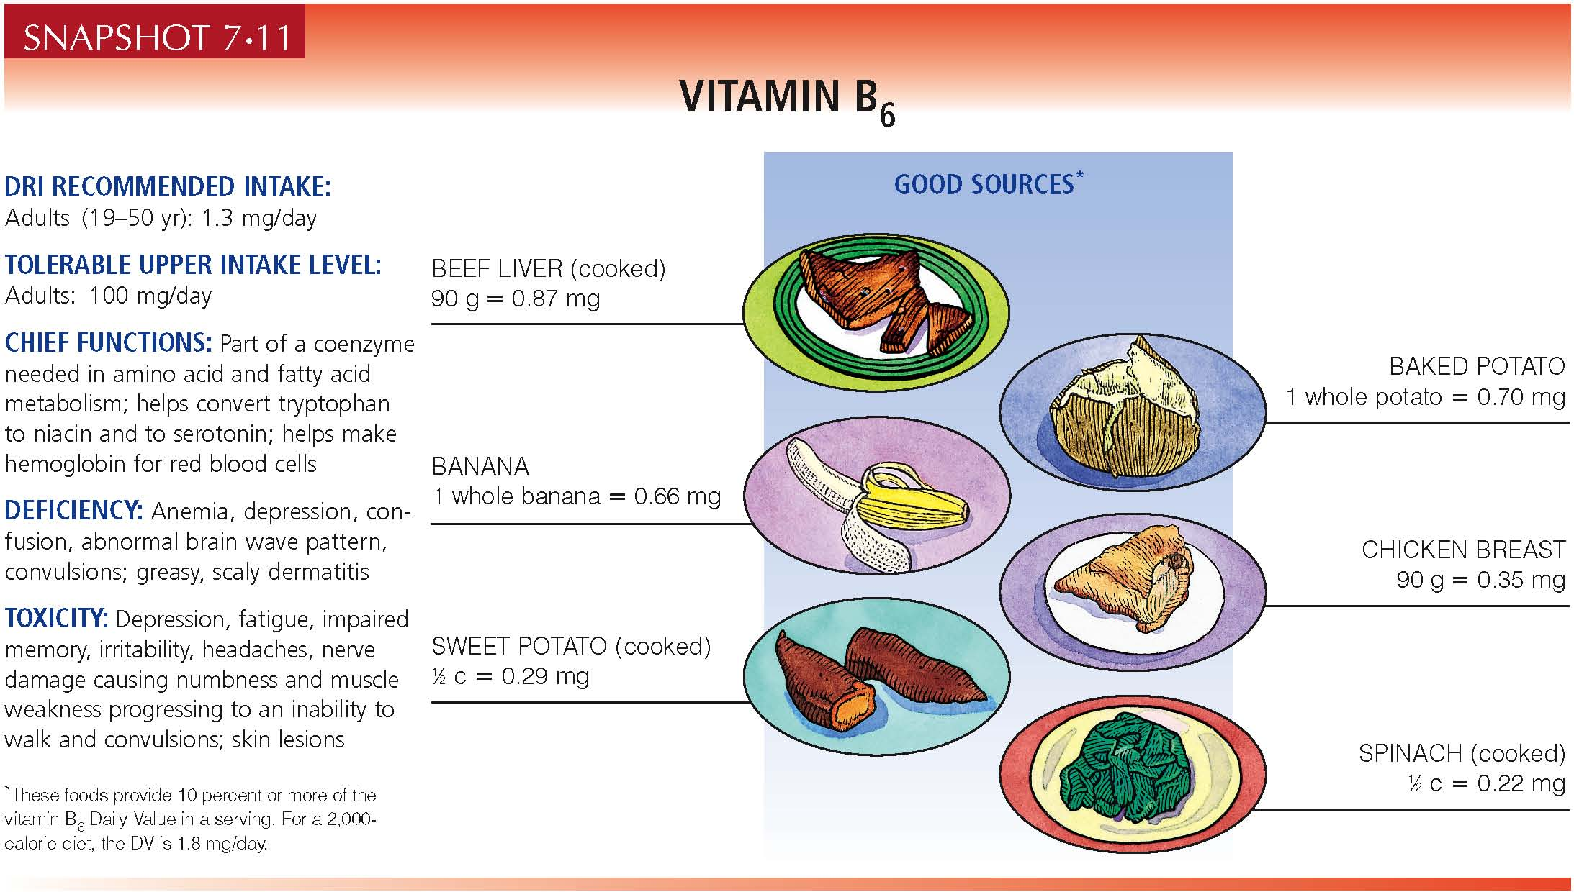

Slide 29
Pantothenic Acid & Biotin
Pantothenic acid:
Meats (esp. heart & liver), baker’s yeast, white and rice bran, mushrooms, nuts (cashews & peanuts), soybeans, broccoli, avocados, outer layer of grains
Biotin:
Brewer’s yeast, milk, cheese, liver, egg yolks, nuts (peanuts & walnuts), lentils, soybeans, vegetables (cauliflower, spinach, peas), grains
Small amounts are also produced in the intestinal tract of humans

Slide 30
Vitamin Deficiencies & Their Symptoms

Slide 31
Thiamin Deficiency
Beri-beri (wet or dry)
Characterized by loss of sensation in the hands and feet; muscular weakness; advancing paralysis; abnormal heart action in adults; during growth, permanent brain damage may result
Wernicke-Korsakoff syndrome
Affects brain tissues; associated with alcohol abuse; characterized by apathy, irritability, mental confusion & disorientation, loss of memory, jerky eye movements, staggering gait

Slide 32
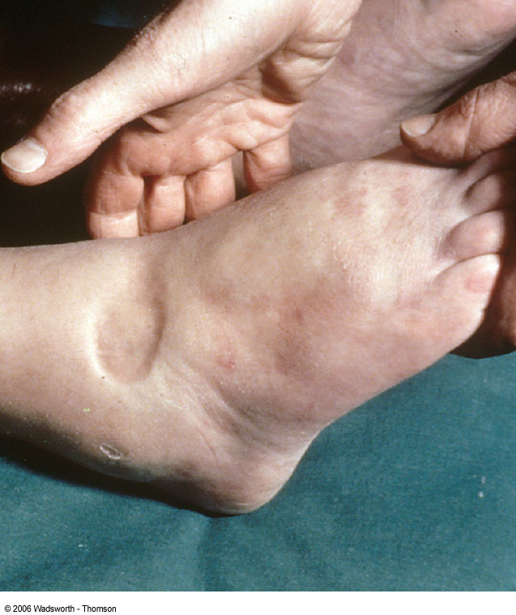

Slide 33
Riboflavin Deficiency
No single disease is associated with low dietary intakes of riboflavin
Low intakes are associated with lesions around the mouth, general dermatitis, and normocytic anemia
Riboflavin is essential for the conversion of vitamin B6 and niacin to their active forms

Slide 34
Vitamin B6 Deficiency
Deficiency symptoms:
weakness, psychological depression, irritability, confusion, insomnia, greasy dermatitis, anemia, convulsions; weakened immune response, increased incidence of heart disease
If high protein intakes accompany low vitamin B6 intakes, the deficiency will appear sooner

Slide 35
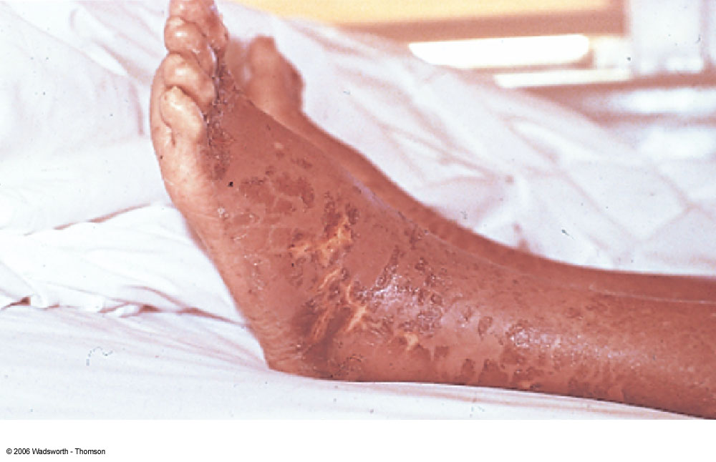
Niacin Deficiency
Deficiency – pellagra
4Ds = diarrhea, dermatitis, dementia, death
Can be prevented by adequate protein because tryptophan can be converted to niacin in the body

Slide 36
Pantothenic Acid & Biotin Deficiencies
There are no deficiency diseases associated with low intakes of pantothenic acid or biotin

Slide 37
Exercise and Vitamin Requirements

Slide 38
Metabolic Diet Studies
How do metabolic diet studies assess vitamin requirements?
Determine how vitamin assessment parameters change under controlled conditions when the dietary intake of a nutrient is closely controlled
How it works: a known amount of the vitamin is fed to both sedentary and active individuals
If subsequent nutrient status is different between the two groups, vitamin requirements are different

Slide 39
B Vitamin Requirements
Exercise may increase the need for B vitamins by 1-2 times the current RDA
- thiamin
- riboflavin
- vitamin B6
- Limited data on the effect of exercise on niacin, pantothenic acid or biotin status

Slide 40
Figure 9.4

Slide 41
Vitamins and Exercise Performance

Slide 42
Do Vitamin and Mineral Supplements Improve Exercise Performance?
Many factors besides diet that affect performance
Many ways to measure performance
Major flaws of research studies:
Researchers did not determine the subject’s nutritional status before the study began
Neither diet nor exercise training were controlled during the study
Supplements often contain other nutrients besides the vitamin in question
No data to support active individuals with good nutrient status experience increased performance with additional supplementation

