Slide 1
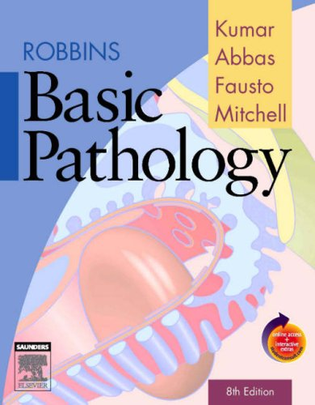
CLS 223

Slide 2
Lecture # 8
Circulatory Disturbance
(continue)

Slide 3
2) Disturbance of obstructive nature
Thrombosis
Embolism
Compression
Spasm
Structural changes
-aneurysm
-atherosclerosis

Slide 4
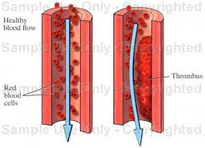
Thrombosis
Formation of a compact mass composed of blood elements inside a vessel or a heart cavity during life.
There are two components to a thrombus, aggregated platelets that form a platelet plug, and a mesh of cross-linked fibrin protein.
Common sites of thrombosis:
Arteries are less common than veins in getting thrombosis because of rapid blood flow in arteries.

Slide 5
Causes if thrombosis
Damage to the vascular endothelium: Mechanical by trauma, inflammatory (known as phlebitis), degenerative (by aneurysm).
Decrease in blood flow (Stasis).
Increase viscosity as in case of polythycaemia or dehydration.
Change in blood constituents:
-increase platelets → after operations.
-increase fibrinogen → during pregnancy.
-increase RBC → causing polythycaemia.
- Decrease plasma → occurs in dehydration.
Notes:
Stasis: in normal blood stream, the blood cells occupy the central part and the plasma at the peripheral part. In stasis, the platelets cross the plasma zone and come in contact to the vascular endothelium.
Platelets: increase in number after operations and become more sticky. They agglutinate in small masses and adhere to the endothelium.
Polycythaemia: decrease in plasma or increase in RBC causing increased blood viscosity and stasis

Slide 6
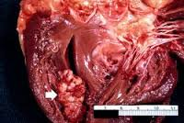
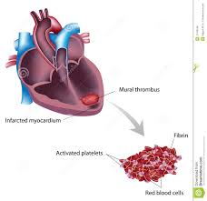
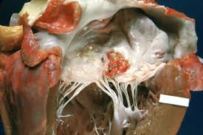
Types of heart thrombosis
Mural thrombus: type of thrombus that occurs in heart chambers.
Vegetation: type of thrombus that occurs in heart valves.
Notes:
Practical exam (vegetation)

Slide 7
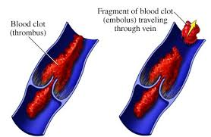
Embolism
A solid, liquid, gaseous mass circulating in the blood stream.
Types:
Detached thrombus.
Air embolism: In case of surgery, blood transfusion.
Fat embolism: Following bone fracture, burns, inflammation of fatty tissue.
Tumor embolism: By malignant cells.
Clumps of bacteria.
Notes:
Air embolism interfere with cardiac contraction and causes acute heart failure.

Slide 8
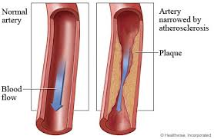
Atherosclerosis
Formation of Plaque that blocks the lumen of the vessels
Risk Factors:
-Increase age
-Genetic factor
-Diabetes
-Hypertension
-Increase cholesterol
-Obesity
-Decrease exercise
-Stress
-Smoking

Slide 9
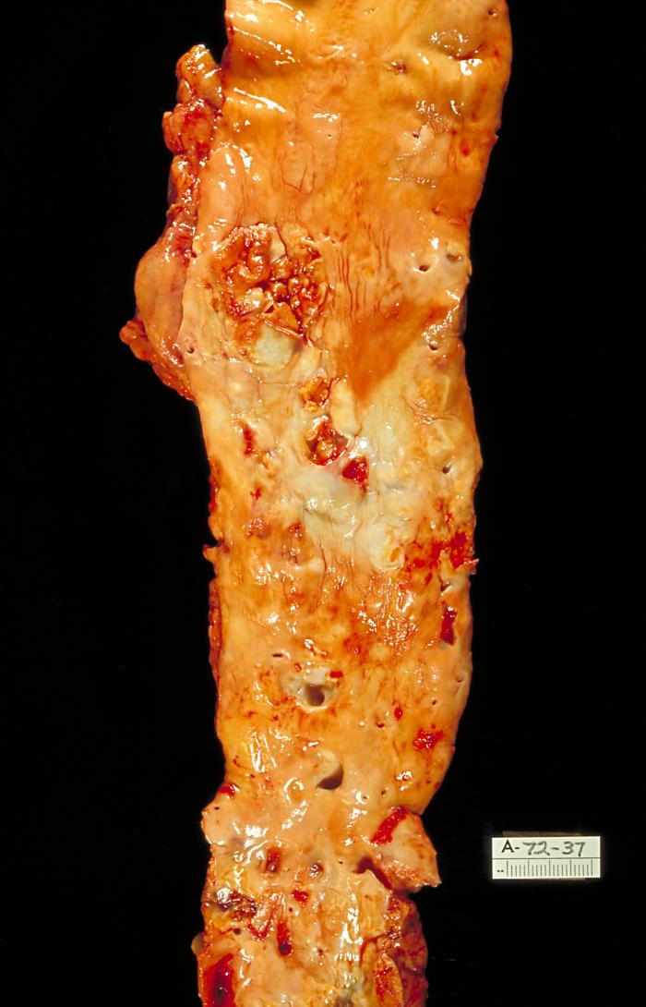
The plaque is formed of
Degenerative endothelial cells
Fat cells
Necrotic cells
Calcium
Cholesterol

Slide 10
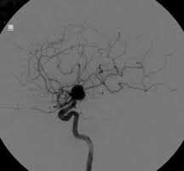
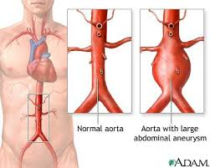
Aneurysm
An aneurysm is a localized, blood-filled balloon-like structure in the wall of a blood vessel.
Aneurysms can occur in any blood vessel, with examples including aortic aneurysms. Aneurysms can also occur within the heart itself.

Slide 11
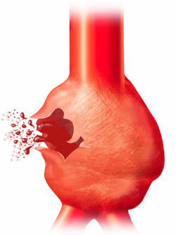
As an aneurysm increases in size, the risk of rupture increases. A ruptured aneurysm can lead to bleeding and subsequent hypovolemic shock, leading to death.
Aneurysms are a result of a weakened blood vessel wall, and can be a result of a hereditary condition or an acquired disease. Aneurysms can also be a reason for clot formation (thrombosis) and embolization.

