Slide 1
More About Objects and Methods
Chapter 6

Slide 2
Objectives
Define and use constructors
Write and use static variables and methods
Write and use overloaded methods

Slide 3
Constructors
Ch 6.1

Slide 4
Constructors: Outline
Defining Constructors
Calling Methods from Constructors
Calling a Constructor from Other Constructors

Slide 5
Defining Constructors
A constructor
  is a special method called automatically when an instance of an object is created with new
  ClassName x = new ClassName();
  has the same name as the class name.
  can have parameters to specify initial values if desired
  but cannot return values and it is not a void method
  May have multiple definitions
    Each with different numbers or types of parameters
A class contains at least one constructor.
Notes:
Before going into details, look at the next example (Pet class)

Slide 6
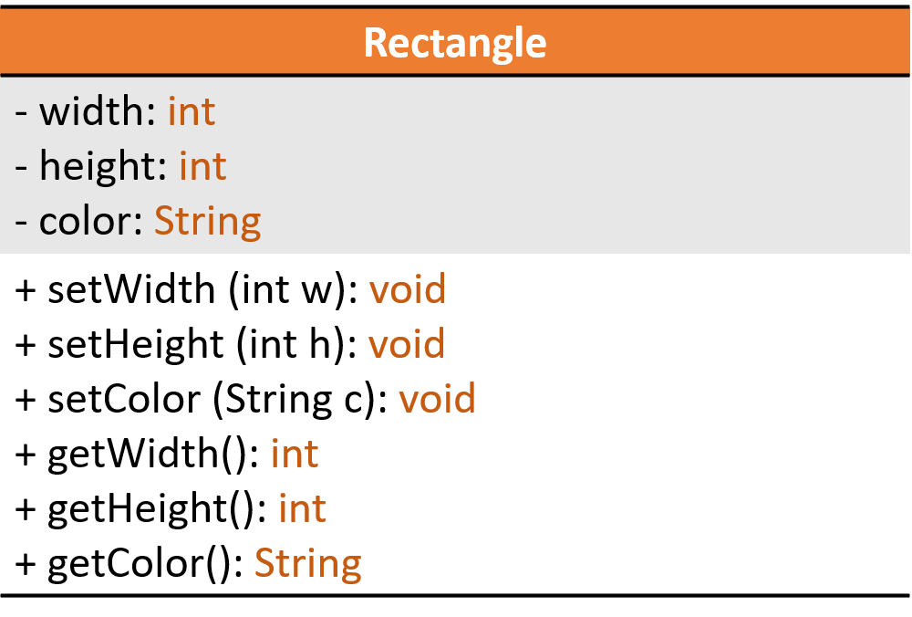
Defining Constructors
Example class to represent rectangles

Slide 7
public class RectangleTest {
  public static void main(String[] args) {
    Rectangle box1 = new Rectangle();
    box1.display();
  }
}
public class Rectangle {
  private int width;
  private int height;
  private String color;
  public Rectangle() {
    width = 1;
    height = 1;
    color = "white";
  }
  public void setWidth(int w){ width = w;}
  public void setHeight(int h){ height = h; }
  public void setColor(String c){ color = c; }
  public int getWidth() { return width; }
  public int getHeight() { return height; }
  public String getColor() { return color; }
  public void display() {
  System.out.println("Width= "+width+", Height= "+height+", Color= "+ color);}}
Default constructor
Sample screen output
Width= 1, Height= 1, Color= white

Slide 8
Defining Constructors
Constructor without parameters is the default constructor
Java will define this automatically, but only if the class designer does not define any constructors
If you do define a constructor, Java will not automatically define a default constructor, but you can still add one.
Usually default constructors are not included in class diagrams (UML)

Slide 9
public class Rectangle {
  private int width;
  private int height;
  private String color;
  public Rectangle() {
    width = 1;
    height = 1;
    color = "white";}
  public Rectangle(int w, int h, String c) {
    width = w;
    height = h;
    color = c;}
  public Rectangle(int w, int h) {
    width = w;
    height = h; }// rest of methods
}
Don’t forget to check the validity
of received values
public class RectangleTest {
  public static void main(String[] args) {
    Rectangle box1 = new Rectangle(5, 10 , "Black");
    box1.display();
    Rectangle box2 = new Rectangle(3, 20);
    box2.display();}}
Sample screen output
Width= 5, Height= 10, Color= Black
Width= 3, Height= 20, Color= null

Slide 10
Calling Methods from Other Constructors
public class Rectangle {
  private int width;
  private int height;
  private String color;
  public Rectangle() {
    width = 1;
    height = 1;
    color = "white";}
  public Rectangle(int w, int h, String c) {
    setWidth(w);
    setHeight(h);
    setColor(c);
  }// rest of methods
}
Checking validity of received values can be done in setters methods
public class RectangleTest {
  public static void main(String[] args) {
    Rectangle box1 = new Rectangle(5, 10, "Black");
    box1.display();}}
Sample screen output
Width= 5, Height= 10, Color= Black

Slide 11
public class Rectangle {
  private int width;
  private int height;
  private String color;
  public Rectangle() {
    width = 1;
    height = 1;
    color = "white";
  }
  public Rectangle(int w, int h, String c) {
    setWidth(w);
    setHeight(h);
    setColor(c);
  }
  // rest of methods
}
You cannot use an existing object to
call a constructor
public class RectangleTest {
  public static void main(String[] args) {
    Rectangle box1 = new Rectangle();
    box1.Rectangle(5, 10, "Black");
  }
}
Compilation error
To change the instance values of an object after it has been created, you should call one of the set methods.

Slide 12
public class Rectangle {
  private int width;
  private int height;
  private String color;
  public Rectangle(int w, int h, String c) {
    setWidth(w);
    setHeight(h);
    setColor(c);
  }
  // rest of methods
}
public class RectangleTest {
  public static void main(String[] args) {
    Rectangle box1 = new Rectangle();
    box1.display();
  }
}
Compilation error: constructor Rectangle() is undefined!
  If you do define a constructor, Java will not automatically define a default constructor

Slide 13
Constructors & set methods calling a private method
public class Rectangle {
  private int width;
  private int height;
  private String color;
  public Rectangle(int w, int h, String c) { set(w, h, c); }
  public Rectangle(int w, int h) { set(w, h, "White"); }
  public Rectangle(String c) { set(1, 1, c); }
  public Rectangle() { set(1,1, "White"); }
  public void setWidth(int w){ set(w, height, color);}
  public void setHeight(int h) { set(width, h, color); }
  public void setColor(String c){ set(width, height, c); }
  private void set(int w, int h, String c) {
    width = w;
    height = h;
    color = c;}
    // rest of methods
}

Slide 14
Calling Constructor from Other Constructors
public class Rectangle {
  private int width;
  private int height;
  private String color;
  public Rectangle(int w, int h, String c) {
    width = w;
    height = h;
    color = c;
  }
  public Rectangle(int w, int h) {
  this(w, h, "White"); }
  public Rectangle(String c) {
  this(1, 1, c); }
  public Rectangle() {
  this(1,1, "White"); }
  // rest of methods
}
In the other constructors use the this reference to call initial constructor
Constructor call must be the first statement in a constructor

Slide 15
Copy Constructor
Sometimes we want to create an exact copy (duplicate) of an existing object, such that the changes made in this copy does not reflect on the original object.
Copy constructor is special type of constructor
  Takes an existing object of the same class as parameter.
  Copies each field (attribute) of the existing object into the new object.

Slide 16
Example: Constructor with No-Parameter
public class Person
{
String name;
int age;
// Constructor
public Person(){
name = “ ”;
age = 0;}
}
A. The instance variable is allocated in memory.
P1
Person
B. The object is created with initial state
name
“ ”
age
0
C. The reference of the object created in B is assigned to the variable.
P1
A
Person P1;
B
P1 = ;
Person
new Person( )
name
“ ”
age
0
C
Code
State of Memory

Slide 17
Example: Class with Multiple Constructors
Public class Person
{
String name;
int age;
// Constructor
public Person(){
name = “ ”;
age = 0;}
public Person(Person other)
{ name = other.name;
age = other.age; }
public Person(String n, int a )
{ name = n;
age = a; }
}
A. The constructor declared with no-parameter is used to create the object
P1
Person
name
“ ”
P2
age
0
B. The constructor declared with parameters is used to create the object
Person
name
Ahmad
P3
age
27
Person P1 , P2, P3;
A
C. Copy constructor
Person
P1 = new Person()
P2 = new Person(“Ahmed”,27);
P3 = new Person(P2);
Ahmad
B
age
27
C
State of Memory
Code

Slide 18
Activity: Class Example

Slide 19
Example - Account Class
Create a Java class based on the following UML :
The class should:
  Have a default constructor that initializes the attributes to default values, and another constructor that initializes the data attributes to given values, and a copy constructor.
  Method deposit will add to balance
  Method withdraw will reduce the balance
  Provide set() and get() methods for each attribute.
In the main() method of the class TestAccount write statements that will call both constructors and test class Accounts capabilities.
Account
- number :int - balance : double
+deposit (double amount) : void +withdraw(double amount) : void

Slide 20
Class Account
public class Account
{ // definition of attributes (data)
private int number;
private double balance;
// constructor
public Account ()
{ number=0;
balance=0; }
public Account (int n , double b)
{ number=n;
balance=b; }
public Account (Account a)
{ number= a.number;
balance= a.balance; }
// definition of operations
public void deposit (double amount)
{ balance = balance + amount;
} //end of deposit
public void withdraw(double amount)
{ if (balance >= amount)
balance = balance – amount;
} //end of withdraw
public void setNumber (int n)
{ number = n;
} //end of setNumber
public void setBalance (double b) { balance=b;
} //end of setBalance
public int getNumber()
{ return number ;
} //end of getNumber
public double getBalance() {
return balance;
} //end of getBalance } //end of class

Slide 21
Class TestAccount
public class TestAccount
{
public static void main(String[] args) {
Account Account1=new Account();
Account Account2=new Account(1,6200);
Account Account3=new Account(Account2);
Account1. setNumber (2) ;
Account1. setBalance (4300) ;
Account2. deposit (550) ;
Account1. withdraw(200);
Account3. deposit (50)
System.out.println(Account1.getBalance()+ "-" +Account2.getBalance()+ "-" + Account3.getBalance() );
}
}

Slide 22
Static Variables And Methods
Ch 6.2

Slide 23
Static Variables & Methods: Outline
Static Variables
Static Methods
Dividing the Task of a main Method into Subtasks
Adding a main Method to a class (optional)
Predefined methods
Wrapper Classes (optional)

Slide 24
Static Variables
They are variables declared as static
They are shared by all objects of a class
  Only one instance of the variable exists
  It can be accessed by all instances of the class via the class name or the object name
Static variables are also called class variables
  Contrast with instance variables
  Note: Do not confuse class variables with variables of a class type
Both static (class) variables and instance variables are sometimes called fields or data members or attributes
Underline static variables in UML diagram

Slide 25
Static Variables
Values of variables declared:
  static final cannot be changed, they are constants
  static (without final) can be changed
A common examples of static attributes is to have a variable that keeps track of how many objects of a class have been created.

Slide 26
Constructor and Static attribute
public class Person {
String name;
int age;
public static int numofPerson=0;
// Constructor
  public Person()
  { name = “ ”;
  age = 0;
  numofPerson++; }
public Person(String n , int a)
{ name = n;
age = a;
numofPerson++; }
} // end class Person
...
public static void main(String[] args)
{
System.out.println
(Person.numofPerson);
Person P1 = new Person();
Person P2 = new
Person(“ahmed”, 27);
System.out.println
(Person.numofPerson);
}
...

Slide 27
Constructor and Static attribute
public static void main(string[] args)
{
Person P1 = new Person();
Person P2 = new Person (“ahmed”, 27);
}
P1
Person
name
“ ”
numofPerson
age
0
0
A
1
B
P2
2
Person P1 , P2;
A
Person
P1 = new Person()
P2 = new Person(“Ahmed”,27);
name
Ahmed
B
27
age
State of Memory
Code

Slide 28
class Course {
// attributes
public String studentName; // Instance variables public String courseCode ; // Instance variables
public static int studentNumber; // Class variables
}
Course
+studentName: String
+courseCode: String
_{+studentNumber:int}
public class CourseRegistration {
public static void main(String[] args) {
Course course1, course2;
//Create and assign values to course1
course1 = new Course( ); Course.studentNumber = 1;
course1.courseCode= “CSC112”;
course1.studentName= “Majed AlKebir“;
//Create and assign values to course2
course2 = new Course( ); Course.studentNumber ++;
course2.courseCode= “CSC107”;
course2.studentName= “Fahd AlAmri”;
System.out.println(course1.studentName + " has the course “+
course1.courseCode + “ ” + course1.studentNumber);
System.out.println(course2.studentName + " has the course “+
course2.courseCode + “ ” + course2.studentNumber);
}
}

Slide 29
Class Attributes and instance Attributes
course
1
Object: Course
studentName
Majed AlKebir
course
courseCode
CSC112
2
Object: Course
studentNumber
studentName
Fahd AlAmri
2
courseCode
CSC107

Slide 30
Static Methods
Some methods may have no relation to any type of object
Example
  Compute max of two integers
  Convert character from upper- to lower case
Static methods declared in a class
  Can be invoked without using an object
  Instead use the class name
For example, Math library functions.

Slide 31
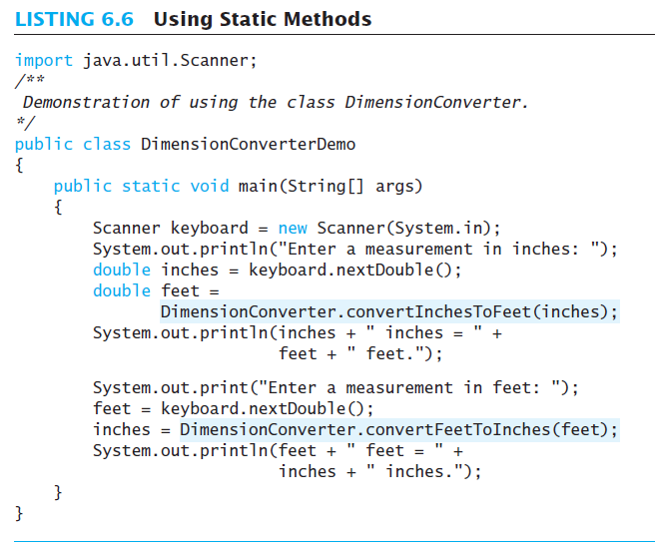
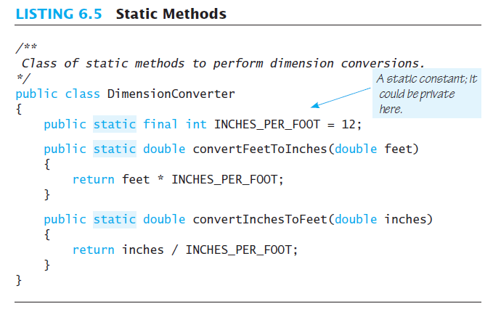
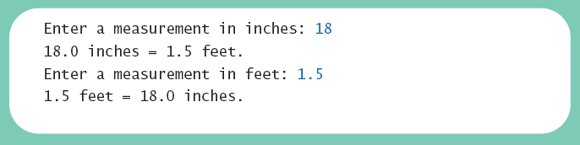
Static Methods
Sample
screen output

Slide 32
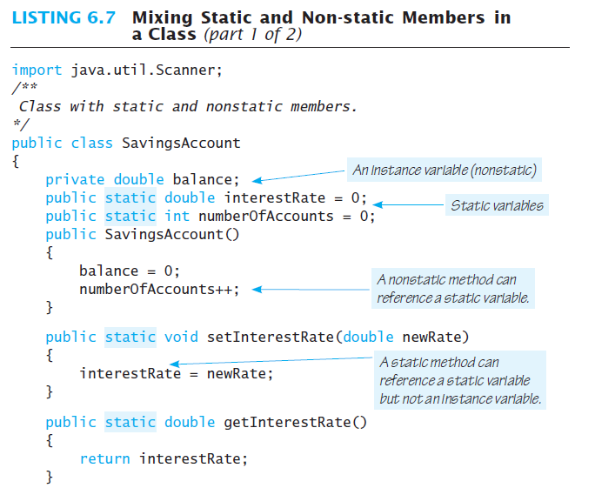
Mixing Static and Nonstatic Methods
Notes:
Remember: static variables belong to a class as a whole, they are shared with ALL instances (all objects created) of that class
Similarly static methods belong to a class and NOT to any specific object.
Therefore, a static method can not access non-static variables or non-static methods directly, UNLESS they are accessed through an appropriate object. (see next slide)

Slide 33
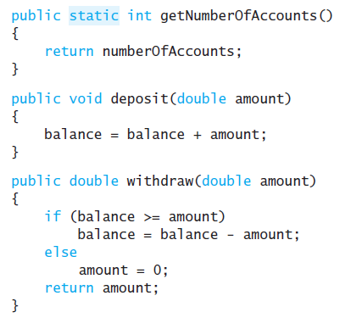
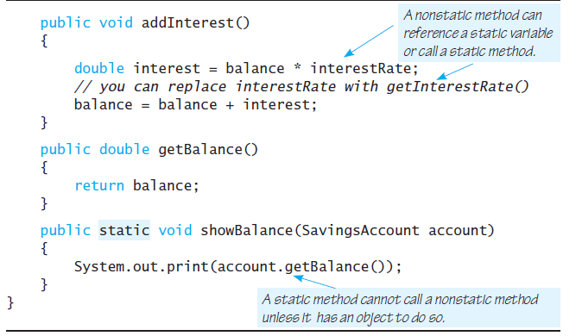
Mixing Static and Nonstatic Methods

Slide 34
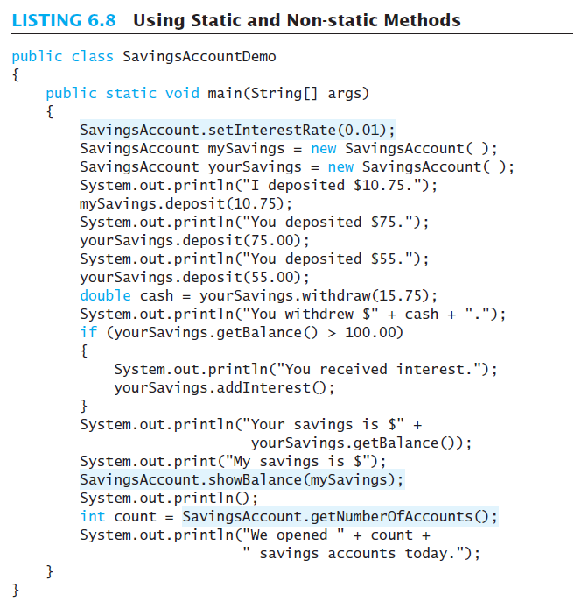
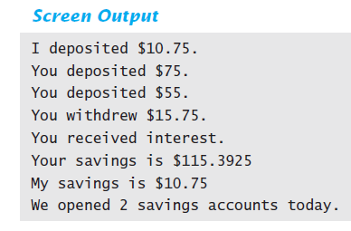
Mixing Static and Nonstatic Methods

Slide 35
Tasks of main in Subtasks
Program may have
  Complicated logic
  Repetitive code
Create static methods to accomplish subtasks
Consider example code, listing 6.9
a main method with repetitive code
Note alternative code, listing 6.10
uses helping methods
Notes:
Since main is a static method, other methods that we want to be able to use inside the main method have to be static too

Slide 36
Tasks of main in Subtasks
public class RectangleTest {
  public static void main(String[] args) {
  Rectangle box1 = new Rectangle(5, 10 , "Black");
  Rectangle box2 = new Rectangle(5, 10, "Red");
  if(box1.equals(box2))
    System.out.println("Math with equals method");
  else
  System.out.println("Do not match with equals method");
  // change the color of box 2 to Black
  box2.setColor("Black");
  if(box1.equals(box2))
  System.out.println("Math with equals method");
  else
  System.out.println("Do not match with equals method");
  }
}
  Repetitive code

Slide 37
Tasks of main in Subtasks
public class RectangleTest {
  public static void main(String[] args) {
  Rectangle box1 = new Rectangle(5, 10 , "Black");
  Rectangle box2 = new Rectangle(5, 10, "Red");
  testEqualsMethod(box1, box2);
  // change the color of box 2 to Black
  box2.setColor("Black");
  testEqualsMethod(box1, box2);
  }
  private static void testEqualsMethod(Rectangle r1, Rectangle r2) {
    if(r1.equals(r2))
    System.out.println("Math with equals method");
    else
    System.out.println("Do not match with equals method");
  }
}
  Calling one static method
Sample screen output
Do not match with equals method
Math with equals method

Slide 38
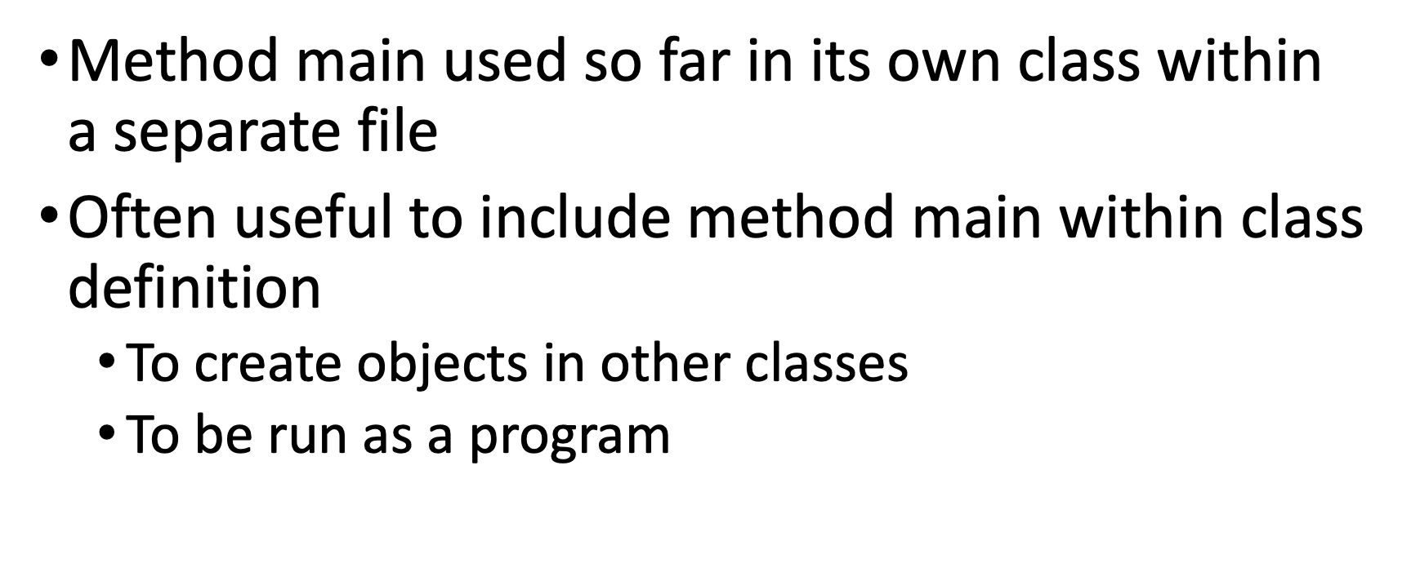
Adding Method main to a Class

Slide 39
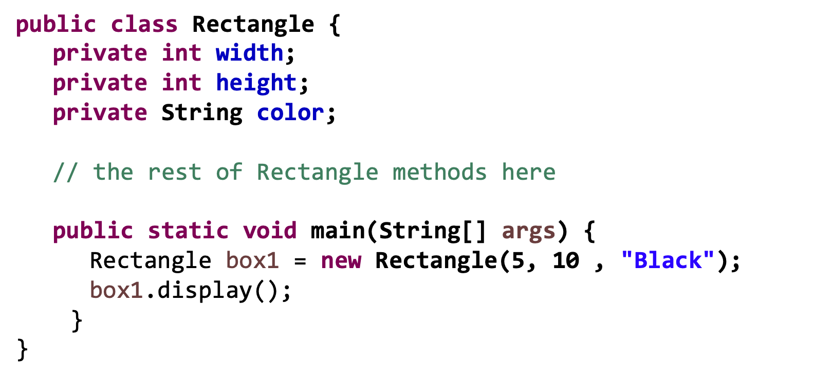
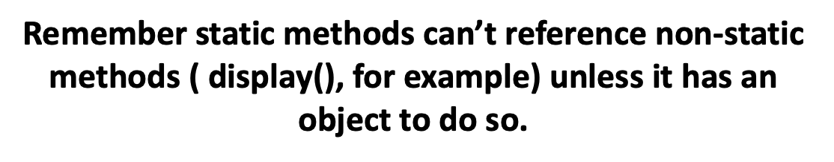
Adding Method main to a Class

