Slide 1
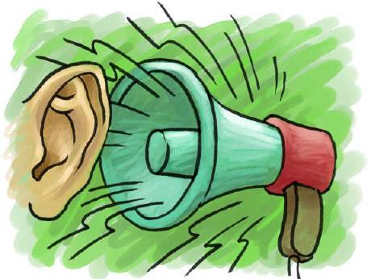
Other sources of pollution
Lecture 8

Slide 2
Outline
Describe additional sources of environmental threats to human health
  Radiation
  Thermal
  Light
  Noise

Slide 3
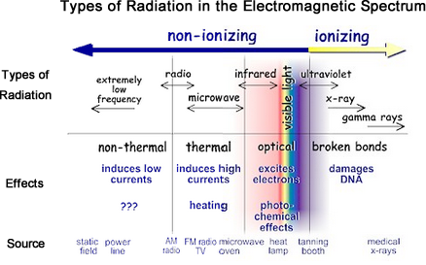
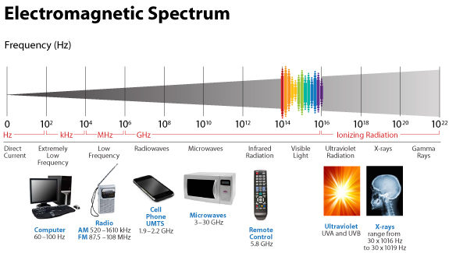
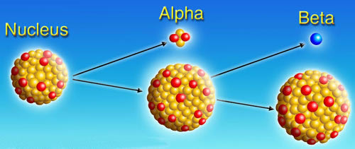
Radiation
  A radioactive element is unstable and its atomic nucleus spontaneously breaks down into smaller particles.
  Radiation is the energy that radioactive materials matter give off in the form of waves or high-moving particles.

Slide 4
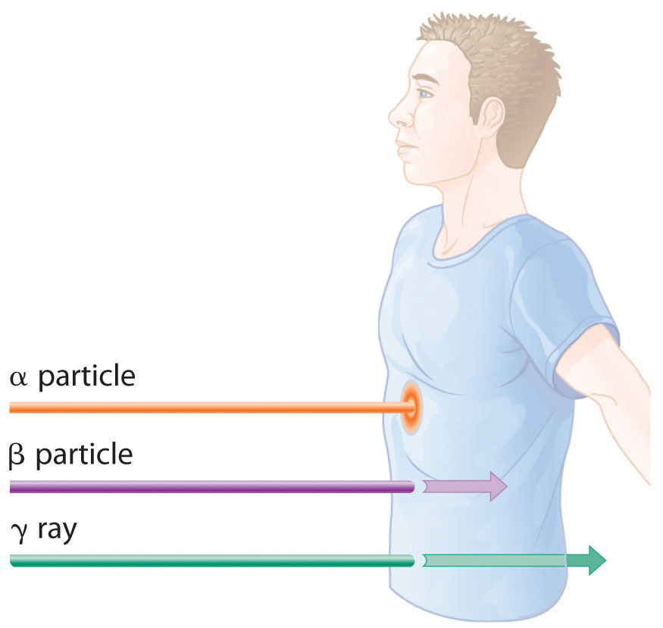
Radiation
Radioactive contamination and radiation exposure occur when radioactive materials are released into the environment.
Objects or living organisms become contaminated when a radioactive material is deposited in or on them.
  Air, water, soil, plants, buildings, people, or animals.
When a person is exposed to radiation, the energy that radioactive materials give off penetrates the body – CT scan.
Exposure does not necessarily lead to contamination.

Slide 5
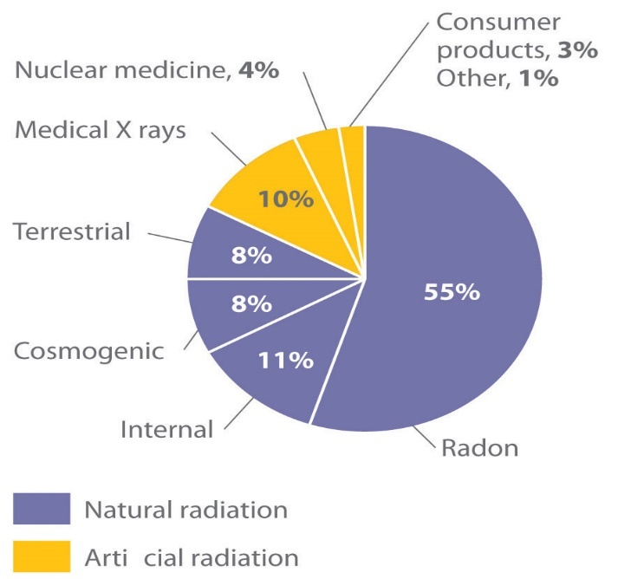
Radiation
Radiation Exposure of a Typical Adult in the United States
Types of exposure
Continuous – constant exposure to radioactive materials. Protective clothing is necessary.
  Uranium/phosphate mines, nuclear labs and plants.
Accidental – failure of protective equipment.
  Accidents and radiation leaks.
Artificial radiation
Occasional – can happen during isolated experiments or tests with radioactive substances.
  Medical tests, x-rays, CT scans.

Slide 6
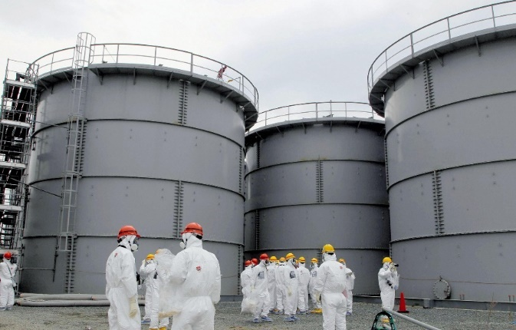
Radiation
Types of contamination
External – radioactive material, in the form of dust, powder, or liquid, comes into contact with the skin, hair, or clothing.
  External contamination can become internal.
Internal – the radioactive materials enter the body through inhalation, ingestion or through a skin wound.
  Radioactive materials may bioaccumulate in different body organs, while others are eliminated via blood, sweat, urine, and/or feces.

Slide 7
Radiation
Types of radiation
Non-ionizing radiation causes atoms in molecules to vibrate. It deposits energy in the materials as it passes, but it does not change their internal structure.
  Electromagnetic radiation.
  Visible light, infrared radiation (heat), microwaves, radio waves, low frequency radiation (from power lines).
Ionizing radiation has more energy than non-ionizing radiation, can remove electrons from atoms and may cause changes in living cells of living organisms.
  UV rays (*), X-rays, gamma rays, and cosmic rays are potentially harmful.
    Can be used to generate electric power, kill cancer cells, or to perform medical tests.

Slide 8
Radiation
  The amount of radiation absorbed by an individual depends on
    Individual susceptibility
      Age
      Genetics
    Amount of exposure
      Total amount of time exposed to the source.
      Distance from the source.
      Degree of radioactivity of the material.

Slide 9
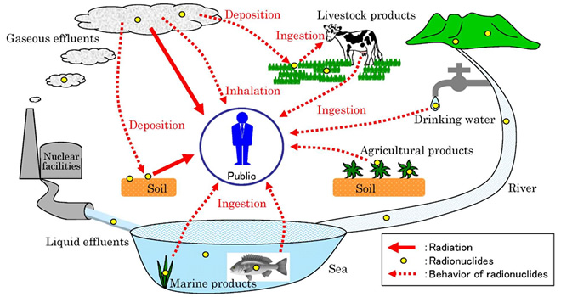
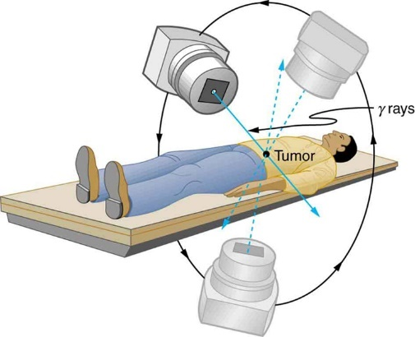
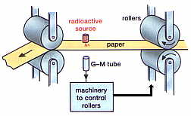
Radiation
Sources of man-made radioactive pollution
  Mining of radioactive materials (uranium from phosphate deposits).
  Coal ash from coal burning and release of radioactive particles in the air.
  Military applications – nuclear weapons.
Nuclear waste.
Nuclear medicine – radioactive isotopes used in medical treatment and diagnostics.
  Consumer products and industrial applications.

Slide 10
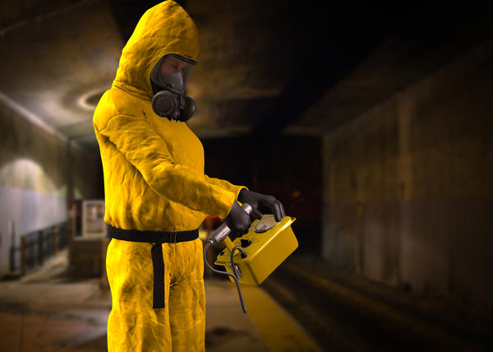
Radiation
Effects on humans
  Ionizing radiation exposure
    Low levels of exposure for a short time usually do not produced immediate detectable harm.
    Chronic low-level exposure over long periods can lead to cancer years after exposure.
      Skin, lung and thyroid cancers.
  Extent of damage is associated with the magnitude of the dose.
  Skin redness, hair loss, radiation burns, nausea, weakness in acute exposure.
  Acute radiation syndrome – loss of appetite, fatigue, fever, nausea, vomiting, diarrhea, and possibly even seizures and coma after high dose of radiation in a short time.

Slide 11
Radiation
  Skin and bone marrow cells are more sensitive to radiation because these cells grow and divide rapidly.
Children and adolescents at higher risk – more sensitive to radiation exposure than adults.
Acute dose exposure and brain damage in fetuses between weeks 8 to 25 of pregnancy.
Risk of developing cancer after radiation exposure is the same for fetuses and infants.
Effects on humans
Damage to tissues/organs depends on the absorbed dose, the type of radiation and the sensitivity of the tissues/organs.
  Risk is proportional to the radiation dose.
  High levels of long-term exposure and DNA damage, and possibly death.

Slide 12
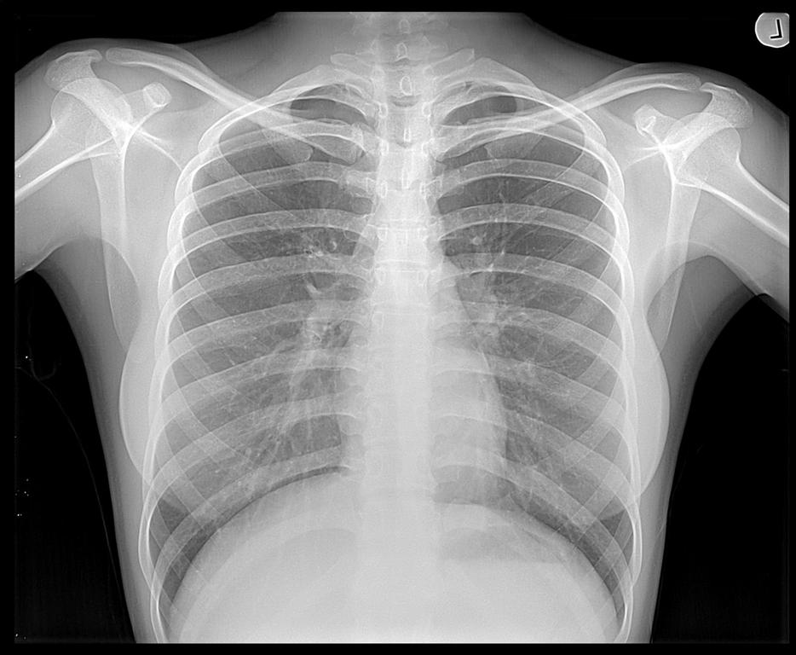
Radiation
Effects on humans
A single chest x-ray exposes a person to the radiation dose people are naturally exposed to over the course of about 10 days.
A mammogram exposes a woman to the amount of exposure a person would expect to get in about 7 weeks.
Non-ionizing radiation and skin burns, eye injuries, nausea and vertigo from electromagnetic fields.

Slide 13
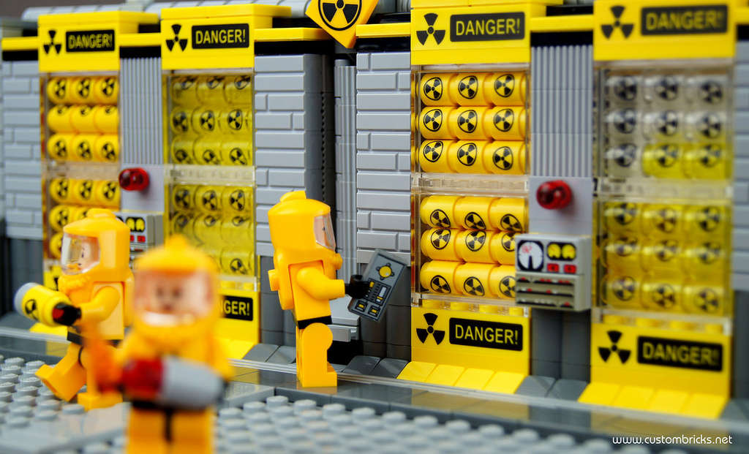
Radiation
Prevention
Use of adequate protective gear and measures to prevent exposure and/or contamination.
Nuclear medicines and radiation therapies should be used only if necessary and at the minimum effective dose.
Strict control of operations involving mining, operating with, destroying and disposing of radioactive materials.

Slide 14
Radiation
Bioremediation
Microbial bioremediation – uses bacteria to convert uranium found in contaminated water into an insoluble form for easy removal.

Slide 15
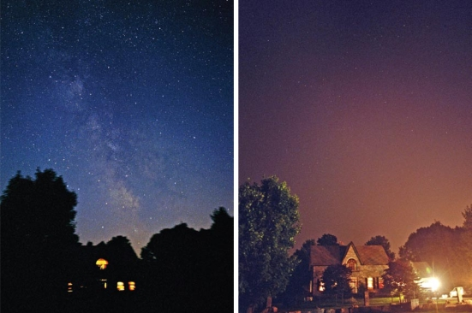
Light
Light pollution is the inefficient, annoying and/or excessive use of artificial lighting.
Group Activity (examples)
Types of light pollution
Sky glow is a brightening of the sky over the cities caused by light scattered by water droplets or particles in the air.
Glare is unshielded light that shines horizontally and causes discomfort.
Light clutter is bright, excessive and confusing grouping of lights.
Light trespass is light cast/spillover where it is not wanted or needed.
Over-illumination is the use of unnecessarily large amounts of artificial lighting.

Slide 16
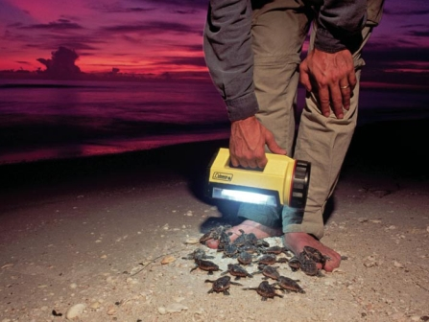
Light
Light pollution can adversely affect both human and wildlife health.
Light pollution has been shown to affect both flora and fauna.
  Ability of frogs to mate decreases when exposed to excessive night light.
  Bats alter their feeding behaviors and many small animals feed and mate and night.
    Night lights can disorient birds during their migration at night.
    Artificial light on beaches can disrupt and disorient sea turtles.
      (Keeping the females from laying their eggs).
    Prolonged exposure to artificial light alters seasonal changes in trees, affecting the wildlife that depend on them for habitat.

Slide 17
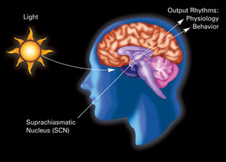
Light
Indoor light pollution is excessive exposure to indoor artificial light, which can negatively affect health.
The 24-hour day/night cycle, known as the circadian clock, affects physiologic processes in almost all organisms.
These processes include brain wave patterns, hormone production, cell regulation, and other biologic activities.
Disruption of the circadian clock is linked to several medical disorders in humans, including depression, insomnia, cardiovascular disease, and cancer.
Exposure of the retina to photons may disrupt circadian rhythm.

Slide 18
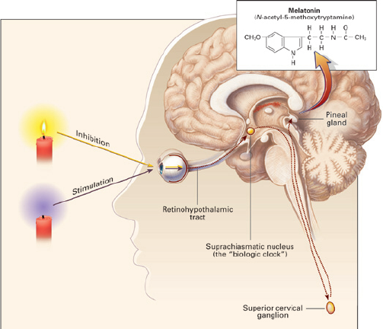
Light
Studies show that the circadian cycle controls from ten to fifteen percent of our genes.
Association between exposure to indoor artificial nighttime light and health problems such as breast cancer.
Night light exposure disrupts circadian and neuroendocrine systems, and accelerate tumor growth.
Melatonin is a hormone produced by the pineal gland. It is secreted at night and helps to regulate the body’s biologic clock.
Melatonin regulates many biologic activities, that may include a nocturnal reduction in the body’s production of estrogen.

Slide 19
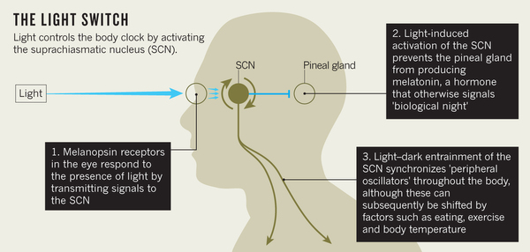
Light
Melatonin levels drop in the presence of artificial or natural light.
Studies suggest that decreasing production of melatonin at night increases an individual’s risk of developing cancer.
Increase in risk of breast and prostate cancers, obesity, and early-onset diabetes associated with increases in the amount and pattern of artificial light generated during the night and day.
  Rotating night shift work in women and increased breast cancer risk.

Slide 20
Light
Research into the effect of constant artificial light exposure in neonatal intensive care units on the developing circadian rhythm of premature babies.
Possible links between artificial light exposure and insomnia and depression.
Prevention/Remediation
  Lighting what is needed, when it is needed, and to the appropriate level.
  Control light/dark patterns for sleep and wakefulness.
    Maintaining a constant shift appears less harmful than rotating shifts.

Slide 21
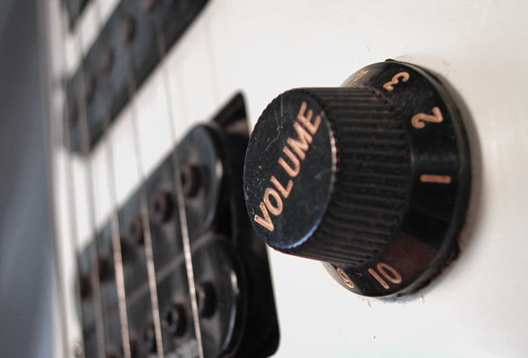
Noise
Noise is any unwanted sound that is loud, unpleasant or unexpected and that disrupts normal life and can harm physical and mental health.
  Human, animal or machine-created.
  It can interfere with sleep, concentration, communication, and recreation.
  “Noise must be recognized as a major threat to human well- being.” (WHO)
Sources
  Loud voices, animal sounds.
  Transportation systems, roads, vehicles.
  Construction and industrial equipment and activities.
  Household appliances, medical equipment, electronic devices, toys, loud speakers.

Slide 22
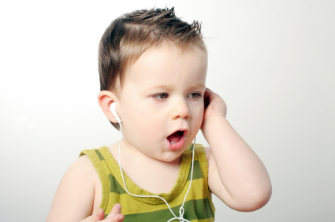
Noise
Susceptible groups
Anyone, but specially vulnerable are newborns, infants, children, those with mental or physical illnesses, and the elderly.
Noise in the NICU may cause cochlear damage and may impair the growth and development of the premature infant.
The effects of noise on the fetus and newborn are unclear.
Exposure to noise during pregnancy may increase the risk of high-frequency hearing loss in the newborn, shortened gestation, prematurity, and intrauterine growth retardation.

Slide 23
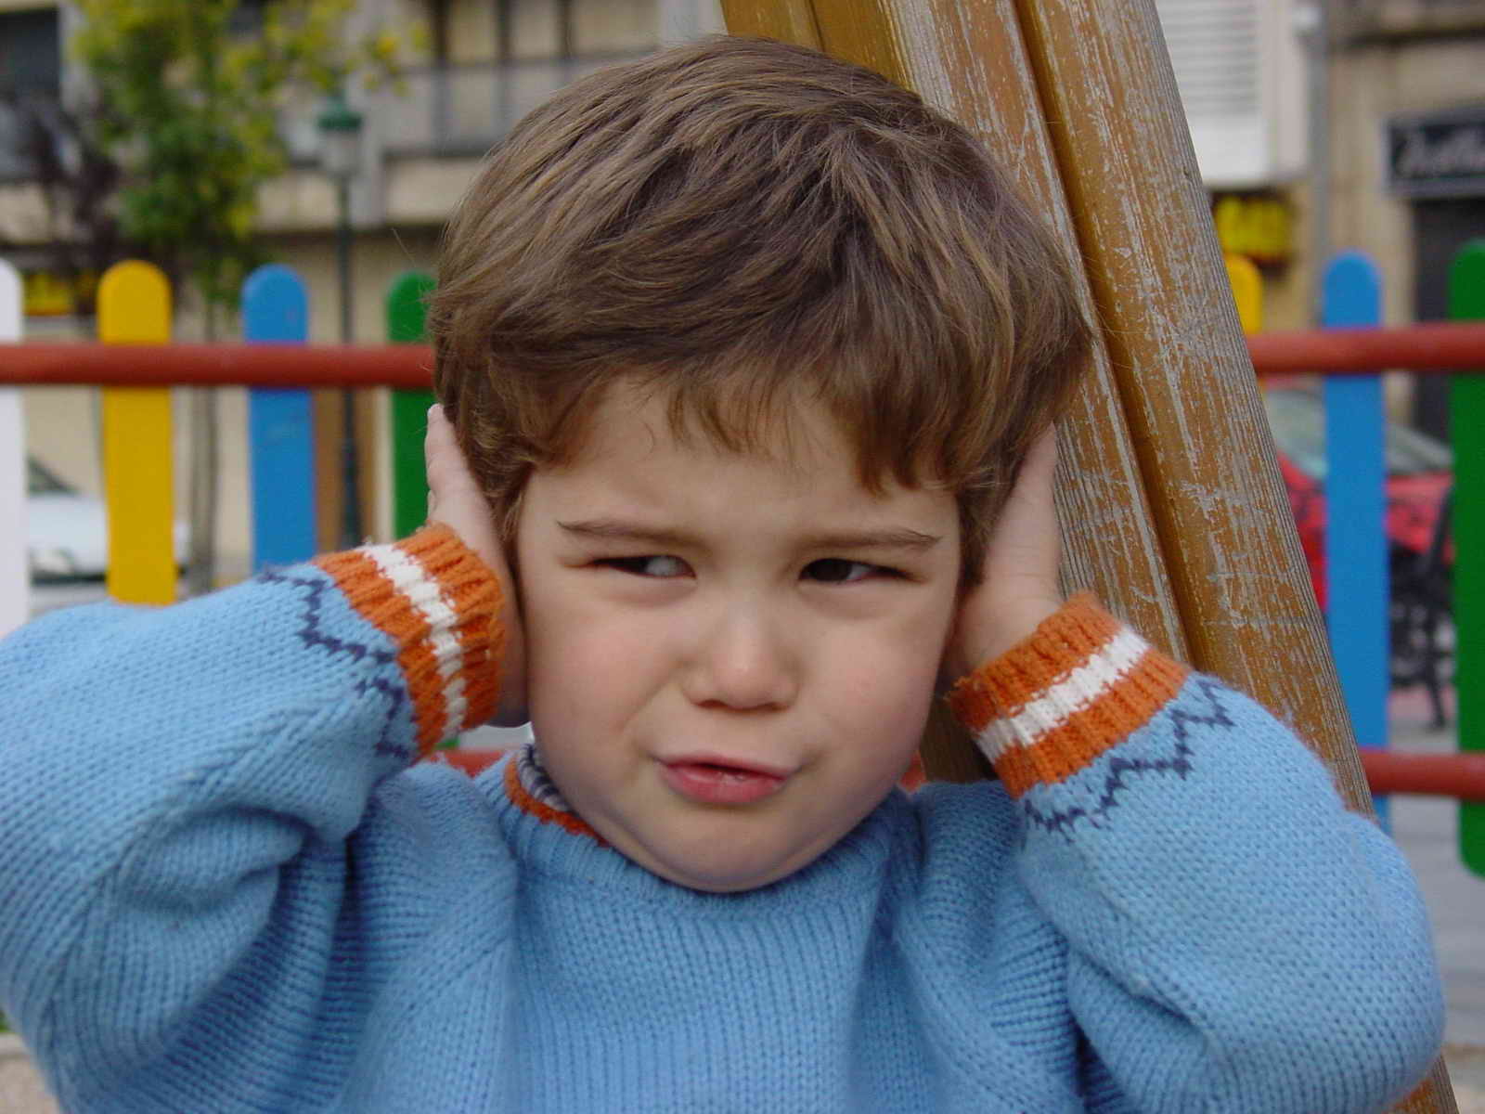
Noise
Susceptible groups
Hearing loss is not just an ailment of old age. It can strike at any time and any age, even childhood.
Children’s vulnerability to noise may be because of their age, stage of development and behavior.
  Use of loud toys and electronics, lack of self-control.
In children, even a mild or moderate case of hearing loss could bring difficulty learning, developing speech and building interpersonal life skills.
There is no cure for hearing loss caused by noise as hearing aids do not restore noise-damaged hearing.

Slide 24
Noise
Health effects
Disturbances in mental health.
Aggressivity and negative social behavior.
Depression.
Memory losses.
Panic attacks.
Affects spoken communication.
Affects learning and concentration.
Increased risk of accidents.
Hearing losses.
Tinnitus – ringing in the ears.
Sleep disturbances.
High blood pressure.
Cardiovascular problems.
Fatigue.
Elevated levels of stress-induced hormones.
Chronic stress.

Slide 25
Noise
Average decibel levels for everyday noises.
DECIBELS | SOUND CATEGORY | EXPOSURE | EFFECTS
30 | Faint | Whisper, quiet library | Exposure will not lead to hearing loss, no matter the amount of time.
40-60 | Moderate | Moderate rainfall, normal conversation | Exposure will not lead to hearing loss, no matter the amount of time.
70-90 | Very loud | Loud shouts, vacuum cleaner, blow dryer, food processor.. | Above this level of exposure, the noise can be uncomfortable and exposure over a length of time causes hearing loss – weeks, months or years. No pain at this level of exposure.
90-110 | Extremely loud | Power tools, motorcycle.
Above 120 | Painful | Exposure over a short period of time causes hearing loss – rock concert, siren, jet plane takeoff, maximum output from electronics, jackhammer. | Tinnitus (ringing in the ears) may occur after an exposure at this level. Discomfort threshold is 120 dB. Above this level exposure over a short period of time causes hearing loss. Pain threshold is above 140 dB. A single exposure may cause permanent hearing loss.
This is how long it takes before a particular sound level causes damage to the human ear.

Slide 26
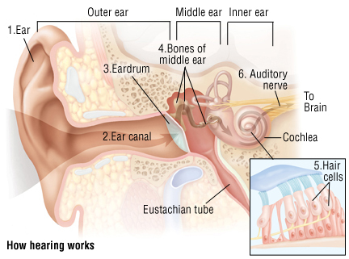
Noise
Noise-Induced Hearing Loss (NIHL) can happen from a one-time exposure to a loud sound or by repeated exposure to sounds at various loudness levels over a long time.
Exposure to loud sound over time causes the microscopic hair cells inside the cochlea to get damaged or broken, leading to hearing loss.
Different groups of hair cells are responsible for different frequencies (rate of vibrations). The high frequency area of the cochlea is often damaged by loud sound.

Slide 27

Noise
When listening to music on earphones at maxiumum volume level, the sound generated reaches a level of over 100 dB, loud enough to begin to cause permanent damage after just 15 minutes per day!
Cases of noise-induced hearing loss and/or tinnitus can also happen in children.
Noise-induced hearing loss is usually gradual and painless but permanent.
Once destroyed, the hearing nerve and its sensory nerve cells do not repair.
Not such a thing as “getting used” to a high noise level.
  It may mean that some hearing damage may have already occurred.

Slide 28
Noise
Do not listen to loud sounds for too long.
  If you don’t have hearing protection, move away from the loud sound.
Lower the loudness of the sound.
  Keep personal listening devices set to no more than half volume.
Purchase quieter products.
  Look for noise ratings on appliances and other products – especially important for children’s toys.
Encourage others to keep the volume down.
Preventing hearing damage
Wear hearing protection
  Earmuffs or earplugs can reduce noise by up to 15-30 dB.
  Earplugs are placed into the ear canal so that they totally block the canal.
  Earmuffs fit completely over both ears. They must fit tightly so that sound is blocked from entering the ears.
  Earplugs and earmuffs can be used together to achieve greater sound reduction.

Slide 29
Noise
When around loud sounds, use hearing protection (ear plugs or ear muffs).
Allow children to nap in quiet – do not play music or use white nose machines while children are sleeping.
Place noisy activities away from “quiet areas” reserved for learning activities requiring concentration.
Monitoring programs in schools and elsewhere to protect children from noise exposure.
International Noise Awareness Day 2016: Wednesday, April 27
Reducing noise
Turn off appliances if not needed.
Reduce the volume level of electronics.
Avoid playing music as white noise.
Install sound-proof windows, and noise absorbent materials on ceilings and walls – wall quilts and carpeting, cork board.
Close windows and doors to shut out outdoor loud noise.
Avoid places and activities that have high levels of noise.

Slide 30
References
On the risk to low doses (<100 mSv) of ionizing radiation during medical imaging procedures - IOMP policy statement http://www.ncbi.nlm.nih.gov/pmc/articles/PMC3683301/
Chepesiuk, R. Missing the Dark: Health Effects of Light Pollution.Environ Health Perspect. 2009. Jan; 117(1): A20–A27.
PMCID: PMC2627884
How Light Pollution Affects Human Health http://physics.fau.edu/observatory/lightpol-health.html
Microwave Oven Radiation http://www.fda.gov/Radiation-EmittingProducts/ResourcesforYouRadiationEmittingProducts/ucm252762.htm Page Last Updated: 10/08/2014
http://www.who.int/ceh/capacity/noise.pdf
Radiation basics http://www.nrc.gov/about-nrc/radiation/health-effects/radiation-basics.html
What is ionizing radiation? http://www.who.int/ionizing_radiation/about/what_is_ir/en/
http://www.who.int/topics/radiation_non_ionizing/en/
Eco-healthy child care. Noise pollution. https://www.ucdmc.ucdavis.edu/mindinstitute/resources/resources_pdf/Noise_Pollution_7_14.pdf
Radioactive contamination and radiation exposure http://ccnmtl.columbia.edu/projects/eprep/radiological/partidx_09_01.html
American Speech Language Hearing Association http://www.asha.org/public/hearing/Noise/

