Slide 1
Object-Oriented Programming-Inheritance
Binhadba Edit

Slide 2
Object-Oriented Programming (OOP)
An object-oriented programming language has three core technologies namely encapsulation, inheritance and polymorphism.

Slide 3
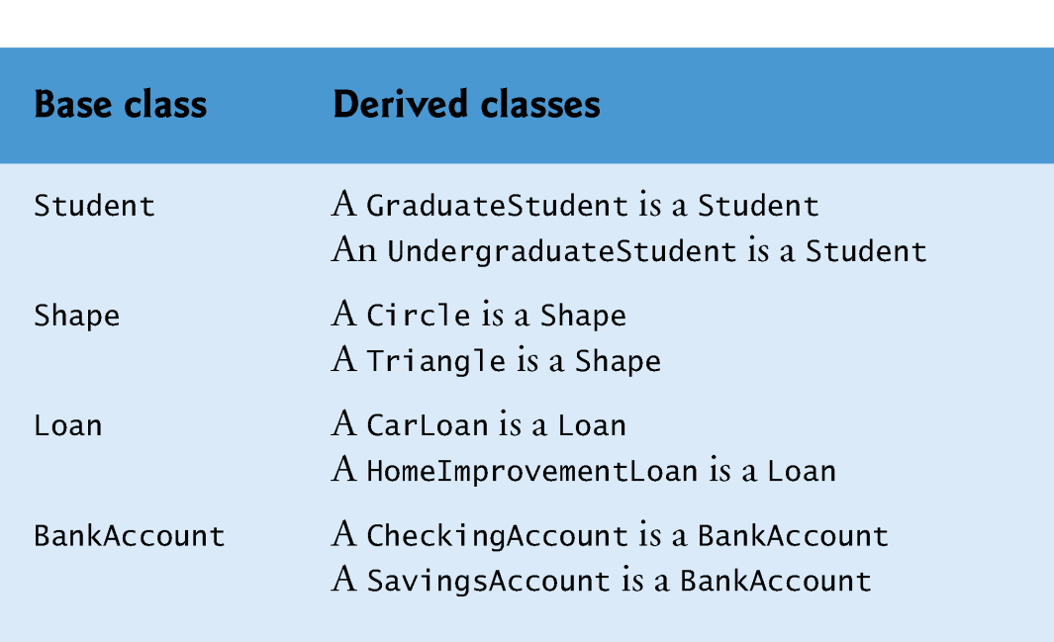
Base Classes and Derived Classes

Slide 4
Inheritance in VB
Inheritance in Visual Basic allows us to design child classes, that take characteristics of the parent class.
It helps in promoting code re-usability.
The child class is called as Derived class or Sub class. The parent is called as Base class.
A derived class can add its own instance variables, shared variables, properties and methods, and it can customize methods and properties it inherits.

Slide 5
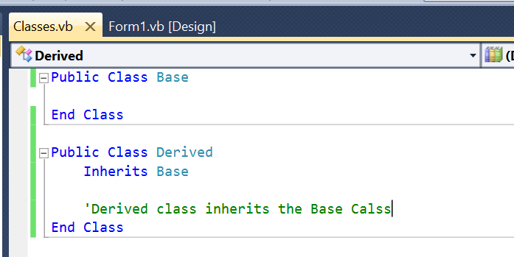
Declare Inheritance

Slide 6
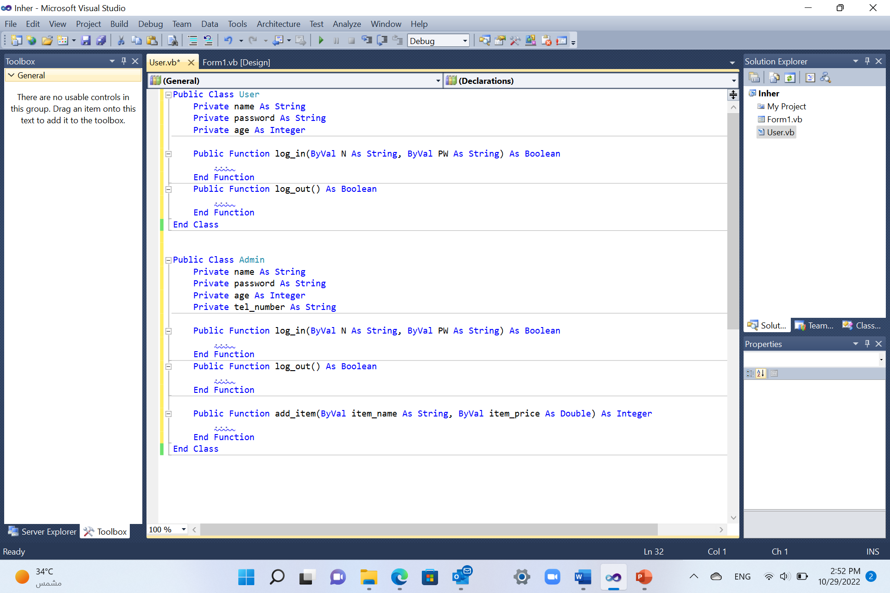


Example

Slide 7
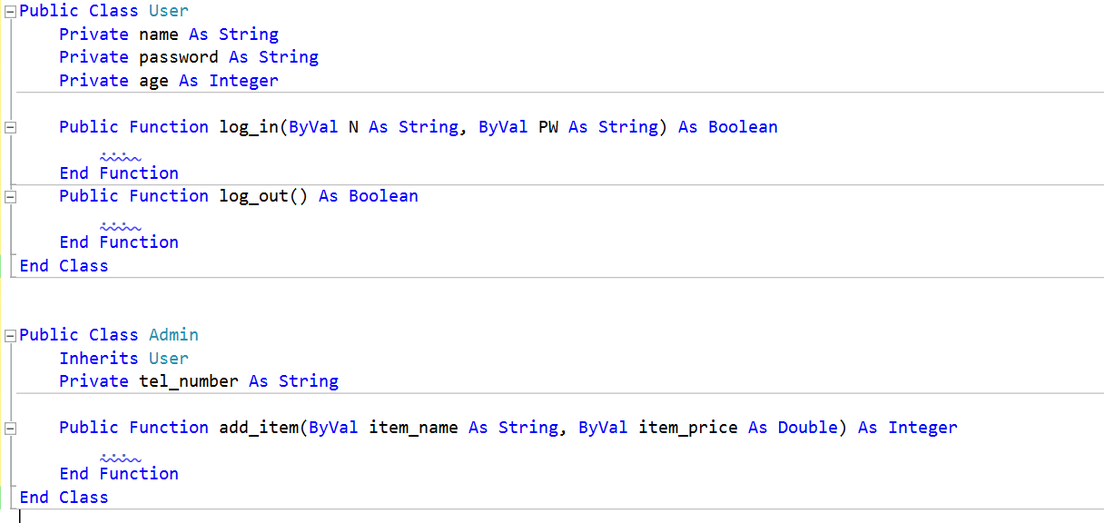



Example (Cont.)

Slide 8
Inheritance Modifiers
Visual Basic introduces the following class-level statements and modifiers to support inheritance:
Inherits statement — Specifies the base class.
NotInheritable modifier — Prevents programmers from using the class as a base class.
MustInherit modifier — Specifies that the class is intended for use as a base class only. Instances of MustInherit classes cannot be created directly; they can only be created as base class and instances can be only made from derived class.

Slide 9
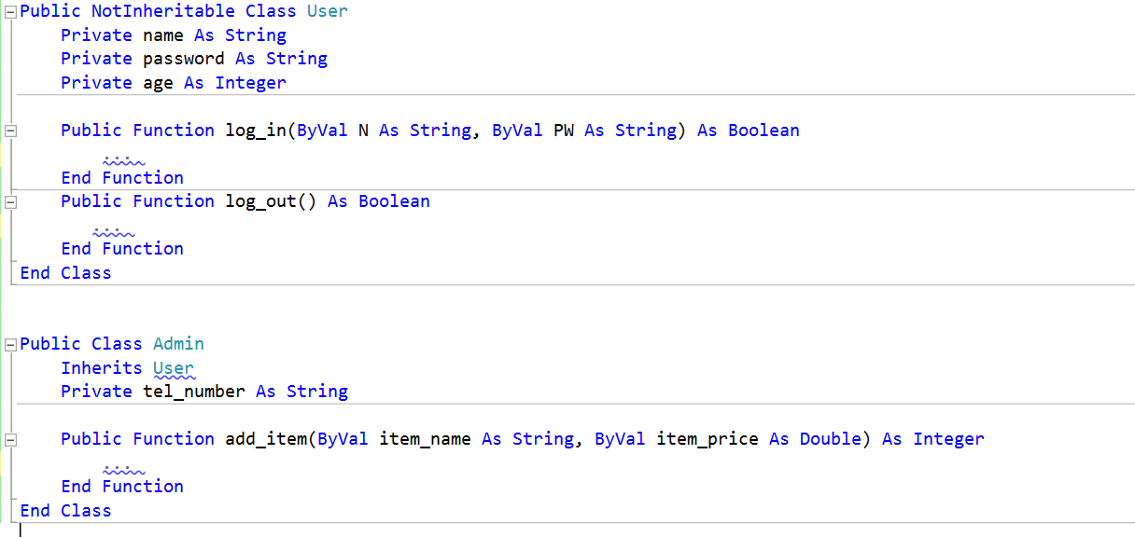
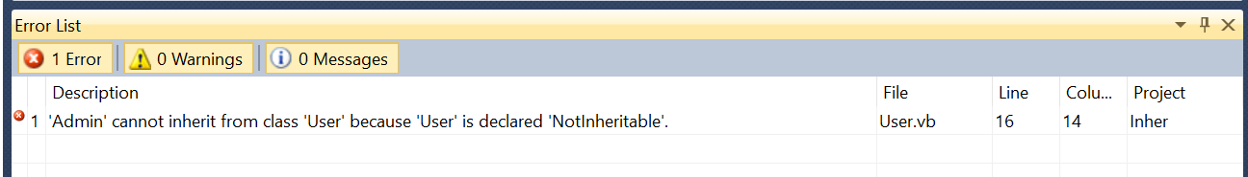


Inheritance Modifiers: NotInheritable

Slide 10
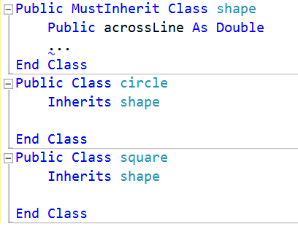
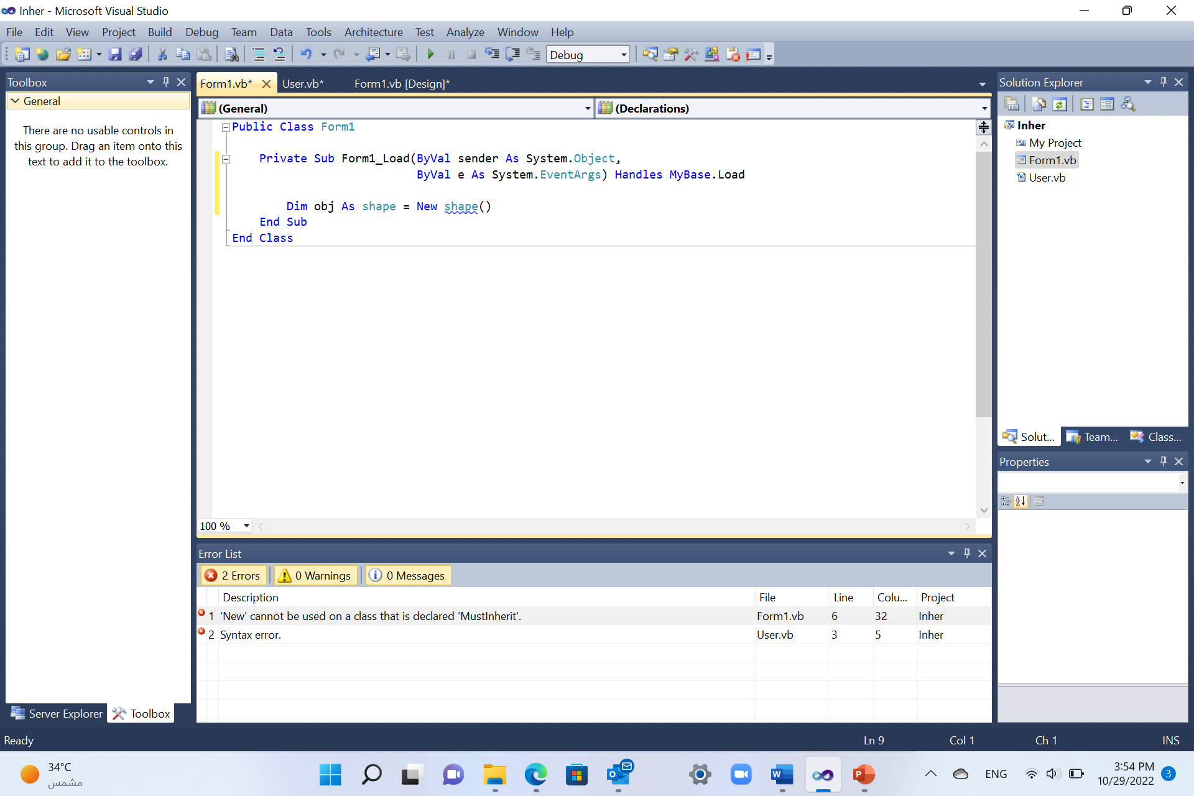




Inheritance Modifiers: MustInherit

Slide 11
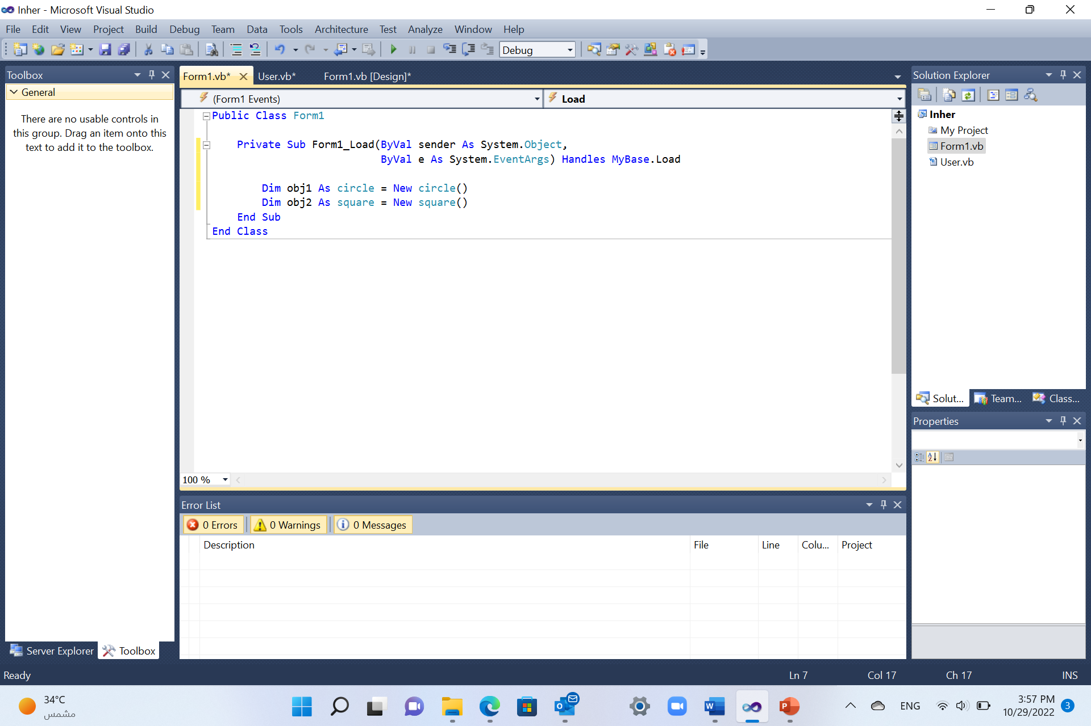




Inheritance Modifiers: MustInherit

Slide 12
Overriding Properties and Methods in Derived Classes
By default, a derived class inherits properties and methods from its base class.
If an inherited property or method has to behave differently in the derived class it can be overridden. That is, you can define a new implementation of the method in the derived class.

Slide 13
Overriding Modifiers
Overridable — Allows a property or method in a class to be overridden in a derived class.
Overrides — Overrides an Overridable property or method defined in the base class.
NotOverridable — Prevents a property or method from being overridden in an inheriting class. By default, Public methods are NotOverridable.
MustOverride — Requires that a derived class override the property or method. When the MustOverride keyword is used, the method definition consists of just the Sub, Function, or Property statement. No other statements are allowed, and specifically there is no End Sub or End Function statement.

Slide 14
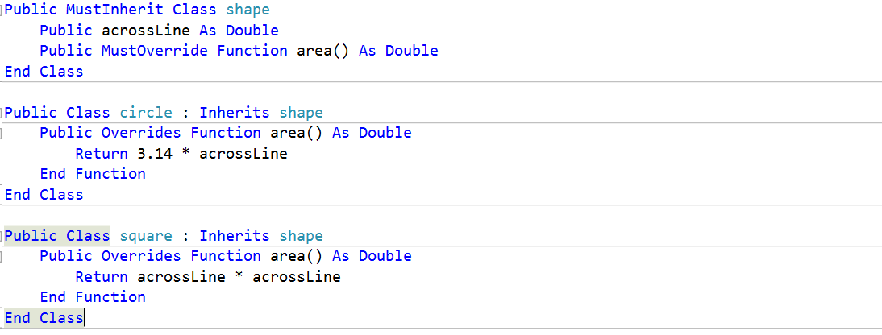
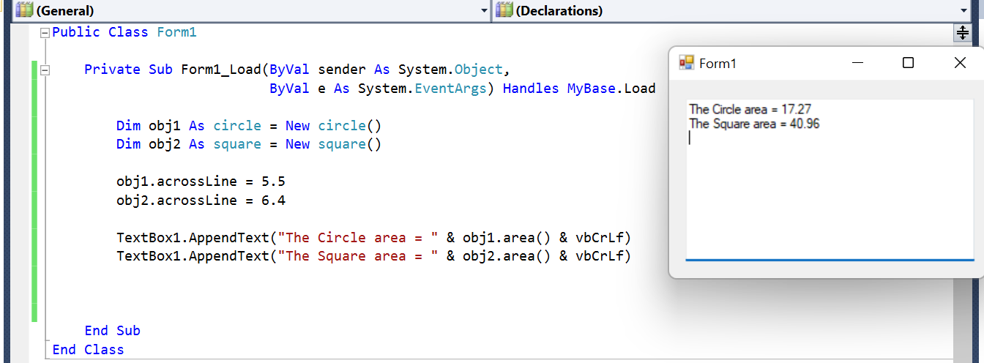





Example1

Slide 15
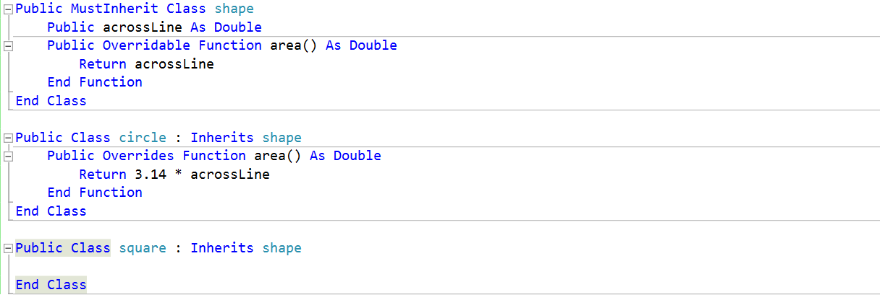
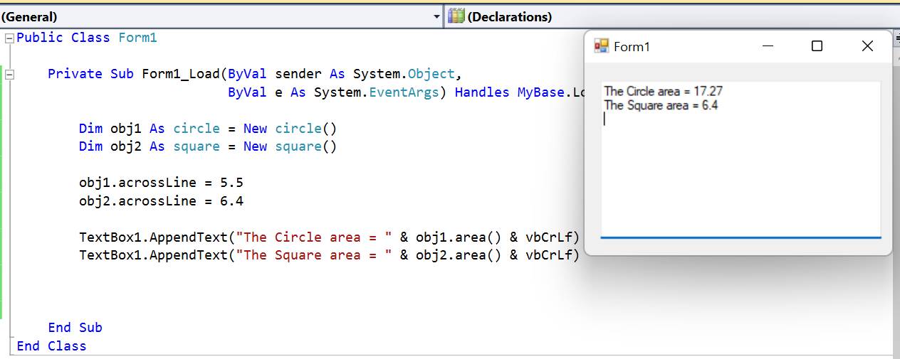




Example2

Slide 16
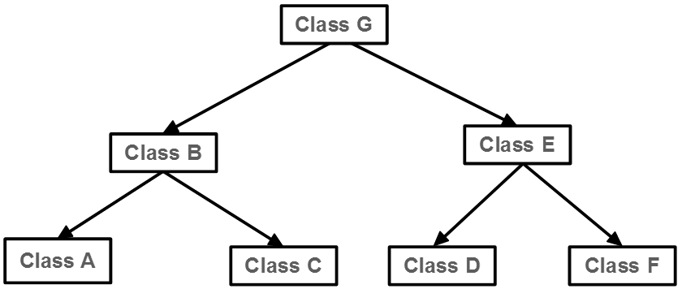
Inheritance Hierarchy
A direct base class is the class from which a derived class explicitly inherits (e.g. B inherits from G directly).
An indirect base class is inherited from two or more levels up in the class hierarchy. (e.g. A inherits from B, thus it inherits from G indirectly)

Slide 17
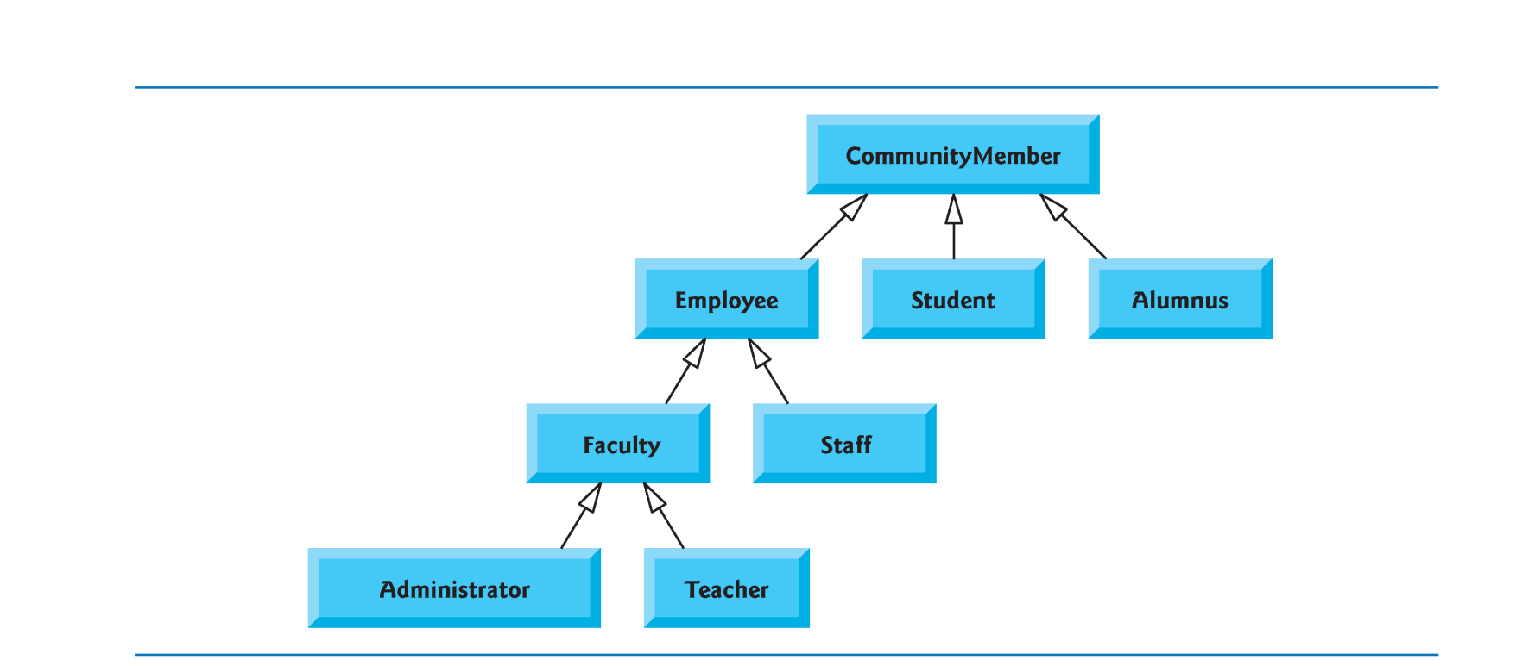
Example: CommunityMember Inheritance Hierarchy

Slide 18
The MyBase Keyword
The MyBase keyword behaves like an object variable that refers to the base class of the current instance of a class.
MyBase is frequently used to access base class members that are overridden or shadowed in a derived class.
MyBase refers to the immediate base class and its inherited members. It cannot be used to access Private members in the class.
MyBase is a keyword, not a real object.

Slide 19
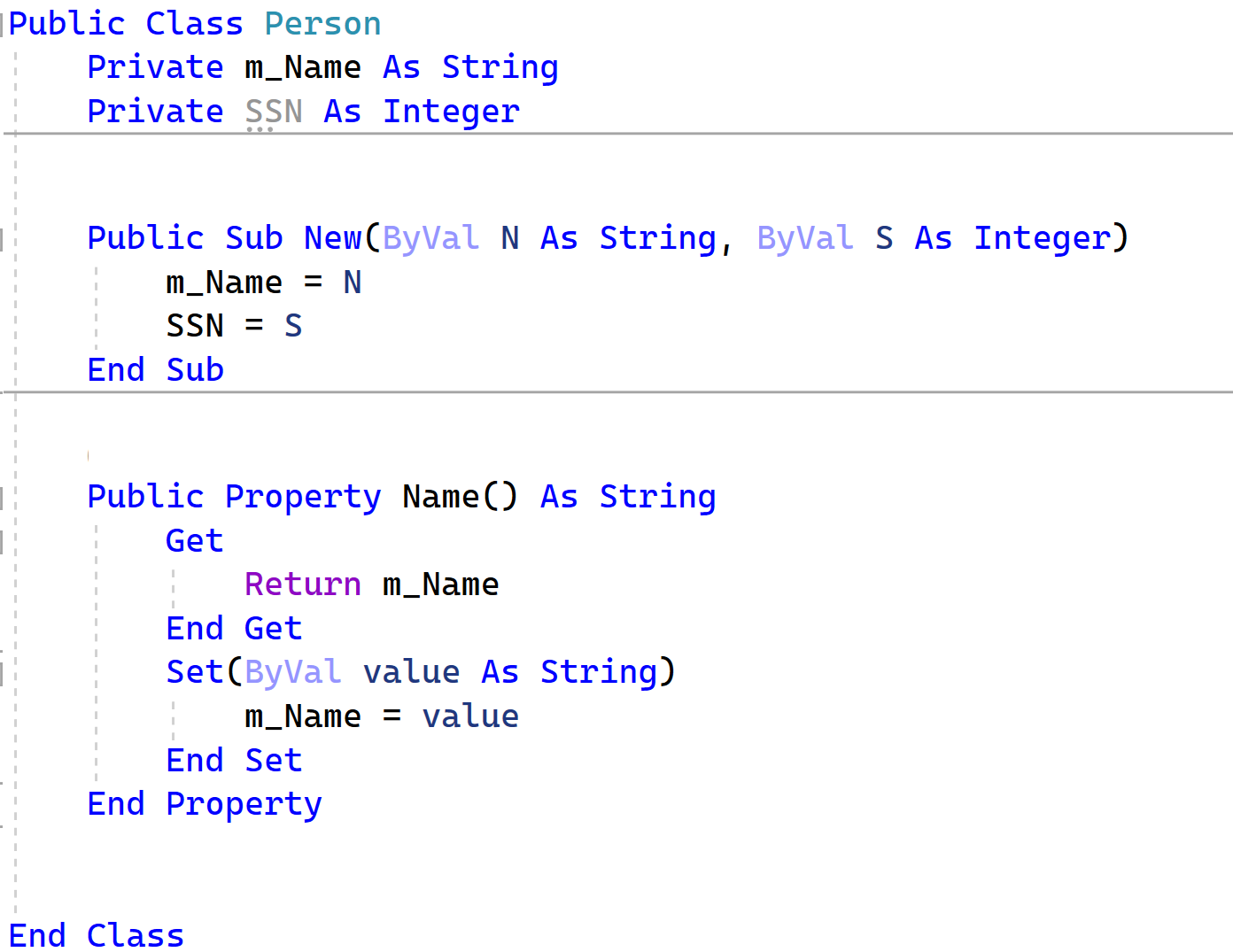
Example

Slide 20
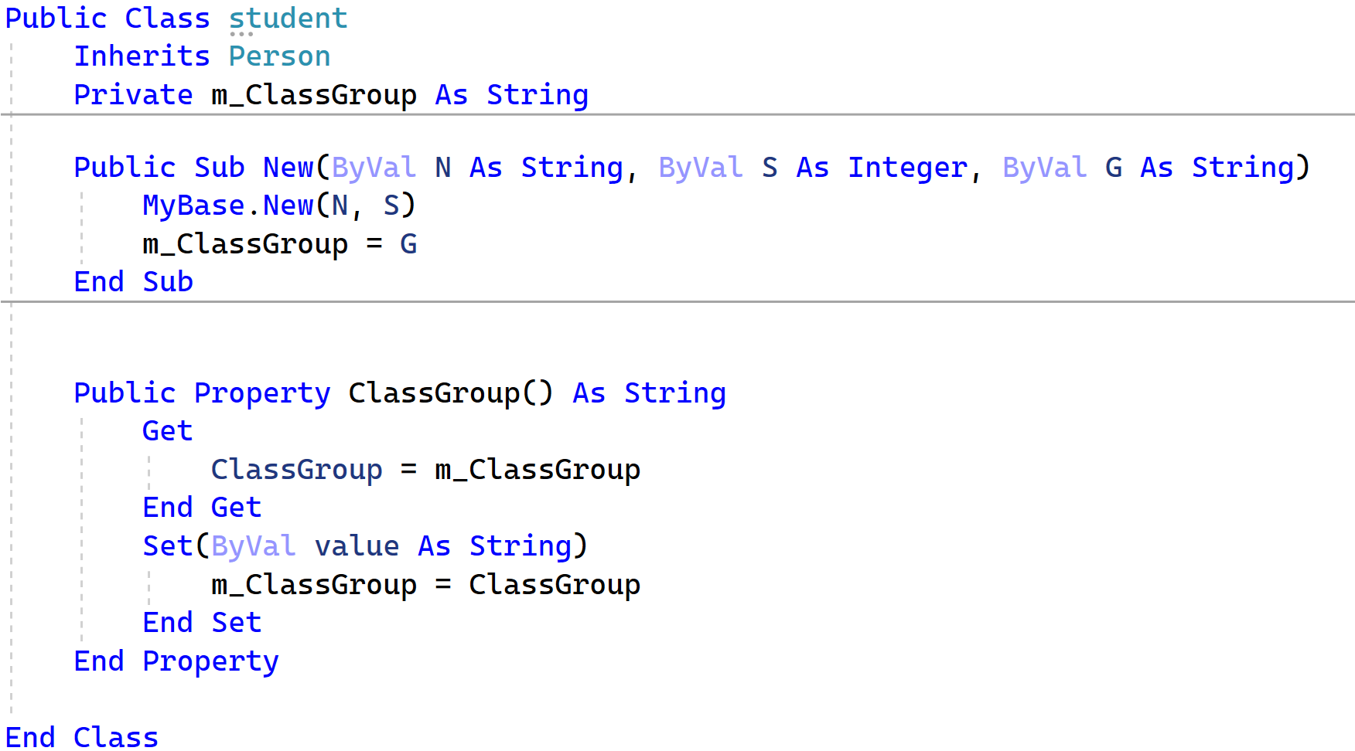
Example

Slide 21
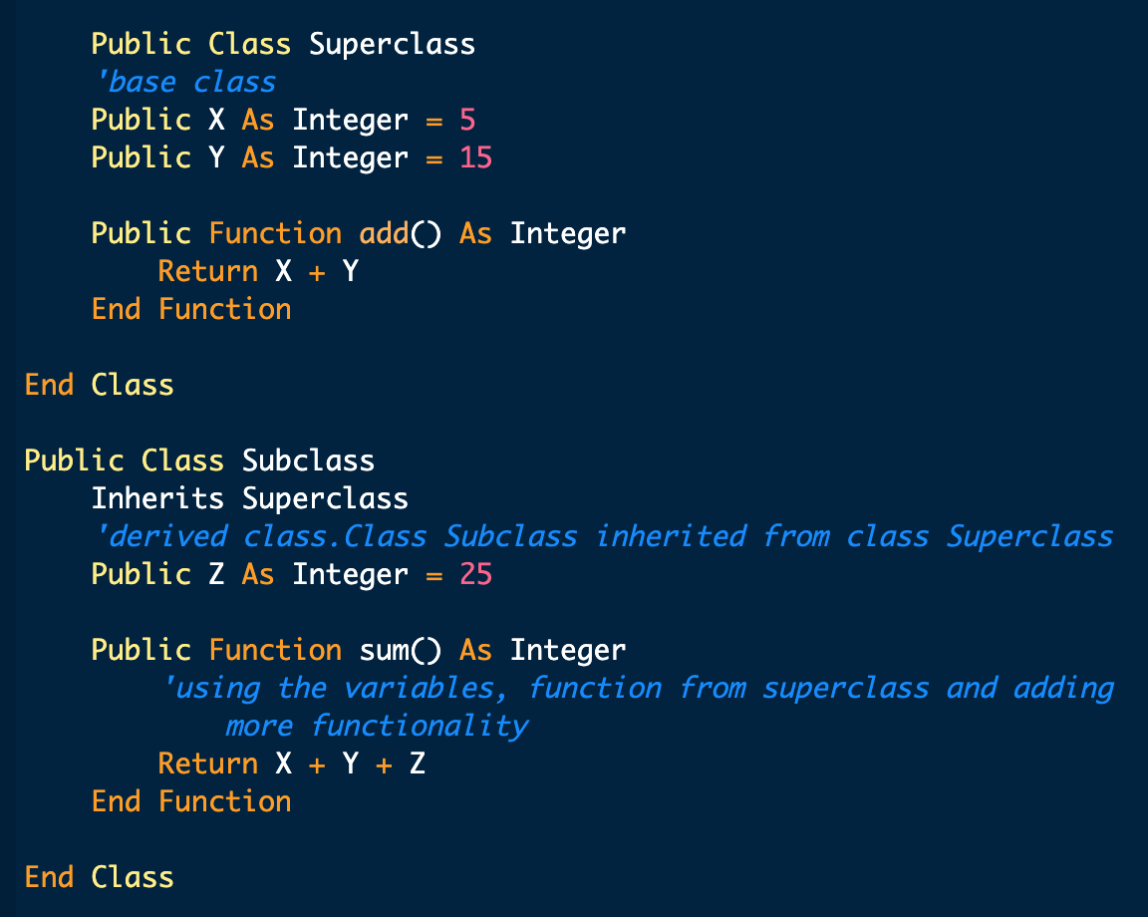
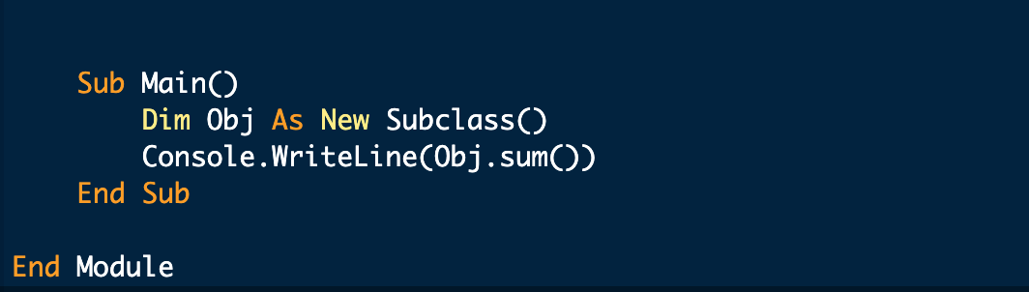
Example

Slide 22
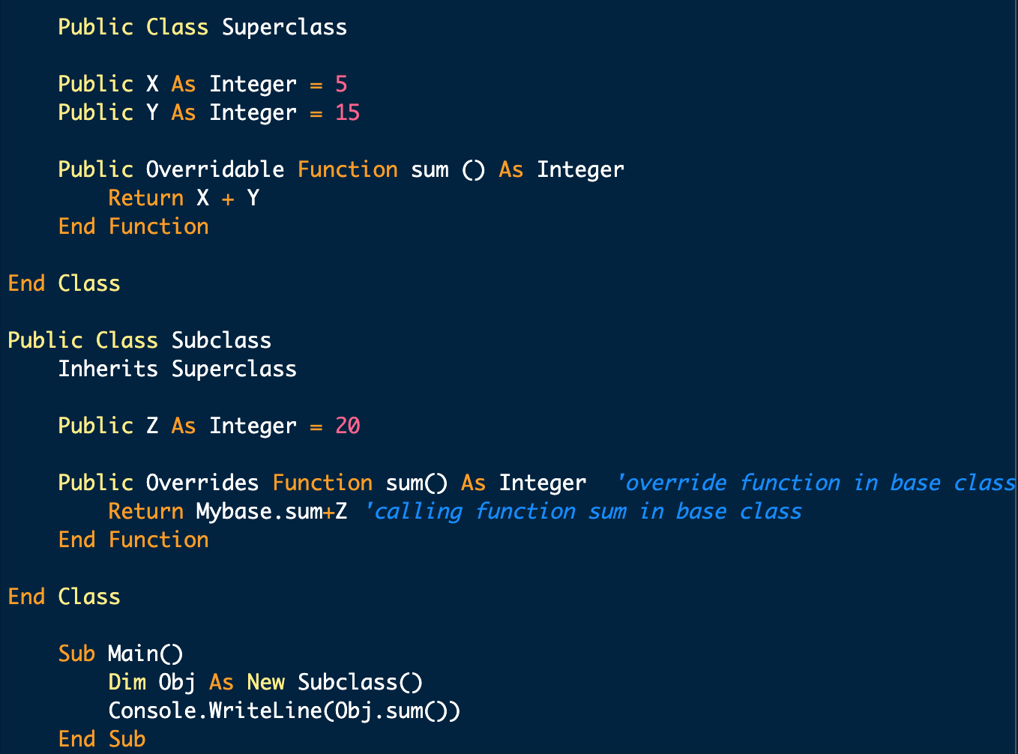
Example

