Slide 1

Fundamentals of Organic Chemistry
CHEM 108
King Saud University
College of Science, Chemistry Department
CHAPTER 8. AMINES
CHEM 108

Slide 2
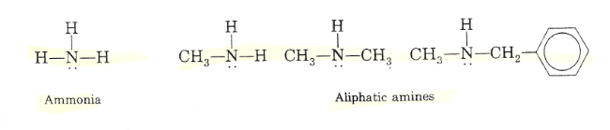
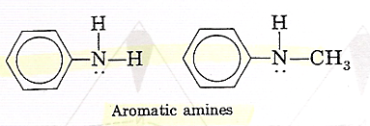
Structure and Classification of Amines
Amines are compounds that derived from ammonia by replacement of one, two, or three hydrogens by alkyl or aryl groups.
Aliphatic amines contain only alkyl groups bonded directly to the nitrogen atom.
Aromatic amines are those in which one or more aryl groups are bonded directly to nitrogen.

Slide 3
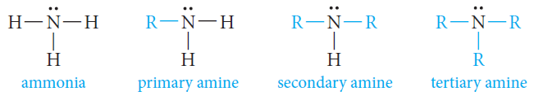
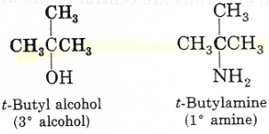
Classification and Structure of Amines
The relation between ammonia and amines is illustrated by the following structures:
Amines are classified as primary, secondary, or tertiary, depending on whether one, two, or three organic groups are attached to the nitrogen.
NOTE:
t-butyl alcohol is a tertiary alcohol (because three carbons are attached to the carbinol carbon).
t-butyl amine is a primary amine (because only one carbon is attached directly to the nitrogen atom).

Slide 4
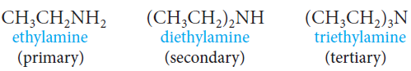
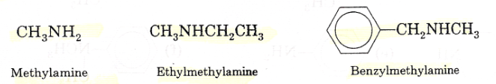
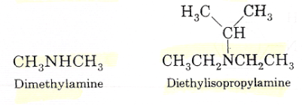
Nomenclature of Amines
Common Names
Amines are named by specifying the alkyl groups attached to the nitrogen and adding the suffix –amine (Alkylamine).

Slide 5
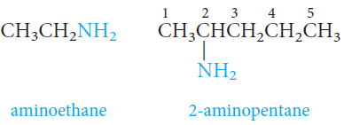
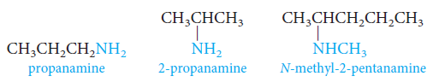
Nomenclature of Amines
IUPAC System
The amino group, -NH₂, is named as a substituent.
Amines can be named as alkanamines.

Slide 6
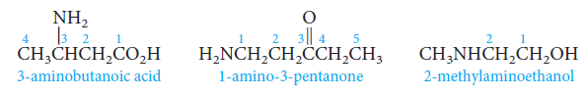
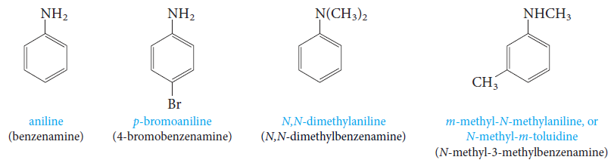
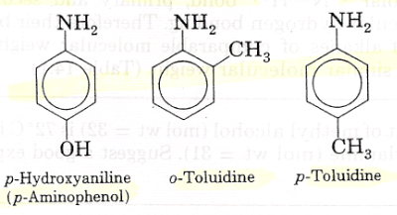
Nomenclature of Amines
IUPAC System
When other functional groups are present, the amino group, -NH₂, is named as a substituent.
Aromatic amines are named as derivatives of aniline.
In the CA system, aniline is called benzenamine.

Slide 7
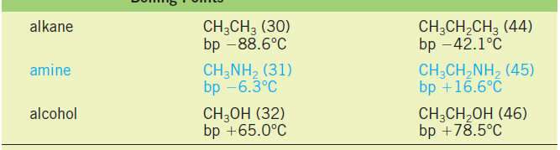
Physical Properties of Amines
Boiling Point
Methylamine and ethylamine are gases, but primary amines with three or more carbons are liquids.
Primary amines boil well above alkanes with comparable molecular weights, but below comparable alcohols.
Intermolecular N-H· · ·N hydrogen bonds are important and raise the boiling points of primary and secondary amines but are not as strong as the O-H· · ·O bonds of alcohols.
The reason for this is that nitrogen is not as electronegative as oxygen.

Slide 8
Physical Properties of Amines
Boiling Point
Tertiary amines are also polar compounds, but because hydrogen is not bonded to nitrogen, these amines are incapable of intermolecular hydrogen bonding.
Their boiling points are Lower than primary and secondary amines of identical molecular weights and Higher than those of alkanes of similar molecular weight.
Solubility in Water
All three classes of amines can form hydrogen bonds with the -OH group of water (that is, O-H· · ·N).
Primary and secondary amines can also form hydrogen bonds with the oxygen atom in water: N-H· · ·O.
Amines with up to six carbons show appreciable solubility in water.

Slide 9
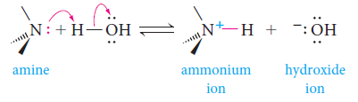

The Basicity of Amines
The unshared pair of electrons on the nitrogen atom dominates the chemistry of amines.
Because of this electron pair, amines are both basic and nucleophilic.
Aqueous solutions of amines are basic because of the following equilibrium:
Electron-donating groups increase the basicity of amines.
Electron-withdrawing groups decrease their basicity.

Slide 10
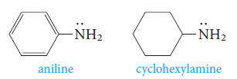
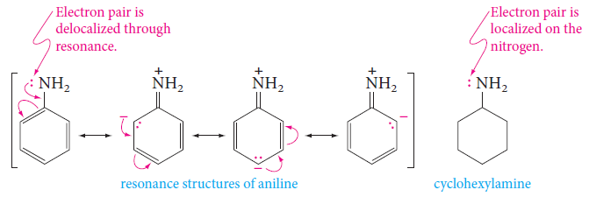
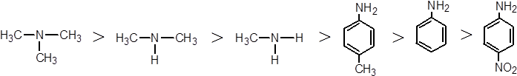
The Basicity of Amines
Aromatic amines are much weaker than aliphatic amines or ammonia.
- Example: aniline is less basic than cyclohexylamine.
The reason is the resonance delocalization of the unshared electron pair that is possible in aniline, but not in cyclohexylamine:

Slide 11

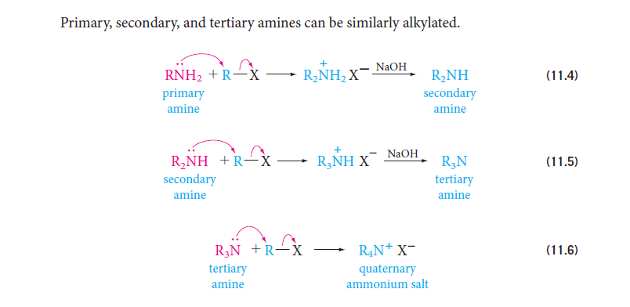
Preparation of Amines
1) Alkylation of Ammonia
Ammonia reacts with alkyl halides to give amines via a two-step process.
The first step is a nucleophilic substitution reaction. The free amine can then be obtained from its salt by treatment with a strong base
Primary, secondary, and tertiary amines can be similarly alkylated.

Slide 12
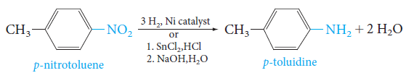
Preparation of Amines
2) Reduction of Nitro Groups
The best route to aromatic primary amines is by reduction of the corresponding nitro compounds.
The nitro group is easily reduced, either catalytically with hydrogen or by chemical reducing agents.

Slide 13
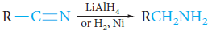
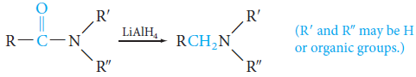
Preparation of Amines
3) Reduction of Nitriles
Reduction of nitriles (cyanides) gives primary amines.
4) Reduction of Amides
Amides can be reduced to amines with lithium aluminum hydride.

Slide 14
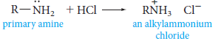
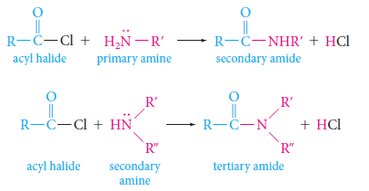
Reactions of Amines
1) Reactions with Acids: Salt Formation
Amines react with strong acids to form alkylammonium salts.
2) Acylation of Amines: Amides Formation
Primary and secondary amines react with acyl halides to form amides.

Slide 15
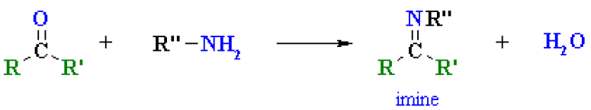
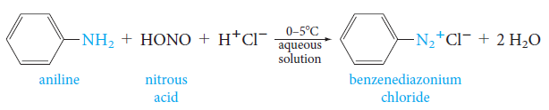
Reactions of Amines
3) Imines Formation
Primary amines, R-NH₂ or ArNH₂, undergo nucleophilic addition with aldehydes or ketones in an acidic buffer to give substituted imines.
4) Aromatic Diazonium Salts
Primary aromatic amices react with nitrous acid at 0ºC to yield aryldiazonium ions.
The process is called diazotization.

Slide 16
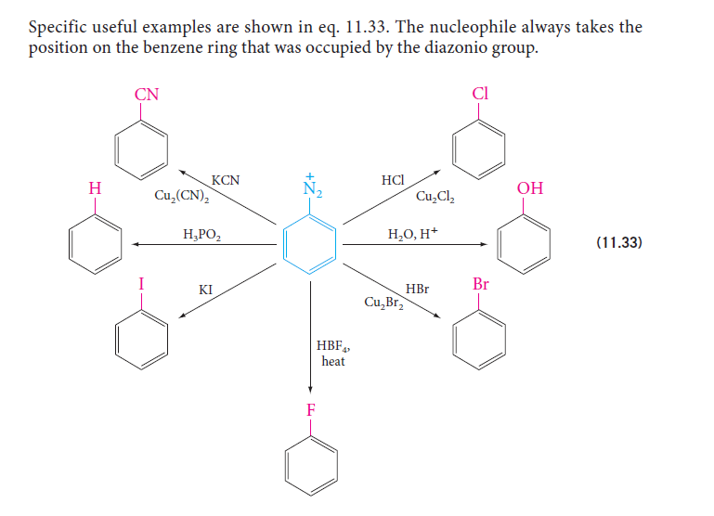
Reactions of Amines
4) Aromatic Diazonium Salts
They are useful in synthesis because the diazonio groum (-N₂⁺) can be replaced by nucleophiles; the other product is nitrogen gas.

