Slide 1
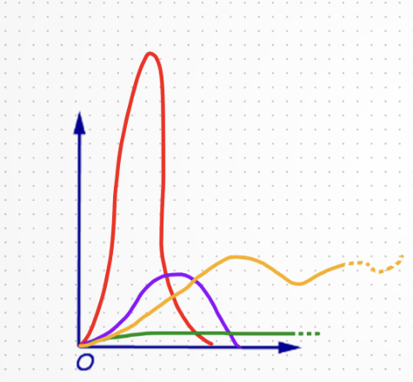
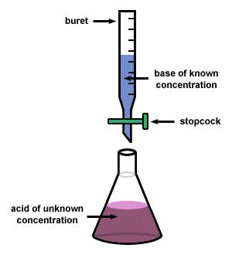
Titration curves
Titration of a weak acid

Slide 2
What is a Titration Curve?
A titration curve graphically represents the pH level of a solution as a function of the volume of titrant added. This curve provides essential insights into the acid-base reaction taking place during the titration process.
Phases of a Titration Curve
The titration curve consists of four main phases: the initial, buffer, equivalence, and post-equivalence phases. Each phase represents specific chemical behaviors, including buffering capacity and rapid pH changes near the equivalence point.

Slide 3

Analysing Regions of the Curve
Different regions of the titration curve provide insights into the behavior of the reactants.
The initial region shows how the pH changes slowly, while the steep section highlights the rapid pH change at the equivalence point and the endpoint involves stabilization once neutralization is complete.

Slide 4
Titration of a strong acid
When a strong acid is titrated with a strong base the pH at any point is determined solely by the concentration of un-titrated acid or excess base.
The conjugated base that is formed has no effect on pH.

Slide 5
Titration of a weak acid
When a weak acid is titrated with a strong base, the weak acid dissociates to yield a small amount of H⁺.
Weak acids or bases do not dissociate completely, therefore an equilibrium expression with K_{a} must be used.

Slide 6
Titration of a weak acid
Weak acid dissociates in aqueous solution partially to give a small amount of H⁺ ions.
Weak acids or bases do not dissociate completely, therefore an equilibrium expression with Ka must be used.
HA. H⁺ + A⁻
When OH⁻ ions are added during titration it is neutralized by H⁺ ions to produce H₂O.
The removal of the H⁺ ions disturbs the equilibrium thus more HA molecules will ionize to produce H⁺ ions to re-establish the equilibrium.

Slide 7
Titration of a weak acid cont’ed
This process will continue until all the HA molecules are ionized.
Thus the no. of moles of HA will be equal to the no. of moles of proton.

Slide 8
Titration curve of a monoprotic weak acid
CH₃COO-
e
9
PH
8
CH₃COOH <CH₃COO-
7
d
CH₃COOH> CH₃COO-
6
c
5
b
CH₃COOH = CH₃COO-
4
CH₃COOH
3
a
2
1
ml of 0.1M KOH added

Slide 9
Example 1
Calculate the appropriate values and draw the curve for the titration of 500 ml of 0.1 M weak acid HA; with 0.1 M KOH; pK_{a} = 5; pK_{b} = 9
Point a: the pH before the addition of any base
pH = ½ ( pK_{a} + p [HA])
pH = ½ [(5 + (-log 0.1)]
pH = 3

Slide 10
NOTE: at any point during the titration (after any addition of a base), the pH should be calculated using Henderson-Hasselbalch equation.
Point b: the pH after the addition of 100 ml of KOH
pH = pK_{a} + Log
The no. of moles OH⁻ added = M × V = 0.1 × 0.1 = 0.01 mole
Thus 0.01 moles of KOH will react with 0.01 mole of HA to produce 0.01 mole A⁻
The no. of moles of HA originally present = 0.1 × 0.5 = 0.05 mole
[A⁻]
[HA]

Slide 11
The no. of HA remaining = 0.05 – 0.01 = 0.04 mole
Total volume = 500 + 100 = 600 ml
Here we will use the no. of moles because when we calculate the volume it will give the same ratio at the end
pH = pK_{a} + Log
pH = 5 + Log (0.01/0.04)
pH = 4.4
[A⁻]
[HA]

Slide 12
Point c: the pH after the addition of 250 ml of KOH (half)
pH = pK_{a} + Log
The no. of moles OH⁻ added = M × V = 0.1 × 0.25 = 0.025 mole
Thus 0.025 moles of KOH will react with 0.025 mole of HA to produce 0.025 mole A⁻
The no. of moles of HA remaining = 0.05 – 0.025 = 0.025 mole
pH = pK_{a} + Log
pH = 5 + Log (0.025/0.025)
pH = 5
[A⁻]
[HA]
[A⁻]
Here the [A-] = [ HA] thus, pH = pKa acts as a buffer
[HA]

Slide 13
OR
At this point half the weak acid HA is titrated, since the reaction between HA and KOH is one to one reaction and they both have the same concentration
HA + KOH H₂O + KA
[HA] = [A⁻]
Monoprotic acid (one proton) that reacts with a base containing one hydroxyl group (one OH⁻)
Ratio = [A⁻]/[HA] = 1
pH = pK_{a} + Log [A⁻]/[HA]
pH = 5 + Log 1
pH = 5 + 0 = 5

Slide 14
Point d: the pH after the addition of 375 ml of KOH
pH = pK_{a} + Log
The no. of moles OH⁻ added = M × V = 0.1 × 0.375 = 0.0375 mole
Thus 0.0375 moles of KOH will react with 0.0375 mole of HA to produce 0.0375 mole A⁻
The no. of moles of HA remaining = 0.05 – 0.0375 = 0.0125 mole
pH = pK_{a} + Log
pH = 5 + Log (0.0375/0.0125)
pH = 5.48
[A⁻]
[HA]
[A⁻]
[HA]

Slide 15
NOTICE:
When the acid is less than half titrated the pH is less than pK_{a}
When the acid is half titrated the pH = pK_{a}
When the acid is more than half titrated the pH is greater than pK_{a}
Point e: When 500 ml of KOH is added
pOH = ½ ( pK_{b} + p [A⁻]) (pOH of weak base)
The no. of moles OH⁻ added = M × V = 0.1 × 0.5 = 0.05 mole
Thus 0.05 moles of KOH will react with 0.05 mole of HA to produce 0.05 mole A⁻
Molarity of A⁻ = no. of moles / vol. in L
The total volume of whole solution = 1000 ml = 1 L

Slide 16
Molarity of A⁻ = no. of moles / vol. in L
Molarity of A⁻ = 0.05 / 1 = 0.05 M
p [A⁻ ] = - log [A⁻ ]
p [A⁻ ] = - log 0.05
p [A⁻ ] = 1.3
K_{w} = K_{a} × K_{b}
K_{b} = K_{w} / K_{a} = 10⁻¹⁴/10⁻⁵ = 10⁻⁹

Slide 17
pOH = ½ ( pK_{b} + p [A⁻])
pOH = ½ (9 + 1.3)
pOH = 5.15
pKw = pH + pOH
pH = pK_{w} – pOH
pH = 14 – 5.15 = 8.85

Slide 18
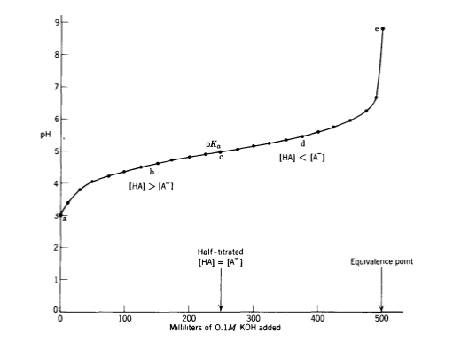
Titration of a Weak Acid Cont’ed

Slide 20
Titration of a Weak Acid Cont’ed
From the previous example:
All HA is in the form of CH₃COOH
[CH₃COOH] > [CH₃COO⁻]
[CH₃COOH] = [CH₃COO⁻]
[CH₃COOH] < [CH₃COO⁻]
All as CH₃COO⁻

Slide 21
NOTICE:
•When the acid is less than half titrated the pH is less than pKa
•When the acid is half titrated the pH = pKa
•When the acid is more than half titrated the pH is greater than pKa

Slide 22
How to calculated the pH!
The pH is calculated through different ways:
At starting point pH= (pKa+p[HA]) /2
At any point within the curve (after, in or after middle titration) pH = pKa+ log[A⁻]/[HA]
At end point pOH = (pKb+p[A⁻]) /2
pH = pK_{w} – pOH

Slide 23
Example 2
The Ka for a weak acid is 1.6×10⁻⁶. The morality of acid is 10⁻³ M. What are the:
A) pH. B) Calculate pKa and pKb.
A) pH = ½( pKa+ p [HA])
pKa= -log Ka, pKa= -log Ka, pKa = -log 1.6 ×10⁻⁶
pKa= 5.796
p [HA] = -log [HA] = -log 10⁻³
p [HA] = 3
apply it to “pH of weak acid”
pH = ½ (5.79 + 3)
pH = 4.398

Slide 24
pKa= -log Ka
pKa= -log Ka
pKa= -log1.6 ×10-6
pKa= 5.796
pKa+ pKb= 14
pKb= 14 -pKa= 14 –5.796
pKb= 8.204

Slide 25
[Acids and Bases – Tutorial]

Slide 26
For which type of titration will the pH be basic at the equivalence point?
Strong acid vs. strong base.
Strong acid vs. weak base.
Weak acid vs. strong base.
all of the these
none of these
Calculate the pH at the equivalence point for the titration of 0.22 M HCN with 0.22 M NaOH. (Ka = 4.9 × 10⁻¹⁰ for HCN.)

Slide 27
At equivalance point the acid and base nuetralize.
because the moles of both the acid and base are equal, neither will be in excess or determine the pH of the solution.
So you must look at the salt formed.
This basic salt yields this equation. NaCN -> Na+ + CN-.
pOH=(pKb+ p[A⁻])/2
pOH= (4.6+0.65)
pOH= 2.625
pH=11.375 This pH value makes sense by noticing that the solution should be basic, yielding a high pH value, such as the 11.3 found.

Slide 28
1- Calculate the pH of a buffer solution that contains 0.25 M benzoic acid (C6H5CO2H) and 0.15 M sodium benzoate (C6H5COONa). [Ka = 6.5 × 10⁻⁵ for benzoic acid]
A. 3.97
B. 4.83
C. 4.19
D. 3.40
E. 4.41
pH=pKa+ log [A-]/[HA]
pKa= -log ka
= -log 6.5x10⁻⁵
pKa = 4.187
PH= 4.187+log (0.15/0.25)
pH= 3.97

Slide 29
2- A solution is prepared by mixing 500 mL of 0.10 M NaOCl (SALT) and 500. mL of 0.20 M HOCl (ACID). What is the pH of this solution? [Ka(HOCl) = 3.2 × 10⁻⁸]
A. 4.10
B. 7.00
C. 7.19
D. 7.49
PH= pKa+ log [NaOCl] / [HOCl]
pKa= -log Ka= 7.49
[NaOCl]= 0.5x0.1 =0.05
[HOCl] = 0.5x 0.20= 0.1
PH= 7.49+ log 0.05/ 0.1
pH= 7.19.

Slide 30
3- Which of the following is not a conjugate acid/base pair?
NH₄⁺/NH₃
OH–/O^{2–}
H₃PO₄/H₂PO₄–
CO₂/CO₃–

Slide 31
4- The pH of a solution for which [OH–] = 1.0 x 10^{–6} is
a) 1.00.
b) 8.00.
c) 6.00.
d) –6.00.
POH= -log [OH⁻]= 6
PH= 14 –POH = 8

Slide 32
Do you have questions?

