Slide 1
Introduction To Digital Radiography And PACS
By : Alanoud Al Saleh

Slide 2
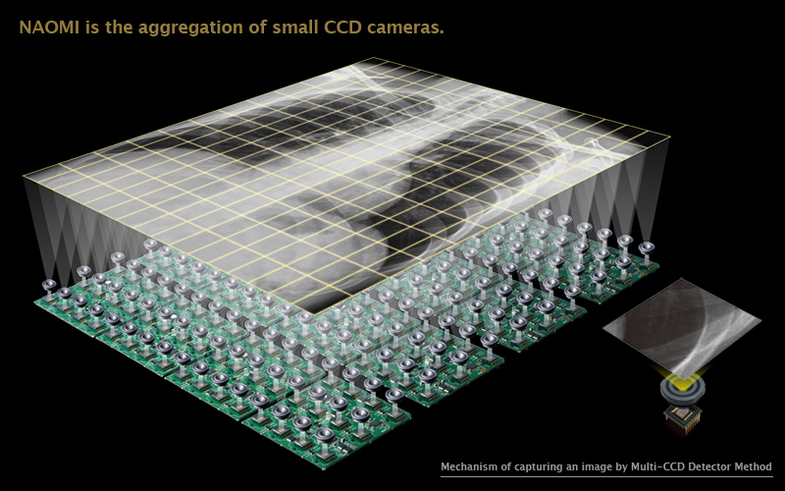
Digital Imaging
Digital imaging is defined as any image acquisition process that produces an electronic image that can be viewed and manipulated on a computer.
In radiology, images can be sent via computer networks to a variety of locations.

Slide 3
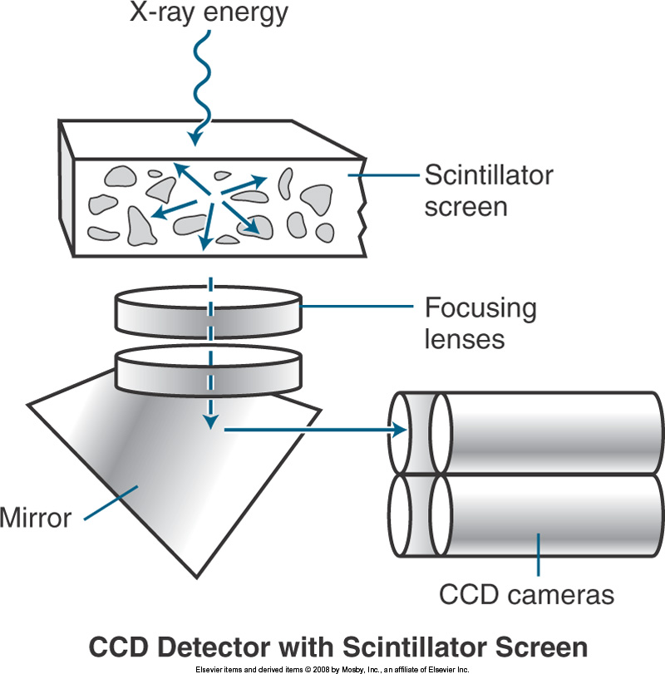
Digital Radiography
Two types of digital radiography
Indirect capture DR :
Machine absorbs x-rays and converts them to light.
Uses of charge-coupled device CCD or thin-film transistor (TFT) converts light to electric signals.
Computer processes electric signals.
Images are viewed on computer monitor.

Slide 4
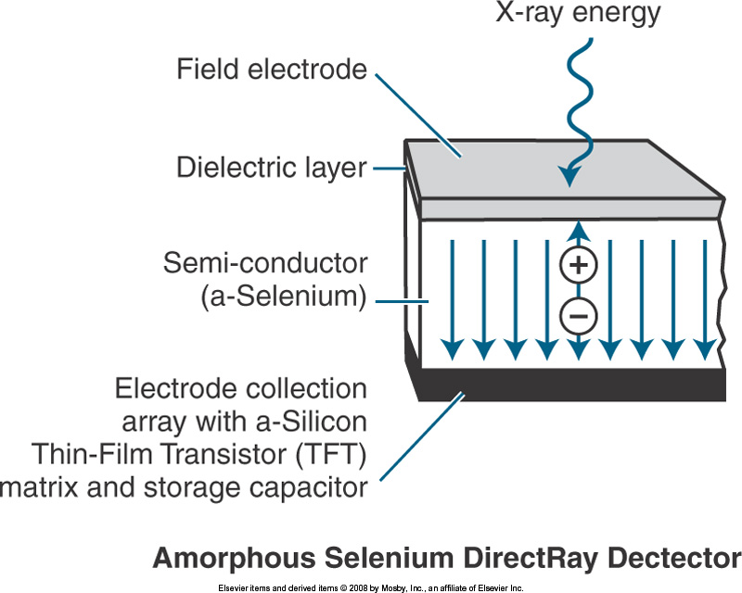
Digital Radiography
Direct capture DR
Photoconductor absorbs x-rays.
Thin-film transistor TFT collects signal.
Electrical signal is sent to computer for processing.
Image is viewed on computer screen.

Slide 5
Picture archiving and communication system
In medical imaging, picture archiving and communication systems (PACS) are computers or networks dedicated to the storage, retrieval, distribution and presentation of images. The medical images are stored in an DICOM format (Digital Imaging and Communications in Medicine).

Slide 6
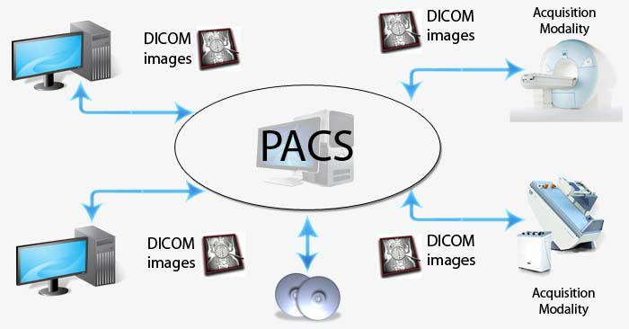
DICOM (Digital Imaging and Communications in Medicine)
(DICOM) is a standard for handling, storing, printing, and transmitting information in medical imaging. It includes a file format definition and a network communications protocol.

Slide 7
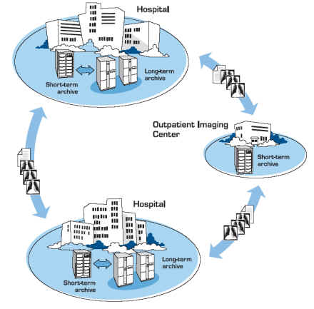
DICOM files can be exchanged between two entities that are capable of receiving image and patient data in DICOM format.
DICOM enables the integration of scanners, servers, workstations, printers, and network hardware from multiple manufacturers into (PACS).

Slide 8
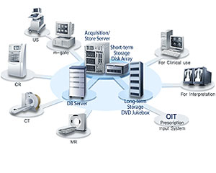
Types of images in PACS
Most PACSs handle images from various medical imaging instruments, including ultrasound, magnetic resonance, PET, computed tomography, endoscopy, mammograms, etc.

Slide 9
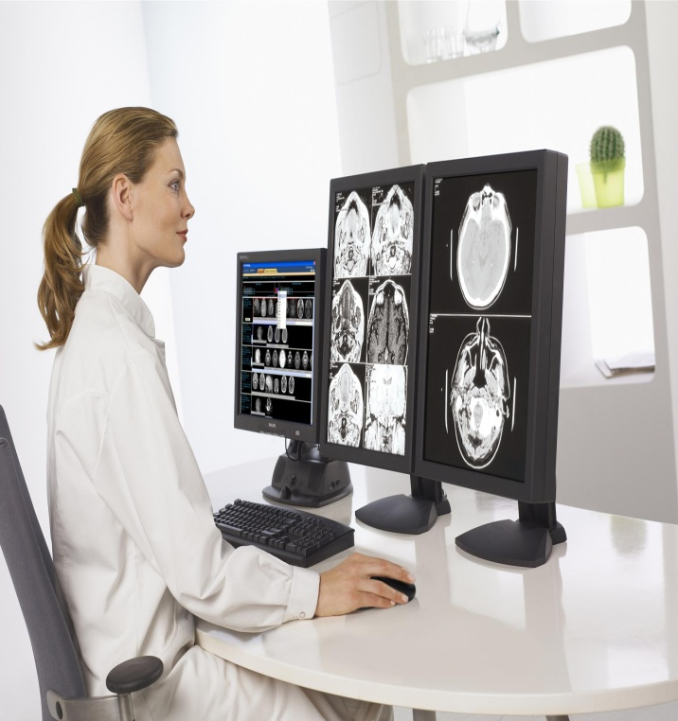
PACS uses
Reading stations
Physician review stations
Web access
Technologist quality control stations
Administrative stations
Archive systems
Multiple interfaces to other
hospital and radiology systems

