Slide 1
Predetermined Motion Time Systems
Sections:
Overview of Predetermined Motion Time Systems – part 1
Methods-Time Measurement – part 2
Maynard Operation Sequence Technique
Notes:
* Note, MOST will NOT be discussed in class (left as lab exercise only); it is available to read in the textbook, with great, solved examples to illustrate concept

Slide 2
PMTS Defined
Problem with DTS:
involves performance rating
this’s based on judgment by time study analyst
disagreement can occur between worker doing task and analyst
Alternative to DTS is predetermined motion time systems (PMTS)
doesn’t involve PR step

Slide 3
PMTS Defined
General: A database of basic motion elements and their associated normal time values, together with procedures for applying the data to analyze manual tasks and establish standard times for the tasks
ANSI definition: organized body of information, procedures, techniques, and motion times employed in the study and evaluation of manual work elements. The system is expressed in terms of the motions used, their general and specific nature, the conditions under which they occur, and their previously determined performance times

Slide 4
PMTS Defined
PMTS database involves:
set of tables listing time values
values correspond to basic motions elements
determined based on extensive research of manual work activity
based on frame-by-frame analysis of motion pictures of activity
BME’s include:
Reach
Grasp
Move
Release (and others)

Slide 5
PMTS Defined
Time required to perform BME depends on certain work variables
e.g. time to reach object increases with the distance of reach
e.g. time to move object depends on its weight and distance moved
Contents of chapter:
General discussion of PMTS [1]
Two important examples of PMTS:
Methods-time measurement (MTM) [2]
Maynard Operation Sequence Technique (MOST) [3]*
Notes:
* Note, MOST will NOT be discussed in class (left as lab exercise only); it is available to read in the textbook, with great, solved examples to illustrate concept

Slide 6
Predetermined Motion Time Systems
Overview of Predetermined Motion Time Systems

Slide 7
1.1 PMTS Procedure
Overview of PMTS
applying PMTS procedure to a task
use to determine $T_{std}$ for a task:
before task is in production, or
for an existing task
PMT systems
differences among them
how they can be classified

Slide 8
PMTS Procedure
All PMT systems use same procedure (4 steps)
differences are in details
Synthesize method used to perform the task
method is described i.t.o. BME’s,
based on workplace layout and set of tools*
Retrieve $T_{n}$ values for each BME
This is based on:
work variables, and
conditions under which BME is performed
∑ element times for all BME’s to find task $T_{n}$
Notes:
* Note, different PMTS’s have different BME definitions, and the analyst must describe the method using the definitions and conventions of the particular system

Slide 9
PMTS Procedure
Evaluate method to make improvements
Result: reducing $T_{n}$
Achieved by:
Eliminating motions,
Reducing distances,
introducing special tools,
using simultaneous right/left hand motions,
etc.
This requires:
detailed listing of BME’s
corresponding time values

Slide 10
PMTS Procedure
Apply allowances to determine $T_{std}$
Note, may be omitted if emphasizing methods improvement only
Also, basic time values in PMT systems do not include any allowances
⇒ organization must add P, F, D allowances (according to its policies)
Usual equation is used to find $T_{std}$:
$T_{std}=T_{n} (1+A_{pfd})$
$T_{std}$: standard time ($T_{std}$ and $T_{n}$ in $min$)
$T_{n}$: normal time (∑ BME time values for task*)
$A_{pfd}$: PFD allowance
Notes:
* step 2 with possible adjustments resulting from step 3 in the PMTS procedure

Slide 11
1.2 PMTS Levels and Generations
Various levels of PMT systems:
First-level PMT Systems: use BME’s
e.g. reach, grasp, and move used separately to define the task
Higher-level systems: combine several motion elements into motion aggregates
motion aggregates: combined “motion sequences” commonly used in work situations
e.g. reach and grasp combined into one element called get (used assembly work)

Slide 12
PMTS Levels and Generations
Times in PMTS Levels:
First-level PMTS’s:
very detailed
body motions differentiated very precisely
e.g. reach and grasp distinguished as 2 separate motion elements
⇒ times for BME’s: v. short (may be $<1s$)
Higher-level systems
use condensed databases
fewer body motions (contained in tables)
⇒ longer times for each motion sequence
tables: simplified, with fewer work variables

Slide 13
PMTS Levels and Generations
PMTS Generations:
First-level PMTS’s:
chronologically: 1st to be developed ⇒ called 1st gen. PMTS (e.g. MTM-1)
see reading handout
Second- and higher-level systems:
constructed based on first-level systems
called 2nd and 3rd generation systems
e.g. MTM-2 (based on MTM-1) and MTM-3

Slide 14
PMTS Levels and Generations
Characteristics of PMT system levels (Table 1)
First-level PMTS’s:
long lists of elements
long time to set standard for task
⇒ high “application speed ratio”
e.g. for MTM-1: time to set std $ 250∗T_{task}$
e.g. for $T_{task}=1 min$ ⇒ $T_{set−std}>4 hr$
Second- and higher-level systems:
require less application time
e.g. MTM-2: $T_{set−std}  100∗T_{task}$
⇒ more convenience, but less accuracy

Slide 15
Comparisons
First-level PMTS
Most accurate
High application speed ratio
Most suited to highly repetitive short cycles
Basic motion elements
Very detailed
Highest flexibility
Higher-level PMTS
Less accurate
Less time to set standards
Longer cycle times feasible
Motion aggregates
Less detailed
Less flexible
Notes:
This is Table 1

Slide 16
PMTS Levels and Generations
PMT Systems:
$>50$ PMTS’s developed over the years
Table 2:
brief description of major PMT systems
focuses on those commercially used today
Most systems no longer used
Most widely used PMTS: based on MTM
Note, MOST*:
widely used higher-level PMTS
based on MTM
Notes:
* Note, MOST will NOT be discussed in class (left as lab exercise only); it is available to read in the textbook, with great, solved examples to illustrate concept

Slide 17
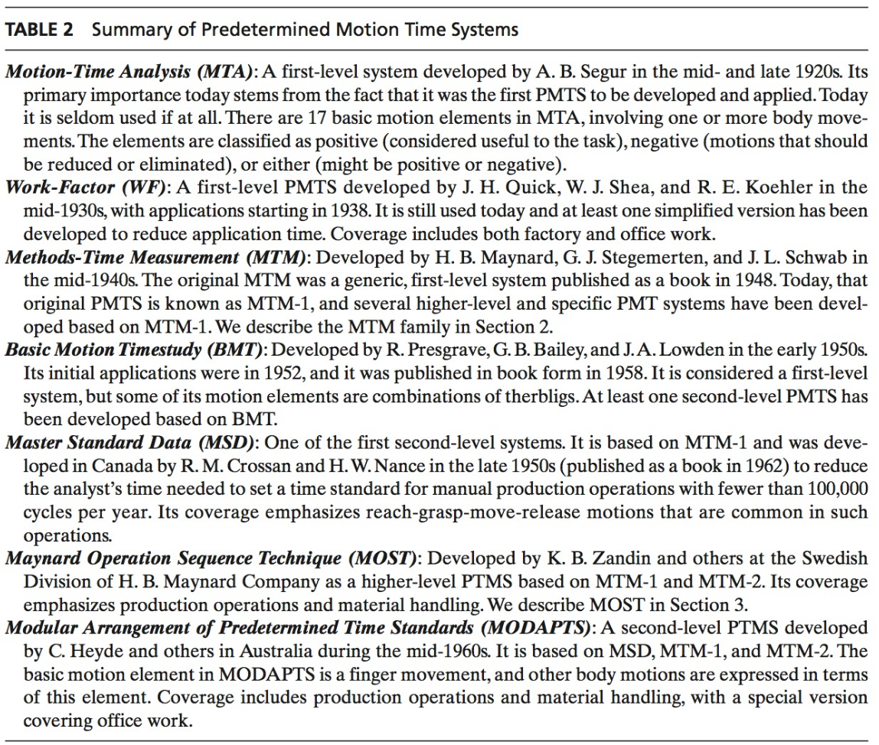
Summary of PMT Systems
Notes:
This is Table 2: Most important in this list are MTM and MOST

