Slide 1
Lesson 2: Configuring Servers
MOAC 70-410: Installing and Configuring Windows Server 2012

Slide 2
Overview
Exam Objective 1.2: Configure Servers
Completing Post-Installation Tasks
Using Roles, Features, and Services
Using Server Manager
Delegating Server Administration
Notes:
Lecture notes go here

Slide 3
Completing Post-Installation Tasks
Lesson 2: Configuring Servers
Notes:
Lecture notes go here

Slide 4
Completing Post-Installation Tasks
While Server 2012 R2 has been redesigned to allow most tasks to be completed remotely, there are tasks that must be performed directly from the server, including:
Configure the network connection.
Set the time zone.
Rename the computer.
Join a domain.
Enable Remote Desktop.
Configure Windows Update settings.
Notes:
Lecture notes go here

Slide 5
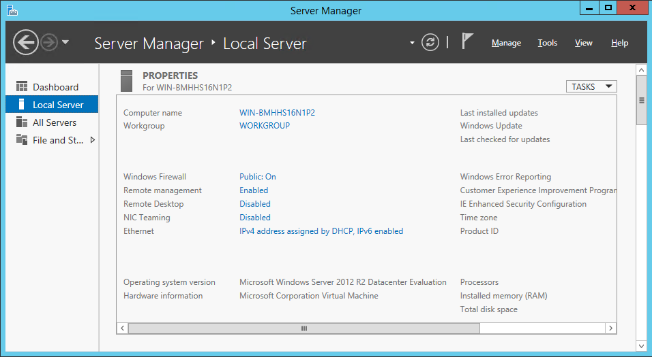
Using GUI Tools
Use the Server Manager for the Local Server to Complete Post-Installation Tasks

Slide 6
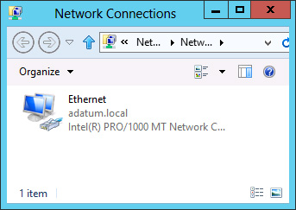
Using GUI Tools
The Network Connections window

Slide 7
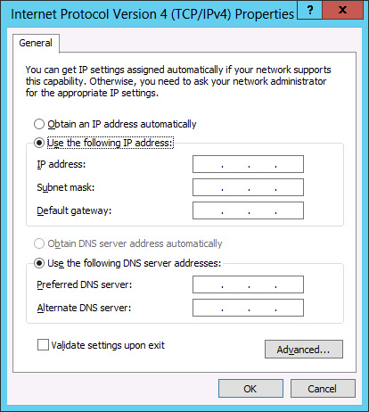
Using GUI Tools
The Internet Protocol Version 4 (TCP/IPv4)
Properties sheet

Slide 8
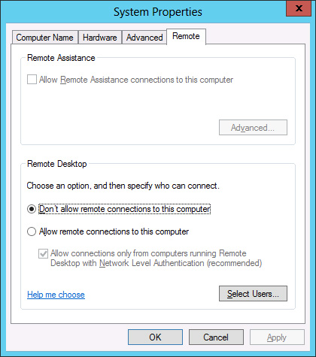
Using GUI Tools
The Remote tab of the System Properties sheet

Slide 9
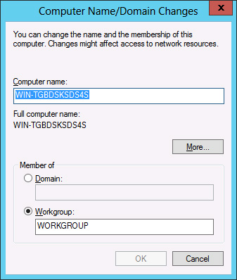
Using GUI Tools
The Computer Name/Domain Changes dialog box

Slide 10
Using Command Line Tools
If you selected Server Core when installing, you can perform the post-installation tasks from the command line.
Minimum requirements:
Rename the computer
Join the domain
Use the Netdom.exe command.

Slide 11
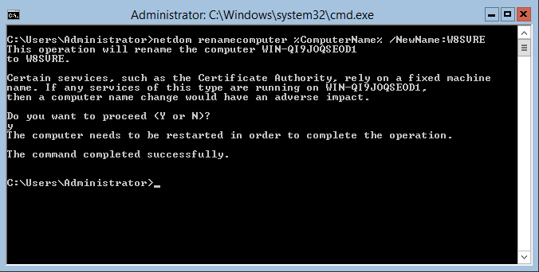
Using Command Line Tools
Renaming a Computer from the Command Line

Slide 12
Converting Between GUI and Server Core
This is a major improvement in Server 2012 and Server 2012 R2 over Server 2008 R2.
Previously, you could only change from Server Core to GUI by performing a re-install.
Server 2012 R2 allows you to convert between GUI and Server Core as needed.
Allows the ease of configuration using the GUI and then allows you to conserve system resources by converting to Server Core.

Slide 13
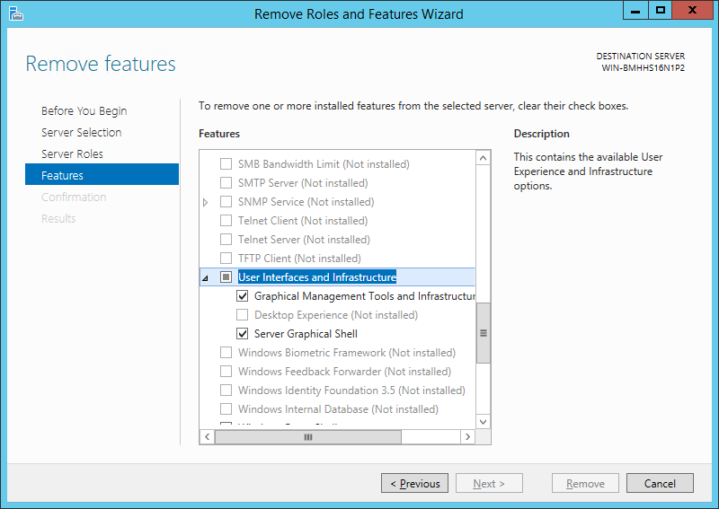
Converting a GUI Server to Server Core
The Remove features page in Server Manager

Slide 14
Using PowerShell
To convert a Windows Server 2012 R2 Server Core installation to the full GUI option, use this Windows PowerShell command:
Install-WindowsFeature Server-Gui-Mgmt-Infra,Server-Gui-Shell –Restart
To convert a full GUI server installation to Server Core, use this command:
Uninstall-WindowsFeature Server-Gui-Mgmt-Infra,Server-Gui-Shell -Restart

Slide 15
Configuring NIC Teaming
Allows administrators to combine the bandwidth of multiple network interface adapters, providing increased performance and fault tolerance.
NIC teaming is also called bonding, balancing, and aggregation.

Slide 16
NIC Teaming Modes
Switch Independent Mode
All adapters are connected to different switches, providing alternate routes through the network
Switch Dependent Mode
All adapters are connected to the same switch, providing a single interface with their combined bandwidth

Slide 17
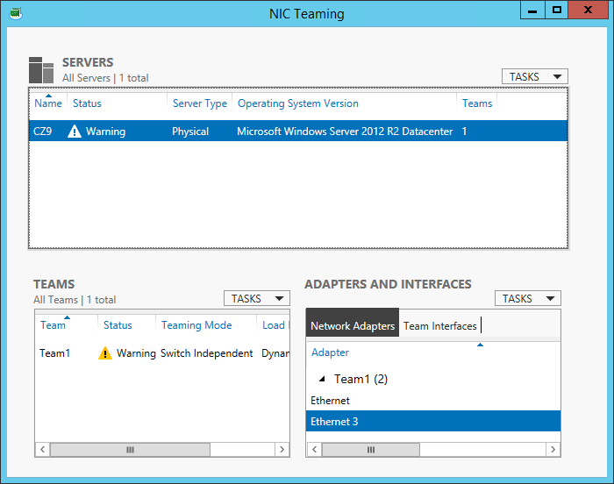
Creating a NIC Team
The NIC Teaming window in Server Manager

Slide 18
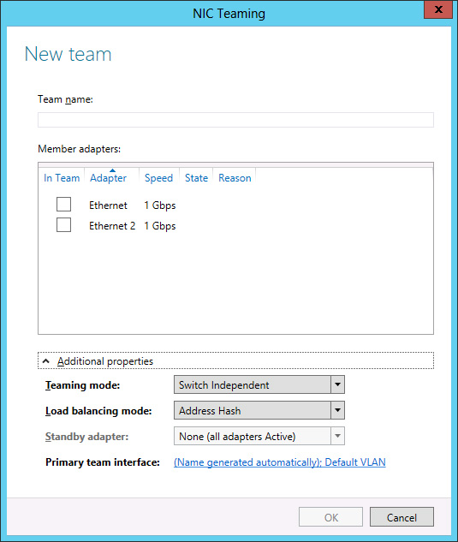
Creating a NIC Team
The New team page in Server Manager

Slide 19
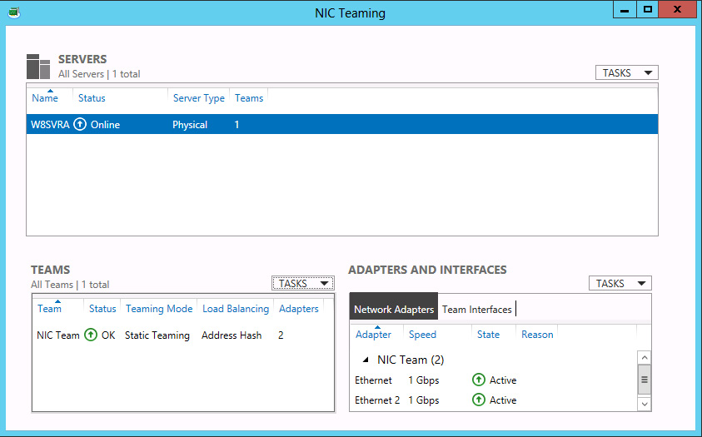
Creating a NIC Team
A new NIC team in the NIC Teaming window in
Server Manager

Slide 20
Using Roles, Features, and Services
Lesson 2: Configuring Servers

Slide 21
Using Roles, Features, and Services
Role: Define the primary function of a server
Example: Web Server (IIS)
Feature: A smaller module, typically with a single purpose
Example: a management tool, extension, or optional component
Service: Programs that run continuously in the background, waiting for a client to send a request

Slide 22
Using Server Manager
Lesson 2: Configuring Servers

Slide 23
Adding Roles and Features
Use the Add Roles and Features Wizard in the Server Manager.
Add multiple servers to the Server Manager interface to deploy roles and features to any of your servers.

Slide 24
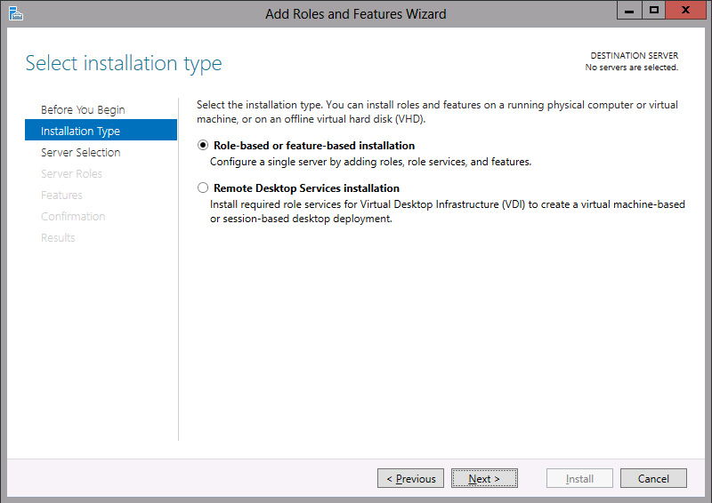
Installing Roles and Features
The Select Installation type page in the Add Roles and Features Wizard

Slide 25
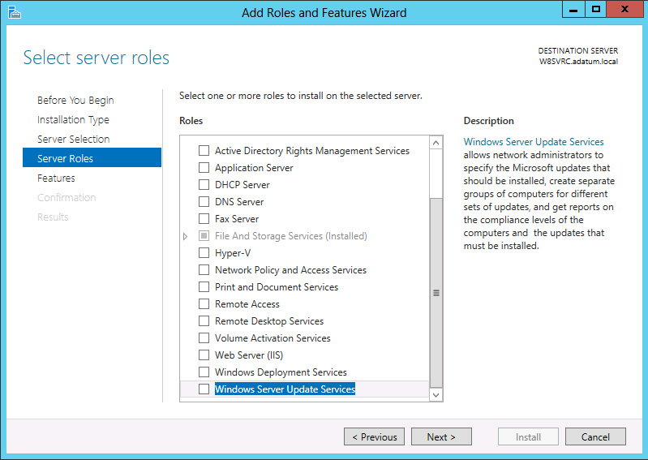
Installing Roles and Features
The Select server roles page in the Add Roles and Features Wizard

Slide 26
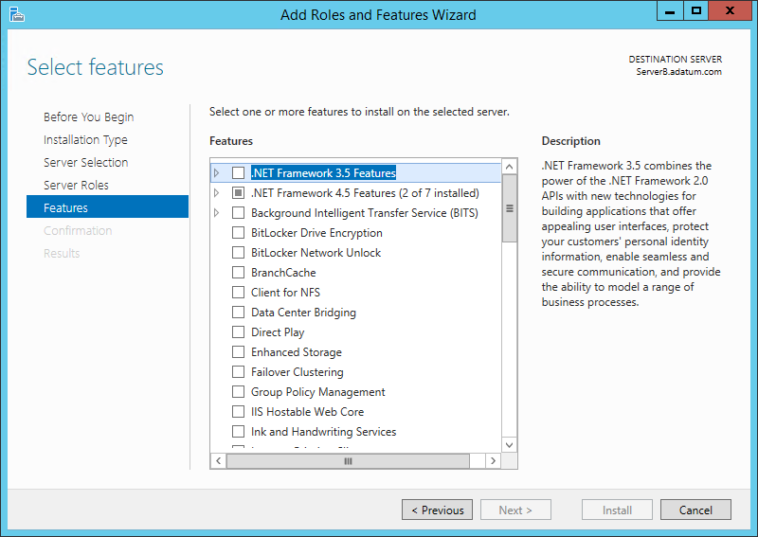
Installing Roles and Features
The Select features page in the Add Roles and
Features Wizard

Slide 27
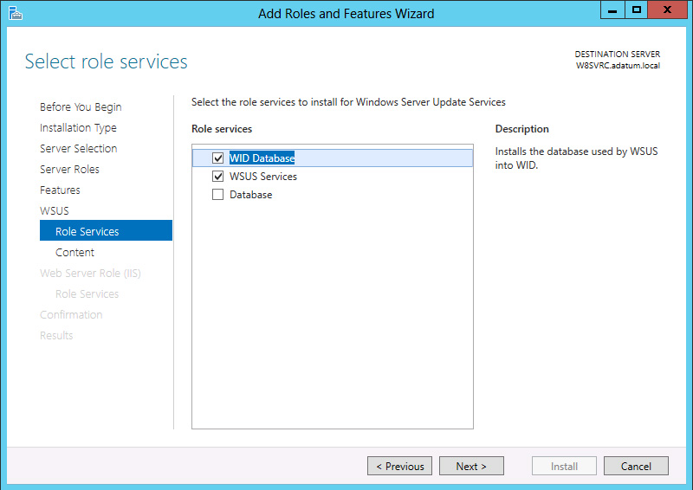
Installing Roles and Features
The Select role services page in the Add Roles and Features Wizard

Slide 28
Deploying Roles to VHDs
In addition to installing roles and features to servers on the network, Server Manager enables administrators to install them to virtual machines that are in an offline state.

Slide 29
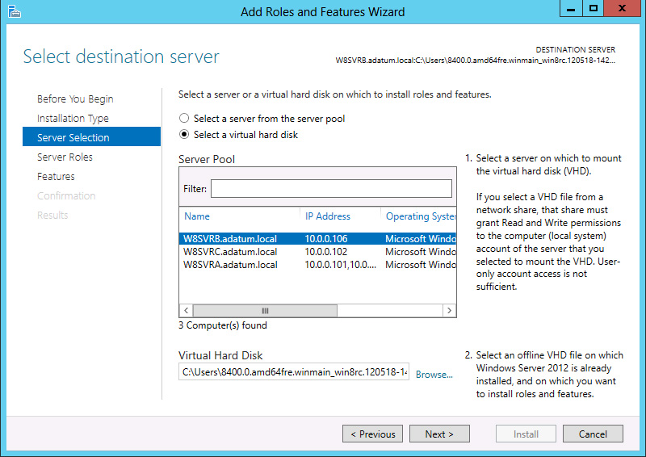
Installing Roles and Features— Offline VHD
The Select destination server page in the Add Roles and Features Wizard
.

Slide 30
Configuring Services
Server Manager will allow you to view all of the services installed on a server and stop, start, restart, pause, and resume a service.
To configure services you need to use the Services MMC snap-in.

Slide 31
Delegating Server Administration
Lesson 2: Configuring Servers

Slide 32
Delegating Server Administration
Delegation allows you to have specific administrators or IT staff responsible for different parts of network administration.
Not all IT staff require full administrative access to servers.
Have junior IT personnel responsible only for tasks like creating user accounts and changing passwords.

Slide 33
Using Windows PowerShell Desired State Configuration
In Windows PowerShell 4.0, Desired State Configuration (DSC) provides a new scripting model that enables administrators to create modules called configurations.
Configurations consist of nodes representing computers and resources that define elements that administrators want to define as part of the configuration for a particular node.

Slide 34
Lesson Summary
The new Server Manager is designed to enable administrators to fully manage Windows servers without ever having to interact directly with the server console, either physically or remotely.
There are some tasks that administrators might have to perform immediately after the operating system installation that require direct access to the server console.
If you selected the Server Core option when installing Windows Server 2012 R2, you can perform post-installation tasks from the command line.
In Windows Server 2012 R2, the Properties tile in Server Manager provides the same functionality as the Initial Configuration Tasks window in previous versions.
Notes:
Lecture notes go here

Slide 35
Lesson Summary
In Windows Server 2012 R2, you can convert a computer installed with the full GUI option to Server Core, and add the full GUI to a Server Core computer.
NIC teaming is a new feature in Windows Server 2012 R2 that enables administrators to combine the bandwidth of multiple network interface adapters, providing increased performance and fault tolerance.
For administrators of enterprise networks, it might be necessary to add a large number of servers to Server Manager. To avoid having to work with a long scrolling list of servers, you can create server groups, based on server locations, functions, or any other organizational paradigm.
Notes:
Lecture notes go here

Slide 36
Lesson Summary
In addition to installing roles and features to servers on the network, Server Manager also enables administrators to install them to virtual machines that are currently in an offline state.
In Windows PowerShell 4.0, Desired State Configuration (DSC) provides a new scripting model that enables administrators to create modules called configurations, which consist of nodes representing computers and resources that define elements that administrators want to define as part of the configuration for a particular node.

Slide 37
Copyright 2013 John Wiley & Sons, Inc.
All rights reserved. Reproduction or translation of this work beyond that named in Section 117 of the 1976 United States Copyright Act without the express written consent of the copyright owner is unlawful. Requests for further information should be addressed to the Permissions Department, John Wiley & Sons, Inc. The purchaser may make back-up copies for his/her own use only and not for distribution or resale. The Publisher assumes no responsibility for errors, omissions, or damages, caused by the use of these programs or from the use of the information contained herein.

