Slide 1
Lesson 1: Installing Servers
MOAC 70-410: Installing and Configuring Windows Server 2012

Slide 2
Overview
Exam Objective 1.1: Install Servers
Selecting a Windows Server 2012 R2 Edition
Installing Windows Server 2012 R2
Choosing Installation Options
Upgrading Servers
Migrating Roles
Notes:
Lecture notes go here

Slide 3
Selecting a Windows Server 2012 R2 Edition
Lesson 1: Installing Servers
Notes:
Lecture notes go here

Slide 4
Planning
The Windows Server 2012 R2 Edition you choose should be based on multiple factors, including:
The roles you intend the servers to perform
The virtualization strategy you intend to implement
The licensing strategy you plan to use
Notes:
Lecture notes go here

Slide 5
Windows Server 2012 R2 Core Editions
Windows Server 2012 R2 Datacenter
Windows Server 2012 R2 Standard
Windows Server 2012 R2 Essentials
Windows Server 2012 R2 Foundation

Slide 6
Datacenter
Designed for large and powerful servers
Supports up to 64 processors
Fault tolerance—hot-add processors
Only available to purchase through:
Microsoft volume-licensing program
Original equipment manufacturers (OEMs), bundled with a server

Slide 7
Standard
Includes the full set of Windows Server 2012 R2 features
Only differs from Datacenter by the number of virtual machine instances permitted by the license

Slide 8
Essentials
Includes nearly all features from Datacenter and Standard editions, except:
Server Core
Hyper-V
Active Directory Federation Services
Limited to one physical or virtual server instance
Maximum of 25 users

Slide 9
Foundation
Reduced version of the operating system designed for small businesses
Supports only basic server features:
File and print services
Application support
No virtualization rights
Limited to 15 users

Slide 10
Supporting Server Roles
Three basic categories of server roles are:
Directory services
Store, organize, and supply information about a network and its resources
Infrastructure services
Provide support services for network clients
Application services
Provide communication services, operating environments, or programming interfaces for specific applications

Slide 11
Directory Services Roles
Active Directory Certificate Services
Active Directory Domain Services (AD DS)
Active Directory Federation Services
Active Directory Lightweight Directory Services (AD LDS)
Active Directory Rights Management Services (AD RMS)

Slide 12
Infrastructure Services
DHCP (Dynamic Host Configuration Protocol)
DNS Server
Hyper-V
Network Policy and Access Services (NPAS)
Health Registration Authority (HRA)
Remote Access
Volume Activation Services
Windows Deployment Services (WDS)
Windows Server Update Services (WSUS)

Slide 13
Application Services
Application Server
Fax Server
File and Storage Services
Print and Document Services
Remote Desktop Services
Web Server (IIS)

Slide 14
Supporting Server Virtualization
POSE: Physical operating system environment
VOSE: Virtual operating system environment
Edition | POSE Instances | VOSE Instances
Datacenter | 1 | Unlimited
Standard | 1 | 2
Foundation | 1 | 0
Essentials | 1 POSE or VOSE | 1 POSE or VOSE

Slide 15
Server Licensing
Licensing Windows Server 2012 R2 includes purchasing licenses for both servers and clients.
 | Retail | Volume Licensing | Original Equipment Manufacturer
Datacenter | No | Yes | Yes
Standard | Yes | Yes | Yes
Foundation | No | No | Yes
Essentials | No | Yes | Yes
Windows Server Sales Channel Availability, by Edition

Slide 16
Installing Windows Server 2012 R2
Lesson 1: Installing Servers

Slide 17
System Requirements
Minimum system requirements for all editions of Windows Server 2012 R2:
Processor: 1.4 GHz 64-bit
RAM: 512 MB
Disk space: 32 GB
DVD or USB flash drive
Super VGA or higher resolution monitor

Slide 18
Maximum Hardware Configurations
 | Windows Server 2012 | Windows Server 2008 R2
Logical processors | 640 | 256
RAM | 4 terabytes | 2 terabytes
Failover cluster nodes | 64 | 16

Slide 19
Clean Installation
Necessary when you have a bare metal computer.
Use if you are willing to reformat an existing disk.
Creates the most stable environment.

Slide 20
Performing a Clean Installation
Connect and power on all devices.
Boot from the Windows Server installation DVD.
Select Language, Time and Currency format, and Keyboard layout.
Click Install Now.
Select your edition of Windows Server 2012 R2.
Select Custom: Install Windows only (advanced).
Select the partition on which to install.
When the installation is complete, set your password.

Slide 21
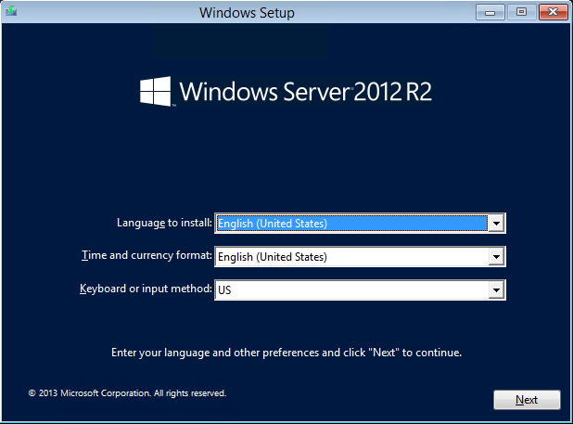
Performing a Clean Installation
Select Your Preferences

Slide 22
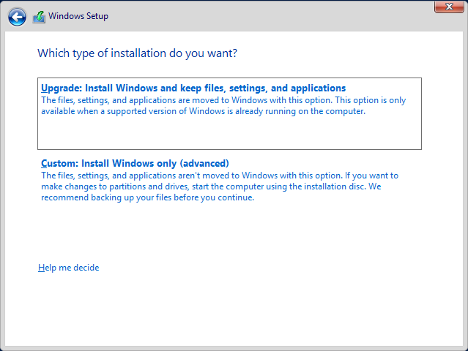
Performing a Clean Installation
Select Custom: Install Windows only (advanced)

Slide 23
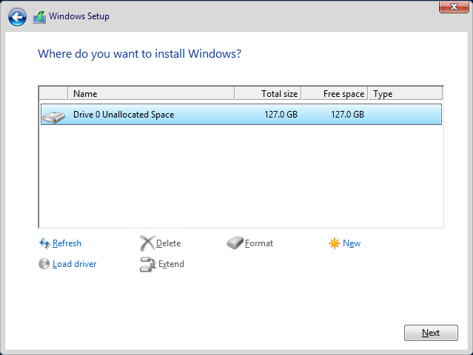
Performing a Clean Installation
Select the Partition/Drive on which to Install
Windows Server

Slide 24
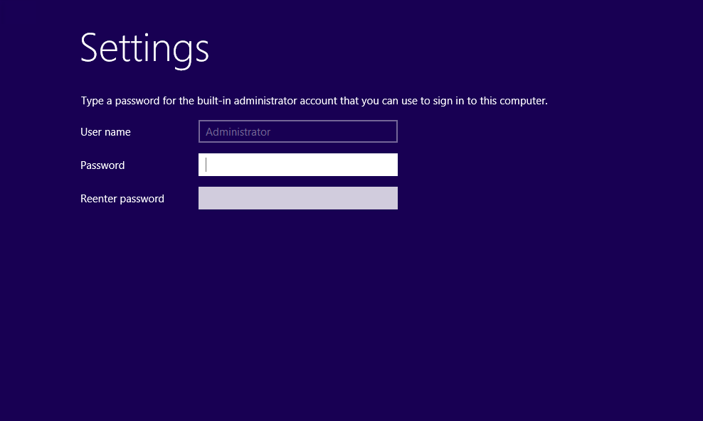
Performing a Clean Installation
Set the Administrator Password

Slide 25
Installing Third-Party Drivers
If hard drives are connected to a third-party controller, rather than the one integrated into the motherboard, the installation procedure may not detect your hard drive.
The Where do you want to install Windows? page will not list hard drives.
Install a third-party driver to allow the installation program access to your hard drive to continue the installation.

Slide 26
Working with Installation Partitions
You can create, manage, and delete partitions on your hard drive.
Click Drive options (advanced) and four buttons will appear:
Delete
Extend
Format
New

Slide 27
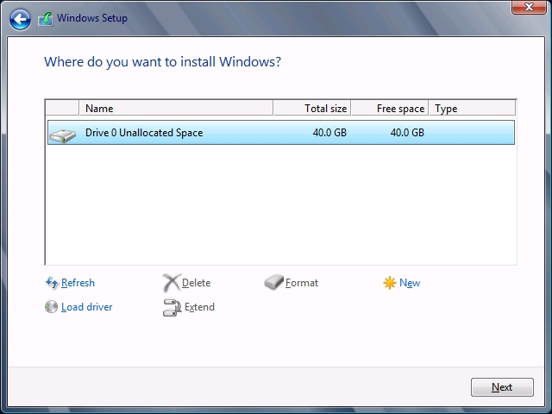
Working with Installation Partitions
Advanced Drive Options Buttons

Slide 28
Choosing Installation Options
Lesson 1: Installing Servers

Slide 29
Using Server Core
Stripped-down version of the operating system
Takes you to a Graphical User Interface (GUI)
Type commands at the command prompt

Slide 30
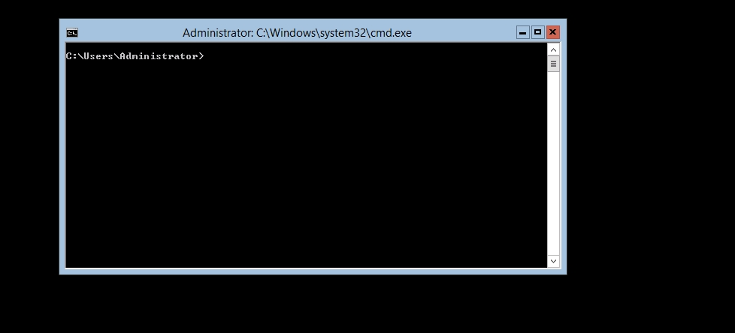
Server Core
Server Core’s Command Line Interface

Slide 31
Advantages of Server Core
Hardware resource conservation
Reduced disk space
Reduced patch frequency
Reduced attack surface

Slide 32
Server Core Defaults
Server Core is now the default installation option.
GUI tools can be added and removed using Windows PowerShell commands.
New Server Manager includes comprehensive remote administration tools.

Slide 33
Using the Minimal Server Interface
A setting that removes some of the most hardware-intensive elements from the GUI.
Middle ground between Server Core and full GUI installation.
Administrators are left with essential tools:
Server Manager
MMC applications
Device Manager
Windows PowerShell

Slide 34
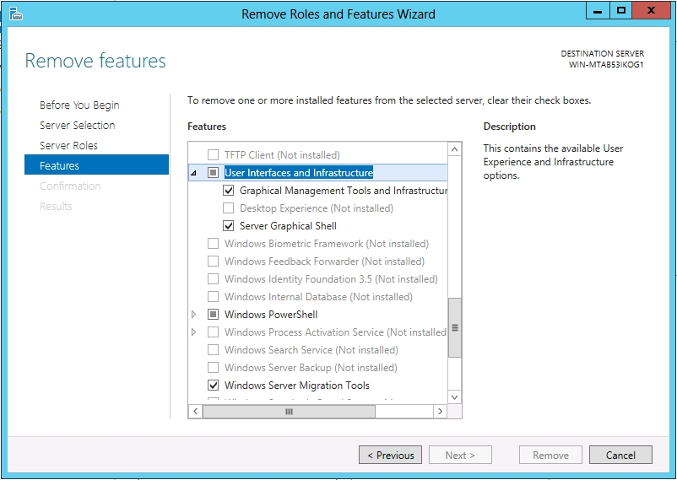
Configure the Minimal Interface
User Interfaces and Infrastructure Feature in the Remove Roles and Features Wizard

Slide 35
Using Features on Demand
Allows you to optimize resource utilization by removing files related to unused Windows features stored in WinSxS directory.
Permanently remove files for unused features using Windows PowerShell commands.
The following command will disable the Server Graphical Shell and remove its source files from WinSxS:
Uninstall-WindowsFeature Server-Gui-Shell –Remove
If you attempt to enable the feature in the future, the system will download it from Windows Update or from an image file you specify.

Slide 36
Upgrading Servers
Lesson 1: Installing Servers

Slide 37
Upgrading Servers
Setup program creates a new Windows folder in which to install the new version of Windows Server 2012 R2.
The program then migrates applications, files, and settings from the old OS to the new.
To minimize risks involved in this complex procedure, administrators must perform backups and be able to troubleshoot problems that may arise.

Slide 38
Upgrade Paths
Windows Server 2012 R2 has very limited upgrade paths.
You can only upgrade Windows Server 2008 or Windows Server 2008 R2, 64 bit versions only, to their comparable Windows Server 2012 edition.
For all other Windows versions and editions, you will have to perform a Clean Installation.

Slide 39
Preparing to Upgrade
Check hardware compatibility.
Check disk space.
Confirm that software is signed.
Check application compatibility.
Ensure computer functionality.
Perform a full backup.
Purchase Windows Server 2012.

Slide 40
Performing an Upgrade Installation
Insert the Windows Server 2012 installation DVD while your current server is still running, and run the Setup program.
The installation program will run the same way as a clean installation except on the Which type of installation do you want page, you must select Upgrade: Install Windows and keep files, settings, and applications option.
The Setup program will provide a Compatibility Report.

Slide 41
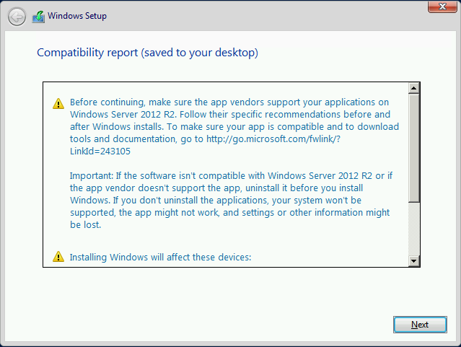
Performing an Upgrade Installation
Compatibility report page

Slide 42
Migrating Roles
Lesson 1: Installing Servers

Slide 43
Migrating Roles
Migration is the preferred method of replacing an existing server with one running Windows Server 2012 R2.
Migration copies vital information from an existing server to a clean Windows Server 2012 R2 installation.
Upgrade restrictions do not apply to migrations.
You can migrate between versions, platforms, editions, physical and virtual instances, and installation options.

Slide 44
Server Migration
Different from workstation migration.
Migrate roles or role services individually.
Migration guides exist for different roles supported by Windows Server 2012 R2.
Some migrations require the use of Windows Server Migration Tools and others do not.

Slide 45
Server Migration Steps
Install Windows Server Migration Tools on the destination server, running Windows Server 2012 R2.
Create a distribution folder and copy an appropriate version of the tools for the source server.
Copy the distribution folder to the source server and then register the Windows Server Migration Tools.
Use Migration Guides to migrate roles, features shares, settings, and other data.

Slide 46
Migration Guide Elements
Compatibility notes
Guide contents
Migration overview
Migration requirements
Pre-migration tasks
Migration procedures
Post-migration procedures

Slide 47
Lesson Summary
Microsoft releases all of its operating systems in multiple editions, which provides consumers with varying price points and feature sets.
Windows Server 2012 R2 includes predefined combinations of services called roles that implement common server functions.
A clean installation is the simplest way to deploy Windows Server 2012 R2 on a bare metal computer or a computer with a partition that you are willing to reformat (losing all of the data on the partition in the process).
Notes:
Lecture notes go here

Slide 48
Lesson Summary
Many enterprise networks today use servers that are dedicated to a particular role. When a server is performing a single role, does it really make sense to have so many other processes running on the server that contribute little to that role?
When you select the Windows Server Core installation option, you get a stripped-down version of the operating system.
If the advantages of Server Core sound tempting, but there are traditional server administration tools you don’t want to give up, Windows Server 2012 R2 provides a compromise that it calls the Minimal Server Interface.
The Minimal Server Interface is a setting that removes some of the most hardware-intensive elements from the GUI.
Notes:
Lecture notes go here

Slide 49
Lesson Summary
An in-place upgrade is the most complicated form of Windows Server 2012 R2 installation. It is also the lengthiest, and the most likely to cause problems during its execution. Whenever possible, Microsoft recommends that administrators perform a clean installation, or migrate required applications and settings instead.
Migration is the preferred method of replacing an existing server with one running Windows Server 2012 R2. Unlike an in-place upgrade, a migration copies vital information from an existing server to a clean Windows Server 2012 R2 installation.
Windows Server Migration Tools is a Windows Server 2012 R2 feature that consists of Windows PowerShell cmdlets and help files that enable administrators to migrate certain roles between servers.
Notes:
Lecture notes go here

Slide 50
Copyright 2013 John Wiley & Sons, Inc.
All rights reserved. Reproduction or translation of this work beyond that named in Section 117 of the 1976 United States Copyright Act without the express written consent of the copyright owner is unlawful. Requests for further information should be addressed to the Permissions Department, John Wiley & Sons, Inc. The purchaser may make back-up copies for his/her own use only and not for distribution or resale. The Publisher assumes no responsibility for errors, omissions, or damages, caused by the use of these programs or from the use of the information contained herein.

