Slide 1
The Cell Division
Mitosis & Meiosis

Slide 2
The Cell Division
Cell division is a process by which the cellular material is divided between 2 new daughter cells.
Types of cell division:
Mitosis (indirect division)
Meiosis (reduction division)
occurs in somatic cells of higher organisms, and is the means of population growth in unicellular organisms.
occurs in the diploid germ cells of animals
results in 4 daughter cells each having a haploid number of chromosomes (i.e. half the number of chromosomes of the original cell).
results in two daughter cells, each having the same number of chromosomes of the mother cell.
involves exchange of the chromosomal segments between homologous (identical) chromosomes

Slide 3
The phases of Mitosis division
Plant cell
Animal cell
(1) Prophase
(2) Metaphase
(3) Anaphase
(4) Telophase

Slide 4
Prophase
Mitosis division in plant cell

Slide 5
Mitosis division in plant cell
Metaphase

Slide 6
Mitosis division in plant cell
Anaphase

Slide 7
Mitosis division in plant cell
Telophase

Slide 8
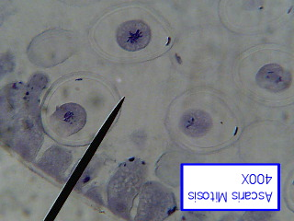
Mitosis division in animal cell
Prophase

Slide 9
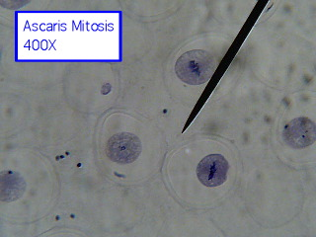
Mitosis division in animal cell
Metaphase

Slide 10
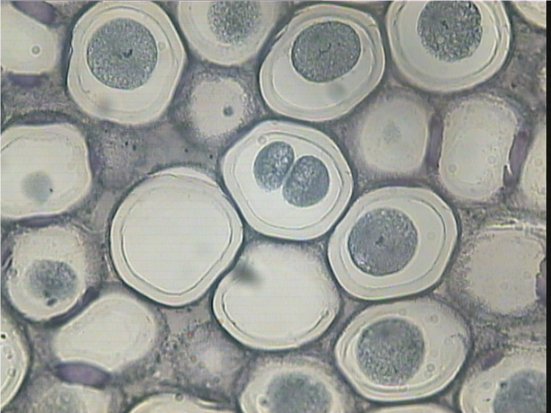
Metaphase
Mitosis division in animal cell

Slide 11
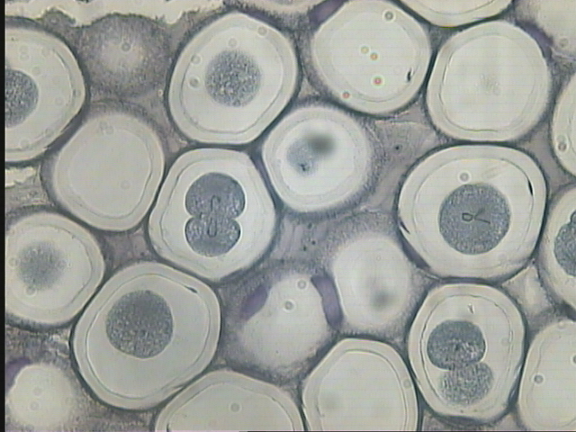
Mitosis division in animal cell
Anaphase

Slide 12
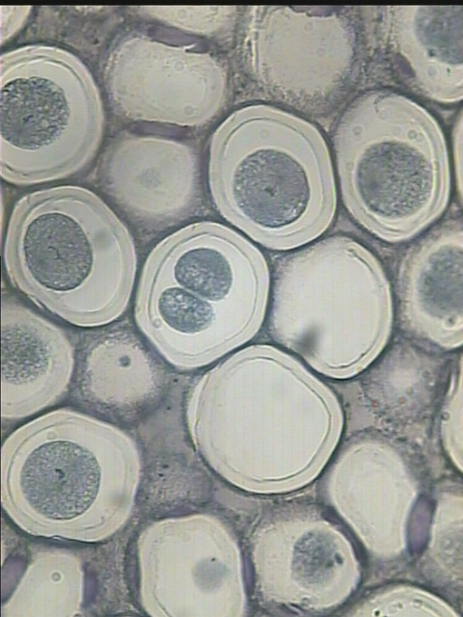
Mitosis division in animal cell
Telophase

Slide 13
The phases of Meiosis division
Meiosis I
Meiosis II
(1) Prophase
(2)Metaphase
(3) Anaphase
(4) Telophase

Slide 14
Meiosis I division in plant cell
Prophase

Slide 15
Meiosis I division in plant cell
Metaphase

Slide 16
Meiosis I division in plant cell
Anaphase

Slide 17
Meiosis I division in plant cell
Telophase

Slide 18
Meiosis II division in plant cell
Prophase

Slide 19
Meiosis II division in plant cell
Metaphase

Slide 20
Meiosis II division in plant cell
Metaphase

Slide 21
Meiosis II division in plant cell
Anaphase

Slide 22
Meiosis II division in plant cell
Telophase

