Slide 1
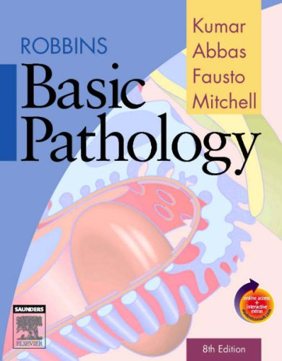
CLS 223

Slide 2
Lecture # 7
Circulatory Disturbance

Slide 3
Classification
Disturbance in the volume of circulating blood.
Disturbance of obstructive nature (next lecture).

Slide 4
1)Disturbance in the volume of circulating blood
Hemorrhage
Hyperemia
Congestion

Slide 5
Hemorrhage
Definition:
Escape of blood from blood vessels to extravascular space.
Causes:
Trauma: Mechanical injury to the vascular wall either accidental or surgical.
Increased intravascular tension: Hypertension.
Destruction of BV wall: Malignancy.
Disease of vascular wall: Aneurysm.
Hemorrhagic blood disease: Hemophilia.
Vitamin C and K deficiency.
Notes:
Vitamin C is important In the synthesis of collagen. Defective connective tissue leads to fragile capillaries, resulting in abnormal bleeding and impaired wound healing.
Vitamin K is in involved in coagulation. Inability to activate the clotting cascade leads to the bleeding symptoms.

Slide 6
Types of hemorrhage:
External:
Epistaxis: bleeding through the nose.
Hemoptysis: coughing of blood.
Hematemesis: vomiting of blood.
Melena: bleeding through the anus.
Hematuria: bleeding with urine.
Menorrhagia: excessive or prolonged menstrual bleeding.

Slide 7
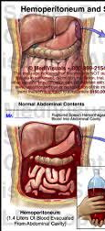
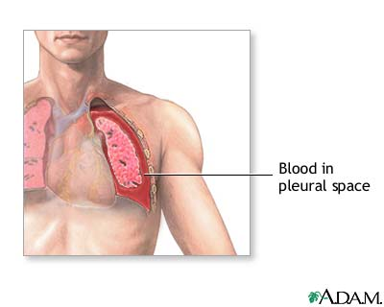
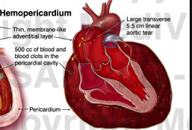
2) Internal:
Escape of blood into serous sacs (body cavities):
-Hemothorax (escape of blood into the thorax cavity).
-Hemopericardium (escape of blood into the pericardial cavity).
-Hemoperitoneum (escape of blood into the peritoneal cavity).
Notes:
Spaces within body tissues that are outside the blood vessels
Practical exam (choose any one)

Slide 8
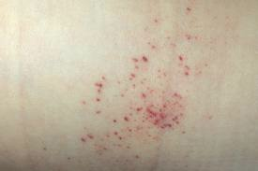
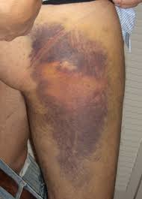
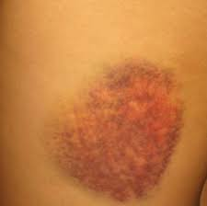
Escape of blood into interstitial tissue spaces:
-Petechiae (small amount of blood).
-Ecchymosis ( moderate amount of blood).
-Hematoma (large amount of blood).
Notes:
Practical exam ( petechiae or hematoma)

Slide 9
Effects of hemorrhage
The clinical significance of hemorrhage Depends on the volume and site of blood loss
Small amount: no effect
Small amount in critical location → leads to death.
massive amount → leads to hemorrhagic shock and death.

Slide 10
Hyperemia
Definition:
increase in blood flow to a particular tissues in the body as a result of active dilatation of arterioles and capillaries.
This allows change in blood supply to that tissues.
This increase in the blood flow is represented by hotness and redness.
It can be
Physiological: in skeletal muscle during exercise.
Pathological: at the site of inflammation.

Slide 11
Congestion
Definition:
increase venous blood in a particular tissues in the body through passive venules dilation. This happens as a result of impaired venous return out of a tissue.
It may be:
It may be local as a result of local obstruction of venous outflow, or it may be systematic , as in congestive heart failure.
The tissue has a blue color (cyanosis).
The cause is mainly pathological.

Slide 12
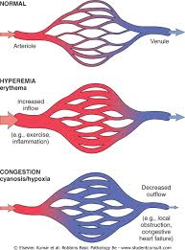
Notes:
In both cases there is an increase in the blood flow in a given tissue. In hyperemia, there is an increase of oxygenated blood flow resulting in redness and hotness . In congestion, diminished outflow leads to capillary beds swollen with deoxygenated blood resulting in cyanosis

