Slide 1

Sodium Dodecyl Sulfate -Polyacryl Amide Gel Electrophoresis
[SDS-PAGE]
Lab# 7
BCH 333[practical]

Slide 2

Objective:
-To be familiar with SDS-PAGE protocols (Linear slab gel).

Slide 3
SDS-Polyacrylamide Gel Electrophoresis
-Sodium Dodecyl Sulfate-PolyacrylAmide gel Electrophoresis (SDS-PAGE) is a low-cost, reproducible and rapid method for: qualifying, comparing , characterizing proteins[e.g. determining MW of proteins] and checking purity of protein samples.
-This method separates proteins based primarily on their molecular weights.

Slide 4
Story of SDS-PAGE
-In general, fractionation by gel electrophoresis is based on differences in size, shape and net charge of macromolecules.[in molecules native condition using native gel electrophoresis].
-Systems where you separate proteins under native conditions cannot distinguish between these effects and therefore proteins of different sizes may have the same mobility in native gels.

Slide 5
-In SDS-PAGE, this problem is overcome by the introduction of an anionic detergent Sodium Dodecyl Sulfate “SDS”, which binds strongly to most proteins.
-When hot SDS is added to a protein all non-covalent bonds[?] are disrupted and the proteins acquire a negative net charge.
-A Concurrent treatment with a disulfide reducing agent such as β-mercaptoethanol or DTT (dithiothreitol) further breaks down the strong bound disulfide.

Slide 6
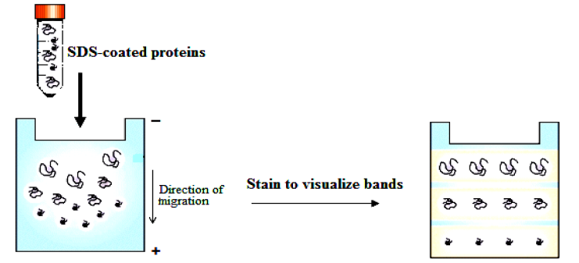
The electrophoretic Mobility of the molecules is now considered to be a function of their sizes i.e. the migration of the (SDS-treated proteins), towards the anode [+] is aversely proportional to the logarithms of their molecular weights, or more simply expressed:
Small proteins migrate faster through the gel.
[Compare this with the situation in gel filtration.]

Slide 7
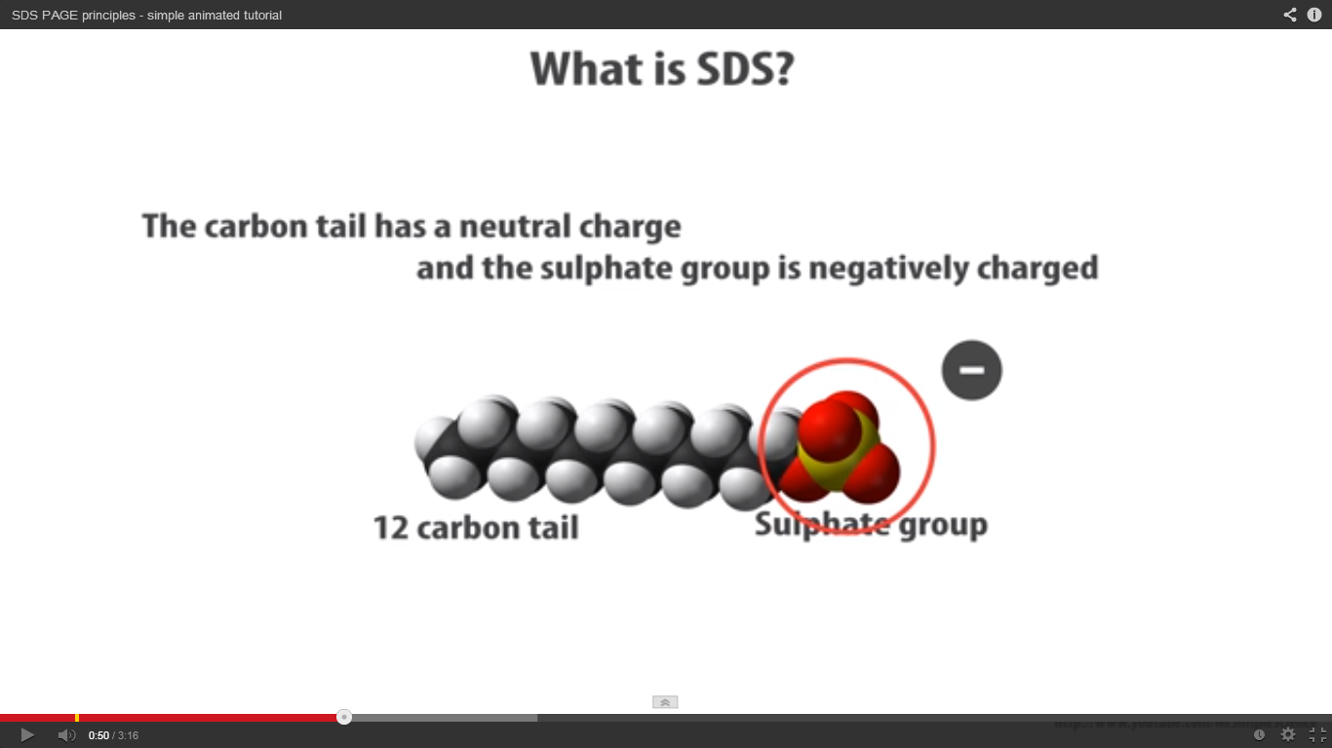
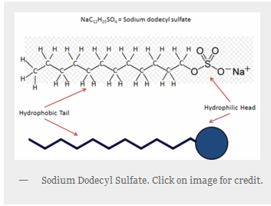
http://www.youtube.com/watch?v=3CrzY7jb9fQ

Slide 8
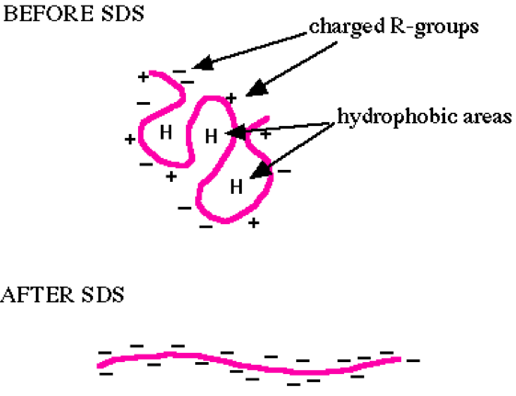

Slide 9
2-Polyacrylamide gel [Acrylamide stock]:
- The polyacrylamide gel is formed by co-polymerization of acrylamide and a cross-linking
By N,N’-methylene-bis-acrylamide.
To polymerize the gel a system, ammonium persilfate (initiator) and tetramethylene ethylene diamin (TEMED) [catalyst], are added.

Slide 10
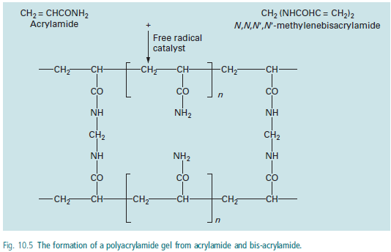

Slide 11
Principle:
In denaturing protein electrophoresis, the addition of SDS to the electrophoresis buffer uniformly coats the proteins with negative charges, and unify the structure of protein samples to the primary structure.
-A Concurrent treatment with a disulfide reducing agent such as β-mercaptoethanol or DTT (dithiothreitol) further breaks down the strong bound disulfide.
-So, the proteins samples are having uniformed structure and charge → the separation will depend on their molecular weight only.
-Small proteins migrate faster through the gel under the influence of the applied electric field.
Note: The number of SDS molecules that bind is proportional to the size of the protein, thereby in the electrical field, protein molecules move towards the anode (+) and separated only according to their molecular weight.

Slide 12
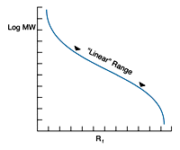
Graph of log MW vs. Rf is sigmoidal, it is nearly linear for a range of molecular weights excluding very small and very large M wt
(Figure has been taken from http://www.nationaldiagnostics.com/article_info.php/articles_id/55)

Slide 13
SDS-Polyacrylamide Gel Electrophoresis Preparation and Data Analysis:

Slide 14
1.Sample preparation, using the disruption buffer which contain:
-10% (w/v) SDS [?]
-1M Tris/HCl, pH 6.8
-Glycerol [?]
-β-Mercaptoethanol [?]
-Bromophenol blue [?]
-with distilled water
[40µl of protein sample + 10 µl of disruption buffer→ boil the mixture 3minets at 99C̊ .]
2. Preparing acrylamide gels:
It is composed of two gels:
A. Separation gel:
HIGH concentration of the acrylamide stock and pH.
B. Stacking gel:
LOW concentration of the acrylamide stock and pH.

Slide 15
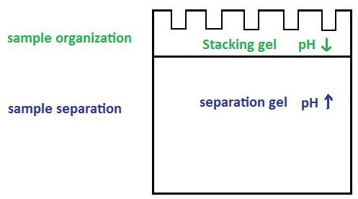
B
A
SDS-Polyacrylamide Gel Electrophoresis

Slide 16
A-Separation gel contents:
Volume of stock solution required to make 12% polyacrylamide gel | Stock solutions
2.0 ml | 1.5 M Tris/HCl, pH 8.8
3.2 ml | Acrylamide stock
2.8 ml | Water
80 µl | 10% SDS
100 µl | 10% Ammonium persulphate (fresh)
20 µl | TEMED

Slide 17
B-Stacking gel contents:
Volume of stock solution required to make 12% polyacrylamide gel | Stock solutions
1.0 ml | 0.5M Tris/HCl, pH6.8
1.0 ml | Acrylamide stock
3.0 ml | Water
80 µl | 10% SDS
100 µl | 10% Ammonium persulphate (fresh)
20 µl | TEMED

Slide 18
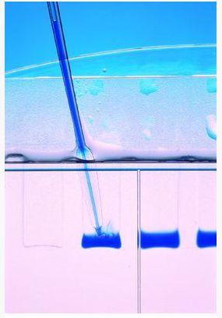
3-Loading the samples:

Slide 19
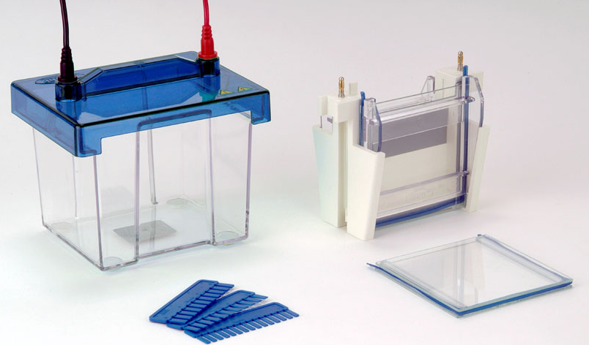
Electrophoresis
4- SDS-PAGE, Running buffer :[?]
-helps is deliver the electric current through the gel.
Tris
Glycine
SDS

Slide 20
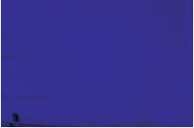
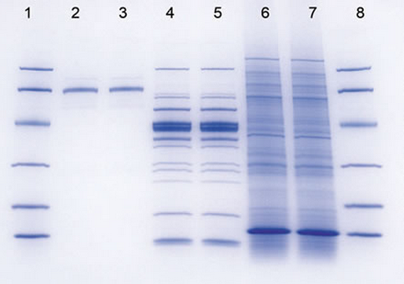
5-SDS-PAGE, Staining buffer: [?]
Glacial acetic acid
Methanol
Coomassie brilliant blue R 250 [?]
6-SDS-PAGE, de-staining buffer:
Glacial acetic acid
Methanol

Slide 21
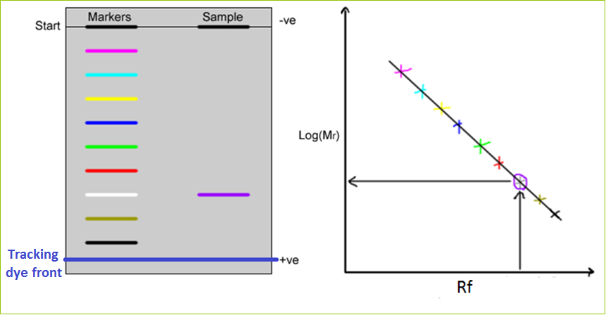
7-Analysis:
For Molecular weight Determination.
- Rf = Distance of migration of sample
Distance moved by tracking dye

Slide 22
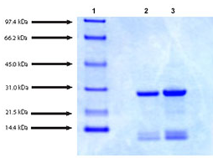

Slide 23
Protein size (KDa) | Gel %
12-43 | 15
16-68 | 10
36-94 | 7
57-212 | 5

Slide 24

Applications:
1. To detect the purity of the protein.
2. Determine of protein molecular weight.
http://www.youtube.com/watch?v=EDi_n_0NiF4

Slide 25
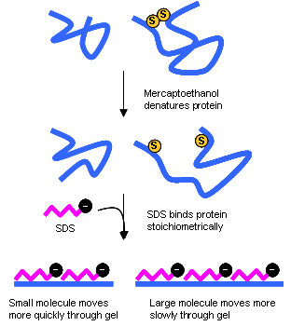

Slide 26
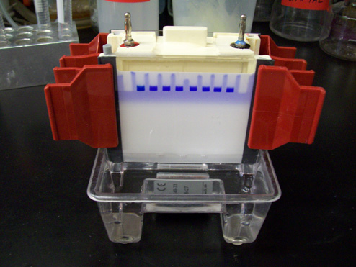
At beginning

Slide 27
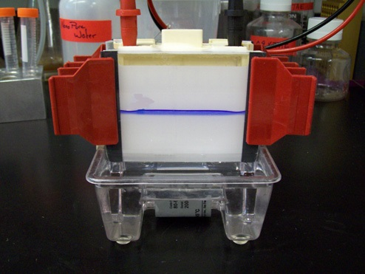
After a while

Slide 28

After more min.

Slide 29
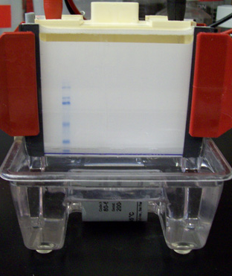
Separated Sample
Marker
Ladder)
Dye front
At the end

Slide 30
Staining
De Staining

