Slide 1
Objects and References
Ch5.3

Slide 2
Objects and References: Outline
Variables of a Class Type
Defining an equals Method for a Class
Boolean-Valued Methods
Parameters of a Class Type

Slide 3
Variables of a Class Type
All variables are implemented as a memory location
Data of primitive type stored in the memory location assigned to the variable
Variable of class type contains memory address of object named by the variable

Slide 4
Variables of a Class Type
Object itself not stored in the variable
  Stored elsewhere in memory
  Variable contains address of where it is stored
Address called the reference to the variable
A reference type variable holds references (memory addresses)
  This makes memory management of class types more efficient

Slide 5
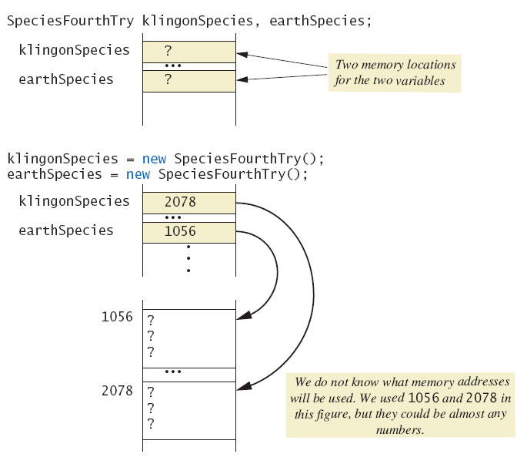
Variables of a Class Type
Figure
5.5a
Behavior
of class
variables

Slide 6
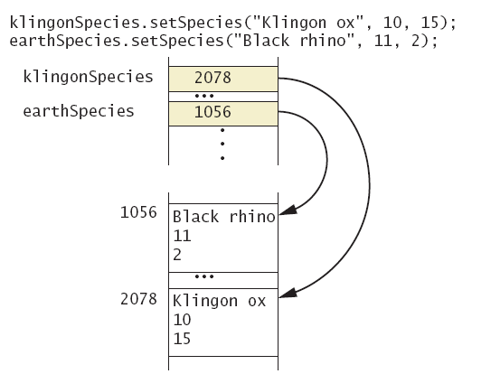
Variables of a Class Type
Figure
5.5b
Behavior
of class
variables

Slide 7
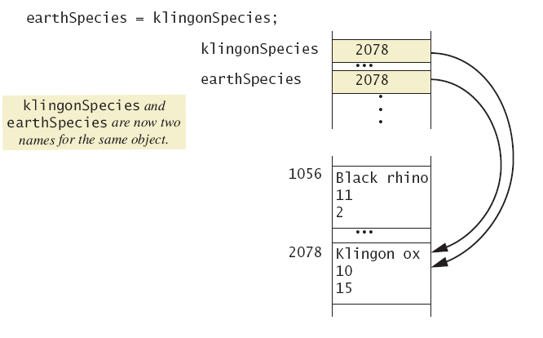
Variables of a Class Type
Figure
5.5c
Behavior
of class
variables

Slide 8
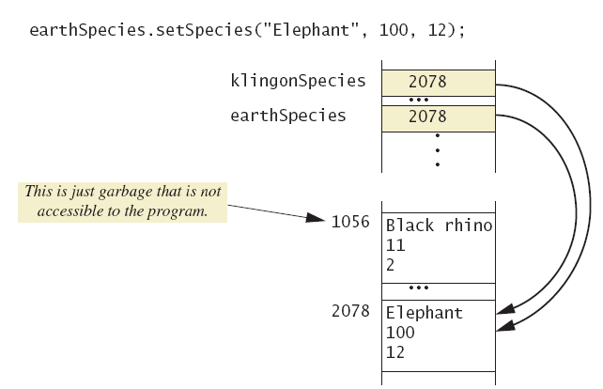
Variables of a Class Type
Figure
5.5d
Behavior
of class
variables

Slide 9
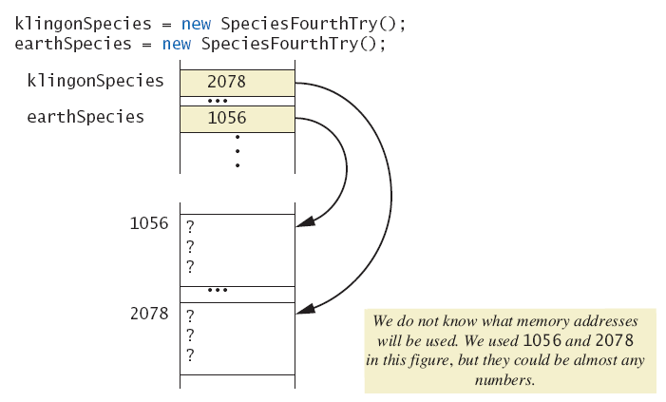
Variables of a Class Type
Figure
5.6a
Dangers of
using ==
with objects

Slide 10
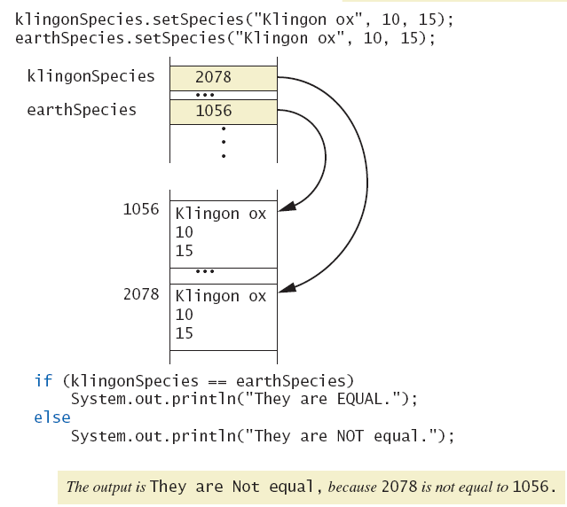
Variables of a Class Type
Figure
5.6b
Dangers of
using ==
with objects

Slide 11
Defining an equals Method
As demonstrated by previous figures
  We cannot use == to compare two objects
  We must write a method for a given class which will make the comparison as needed
The equals for this class method used same way as equals method for String

Slide 12
Demonstrating an equals Method
public class Rectangle {
  private int width;
  private int height;
  public void setWidth(int w){ width = w; }
  public void setHeight(int h){ height = h; }
  public int getWidth() { return width; }
  public int getHeight() { return height; }
  public boolean equals(Rectangle r){
    return r.width == this.width &&
    r.height == this.height;
  }
}

Slide 13
Demonstrating an equals Method
public class RectangleTest {
  public static void main(String[] args) {
  Rectangle box1 = new Rectangle();
  Rectangle box2 = new Rectangle();
  box1.setWidth(5); box1.setHeight(10);
  box2.setWidth(5); box2.setHeight(10);
  if(box1 == box2)
  System.out.println("Match with ==.");
  else
  System.out.println("Do not match with ==.");
  if(box1.equals(box2))
  System.out.println("Match with the method equals.");
  else
  System.out.println("Do not match with the method equals");
  }
}
Note difference in the two comparison methods == versus .equals( )
Sample screen output
Do not match with ==.
Match with the method equals.

Slide 14
Object1 = object2
public class RectangleTest {
  public static void main(String[] args) {
  Rectangle box1 = new Rectangle();
  Rectangle box2 = new Rectangle();
  box1.setWidth(5); box1.setHeight(10);
  box2.setWidth(20); box2.setHeight(30);
  box1 = box2;
  System.out.println("The width of box 1 is " + box1.getWidth());
  System.out.println("The hight of box 1 is " + box1.getHeight());
  }
}
Sample screen output
The width of box 1 is 20
The height of box 1 is 30

Slide 15
Boolean-Valued Methods
Methods can return a value of type boolean
Use a boolean value in the return statement.
public boolean isPositive(int n) {
return n > 0;
}

Slide 16
Parameters of a Class Type
When assignment operator used with objects of class type
  Only memory address is copied
Similar to use of parameter of class type
  Memory address of actual parameter passed to formal parameter
  Formal parameter may access public elements of the class
  Actual parameter thus can be changed by class methods

Slide 17
Parameters of Primitive type vs. class type
Parameter of primitive type initialized with value of actual parameter
Value of actual parameter not altered by method
Parameter of class type initialized with address of actual parameter object
Value of actual parameter may be altered by method calls

Slide 18
Parameter of primitive type vs. parameter of class Type ( Example)
public class ParameterDemo {
  private int x;
  private int y;
  public void setValues(int x, int y){
    this.x = x;
    this.y = y;
  }
  public void tryToChange(int var1){
  var1 = x;}
  public void tryToReplace(ParameterDemo otherObject){
  otherObject = this;
  }
  public void change(ParameterDemo otherObject){
    otherObject.x = this.x;
    otherObject.y = this.y;
  }
  public void display(){
  System.out.println("x = "+ x + ", y = "+ y);} }

Slide 19
Parameter of primitive type vs. parameter of class Type (Example)
public class ParametersDemoTest {
  public static void main(String[] args) {
    ParameterDemo p1 = new ParameterDemo();
    ParameterDemo p2 = new ParameterDemo();
    p1.setValues(2, 3);
    p2.setValues(7, 9);
    int number = 20;
    System.out.println("number before calling tryToChange is " + number);
    p1.tryToChange(number);
    System.out.println("number after calling tryToChange is " + number);
    System.out.println("p2 before calling tryToReplace is ");
    p2.display();
    p1.tryToReplace(p2);
    System.out.println("p2 after calling tryToReplace is ");
    p2.display();
    p1.change(p2);
    System.out.println("p2 after calling change is ");
    p2.display();}}

Slide 20
Parameter of primitive type vs. parameter of class Type (Example)
Sample screen output
number before calling tryToChange is 20
number after calling tryToChange is 20
p2 before calling tryToReplace is
x = 7, y = 9
p2 after calling tryToReplace is
x = 7, y = 9
p2 after calling change is
x = 2, y = 3

Slide 21
Summary
Classes have
  Instance variables to store data
  Method definitions to perform actions
Instance variables should be private
Class needs accessor, mutator methods
Methods may be
  Value returning methods
  Void methods that do not return a value
Notes:
self read

Slide 22
Summary
Keyword this used within method definition represents invoking object
Local variables defined within method definition
Formal arguments must match actual parameters with respect to number, order, and data type
Formal parameters act like local variables
Notes:
self read

Slide 23
Summary
Parameter of primitive type initialized with value of actual parameter
  Value of actual parameter not altered by method
Parameter of class type initialized with address of actual parameter object
  Value of actual parameter may be altered by method calls
A method definition can include call to another method in same or different class
Notes:
self read

