Slide 1
Information Hiding and Encapsulation
Ch 5.2

Slide 2
Information Hiding, Encapsulation: Outline
Information Hiding
The public and private Modifiers
Methods Calling Methods
Encapsulation
UML Class Diagrams

Slide 3
Information Hiding
Programmer using a class method need not know details of the implementation of the method
  Only needs to know what the method does
Information hiding:
  Designing a method so it can be used without knowing details
Also referred to as abstraction
Method design should separate what from how
Careful documentation of what a method does can achieve that. For more info read: pre/post conditions
Notes:
Abstraction will be covered in more detail in CSC113
Pre and post conditions will be emphasized in your Data Structures course.
Do you know what is the code inside the String methods?

Slide 4
The public and private Modifiers
When an identifier is specified as public:
  Any other class can directly access that identifier by name
When an identifier is specified as private:
  Only the class itself can directly access that identifier by name
  It can not be accessed directly from the outside
Classes are generally specified as public
Instance variables are usually private
Notes:
If no modifier is specified, the default is package-private it will act as public within the package.

Slide 5
Programming Example
public class Rectangle
{
public int width;
public int height;
private int area;
public void setDimensions
(int newWidth,
int newHeight)
{ width = newWidth;
height = newHeight;
area = width * height;
}
public int getArea ()
{ return area;
}
}
Could be used like this in main:
Rectangle box = new Rectangle();
box.setDimensions(10,5);
System.out.println(box.getArea());
A statement such as
box.width = 6;
is legal since width is public
Is it a good idea? Why?
No, it causes an inconsistency. Area would still be 50.
Notes:
(Example is different from the book a little bit)

Slide 6
Programming Example
public class Rectangle
{
private int width;
private int height;
private int area;
public void setDimensions
(int newWidth,
int newHeight)
{ width = newWidth;
height = newHeight;
area = width * height;
}
public int getArea ()
{ return area;
}
}
Could be used like this in main:
Rectangle box = new Rectangle();
box.setDimensions(10,5);
System.out.println(box.getArea());
A statement such as
box.width = 6;
is illegal since width is private
Is it a good idea? Why?
Yes, keeps remaining elements of the class consistent
Can we improve it more?

Slide 7
Programming Example
public class Rectangle2
{
private int width;
private int height;
private int area;
public void setDimensions
(int newWidth,
int newHeight)
{ width = newWidth;
height = newHeight;
area = width * height;
}
public int getArea ()
{ return width * height;
}
}
Could be used like this in main:
Rectangle box = new Rectangle();
box.setDimensions(10,5);
System.out.println(box.getArea());
A statement such as
box.width = 6;
is illegal since width is private
And now we are NOT storing area but computing it when needed.

Slide 8
Accessor and Mutator Methods
When instance variables are private must provide methods to access values stored there
  Typically named getSomeValue
  Referred to as an accessor method
Must also provide methods to change the values of the private instance variable
  Typically named setSomeValue
  Referred to as a mutator method

Slide 9
Accessor and Mutator Methods
public class Rectangle
private int width;
private int height;
public void setWidth(int w)
{ width = w; }
public void setHeight(int h)
{ height = h; }
public int getWidth()
{ return width; }
public int getHeight()
{ return height; }
public int getArea()
{ return width * height;}
public class RectangleTest {
public static void main (String[] args) {
Rectangle box1 = new Rectangle();
box1.setWidth(5);
box1.setHeight(10);
System.out.println("The dimensions of”+ “box1 are ("+ box1.getWidth() + “,”+ box1.getHeight() + “)”); System.out.println("The area of box1 is ” + box1.getArea());
}
}

Slide 10
Methods Calling Methods
A method body may call any other method
If the invoked method is within the same class
  Need not use prefix of receiving object
public void method1 (int x, int y)
{ int sum = method2(x,y);
x++; y++;
method3(sum); }
public int method2(int i, int j)
{ i++; return i + j;
}
public void method3(int s )
{System.out.println(s);
System.out.println("Done!" );}
What will be printed when method1(2,3) is called?
6
Done!
Notes:
6
Done!

Slide 11
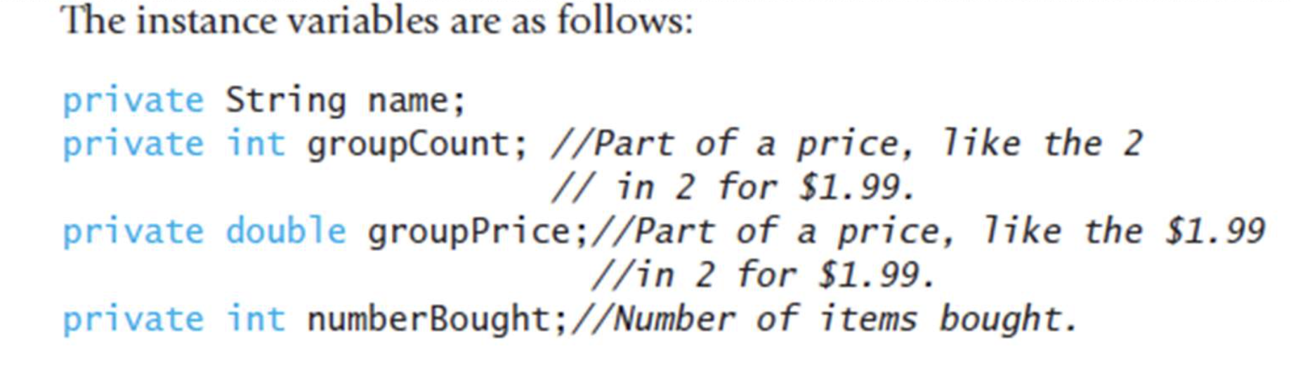
Activity
Supermarkets often give prices for a group of items such as 5 for $1.25 or 3 for $1.00, instead of the price for one item. They hope that if they price apples at 5 for 1.25$ you will buy 5 apples instead of 2. But 5 for $1.25 is really 0.25 each, and if you buy 2 apples, they charge you only $0.5.
Let's define a class named Purchase to manage the purchase of multiple identical items. What instance variables would be needed?
Notes:
This example exist on the book . You need to let the students think:
1- what information could be relevant ?
2- what action may sound reasonable?

Slide 12
Activity(cont)
what about the methods ?
  Accessor and mutator methods
  Compute the total cost
  Compute a single unit cost
  Read information
  Print information

Slide 13
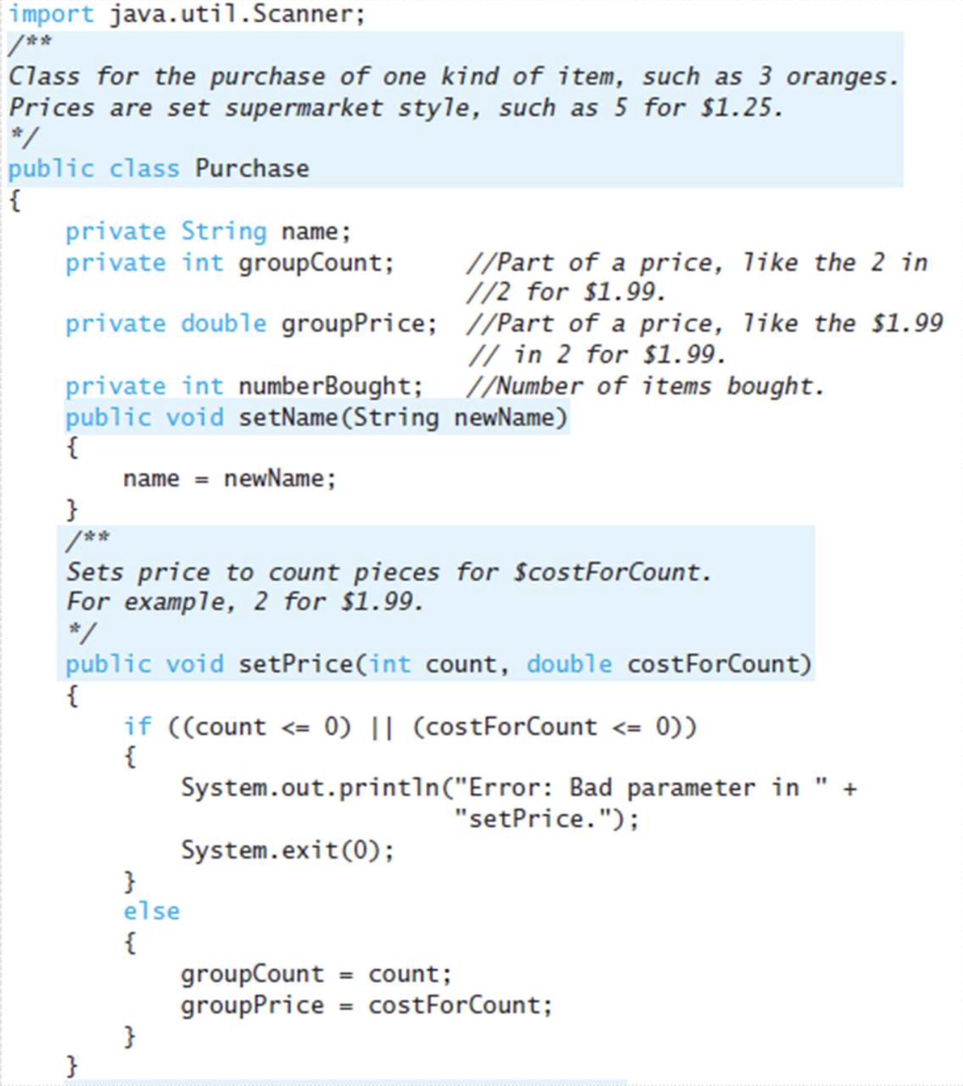
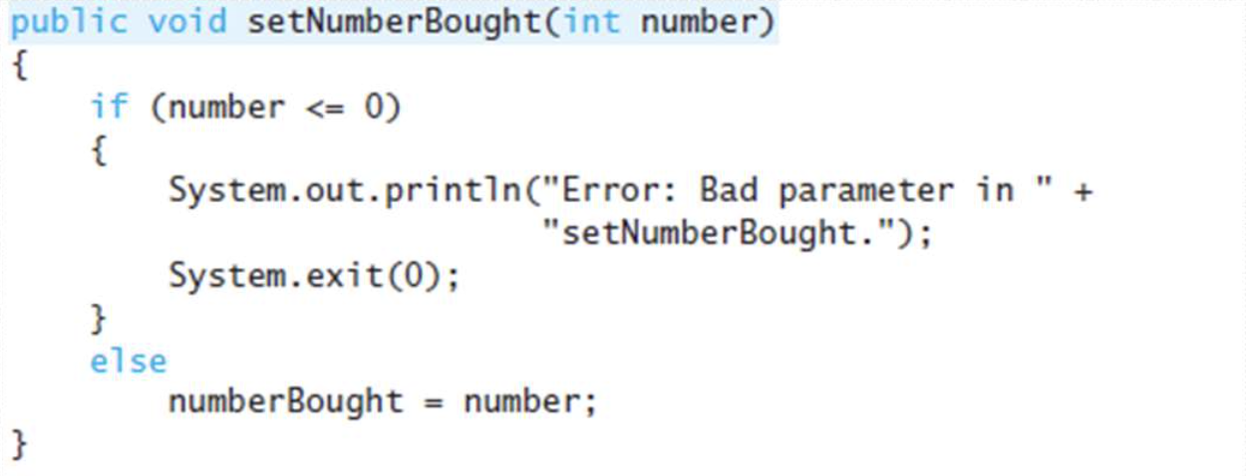

Slide 14
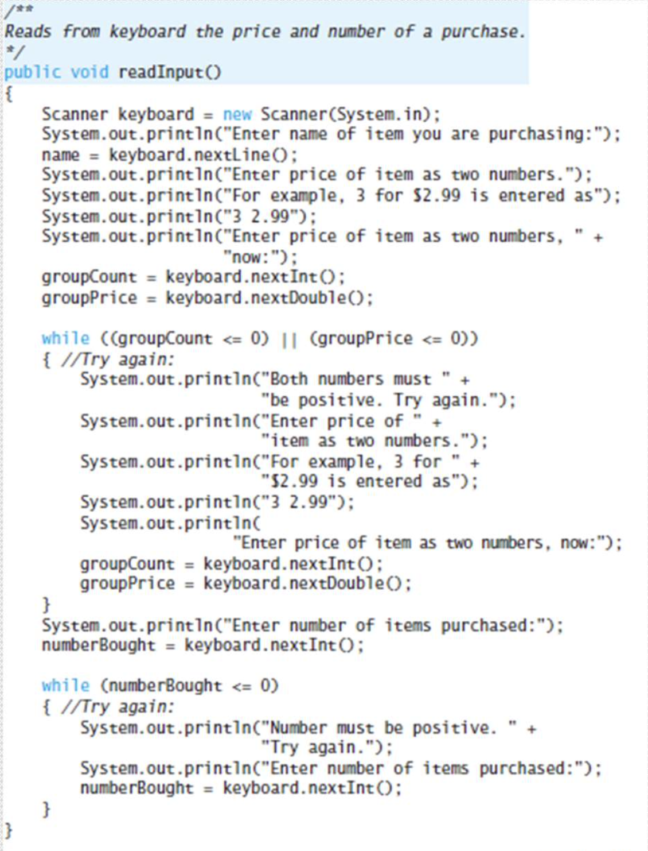
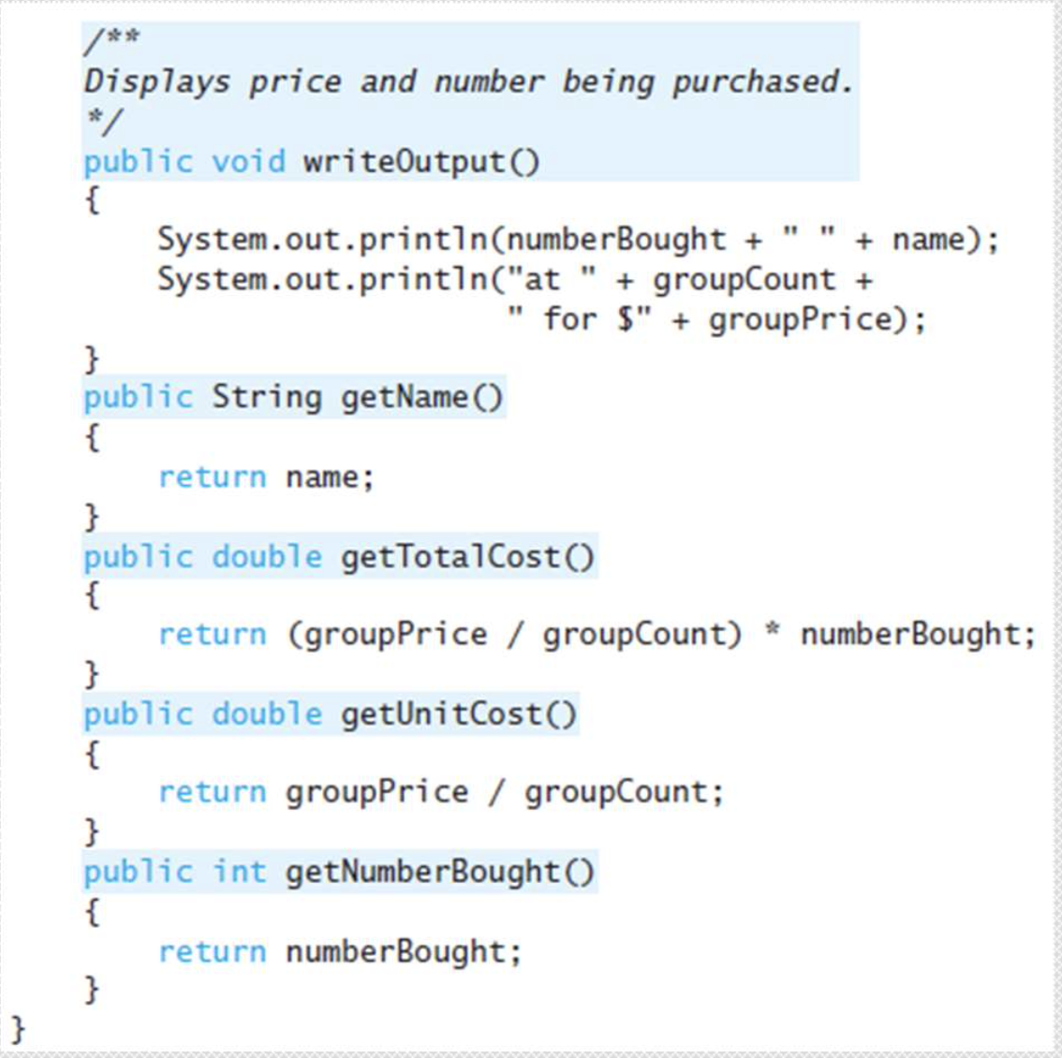

Slide 15
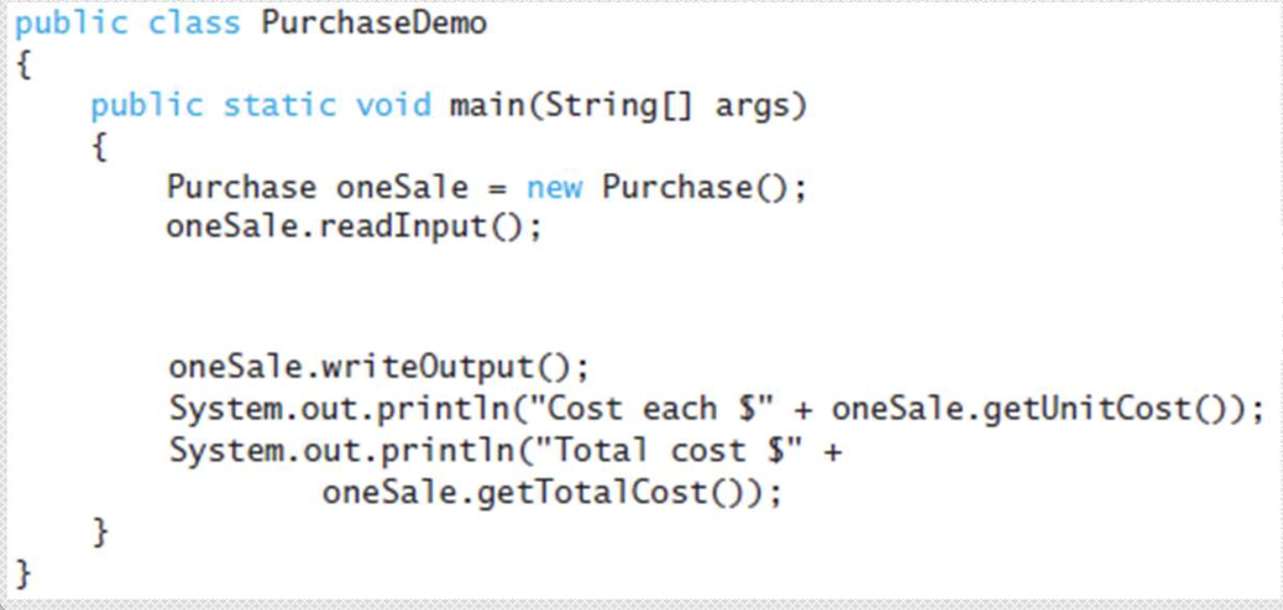

Slide 16
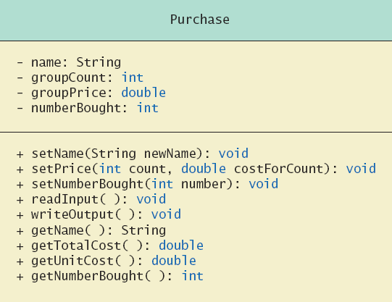
UML Class Diagrams
Note
Figure 5.4
for the
Purchase
class
Minus signs imply private access
Plus signs imply public access

Slide 17
More code samples
listing 5.11
listing 5.12
listing 5.13
listing 5.14
listing 5.15
Notes:
You don't need to go over them. Ask the students to explore these examples. 5.14 and 5.13 already present on the slides( purchase class and demo)

