Slide 1
Class and Method Definitions
Ch 5.1

Slide 2
Class and Method Definitions: Outline
Class Files and Separate Compilation
Instance Variables
Methods
The Keyword this
Local Variables
Blocks
Parameters of a Primitive Type

Slide 3
Class and Method Definitions
Java program consists of objects
  Objects of class types
  Objects that interact with one another
Program objects can represent
  Objects in real world
  Abstractions

Slide 4
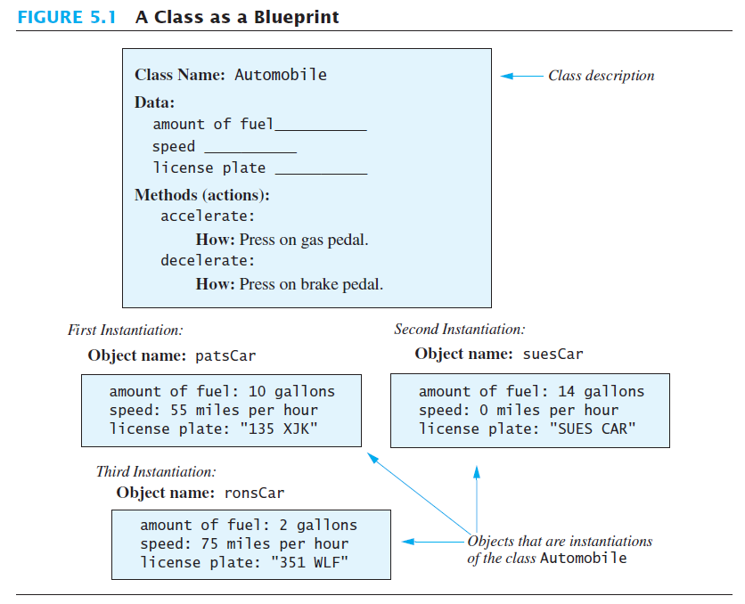
A class is a blueprint …
… for objects that we instantiate from it
Notes:
Note:
Each object has a name: patsCar, suesCar, ronsCar
In Java those would be variables.
And they would be of type Automobile

Slide 5
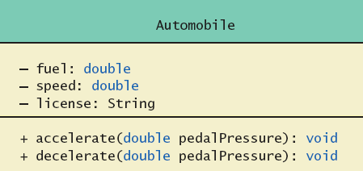
Class and Method Definitions
Figure 5.2 A class outline as a UML class diagram

Slide 6
Class Files and Separate Compilation
Each Java class definition usually in a file by itself
  File begins with name of the class
  Ends with .java
Class can be compiled separately
Helpful to keep all class files used by a program in the same directory
Notes:
You will learn this in your lab session

Slide 7
Methods
Think of a method as defining an action to be taken (a segment of code)
To start the action you invoke or call the method
There are two kinds of Java methods
  Return a single item
  Return nothing – a void method
The method main is a void method
  Invoked by the system
  Not by the application program

Slide 8
Methods
To call a void method
  Write the invocation followed by a semicolon
  Resulting statement performs the action defined by the method
To call a method that returns a quantity
  Write the invocation anywhere a value matching the return type can be used
  The call performs the action and the returned value will be used in the place of the invocation
If you call a method that returns a value the same way you call a void method, the method will be executed, but the returned value will be lost.

Slide 9
Why use User-defined methods?
Using methods has several advantages:
While working on one method, you can focus on just that part of the program/class and construct it, debug it, and perfect it.
Different people can work on different methods simultaneously.
If a method is needed in more than one place in a class, or in different programs, you can write it once and use it many times.
Using methods greatly enhances the program’s readability because it reduces the complexity of the program.

Slide 10
public class Dog
{ public String name;
public String breed;
public int age;
public void writeOutput()
{ System.out.println("Name: " + name);
System.out.println("Breed: " + breed);
System.out.println("Age in calendar years: " + age);
System.out.println("Age in human years: " +
getAgeInHumanYears());
System.out.println();
} // end writeOutput
public int getAgeInHumanYears()
{ int humanYears = 0;
if (age <= 2)
humanYears = age * 11;
else
humanYears = 22 + ((age-2) * 5);
return humanYears;
} // end getAgeInHumanYears
}
3 Instance variables
or Data members
or attributes
Will have different values for each Dog instance created.
Each object will have its own copy
2 behaviors
or methods
Will be the same for all Dog instances created, but act on individual instance variables.
Notes:
Use of public
No restrictions on how variables are used
Later might replace with private

Slide 11


public class DogDemo
{
public static void main(String[] args)
{
Dog balto = new Dog();
balto.name = "Balto";
balto.age = 8;
balto.breed = "Siberian Husky";
balto.writeOutput();
Dog scooby = new Dog();
scooby.name = "Scooby";
scooby.age = 42;
scooby.breed = "Great Dane";
System.out.println(scooby.name + " is a " + scooby.breed + ".");
System.out.print("He is " + scooby.age + " years old, or ");
int humanYears = scooby.getAgeInHumanYears();
System.out.println(humanYears + " in human years.");
}
}
Notes:
Note:
data members are used with the object name
Same for methods
“new” is used to create an object and allocate space in memory for it. (p.312)

Slide 12
Dog Example
public class Dog
{ public String name;
public String breed;
public int age;
public void writeOutput()
{ System.out.println("Name: " + name);
System.out.println("Breed: "+breed);
System.out.println("Age..: "+ age);
System.out.println(
"Age in human years: " +
getAgeInHumanYears() );
System.out.println();
} // end writeOutput
public int getAgeInHumanYears()
{ int humanYears = 0;
if (age <= 2)
humanYears = age * 11;
else
humanYears = 22 + ((age-2) * 5)
return humanYears;
} // end getAgeInHumanYears
}
public class DogDemo {
public static void main(String[] args)
{
Dog balto = new Dog();
balto.name = "Balto";
balto.age = 8;
balto.breed = "Siberian Husky
balto.writeOutput();
Dog scooby = new Dog();
scooby.name = "Scooby";
scooby.age = 42;
scooby.breed = "Great Dane";
System.out.println(scooby.name +
" is a "+ scooby.breed +".");
System.out.print("He is " +
scooby.age + " years old, or ");
int humanYears =
scooby.getAgeInHumanYears();
System.out.println(humanYears +
" in human years.");
} // end main
}

Slide 13
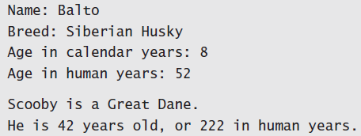
Using a Class and Its Methods
View sample program, listing 5.2
class DogDemo
Sample
screen output

Slide 14
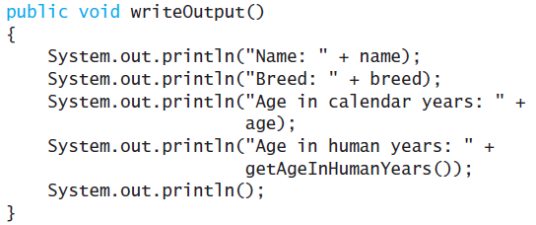
Defining Methods
Consider method writeOutput from
class dog
Method definitions appear inside class definitions
Methods can only be used with objects of that class

Slide 15
Defining Methods
Most method definitions we will see as public
A method that does not return a value is specified as a void method
A method that does return a values must specify the type of the returned value.
Heading includes possible parameters
Body enclosed in braces { }

Slide 16
Methods That Return a Value
Consider method getAgeInHumanYears( )
public int getAgeInHumanYears()
{ int humanYears = 0;
if (age <= 2)
humanYears = age * 11;
else
humanYears = 22 + ((age-2) * 5);
return humanYears;
} // end getAgeInHumanYears
Heading declares type of value to be returned
Last statement executed is return
return statement argument must match return type
Notes:
return statement must match return type
you can use more than one return statement (inside an if statement for example)
see p.319

Slide 17
The return statement
Make sure of the following in the value-returning methods:
  A value is returned.
  Only a single value is returned to the caller method
  The returned value has the same data type as the method
Remember that the return statement:
  is the last to execute in the method
  make sure all paths are considered

Slide 18
Covering all paths
Assume you want a method hasLetter for the class Dog, that checks if a given letter is contained in the name of the dog and returns its index, otherwise it prints an error message:
public int hasLetter (char letter){
int x = name.indexOf(letter);
if (x != -1)
return x;
else
System.out.print(“Doesn’t contain this letter”);
System.out.println();
return -99;
}
What is wrong with this method?
The return is only in one path of all possible paths of execution.
How can we fix that?
There are multiple possibilities, and easy one is to add a return at the end
Notes:
Other questions:
Q: Would it be possible to write: return “Doesn’t contain this letter”; in the else part only?
A: No, for two reasons: (1) the method must return and integer, not a string. (2) a return in the else is possible, but then the remaining print statement is not reachable.
Q: would it be possible to write: return -99; in the else instead or after the print while removing all remaining lines?
public int hasLetter (char letter){
int x = name.indexOf(letter);
if (x != -1) return x;
else return -99;
}
A: yes, this would be correct
Q: any other possiblilty?
A: yes ... this might be the best, because in general it is easier to read and understand a program/method if there is only one return statement at the end of the method.
public int hasLetter (char letter){
int x = name.indexOf(letter);
if (x == -1)
{ System.out.println(“Doesn’t contain this letter”);
x = -99;
}
return x;
}

Slide 19
return is last to execute
Assume you want a method hasLetter for the class Dog, that checks if a given letter is contained in the name of the dog and returns its index, otherwise it prints an error message:
public int hasLetter (char letter){
int x = name.indexOf(letter);
if (x != -1)
return x;
else
System.out.print(“Doesn’t contain this letter”);
return -99;
System.out.println();
}
What is wrong with this method now?
You can NOT have statements AFTER the return.
Notes:
explain that it is ok to have statements in “other paths”

Slide 20
return in void Methods
You can use return in void methods
The syntax is simply:
return;
No value is returned, but the control of the program is transferred back to the caller method.

Slide 21
Second Example – Account Class
public class Account {
  public String id, name;
  public double balance;
  public void readInput(){
    Scanner keyboard = new Scanner(System.in);
    System.out.println("Enter the account number: ");
    id = keyboard.nextLine();
    System.out.println("Enter the account holder name: ");
    name = keyboard.nextLine();
    System.out.println("Enter the account balance in riyals: ");
    balance = keyboard.nextDouble();}
  public void display(){
  System.out.println("\tAccount information");
  System.out.println("ID: " + id);
  System.out.println("Name: " + name);
  System.out.println("Balance: " + balance);
  System.out.println();}
  public double balanceInDollars() {
  double balanceDollars;
  balanceDollars = balance / 3.75;
  return balanceDollars;}}
public class AccountTest {
public static void main(String[] args)
{Account acc1 = new Account();
acc1.readInput();
acc1.display();
Account acc2 = new Account();
acc2.readInput();
acc2.display();}}

Slide 22
The Keyword this
Referring to instance variables:
  outside the class – must use:
    Name of an object of the class
    Followed by a dot
    Followed by Name of instance variable
  Inside the class,
    Use name of variable alone
    The object (unnamed) is understood to be there
    It is the receiving object

Slide 23
The Keyword this
Inside the class the unnamed object can be referred to with the name this
Example
this.name = keyboard.nextLine();
The keyword this stands for the receiving object
For simplicity Java allows you to omit it.
We will see some situations later that require the use of this

Slide 24
Local Variables
Variables declared inside a method are called local variables
  Can only be used inside the method
  For example:
    All variables declared inside method main are local to main
Local variables having the same name and declared in different methods are considered different variables

Slide 25
Two different variables
Local Variables
public class Account {
  public String id;
  public String name;
  public double balance;
  public void display(){
    System.out.println("\tAccount information");
    System.out.println("ID: " + id);
    System.out.println("Name: " + name);
    System.out.println("Balance: " + balance);
    System.out.println();
  }
  public double balanceInDollars() {
    double balanceDollars;
    balanceDollars = balance * 3.75;
    return balanceDollars;
  }
}
public class AccountTest {
  public static void main(String[] args) {
  Account acc1 = new Account();
  acc1.id = "1111";
  acc1.name = "Mohammad";
  acc1.balance = 3000;
  acc1.display();
  Account acc2 = new Account();
  acc2.id = "2222";
  acc2.name ="Saad";
  acc2.balance = 1000;
  acc2.display();
  double balanceDollars;
  balanceDollars = acc1.balanceInDollars();
  System.out.println("Balance of " + acc1.name
  + " in dollars is "+ balanceDollars);
  }
}

Slide 26
Local Variables
public class X {
public int n;
  public void Y(){
    int n=10;
  }
  public void Z() {
    int n=50;
    this.n = n;
    S.o.p(this.n);
  }
}
public class Test {
  public static void main(String[] args) {
  X x = new X();
  x.n = 2;
  int n=100;
  x.Z();
  S.o.p(x.n);
  }
}
Four different variables that have the same name

Slide 27
/** This class is used in the program LocalVariablesDemoProgram.
*/
public class BankAccount
{ public double amount;
public double rate;
public void showNewBalance ()
{
double newAmount = amount + (rate / 100.0) * amount;
System.out.println ("With interest added, the new amount is $"
+ newAmount);
}
}
/** A toy program to illustrate how local variables behave.
*/
public class LocalVariablesDemoProgram
{ public static void main (String [] args)
{
BankAccount myAccount = new BankAccount ();
myAccount.amount = 100.00;
myAccount.rate = 5;
double newAmount = 800.00;
myAccount.showNewBalance ();
System.out.println ("I wish my new amount were $" + newAmount);
}
}
newAmount is a local variable in method showNewBalance
Sample
screen output
it is a different variable from this one
newAmount is a local variable in method main

Slide 28
Blocks
Recall compound statements
  Enclosed in braces { }
When you declare a variable within a compound statement
  The compound statement is called a block
  The scope of the variable is from its declaration to the end of the block
A variable declared outside the block is usable both outside and inside the block
Notes:
We will expand on this later on

Slide 29
Parameters of Primitive Type
public class Account {
  public String id;
  public String name;
  public double balance;
  public double credit(double amount){
    balance+= amount;
    return balance;
  }
  public double debit(double amount){
    if(amount <= balance)
    balance-=amount;
    else
    System.out.println("Amount exceeded balance");
    return balance;
  }
  // the rest of the previously defined methods
}
Note that both credit and debit methods take one parameter which is double
The formal parameter is amount

Slide 30
Parameters of Primitive Type
public class AccountTest {
  public static void main(String[] args) {
    Account acc1 = new Account();
    acc1.id = "1111"; acc1.name = "Mohammd";
    acc1.balance = 3000;
    double newBalance = acc1.credit(1000);
    System.out.println("The new balance "
    + "(after calling credit) is " + newBalance);
    newBalance = acc1.debit(500);
    System.out.println("The new balance "
    + "(after calling debit) is " + newBalance);
  }
}
Calling the method
double newBalance = acc1.credit(1000);
The actual parameter is the double 1000
Sample screen output
The new balance (after calling credit) is 4000.0
The new balance (after calling debit) is 3500.0

Slide 31
Parameters of Primitive Type
Note the declaration
public int predictPopulation(int years)
The formal parameter is years
Calling the method
int futurePopulation =
speciesOfTheMonth.predictPopulation(10);
The actual parameter is the integer 10
View sample program, listing 5.7
class SpeciesSecondClassDemo
Notes:
The output will be the same as before, but if we change the actual parameter to a different number the output will be different of course.

Slide 32
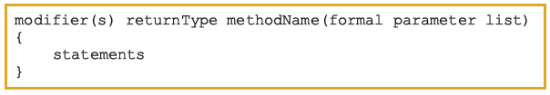
Syntax: Method
public, private, protected, static, abstract, final
The syntax of the formal parameter list is:
type of the value that the method returns (using return statement)
Notes:
A method can have more than one parameter.
Recall methods such as indexOf which can have two parameters.
The order of the actual parameters must match the oder of the formal parameter

Slide 33
Parameters of Primitive Type
Parameter names are local to the method
When a method is invoked
  Each parameter is initialized to the value in the corresponding actual parameter
  A primitive actual parameter is not (and cannot be) altered by invocation of the method
    We will learn later that this is not the case for actual parameters of non-primitive types.
Automatic type conversion is performed
byte
short
int
long
float
double

Slide 34
Passing +1 Parameters of Primitive Type
public class X {
public double n;
  public void Y(int i, int j){
    System.out.println(i + j);
    n++;
  }
  public void Z(double i) {
    System.out.println(n + i);
  }
}
public class Test {
  public static void main(String[] args) {
  X x = new X();
  x.n = 2;
  x.Y(5,6);
  int t1= 1, t2 = 3;
  x.Y(t1,t2);
  x.Z(x.n);
  }
}
Sample screen output
11
4
8.0

Slide 35
The use of the Keyword this
public class X {
public double n;
  public void Y(int i, int j){
    System.out.println(i + j);
    n++;
  }
  public void Z(double n) {
    System.out.println(this.n + n);
  }
}
public class Test {
  public static void main(String[] args) {
  X x = new X();
  x.n = 2;
  x.Y(5,6);
  int t1= 1, t2 = 3;
  x.Y(t1,t2);
  x.Z(6);
  System.out.println(x.n);
  }
}
Sample screen output
11
4
10.0
4.0

