Slide 1
Sodium Dodecyl Sulfate -Polyacryl Amide Gel Electrophoresis [SDS-PAGE]
Lab# 7
BCH 333[practical]

Slide 2
Objective:
-To be familiar with SDS-PAGE protocols (Linear slab gel).

Slide 3
SDS-Polyacrylamide Gel Electrophoresis
-Sodium Dodecyl Sulfate-PolyacrylAmide gel Electrophoresis (SDS-PAGE) is a low-cost, reproducible and rapid method for: qualifying, comparing , characterizing proteins[e.g. determining MW of proteins] and checking purity of protein samples.
-This method separates proteins based primarily on their molecular weights.

Slide 4
Story of SDS-PAGE
-In general, fractionation by gel electrophoresis is based on differences in size, shape and net charge of macromolecules.[in molecules native condition using native gel electrophoresis].
-Systems where you separate proteins under native conditions cannot distinguish between these effects and therefore proteins of different sizes may have the same mobility in native gels.

Slide 5
-In SDS-PAGE, this problem is overcome by using an anionic detergent Sodium Dodecyl Sulfate “SDS”, which binds strongly to most proteins.
-When hot SDS is added to a protein all non-covalent bonds[?] are disrupted and the proteins acquire a negative charge.
-A Concurrent treatment with a disulfide reducing agent such as β-mercaptoethanol or DTT (dithiothreitol) further breaks down the strong bound disulfide.

Slide 6
The electrophoretic Mobility of the molecules is now considered to be a function of their sizes i.e. the migration of the (SDS-treated proteins), towards the anode [+] is aversely proportional to the logarithms of their molecular weights, or more simply expressed:
Small proteins migrate faster through the gel.
[Compare this with the situation in gel filtration.]

Slide 7
http://www.youtube.com/watch?v=3CrzY7jb9fQ

Slide 8
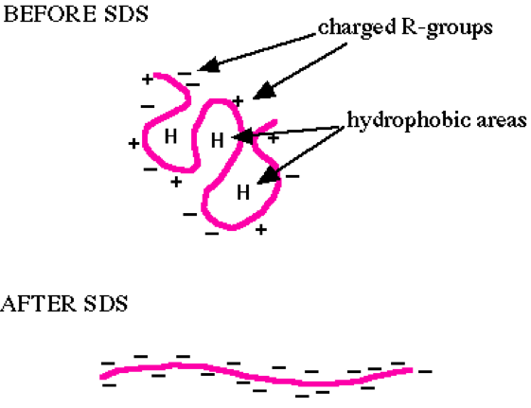

Slide 9
2-Polyacrylamide gel [Acrylamide stock]:
- The polyacrylamide gel is formed by co-polymerization of acrylamide and a cross-linking
By N,N’-methylene-bis-acrylamide.
To polymerize the gel a system, ammonium persilfate (initiator) and tetramethylene ethylene diamin (TEMED) [catalyst], are added.

Slide 11
Principle:
In denaturing protein electrophoresis, the addition of SDS to the electrophoresis buffer uniformly coats the proteins with negative charges, and unify the structure of protein samples to the primary structure.
-A Concurrent treatment with a disulfide reducing agent such as β-mercaptoethanol or DTT (dithiothreitol) further breaks down the strong bound disulfide.
-So, the proteins samples are having uniformed structure and charge → the separation will depend on their molecular weight only.
-Small proteins migrate faster through the gel under the influence of the applied electric field.
Note: The number of SDS molecules that bind is proportional to the size of the protein, thereby in the electrical field, protein molecules move towards the anode (+) and separated only according to their molecular weight.

Slide 12
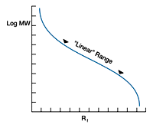
Graph of log MW vs. Rf is sigmoidal, it is nearly linear for a range of molecular weights excluding very small and very large M wt
(Figure has been taken from http://www.nationaldiagnostics.com/article_info.php/articles_id/55)

Slide 13
SDS-PAGE Preparation and Data Analysis:

Slide 14
1.Sample preparation, using the disruption buffer which contain:
-10% (w/v) SDS [?]
-1M Tris/HCl, pH 6.8
-Glycerol [?]
-β-Mercaptoethanol [?]
-Bromophenol blue [?]
-with distilled water
[40µl of protein sample + 10 µl of disruption buffer→ boil the mixture 3minets at 99C̊ .]
2. Preparing acrylamide gels:
It is composed of two gels layers:
A. Separation gel:
HIGH concentration of the acrylamide stock and pH value.
B. Stacking gel:
LOW concentration of the acrylamide stock and pH value.

Slide 15
B
A
SDS-Polyacrylamide Gel Electrophoresis

Slide 16
A-Separation gel contents:
http://www.assay-protocol.com/molecular-biology/electrophoresis/denaturing-page

Slide 17
B-Stacking gel contents:
http://www.assay-protocol.com/molecular-biology/electrophoresis/denaturing-page

Slide 18
3-Loading the samples:

Slide 19
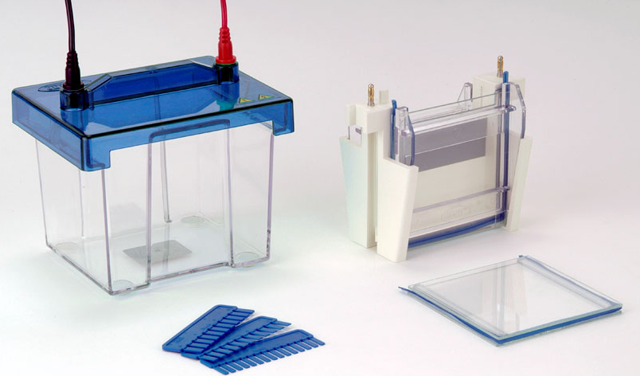
Electrophoresis
4- SDS-PAGE, Running buffer :[?]
-helps is deliver the electric current through the gel.
Tris
Glycine
SDS

Slide 20
5-SDS-PAGE, Staining buffer: [?]
Glacial acetic acid
Methanol
Coomassie brilliant blue R 250 [?]
6-SDS-PAGE, de-staining buffer:
Glacial acetic acid
Methanol

Slide 21
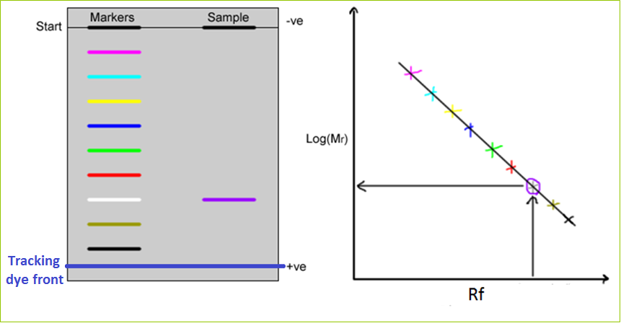
7-Analysis:
For Molecular weight Determination.
- Rf = Distance of migration of sample
Distance moved by tracking dye

Slide 23
The acrylamide percentage in SDS PAGE gel depends on the size of the target protein in the sample. (details shown below)
http://www.assay-protocol.com/molecular-biology/electrophoresis/denaturing-page

Slide 24
Applications:
1. To detect the purity of the protein.
2. Determine of protein molecular weight.
http://www.youtube.com/watch?v=EDi_n_0NiF4

Slide 25
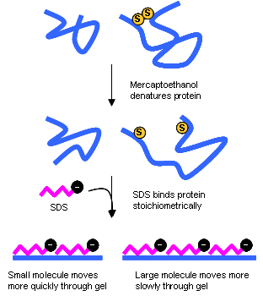

Slide 26
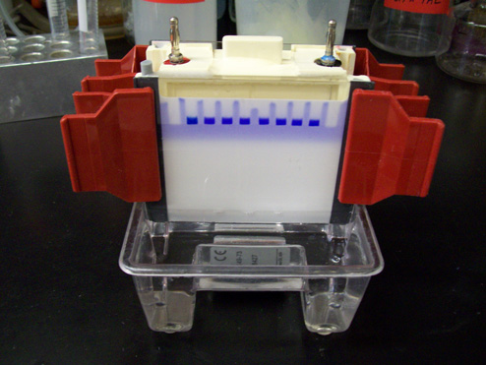
At beginning

Slide 27
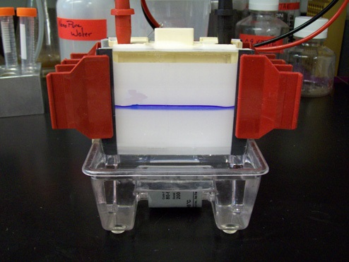
After a while

Slide 28
After more mins.

Slide 29
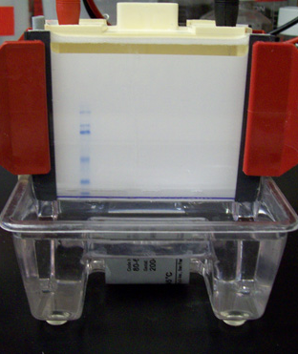
Separated Sample
Marker
Ladder)
Dye front
At the end

Slide 30
Staining
De Staining

