Slide 1
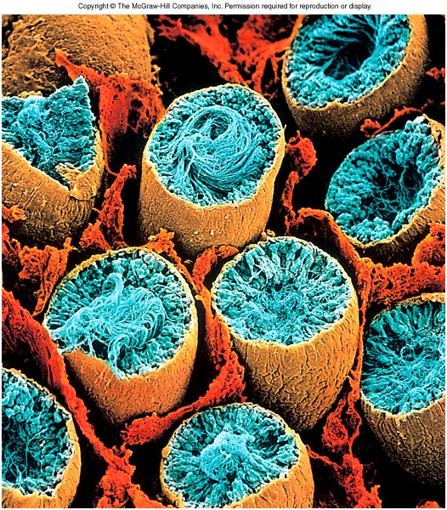
The Male Reproductive System

Slide 2
Objectives:
By the end of this session, students will be able to:
Differentiate between primary and secondary sex organs.
Discuss functions of sex organs.
Recognize pubertal changes.
Identify functions of male sex hormone.
Explain effect of aging on male sexuality.

Slide 3
Overview of Reproductive System
Primary sex organs
  produce gametes (testes)
Secondary sex organs
  - ducts, glands, penis
Secondary sex characteristics
  develop at puberty
    pubic, axillary and facial hair, sweat glands, body morphology and low-pitched voice in males
  In response to hormones

Slide 4
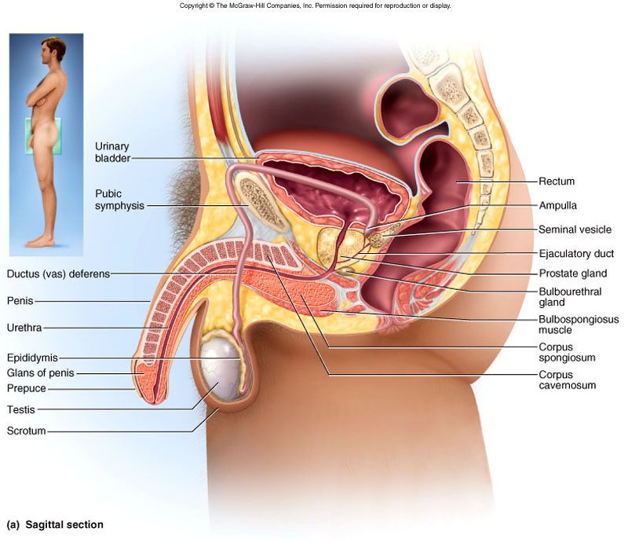
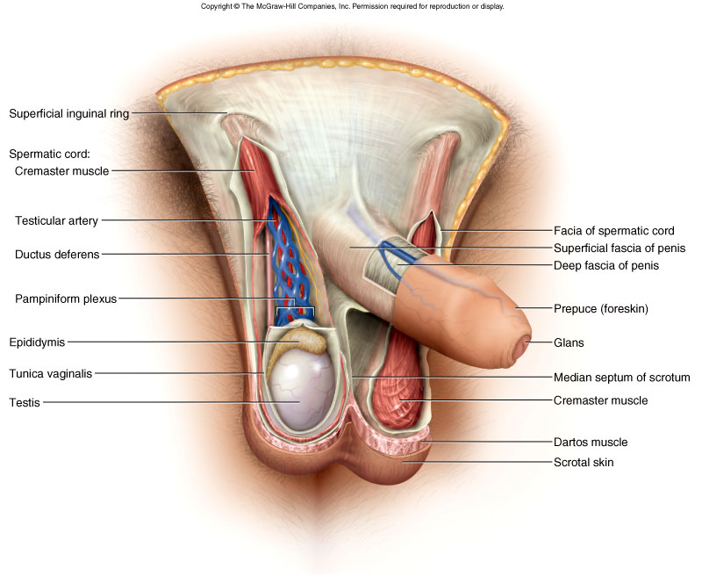
Scrotum
Pouch holding testes
  divided into 2 compartments by median septum
Spermatic cord travels up from scrotum to pass through inguinal canal
  contains testicular artery, vein, nerve and lymphatics

Slide 5
Testicular Thermoregulation
Sperm not produced at core body temperature
  cremaster muscle = pulls testes close to body
  dartos muscle
    wrinkles skin reducing surface area of scrotum
    lifts it upwards

Slide 6
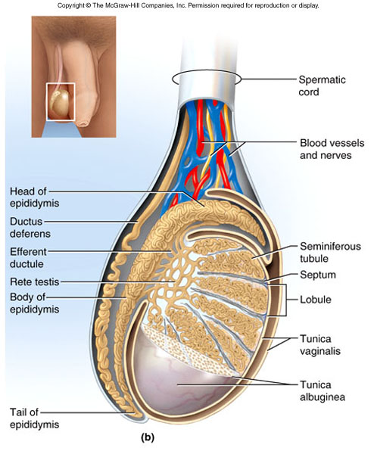
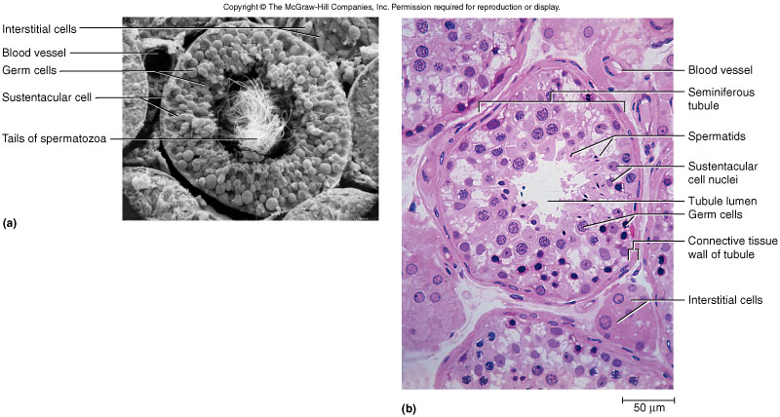
Testes
Oval organ, 4 cm x 2.5 cm
Sustentacular cells
  promote sperm cell
  development

Slide 7
Male Urethra
Regions: prostatic, membranous and penile --- totals 20 cm long

Slide 8
Puberty and Climacteric
Reproductive system dormant till puberty
    10-12 in most boys.
Puberty
  period from onset of gonadotropin secretion until first menstrual period or first ejaculation of viable sperm
Adolescence
  ends when person attains full adult height

Slide 9
Brain-Testicular Axis
Hypothalamus produces GnRH
Anterior pituitary to secretes
  LH
    stimulates interstitial cells to produce testosterone
  FSH
    stimulates sustentacular cells to secrete androgen-binding protein that stimulate spermatogenesis
    Spermatogenesis takes 64 to 72 days

Slide 10
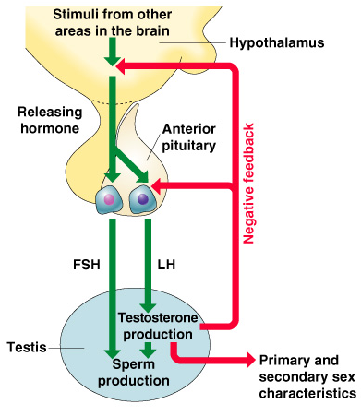
Regulation of Male Androgens (Sex Hormones)

Slide 11
Other Effects of Testosterone
Enlargement of secondary sexual organs
  penis, testes, scrotum, ducts, glands and muscle mass enlarge
  hair, scent and sebaceous glands develop
  stimulates erythropoiesis and libido
During adulthood, testosterone sustains libido, spermatogenesis and reproductive tract

Slide 12
Aging and Sexual Function
Decline in testosterone secretion
  peak secretion at 7 mg/day at age 20
  declines to 1/5 of that by age 80
Rise in FSH and LH secretion after age 50 produces male climacteric (menopause)
  mood changes, hot flashes and “illusions of suffocation”
Erectile dysfunction
  20% of men in 60s; 50% of those in 80s

Slide 13
Semen or Seminal Fluid
2-5 mL of fluid expelled during orgasm
  60% seminal vesicle fluid, 30% prostatic, 10% sperm
    normal sperm count 50-120 million/mL
Other components of semen
  fructose - energy for sperm motility
  fibrinogen causes clotting
    enzymes convert fibrinogen to fibrin
  fibrinolysin liquefies semen within 30 minutes
  prostaglandins stimulate female peristaltic contractions
  spermine is a base stabilizing sperm pH at 7.2 to 7.6

Slide 14
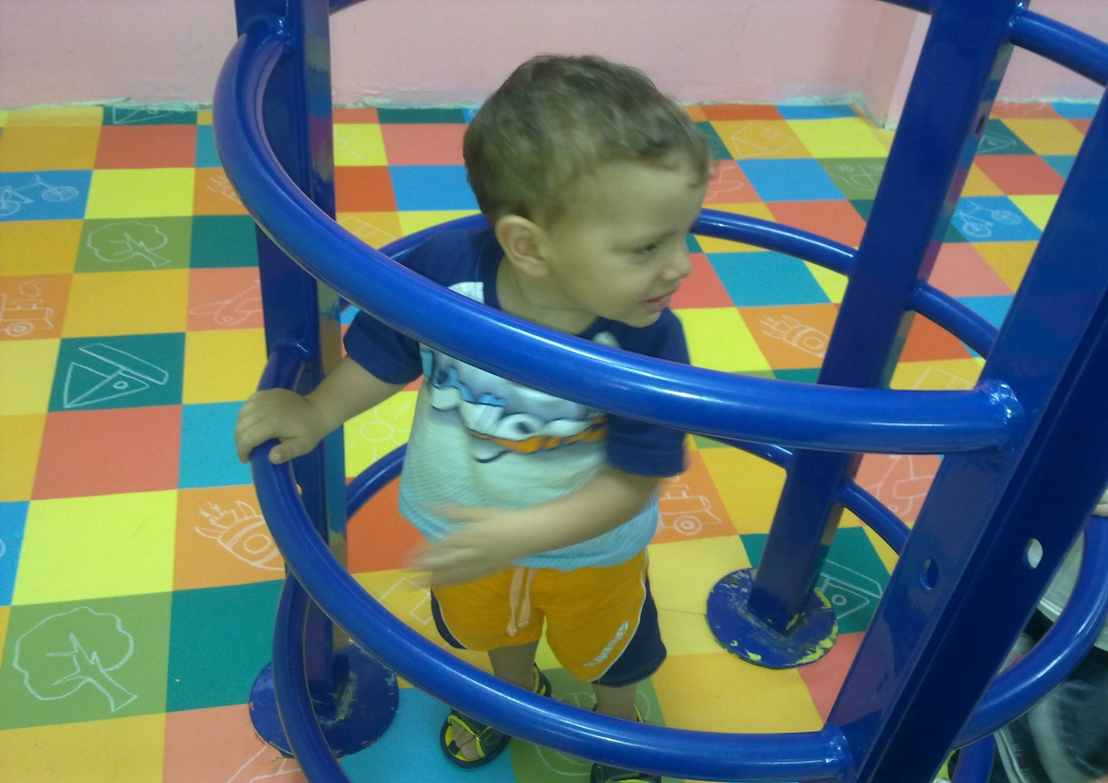
Thank you

