Slide 1

General Chemistry
CHEM 101
(3+1+0)
Dr. Mohamed El-Newehy
http://fac.ksu.edu.sa/melnewehy

Slide 2
Chapter 4
Physical Properties of Solutions

Slide 3
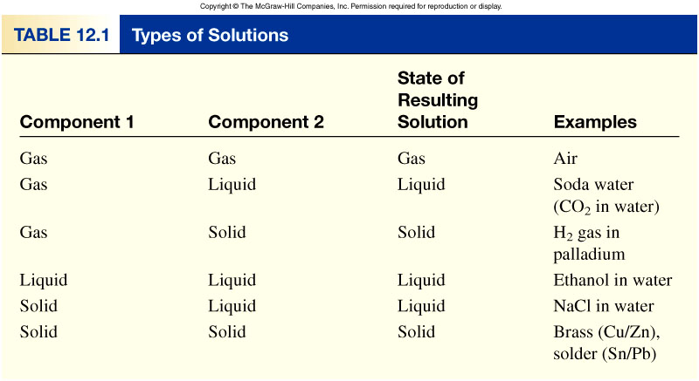
Types of Solutions
A solution is a homogenous mixture of 2 or more substances.
The solute is(are) the substance(s) present in the smaller amount(s).
The solvent is the substance present in the larger amount.
Types of solutions, depending on the original states (solid, liquid, or gas) of the solution components.

Slide 4
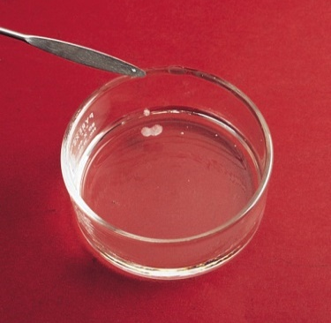
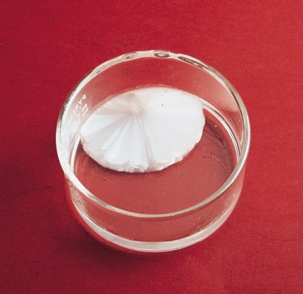
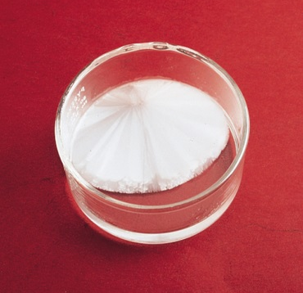
Types of Solutions
A saturated solution contains the maximum amount of a solute that will dissolve in a given solvent at a specific temperature.
An unsaturated solution contains less solute than the solvent has the capacity to dissolve at a specific temperature.
A supersaturated solution contains more solute than is present in a saturated solution at a specific temperature.
Crystallization is the process in which dissolved solute comes out of solution and forms crystals
Sodium acetate crystals rapidly form when a seed crystal is added to a supersaturated solution of sodium acetate.

Slide 5
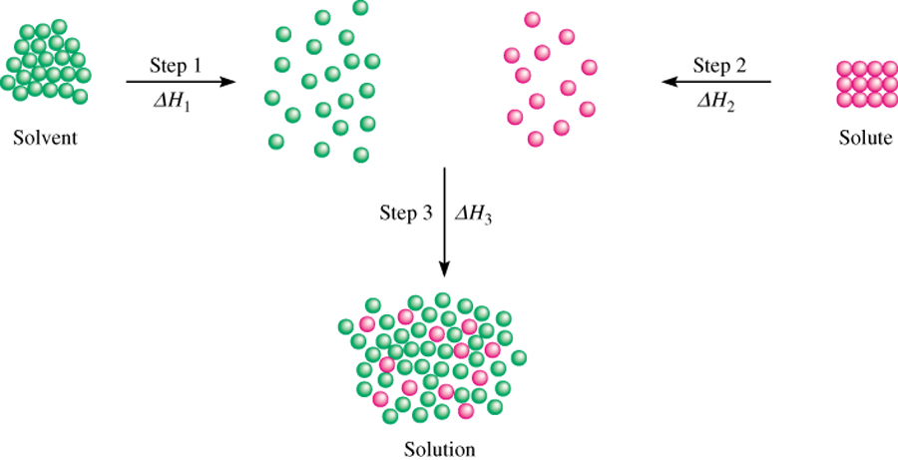
A Molecular View of the Solution Process
Three types of interactions in the solution process:
solvent-solvent interaction
solute-solute interaction
solvent-solute interaction
Step 1 is the separation of solvent molecules.
(endothermic)
Step 2 is the separation of solute molecules.
(endothermic)
Step 3 the solvent and
solute molecules mix.
(exothermic or endothermic)
The heat of solution ΔH_{soln} is given by
ΔH_{soln} = ΔH₁ + ΔH₂ + ΔH₃

Slide 6
A Molecular View of the Solution Process
If the solute-solvent attraction is stronger than the solvent-solvent attraction and solute-solute attraction,
The solution process is favorable, or exothermic (ΔH_{soln} = 0).
If the solute-solvent interaction is weaker than the solvent-solvent and solute-solute interactions,
The solution process is endothermic (ΔH_{soln} = 0).

Slide 7
A Molecular View of the Solution Process
“like dissolves like”
Two substances with similar intermolecular forces are likely to be soluble in each other.
non-polar molecules are soluble in non-polar solvents
    CCl₄ in C₆H₆
polar molecules are soluble in polar solvents
    C₂H₅OH in H₂O
ionic compounds are more soluble in polar solvents
    NaCl in H₂O or NH₃ (l)
Two liquids are said to be miscible if they are completely soluble in each other in all proportions.

Slide 8
Concentration Units
The concentration of a solution is the amount of solute present in a given quantity of solvent or solution.
Types of Concentration Units
Percent by Mass
The percent by mass (also called percent by weight or weight percent) is the ratio of the mass of a solute to the mass of the solution, multiplied by 100 percent:
mass of solute
% by mass =
x 100%
mass of solute + mass of solvent
mass of solute
=
x 100%
mass of solution

Slide 9
Concentration Units

Slide 10
Concentration Units
Types of Concentration Units
Mole Fraction (X)
The mole fraction of a component of a solution, say, component A, is written X_{A} and is defined as
moles of A
X_{A} =
sum of moles of all components

Slide 11
Concentration Units
Types of Concentration Units
Molarity (M)
Molarity was defined as the number of moles of solute in 1 L of solution
moles of solute
M =
liters of solution
The units of molarity are mol/L.
Molality (m)
Molality is the number of moles of solute dissolved in 1 kg (1000 g) of solvent
moles of solute
m =
mass of solvent (kg)

Slide 12
Concentration Units

Slide 13
Concentration Units
Comparison of Concentration Units
For example;
The mole fraction is not used to express the concentrations of solutions for titrations and gravimetric analyses.
It is appropriate for calculating partial pressures of gases and for dealing with vapor pressures of solutions.
Percent by mass is similar to molality in that it is independent of temperature.
It is defined in terms of ratio of mass of solute to mass of solution, We do not need to know the molar mass of the solute in order to calculate the percent by mass.

Slide 14
Concentration Units
Comparison of Concentration Units
The advantage of molarity is that it is generally easier to measure the volume of a solution.
For this reason, molarity is often preferred over molality.
Molality is independent of temperature, because the concentration is expressed in number of moles of solute and mass of solvent.
The volume of a solution typically increases with increasing temperature, so that a solution that is 1.0 M at 25°C may become 0.97 M at 45°C because of the increase in volume on warming.
This concentration dependence on temperature can significantly affect the accuracy of an experiment.
Therefore, it is sometimes preferable to use molality instead of molarity.

Slide 15
Concentration Units
Comparison of Concentration Units
What is the molality of a 5.86 M ethanol (C₂H₅OH) solution whose density is 0.927 g/mL?
moles of solute
moles of solute
m =
M =
mass of solvent (kg)
liters of solution
Assume 1 L of solution:
  5.86 moles ethanol = 270 g ethanol
  927 g of solution (1000 mL x 0.927 g/mL)
mass of solvent = mass of solution – mass of solute
= 927 g – 270 g = 657 g = 0.657 kg
moles of solute
5.86 moles C₂H₅OH
m =
=
= 8.92 m
mass of solvent (kg)
0.657 kg solvent

Slide 16
Concentration Units
Comparison of Concentration Units
To convert one concentration unit of a solution to another;
Example;
Express the concentration of a 0.396 m glucose (C₆H₁₂O₆) solution in molarity.
0.396 m glucose (C₆H₁₂O₆) i.e. there is 0.396 mole of glucose in 1000 g of the solvent.
To calculate molarity; we need to determine the volume of this solution.
First, we calculate the mass of the solution from the molar mass of glucose:

Slide 17
Concentration Units
Comparison of Concentration Units
Determine the density of the solution, which is found to be 1.16 g/mL.
We can now calculate the volume of the solution in liters
The molarity of the solution is given by

Slide 18
Concentration Units

Slide 19
Concentration Units

Slide 20
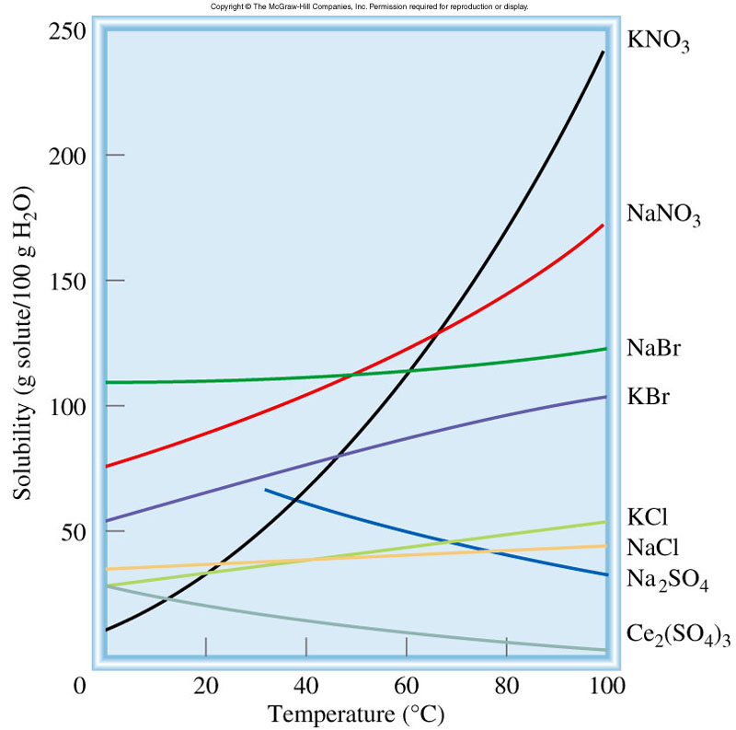
The Effect of Temperature on Solubility
Solid solubility and temperature
Solubility is the maximum amount of a solute that will dissolve in a given quantity of solvent at a specific temperature.
Temperature affects the solubility of most substances.
solubility increases with increasing temperature
solubility decreases with increasing temperature

Slide 21
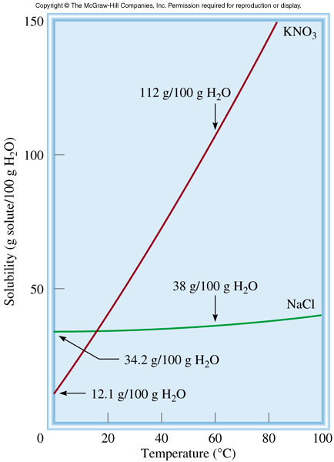
The Effect of Temperature on Solubility
Solid solubility and temperature
Fractional crystallization is the separation of a mixture of substances into pure components on the basis of their differing solubilities.
Suppose you have 90 g KNO₃ contaminated with 10 g NaCl.
Fractional crystallization:
Dissolve sample in 100 mL of water at 60⁰C
Cool solution to 0⁰C
All NaCl will stay in solution (s = 34.2g/100g)
78 g of PURE KNO₃ will precipitate (s = 12 g/100g). 90 g – 12 g = 78 g

Slide 22
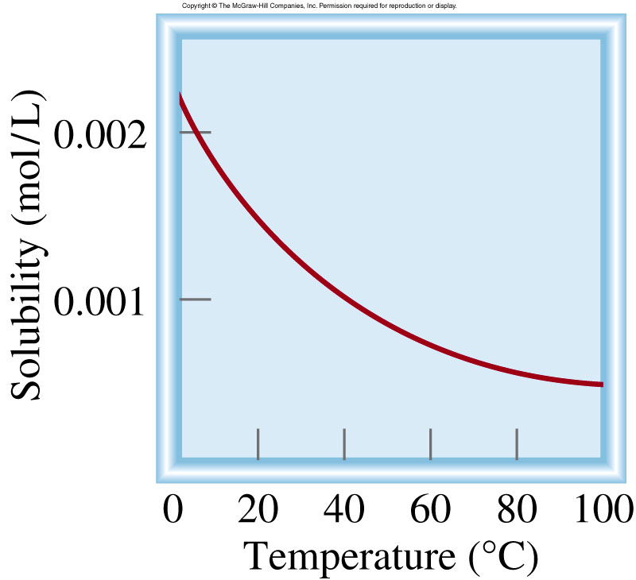
The Effect of Temperature on Solubility
Gas Solubility and Temperature
The solubility of gases in water usually decreases with increasing temperature.
O₂ gas solubility and temperature
solubility usually decreases with increasing temperature

Slide 23
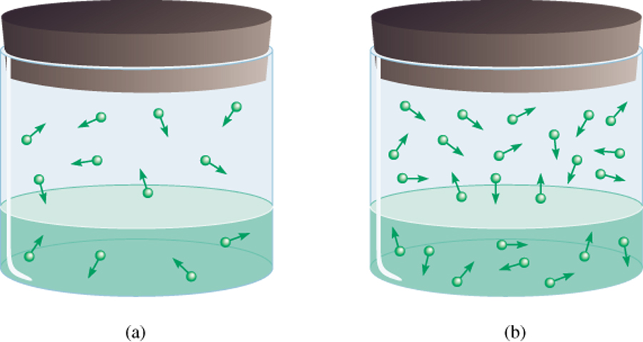
The Effect of Pressure on the Solubility of Gases
The solubility of a gas in a liquid is proportional to the pressure of the gas over the solution (Henry’s law).
c is the concentration (M) of the dissolved gas
c = k_{H} P
P is the pressure of the gas over the solution
k_{H} is a constant for each gas (mol/L•atm) that depends only on temperature
low P
high P
low c
high c
A practical demonstration of Henry’s law is the effervescence of a soft drink when the cap of the bottle is removed (air and CO₂ saturated with water vapor).

Slide 24
The Effect of Pressure on the Solubility of Gases

Slide 25
The Effect of Pressure on the Solubility of Gases
Most gases obey Henry’s law, but there are some important exceptions.
For example, if the dissolved gas reacts with water, higher solubilities can result.
The solubility of ammonia is much higher than expected because of the reaction
Carbon dioxide also reacts with water, as follows:
Another interesting example is the dissolution of molecular oxygen in blood.

Slide 26
Colligative Properties of Nonelectrolyte Solutions
Colligative properties (or collective properties) are properties that depend only on the number of solute particles in solution and not on the nature of the solute particles.
The colligative properties are
vapor-pressure lowering,
boiling-point elevation,
freezing-point depression,
osmotic pressure.
we are talking about relatively dilute solutions, that is, solutions whose concentrations are ≤ 0.2 M.

Slide 27
Colligative Properties of Nonelectrolyte Solutions
Vapor-Pressure Lowering
Raoult’s† law, which states that the vapor pressure of a solvent over a solution, P1, is given by the vapor pressure of the pure solvent, P°1, times the mole fraction of the solvent in the solution, X1:
0
0
P ₁
= vapor pressure of pure solvent
P₁ = X₁ P ₁
X₁ = mole fraction of the solvent
Raoult’s law
If the solution contains only one solute:
X₁ = 1 – X₂
0
0
0
P₁ = (1-X₂)P₁
P₁ = P₁-X₂P₁
0
- P₁ = ΔP = X₂
0
P ₁
P ₁
X₂ = mole fraction of the solute
We see that the decrease in vapor pressure, ΔP, is directly proportional to the solute concentration (measured in mole fraction).

Slide 28
Colligative Properties of Nonelectrolyte Solutions

Slide 29
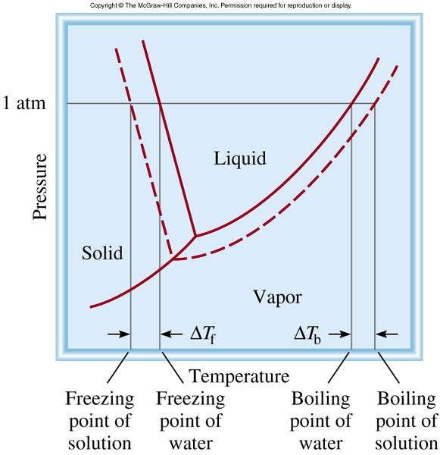
Colligative Properties of Nonelectrolyte Solutions
Boiling-Point Elevation
The boiling point of a solution is the temperature at which its vapor pressure equals the external atmospheric pressure.
Because the presence of a nonvolatile solute lowers the vapor pressure of a solution, it must also affect the boiling point of the solution.
At any temperature the vapor pressure of the solution is lower than that of the pure solvent regardless of temperature.
The boiling point of the solution is higher than that of water.

Slide 30
Colligative Properties of Nonelectrolyte Solutions
Boiling-Point Elevation
The boiling point elevation (ΔT_{b}) is defined as the boiling point of the solution (T_{b}) minus the boiling point of the pure solvent (T°_{b}):
0
ΔT_{b} = T_{b} – T _{b}
0
T _{b} is the boiling point of the pure solvent
T _{b} is the boiling point of the solution
0
T_{b} > T _{b}
ΔT_{b} > 0
ΔT_{b} = K_{b} m
m is the molality of the solution
K_{b} is the molal boiling-point elevation
constant (⁰C/m) for a given solvent

Slide 31
Colligative Properties of Nonelectrolyte Solutions
Freezing-Point Depression
Ice on frozen roads and sidewalks melts when sprinkled with salts such as NaCl or CaCl₂.
This method of thawing succeeds because it depresses the freezing point of water.
Lowering the vapor pressure of the solution shifts the solid-liquid curve to the left

Slide 32
Colligative Properties of Nonelectrolyte Solutions
Freezing-Point Depression
The freezing point depression (DT_{f}) is defi ned as the freezing point of the pure solvent (T _{f}°) minus the freezing point of the solution (T_{f}):
0
ΔT_{f} = T _{f} – T_{f}
0
T _{f} is the freezing point of the pure solvent
T _{f} is the freezing point of the solution
0
ΔT_{f} > 0
T _{f} > T_{f}
ΔT_{f} = K_{f} m
m is the molality of the solution
K_{f} is the molal freezing-point depression
constant (⁰C/m) for a given solvent

Slide 33
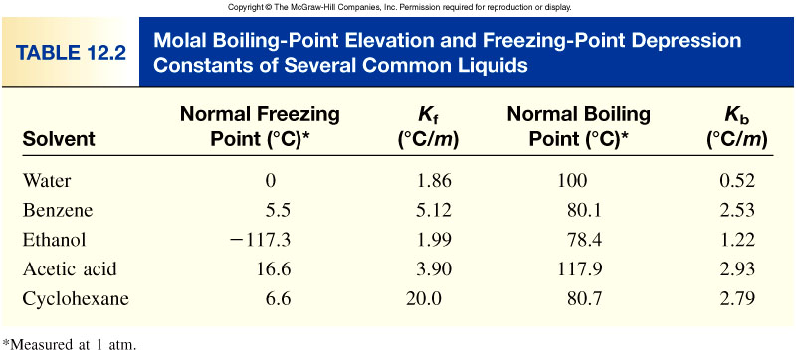
Colligative Properties of Nonelectrolyte Solutions

Slide 34
Colligative Properties of Nonelectrolyte Solutions
What is the freezing point of a solution containing 478 g of ethylene glycol (antifreeze) in 3202 g of water? The molar mass of ethylene glycol is 62.01 g/mol.
ΔT_{f} = K_{f} m
K_{f} water = 1.86 ⁰C/m
1 mol
478 g x
moles of solute
62.01 g
m =
=
= 2.41 m
mass of solvent (kg)
3.202 kg solvent
ΔT_{f} = K_{f} m
= 1.86 ⁰C/m x 2.41 m = 4.48 ⁰C
0
ΔT_{f} = T _{f} – T_{f}
0
= 0.00 ⁰C – 4.48 ⁰C = -4.48 ⁰C
T_{f} = T _{f} – ΔT_{f}

Slide 35
Colligative Properties of Nonelectrolyte Solutions
Osmotic Pressure (π)
Osmosis is the selective passage of solvent molecules through a porous membrane from a dilute solution to a more concentrated one.
A semipermeable membrane allows the passage of solvent molecules but blocks the passage of solute molecules.
Osmotic pressure (π) is the pressure required to stop osmosis.

Slide 36
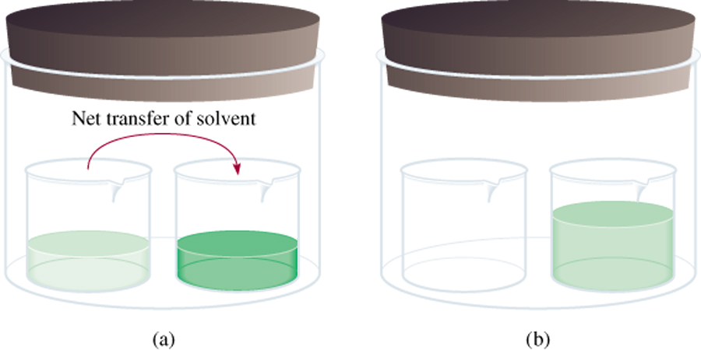
Colligative Properties of Nonelectrolyte Solutions
Osmotic Pressure (π)
High
P
Low
P
π = MRT
M is the molarity of the solution
R is the gas constant (0.0821 L . atm/K . mol)
T is the temperature (in K)

Slide 37
Colligative Properties of Nonelectrolyte Solutions
Osmotic Pressure (π)

Slide 38
Colligative Properties of Nonelectrolyte Solutions
Summary - Colligative Properties of
Nonelectrolyte Solutions
Colligative properties are properties that depend only on the number of solute particles in solution and not on the nature of the solute particles.
0
Vapor-Pressure Lowering
P₁ = X₁ P ₁
Boiling-Point Elevation
ΔT_{b} = K_{b} m
Freezing-Point Depression
ΔT_{f} = K_{f} m
Osmotic Pressure (π)
π = MRT

Slide 39
Colligative Properties of Nonelectrolyte Solutions
Using Colligative Properties to Determine Molar Mass
From the experimentally determined freezing-point depression or osmotic pressure,
We can calculate the molality or molarity of the solution.
Knowing the mass of the solute, we can readily determine its molar mass,

Slide 40
Colligative Properties of Nonelectrolyte Solutions
Using Colligative Properties to Determine Molar Mass

Slide 41
Colligative Properties of Nonelectrolyte Solutions
Using Colligative Properties to Determine Molar Mass

