Slide 1
Object-Oriented Programming
Binhadba Edit

Slide 2
Object-Oriented Programming (OOP)
OOP is currently the most accepted style of programming
Java, C# and SmallTalk were designed to be OO (object oriented) from inception
VB and C++ have been modified to accommodate OOP
VB.NET is the first version of VB to be truly object oriented
As projects become more complex, using objects becomes increasingly important

Slide 3
Reusability
Big advantage of OOP over traditional programming.
New classes created can be used in multiple projects.
Each object created from the class can have its own properties.

Slide 4
Classes and Objects

Slide 5
Classes and Objects (From Lecture 2)
Windows Forms applications consist of pieces called classes.
Classes are logical groupings of methods and data that simplify program organization.
Every Windows Forms application consists of at least one class, which is the form’s class.

Slide 6
Classes and Objects
A class is an abstract representation of something.
An object is a usable example of the thing the class represents.

Slide 7
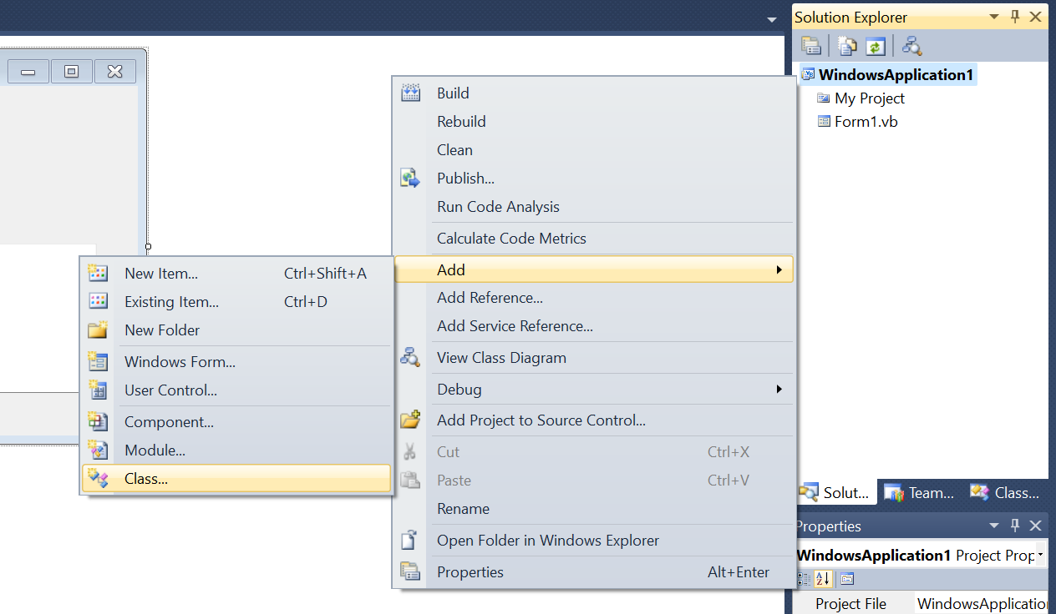


Adding a Class File to a Windows Application
Right-Click

Slide 8
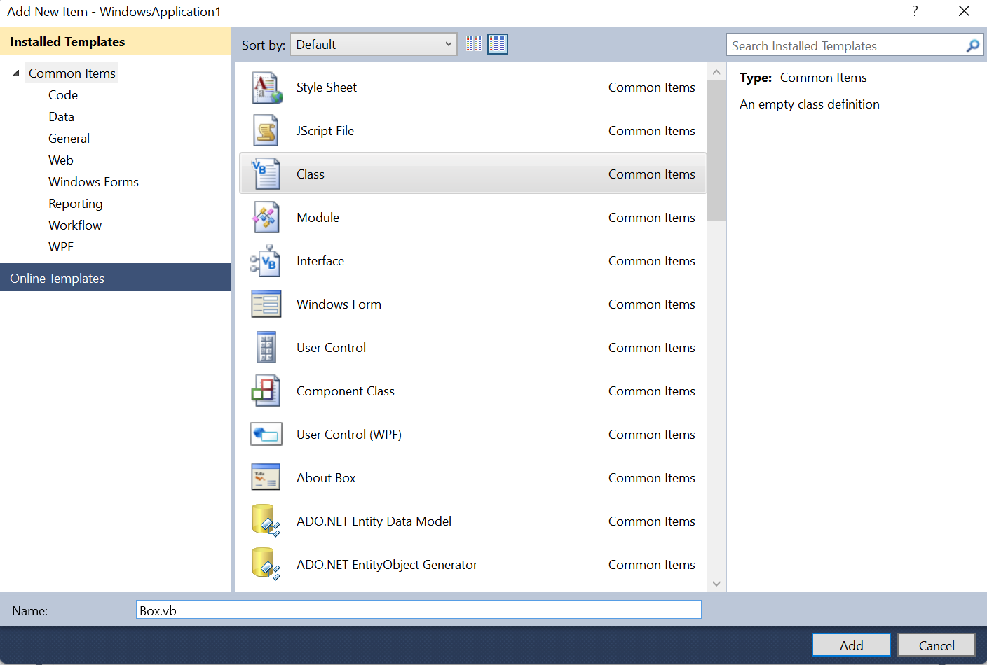
Adding a Class File to a Windows Application
Choose a class name

Slide 9
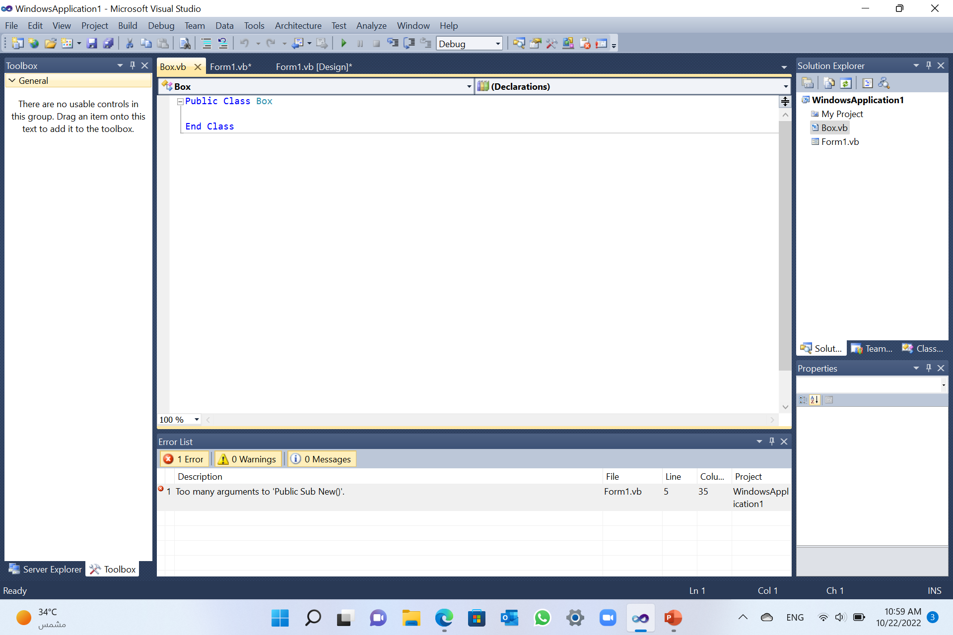
Adding a Class File to a Windows Application
Build the class;
Add class members

Slide 10
Classes and Objects
When you define a class, you define a blueprint for a data type.
It defines what the class name means, that is, what an object of the class will consist of and what operations can be performed on such an object.
Thus, a defined class typically constitutes some variables and/or methods that are called members of the class
Objects are instances of a class

Slide 11
Classes Declaration
  As shown on slide 9, Every class declaration contains keyword Class followed immediately by the class’s name.
  Every class’s body ends with the keywords End Class.
  The keyword Public and Private are access modifiers.

Slide 12
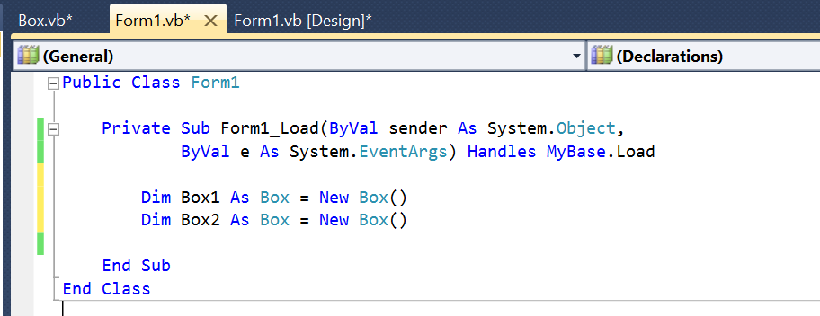

Object Declaration
  To declare an object from a class we use New operator
  Objects are instances of classes; you can create as many objects as possible, once you have defined a class.

Slide 13
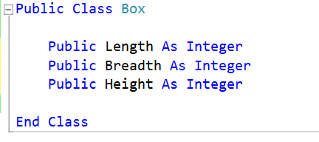
Class Members: Variables
  Class members declared with member access modifier Private are accessible only within the class, which gives the class complete control over how those members are used.
  Class members declared with member-access modifier Public are accessible wherever the program has a reference to an Account object.
  Member variables declared with Dim default to Private access

Slide 14
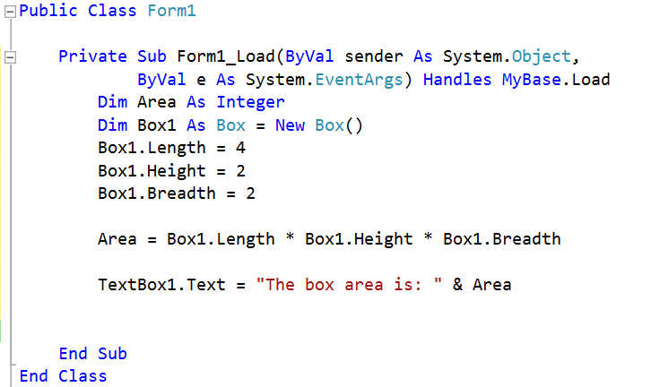
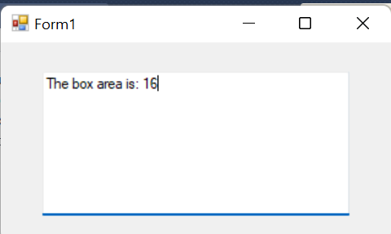
Class Members: Variables
  For instance, since Box class variable members were defined as public, the form’s class can access them directly by creating an instance of the box class and then use the dot (.) operator as follows:
Box.vb
Form1.vb
Run:
Q:What changes if these variables where defined as private?

Slide 15
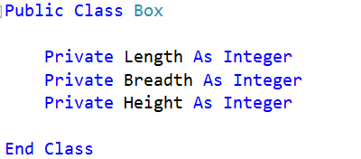
Class Members: Variables
  Once variables are defined as Private they no longer can be accessed outside their class using the dot operator.
  Instead, other class members are used to do the job, including:
    Constructors/Destructors
    Property procedures

Slide 16
Class Members: Constructor
A class constructor is a special member Sub of a class that is executed whenever we create new objects of that class. A constructor has the name New and it does not have any return type.
Constructors must be named New and are declared Public.
Constructors are implemented as Sub procedures, because they cannot return values.
The constructor can be:
  Without parameters.
  With Parameters.

Slide 17
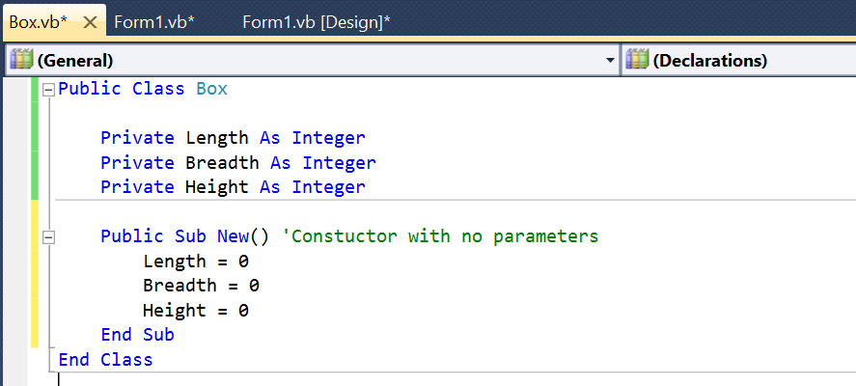
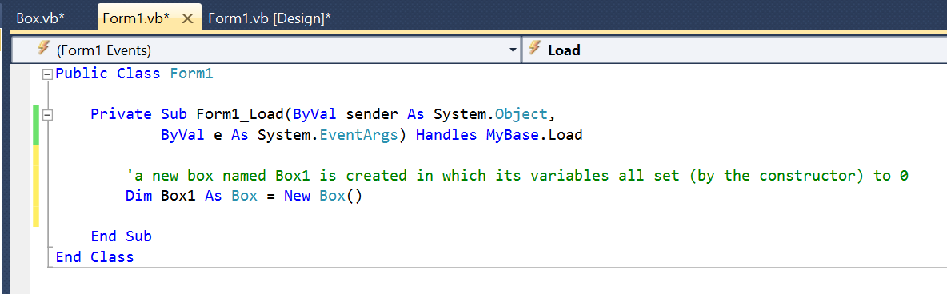

Class Members: Constructor with no parameters

Slide 18
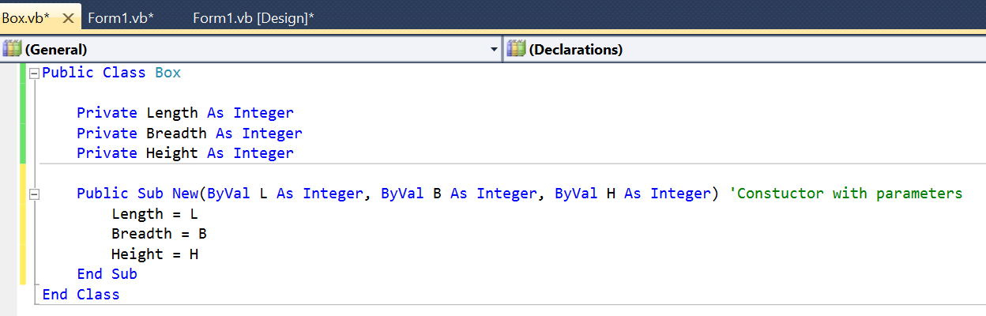

Class Members: Constructor with parameters

Slide 19
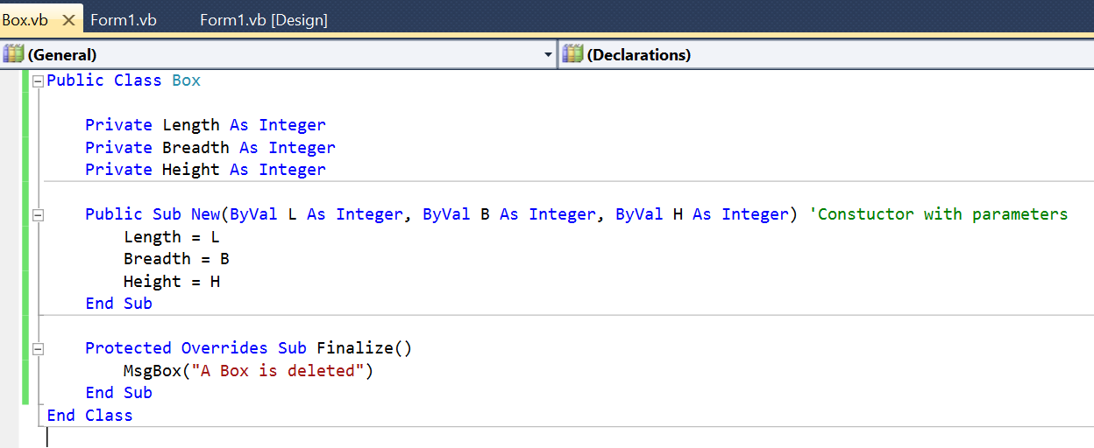
Class Members: Destructor
A destructor is a special member Sub of a class that is executed whenever an object of its class goes out of scope.
A destructor has the name Finalize and it can neither return a value nor can it take any parameters. Destructor can be very useful for releasing resources before coming out of the program like closing files, releasing memories, etc.
Destructors cannot be inherited or overloaded.

Slide 20
Class Members: Property Procedure
Use these procedures:
  to control when and how a variable’s value is set or retrieved.
  Need to validate values.
The Get procedure retrieves the variable's value.
The Set procedure stores a value.
If you want a variable class member to have read/write access, you must define both procedures. For a read-only property, you define only Get, and for a write-only property, you define only Set.

Slide 21
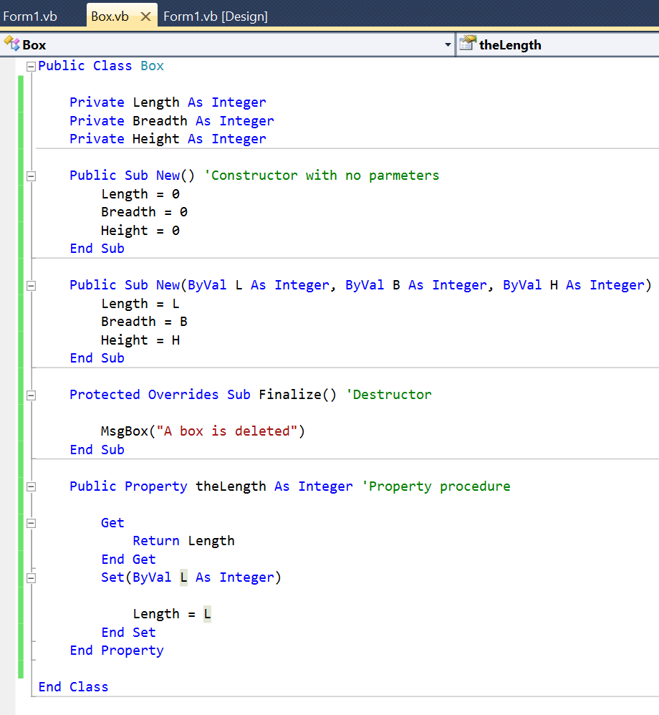

Class Members: Property Procedure
In this example, a property procedure named theLength was defined to give a read/write access to the private variable Length
As you can see in the next slide, we defined a box and used the property procedure theLength to change the Length value then display it in Textbox1.

Slide 22
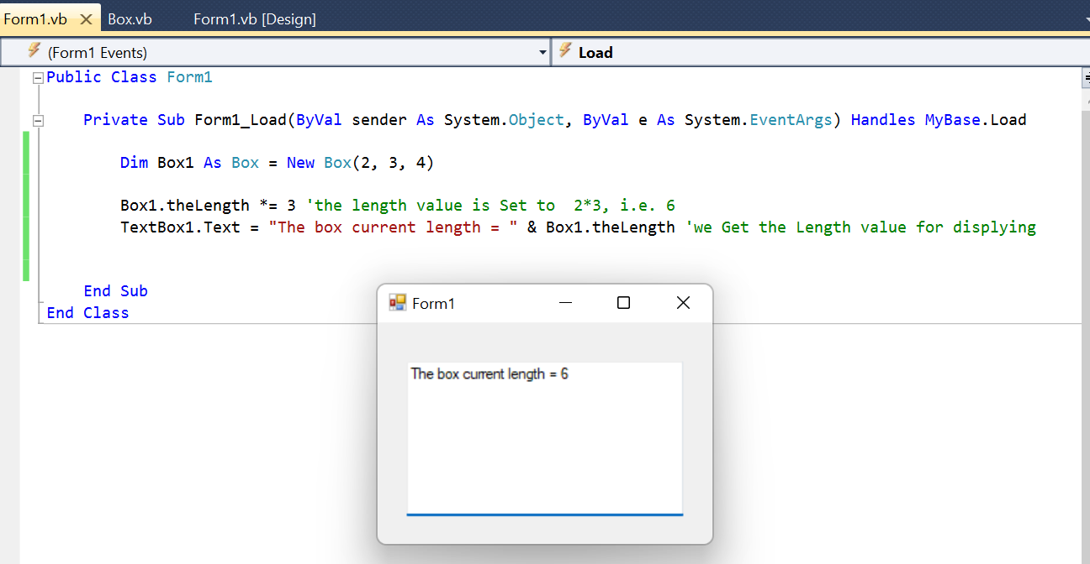
Class Members: Property Procedure
Q:How about the other variables, Breadth and Height?

Slide 23
Class Members: Shared members
Each object has its own copy of the instance variables of its class.
In certain cases, all objects of a class should share only one copy of a particular variable.
A Shared class variable represents class wide information—all objects of the class share the same variable, no matter how many objects of the class have been instantiated.

Slide 24
Class Members: Shared members
Scope of Shared Members
  Shared class members have class scope.
  A class’s Public Shared members can be accessed via the class name using the dot separator.
  A class’s Private Shared members can be accessed only indirectly through the class’s non-Private methods and properties.

Slide 25
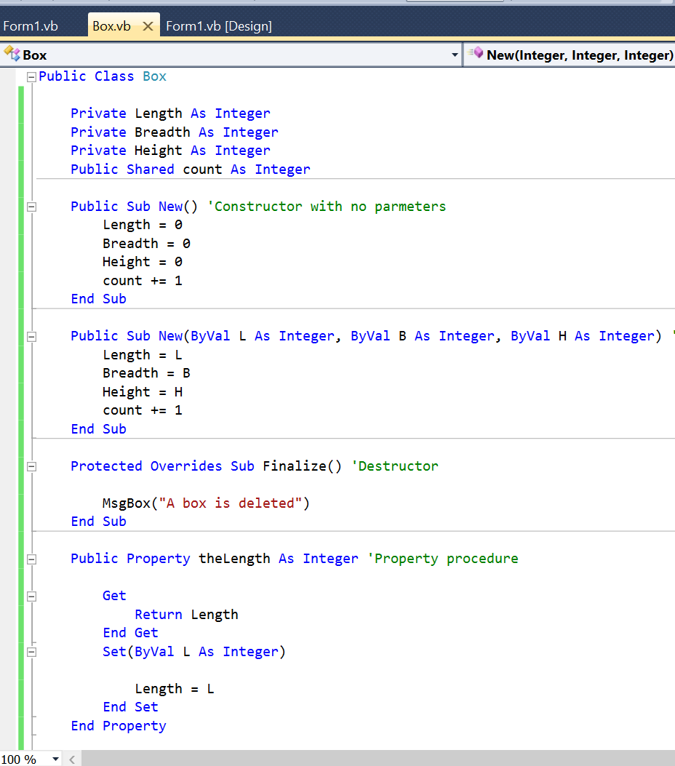
Class Members: Shared members
In our same example we defined the shared member count.
This member will get incremented by 1 every time an object of this class is created.

Slide 26
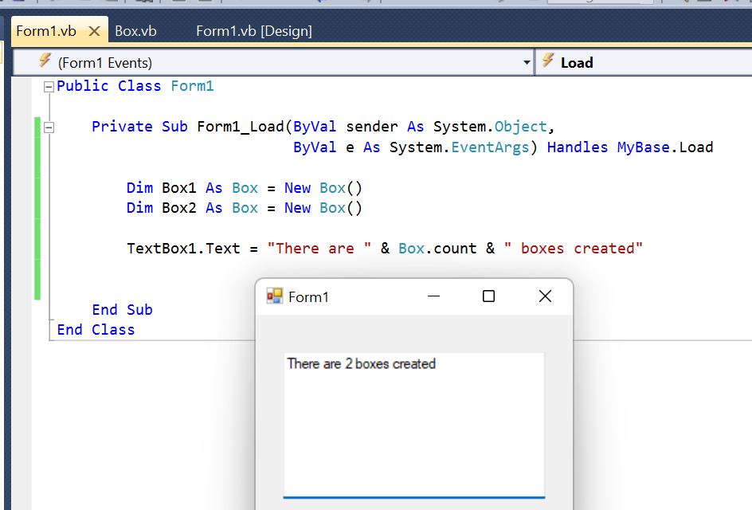
Class Members: Shared members
As shown, 2 objects of class Box were created (Box1 and Box2), hence, Box.count will have 2 as its value.

Slide 27
Class Members: Const and ReadOnly Fields
Constants are fields whose values cannot change during program execution.
To create a constant in a class, declare an identifier as either Const or ReadOnly.
Neither type of constant can be modified once initialized.

Slide 28
Class Members: Const and ReadOnly Fields
Constant and Read-Only both perform a similar function on data members but there are few differences in both.
A constant member is defined at compile time and cannot be changed at run time.
A read only member is not known at compile time. Read-only member initialized at run time.
Constants use const keyword for declaration. Constants must be initialized when declared but read-only does not need initialized when declared.
Constant cannot be modified once initialized. Read-only member can have different values depend by code in the constructor.

Slide 29
Class Members: Const and ReadOnly Fields
Consts are implicitly Shared.
If you have a Public Const value, you can access it with the class name followed by the dot operator and the Const’s name.
Each object of a class with a ReadOnly constant has a separate copy of the constant, unless you explicitly declare the constant as Shared.

Slide 30
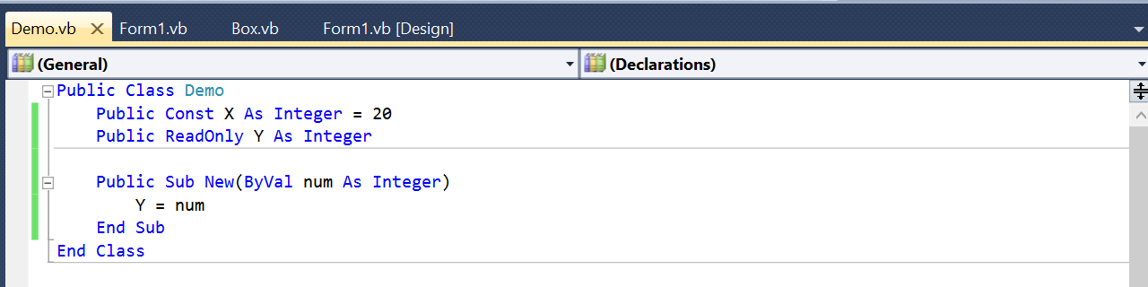
Class Members: Const and ReadOnly Fields

Slide 31
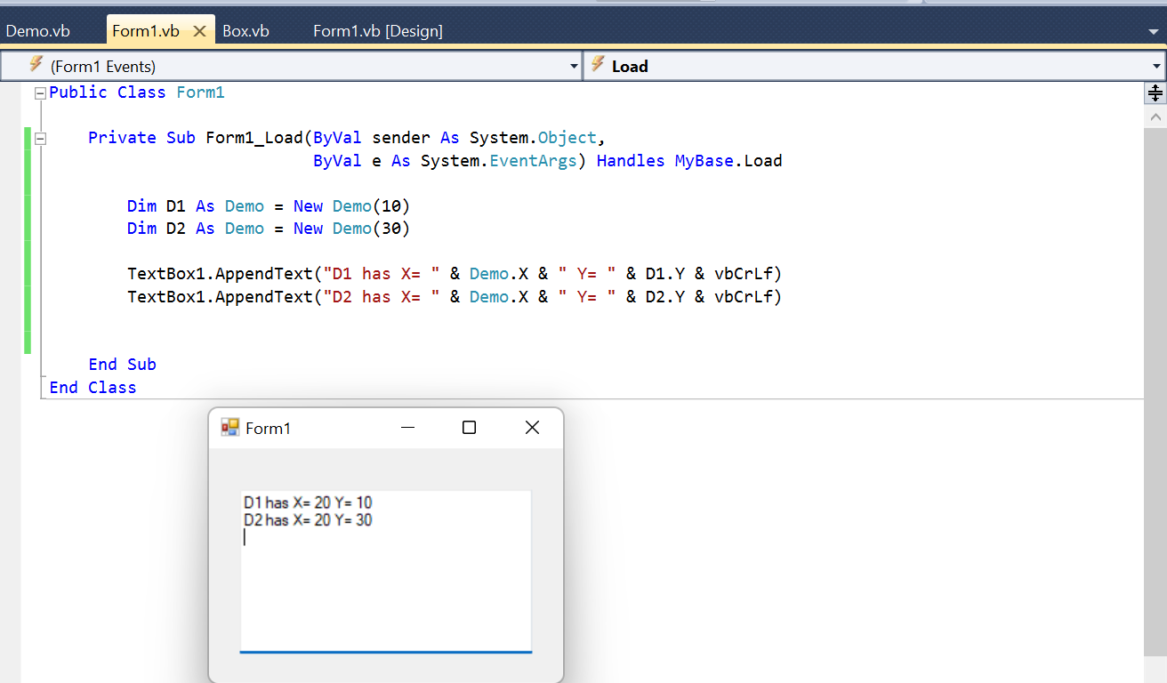
Class Members: Const and ReadOnly Fields

