Slide 1
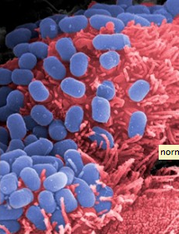
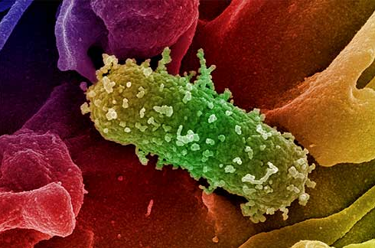
Normal Flora
CLS 212: Medical Microbiology

Slide 2
What is Normal Flora?
Normal flora are microorganisms, mostly bacteria that continuously inhibited the human body. Under normal conditions in a healthy human they are harmless and may even be beneficial.
Also called commensals i.e. organisms that dine together.

Slide 3

Stuff about Normal Flora
New born baby born sterile ,they acquire the organisms after born from environment.
Our internal organs are sterile like the spleen, liver, pancreas, bladder, CNS, blood unless during infection.
Normal flora differ from one human to another depending on age, diet, and geographic habitat.

Slide 4
Why Should We Know About Normal Flora?
We all should know about the types and distribution of normal flora in our bodies because:
  It gives us better understanding of the possible infections that result from injury to a specific body site.
  As well as the possible sources and significance of microorganisms isolated from the site of an infection.

Slide 5

Transient Normal Flora
Transient microbes are just passing through. They are non-pathogenic or potentially pathogenic. Although they may attempt to colonize the same areas of the body as do resident microbial, transients are unable to remain in the body for extended periods of time due to:
Why are these microbes temporary??
They may be washed from external areas by bathing, or hand washing.
They may not be able to compete with resident normal flora.
They may be killed by substances produced by the resident normal flora.
They may not survive in the acidic or alkaline pH of the site.
They may be flushed away by body secretions like tears, sweat, oil, urine, feces,..).

Slide 6
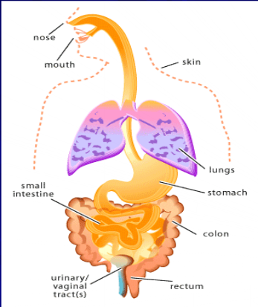
Where Can We find Normal Flora?
They are found in sites exposed to the outside world.
Skin
Eye
Mouth
Upper Respiratory Tract
Gastrointestinal Tract
Urogenital Tract

Slide 7
SKIN
Skin can acquire any bacteria from the environment but it either get washed off or die because the skin is dry, has acidic pH, and produce sweat and oil.
Permanent bacteria present on skin can be in any layer of the skin.

Slide 8
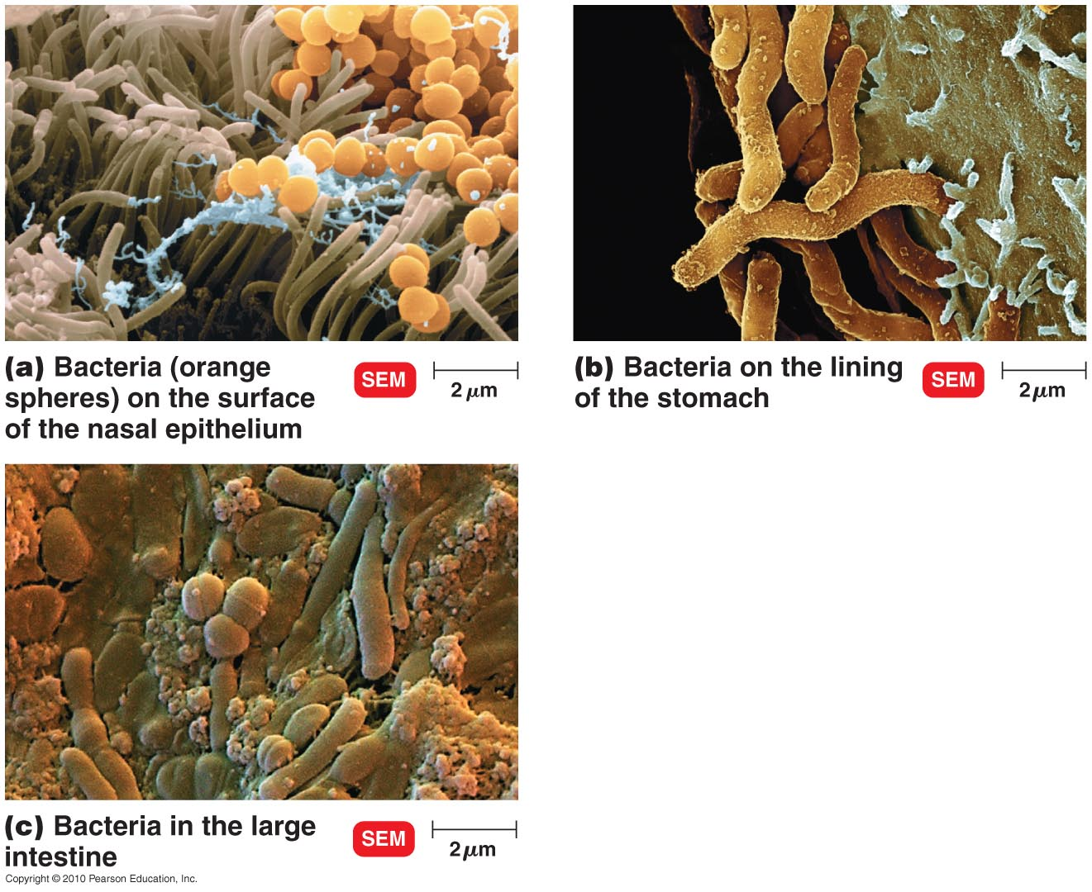

Slide 9
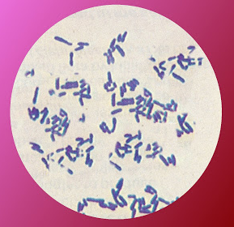
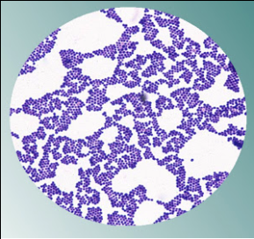
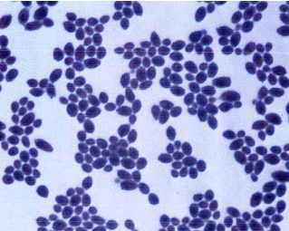
SKIN normal flora
Most of the microbial skin inhabitants can be categorized in three groups:
Diptheroids
Staphylococci
Yeasts/fungi

Slide 10
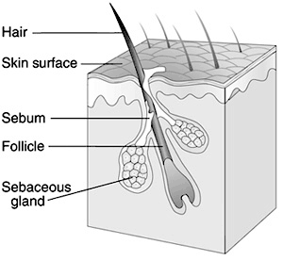
Anaerobic Bacteria:
Diptheroids:
They are responsible for body odor, caused by their breakdown of substances in sweat, which is odorless when it is first secreted.
an example of diptheroids is:
Propionibacterium acnes which lives in hair follicle where conditions are anaerobic. Its growth is enhanced by the oily secretion of the sebaceous glands.

Slide 11
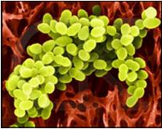
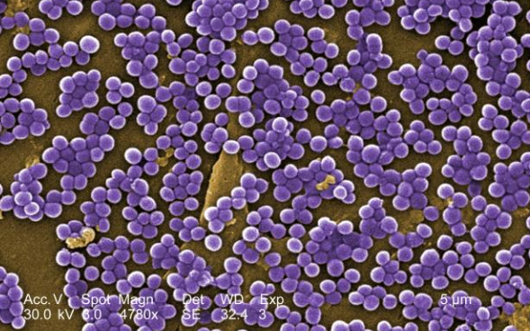
SKIN normal flora
Staphylococci:
Staphylococci are the salt-tolerant organisms that grow well on the salty skin surface. The are able to grow aerobicaly and the most common of species is:
e.g. Staphylococci epidirmitidis.
They protect the skin from other pathogens by outcompeting them for space on the skin and by secreting substances that inhibit the growth of other organisms.

Slide 12
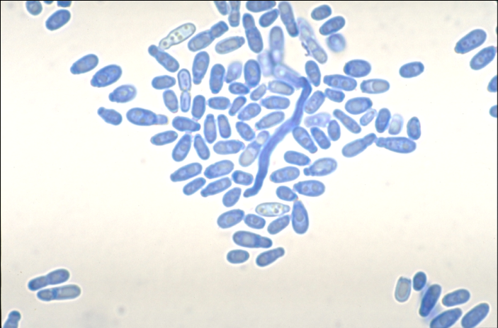
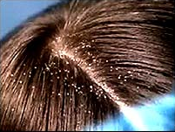
SKIN normal flora
Yeasts/fungi
Tiny lipophilic, meaning oil-requiring, yeasts, almost universally inhabit the normal human skin from late childhood onward.
Some fungi and yeasts can cause opportunistic infections
e.g. Candida albicans & Malasezia furfur.
Malasezia furfur.
It is generally harmless but can cause dandruff

Slide 13
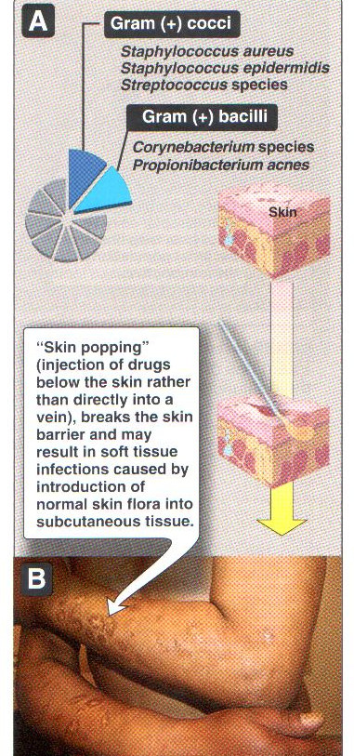
Normal Flora in the Skin

Slide 14
EYE
The conjunctiva of the eye has primarily S. epidermidis, followed by S. aureus, C. diphtheroids, and Strepto pneumoniae.
Some skin normal flora are also present but at fewer amounts.
Tears (Lysozyme enzyme) protects the conjunctiva from colonization by more bacteria.

Slide 15
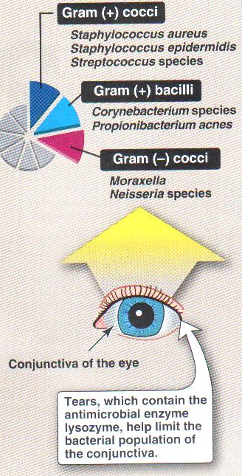
Normal Flora in the Eye

Slide 16
Mouth and Nose
They have both aerobic and anaerobic bacteria. The most common ones are: diphtheroides, S. aureus, S. epidermidis.
Teeth and Gengiva: Streptococcus mutans. After dental surgeries, there might be a risk of bloodstream infection that might cause endocarditis.
Nasopharynx: S. pneumoniae. In immune compromised or elderly it might cause acute bacterial pneumonia.

Slide 17
Gastrointestinal Tract
Stomach: Only few bacteria are present in the stomach due to gastric enzymes and acidic pH.
Intestines: large intestine has more bacteria than the small intestine. 99% of normal flora in the large intestine are anaerobic Bacteroides spp.
Most common Gram negatives: E.coli, Klebsiella spp., Proteus spp., Pseudomonas spp., and Enterobacter spp.

Slide 18
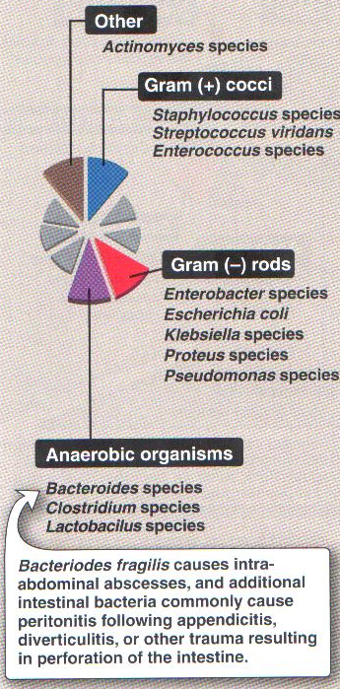
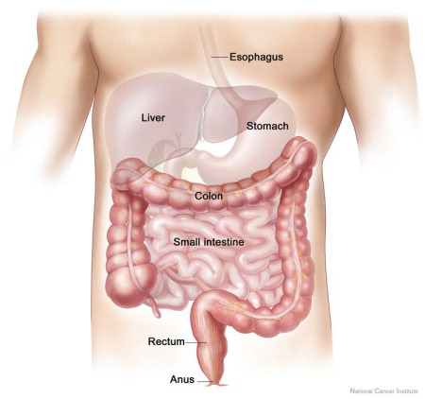
Normal Flora in the GIT

Slide 19
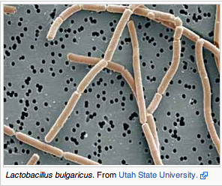
Urogenital Tract
Vagina: Lactobacillus spp. keeps the pH acidic to protect us from fungal infections caused by Candida albicans which is a minor resident.
Kidney and Bladder: are sterile.
Lower Urethra: has the same normal flora present in the skin outer layer.

Slide 20
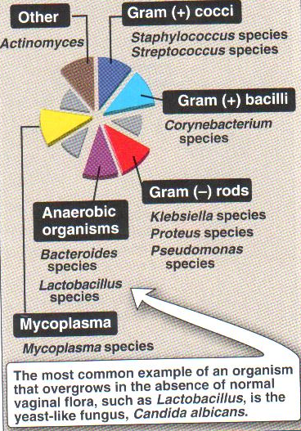
Normal Flora in the Vagina

Slide 21
Beneficial Functions of Normal Flora
Protect our organs and systems that are in direct contact with the outer environment from invading pathogens. Some normal flora produce substances that kills pathogens and others compete for with them for nutrients.
In newborns, normal flora stimulates the development of immune system.
Normal flora of the gut provides important nutrients such as Vitamin K which aid in digestion and absorption of nutrients.

Slide 22
Harmful Effect of Normal Flora
When the normal flora are displaced from their normal site of the body e.g. bloodstream infections by S. epidermidis.
When the number of the normal flora decreased due to uptake of antibiotic the harmful normal flora that are resistant to the antibiotic increase and cause harm to the system eg : C.difficile.
When harmless, commonly ingested food substances are converted into carcinogenic derivatives by bacteria in the colon e.g. sweetener cyclamate.
4. When individuals are immunocompromised, normal flora can overgrow and become pathogenic.

Slide 23


