Slide 1

CHEM 344 (REQUIRED COURSE)
ORGANIC REACTION MECHANISM
FOR CHEMISTRY’ STUDENTS, COLLEGE OF SCIENCE
Pre-requisites Course; CHEM 241
Credit Hours: 2(2+0)
Prof. Mohamed El-Newehy
Chemistry Department, College of Science, King Saud University
https://faculty.ksu.edu.sa/en/melnewehy
Prof. Zainab Almarhoon
Chemistry Department, College of Science, King Saud University
https://faculty.ksu.edu.sa/en/zalmarhoon

Slide 2
Aromatic Substitution Reactions
1) Electrophilic Aromatic Substitution Reactions
2) Nucleophilic Aromatic Substitution Reactions of Aryl halides

Slide 3
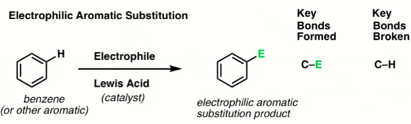
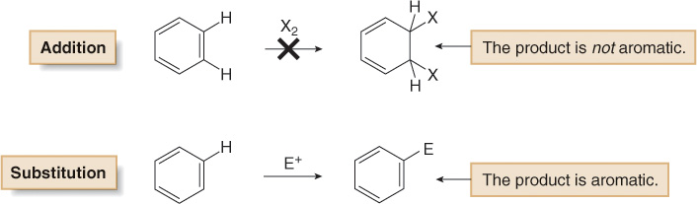
Electrophilic Aromatic Substitution Reactions
Electrophilic aromatic substitution is an organic reaction in which an atom that is attached to an aromatic system (usually hydrogen) is replaced by an electrophile.
Benzene does not undergo addition reactions like other unsaturated hydrocarbons, because addition would yield a product that is not aromatic.

Slide 4
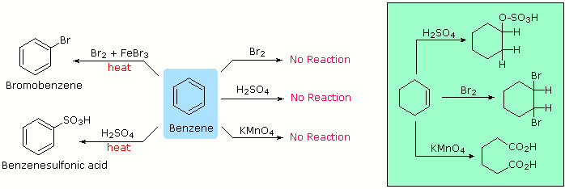
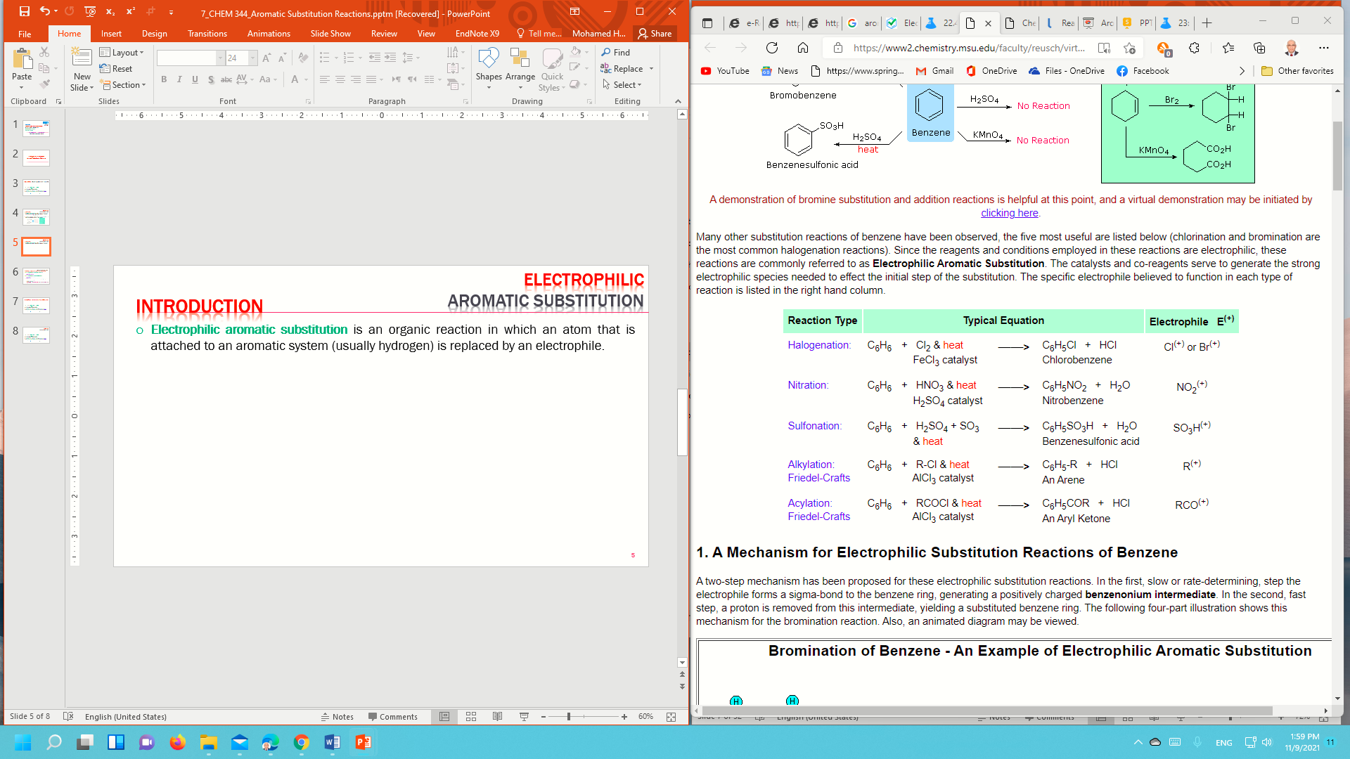
Electrophilic Aromatic Substitution Reactions; Typical Reactions
The chemical reactivity of benzene contrasts with that of the alkenes in that substitution reactions occur in preference to addition reactions.

Slide 5
Electrophilic Aromatic Substitution Reactions; Typical Reactions
Common Electrophilic Aromatic Substitution;
The catalysts and co-reagents serve to generate the strong electrophilic species needed to affect the initial step of the substitution.

Slide 6
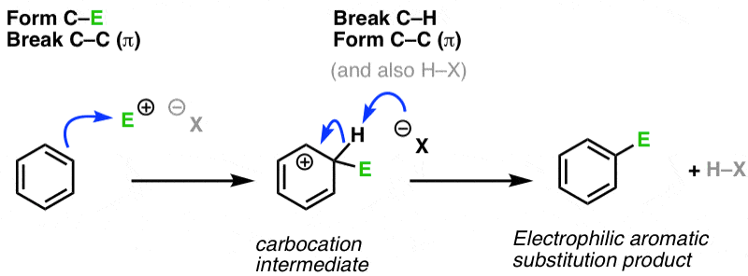
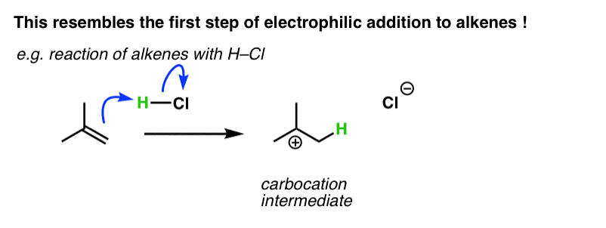
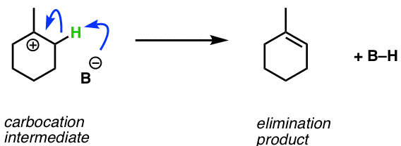
Electrophilic Aromatic Substitution Reactions; General Mechanism
Step 1: Attack of the electrophile (E⁺) by aromatic π-bond results in formation of a carbocation intermediate
Step 2: Deprotonation of the tetrahedral carbon restoring aromaticity
This resemble to the first step of the electrophilic addition to alkenes
This resemble to the second stem of the E1 reaction.

Slide 7
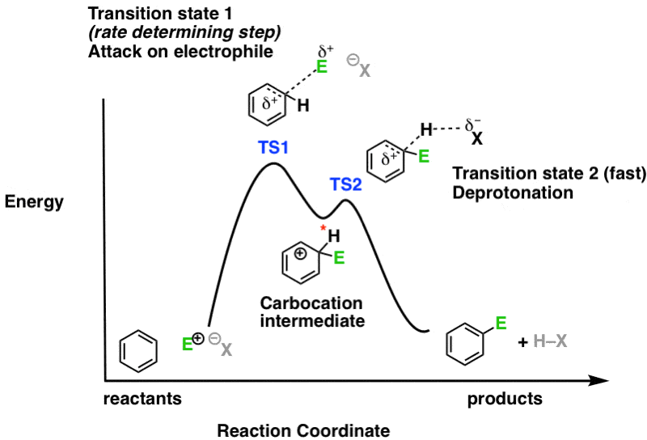
Electrophilic Aromatic Substitution Reactions
Reaction Energy Diagram

Slide 8
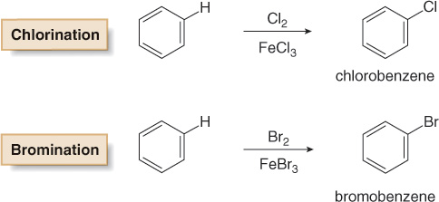
Electrophilic Aromatic Substitution Reactions; Halogenation
In halogenation, benzene reacts with Cl₂ or Br₂ in the presence of a Lewis acid catalyst, such as FeCl₃ or FeBr₃, to give the aryl halides (chlorobenzene or bromobenzene), respectively.
Analogous reactions with I₂ and F₂ are not synthetically useful because
I₂ is too unreactive and
F₂ reacts too violently.

Slide 9
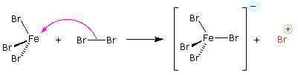
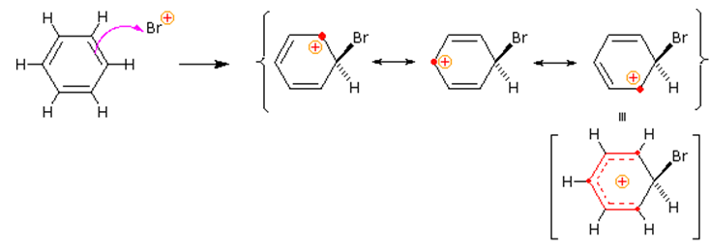
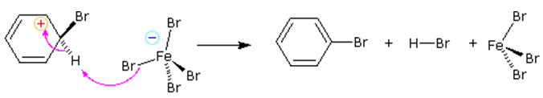
Electrophilic Aromatic Substitution Reactions; Halogenation
Mechanism
A two-step mechanism has been proposed for these electrophilic substitution reactions.
Preliminary step: Formation of the strongly electrophilic bromine cation
Step 1: slow or rate-determining step
The electrophile forms a sigma-bond to the benzene ring, generating a positively charged benzenonium intermediate.
Step 2: fast step
A proton is removed from this intermediate, yielding a substituted benzene ring

Slide 10
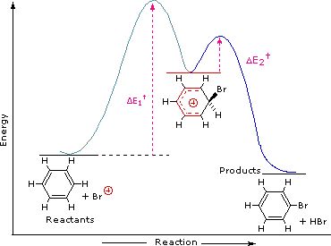
Electrophilic Aromatic Substitution Reactions; Halogenation
Reaction Energy Diagram

Slide 11
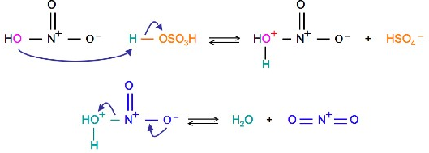
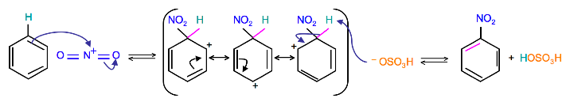
Electrophilic Aromatic Substitution Reactions; Nitration
Mechanism
Preliminary step:
Activation of HNO₃ with sulfuric acid to produce a stronger electrophile (nitronium ion) through the protonation of nitric acid by sulfuric acid, which causes the loss of a water molecule and formation of a nitronium ion.
The nitronium ion as a good electrophile, is attacked by benzene to produce Nitrobenzene.

Slide 12
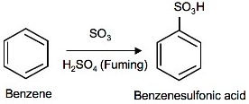
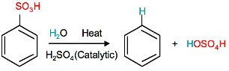
Electrophilic Aromatic Substitution Reactions; Sulfonation
Sulfonation is a reversible reaction that produces benzenesulfonic acid by adding sulfur trioxide and fuming sulfuric acid.
The reaction is reversed by adding hot aqueous acid to benzenesulfonic acid to produce benzene.

Slide 13
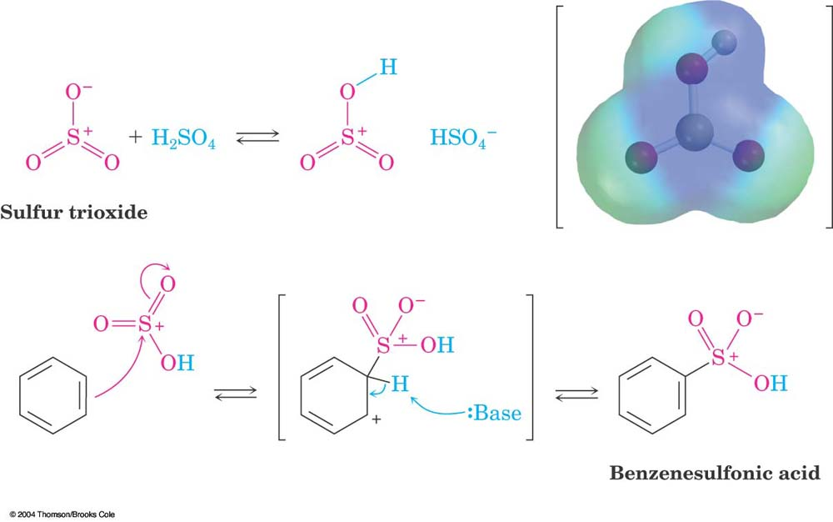
Electrophilic Aromatic Substitution Reactions; Sulfonation
Mechanism
Preliminary step: Reaction with a mixture of sulfuric acid and SO₃
Fuming sulfuric acid (oleum), is a concentrated solution of dissolved sulfur trioxide in sulfuric acid.
The sulfur in sulfur trioxide is electrophilic because the oxygen's pull electrons away from it because oxygen is very electronegative.
The benzene attacks the sulfur (and subsequent proton transfers occur) to produce benzenesulfonic acid.

Slide 14
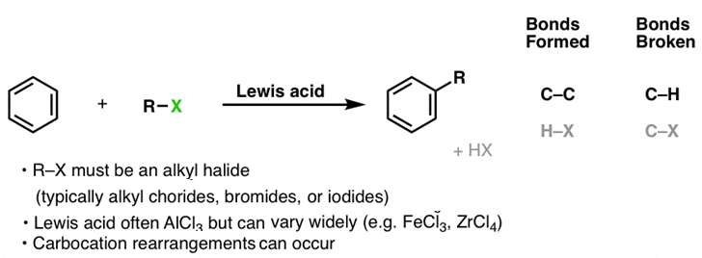
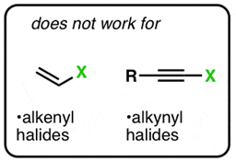
Electrophilic Aromatic Substitution Reactions; Friedel-Crafts Alkylation
Friedel-Crafts Alkylation was first discovered by French scientist Charles Friedel and his partner, American scientist James Crafts, in 1877.
This reaction allowed for the formation of alkyl benzenes from alkyl halides.
The reactivity of haloalkanes increases as you move up the periodic table and increase polarity.
e.g., RF haloalkane is most reactive followed by RCl then RBr and finally RI.

Slide 15
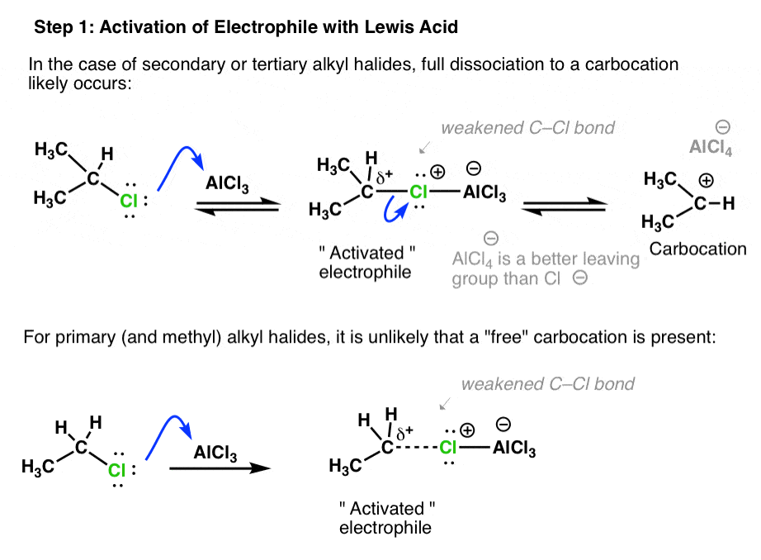
Electrophilic Aromatic Substitution Reactions; Friedel-Crafts Alkylation
Mechanism
Preliminary step: Activation of Electrophile with Lewis Acid
This steps activates the haloalkane and creates a carbocation that acts as the electrophile.
Secondary and tertiary halides only form the free carbocation in this step.
For primary and methyl alkyl halides, it is unlikely that a “free” carbocation is present.

Slide 16
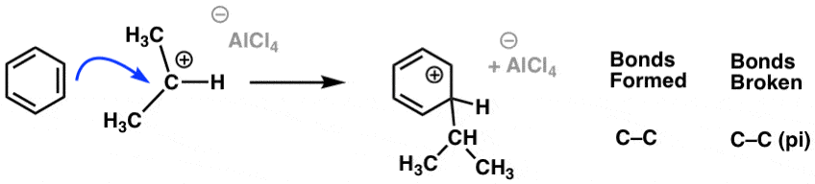
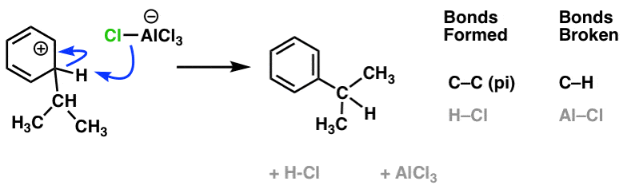
Electrophilic Aromatic Substitution Reactions; Friedel-Crafts Alkylation
Mechanism
Step 1: Attack of activated electrophile by aromatic ring (rate-determining step)
Step 2: Deprotonation at carbon to regenerate aromatic ring
NOTE: This step regenerates AlCl₃, which can react with more alkyl halide starting material.

Slide 17
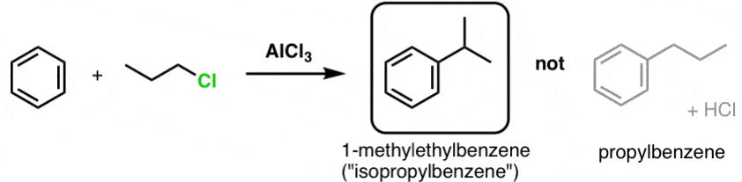
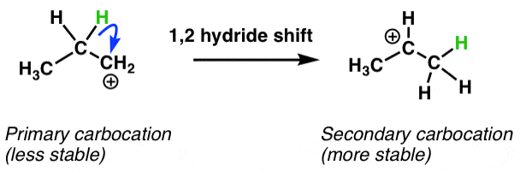
Electrophilic Aromatic Substitution Reactions; Friedel-Crafts Alkylation
Some Limitations of Friedel-crafts Alkylation
Carbocation rearrangements:
The Friedel-Crafts alkylation reaction between propyl chloride and benzene does not give propylbenzene, but isopropyl benzene.
Carbocations can rearrange via hydride and alkyl shifts, and a less stable carbocation is transformed into a more stable carbocation.

Slide 18
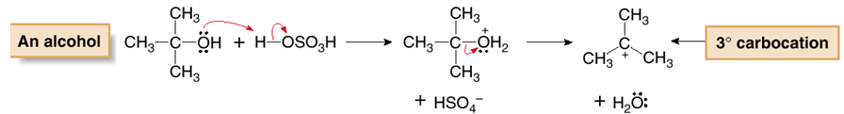
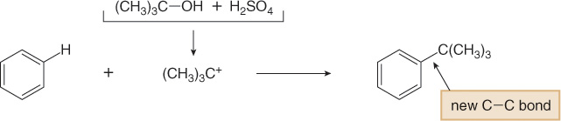
Electrophilic Aromatic Substitution Reactions; Friedel-Crafts Alkylation
Some Limitations of Friedel-crafts Alkylation
1) Other functional groups that form carbocations can also be used as starting materials:
Protonation of an alkene forms a carbocation
Protonation of an alcohol, followed by loss of water, likewise forms a carbocation

Slide 19
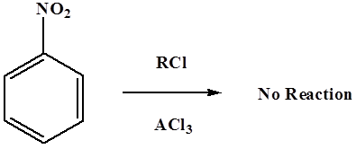
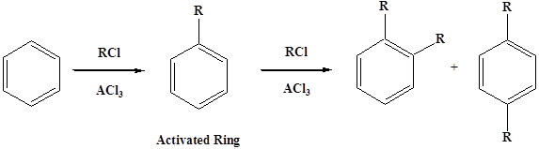
Electrophilic Aromatic Substitution Reactions; Friedel-Crafts Alkylation
Some Limitations of Friedel-crafts Alkylation
2) Alkylation of deactivating Systems:
Friedel-Crafts fails with compounds such as nitrobenzene and other strong deactivating systems.
3) Friedel-Crafts alkylation can undergo polyalkylation:
The reaction adds an electron-donating alkyl group, which activates the benzene ring to further alkylation.

Slide 20
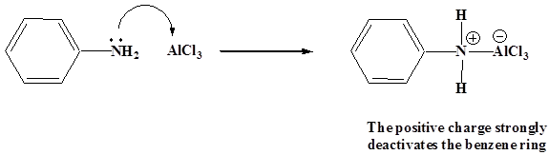
Electrophilic Aromatic Substitution Reactions; Friedel-Crafts Alkylation
Some Limitations of Friedel-crafts Alkylation
4) Friedel-Crafts reactions cannot be preformed with aromatic ring contains a NH₂, NHR, or NR₂ substituent.
The lone pair electrons on the amines react with the Lewis acid AlCl₃.
This places a positive charge next to the benzene ring, which is so strongly deactivate the reaction.

Slide 21
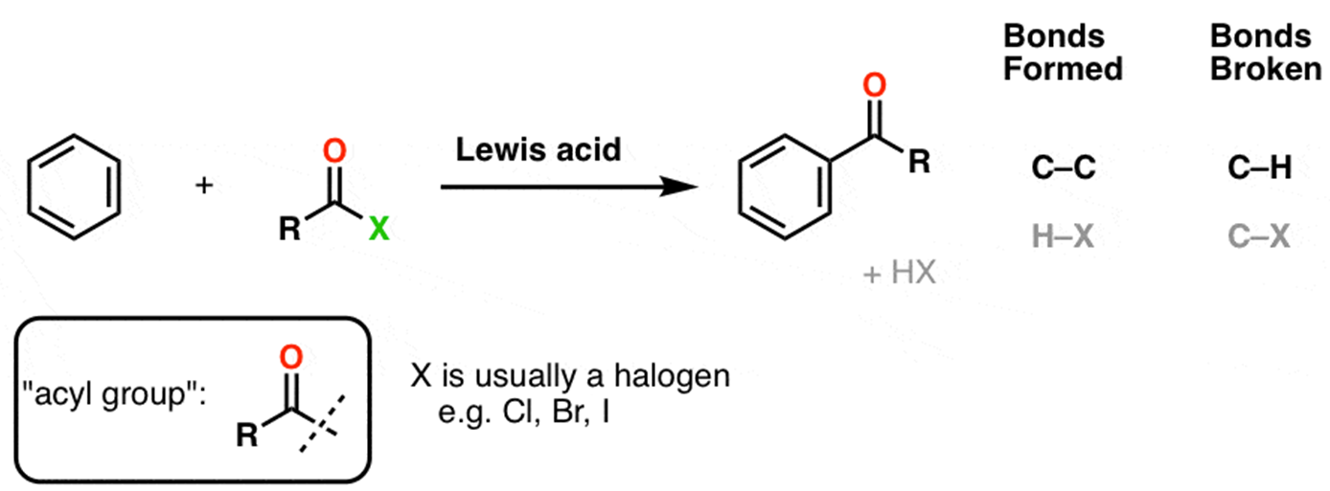
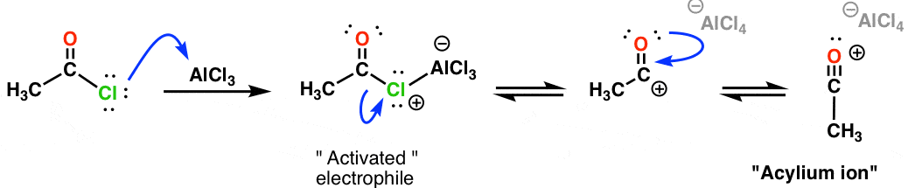
Electrophilic Aromatic Substitution Reactions; Friedel-Crafts Acylation
The Friedel–Crafts acylation is the reaction of an arene with acyl chlorides using a strong Lewis acid catalyst.
Mechanism
Preliminary step: Activation of Electrophile with Lewis Acid
Lewis's acid coordinates to the halogen, and departure of the halogen (as AlCl₄–) results in a stable, resonance-stabilized carbocation know as the “acylium ion”.

Slide 22
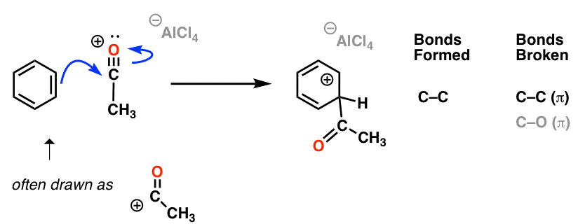
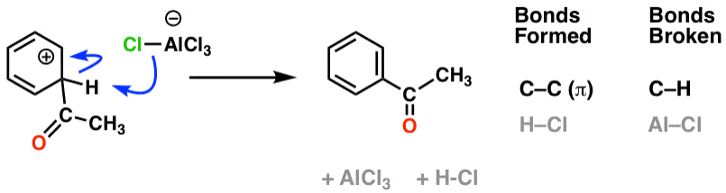
Electrophilic Aromatic Substitution Reactions; Friedel-Crafts Acylation
Mechanism
Step 1: Attack of activated electrophile by aromatic ring (rate-determining step)
Step 2: Deprotonation at carbon to regenerate aromatic ring

Slide 23
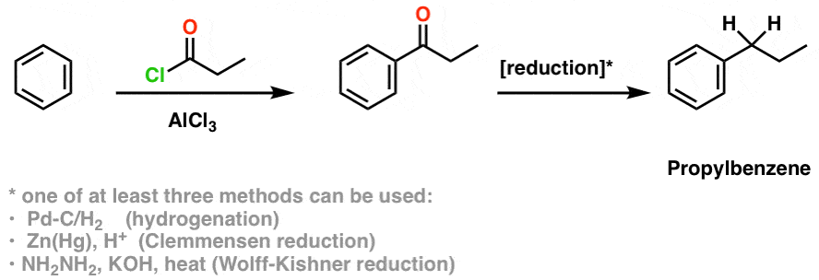
Electrophilic Aromatic Substitution Reactions; Friedel-Crafts Acylation
Unlike the Friedel-Crafts alkylation, no rearrangement occurs with the Friedel-Crafts acylation.
This opens a “workaround” to use the Friedel-Crafts acylation to obtain products that are otherwise difficult to obtain through the Friedel-Crafts alkylation due to carbocation rearrangements.
Example: A rearrangement “workaround”
The Friedel-Crafts acylation in combination with reduction can be used as a workaround for situations where a Friedel-Crafts alkylation reaction would lead to rearrangement.

Slide 24
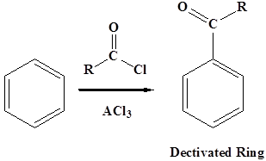
Electrophilic Aromatic Substitution Reactions; Friedel-Crafts Acylation
Some limitations of Friedel-Crafts Acylation
1) Friedel-Crafts acylation tends to fail on aromatic rings with strongly deactivating groups.
Similarly to alkylation, such as nitro, CF₃, sulfonyl and so on.
2) Friedel-Crafts acylation cannot undergo further acylation:
This problem does not occur during Friedel-Crafts Acylation because an acyl group is deactivating, thus prevents further acylation.

Slide 25
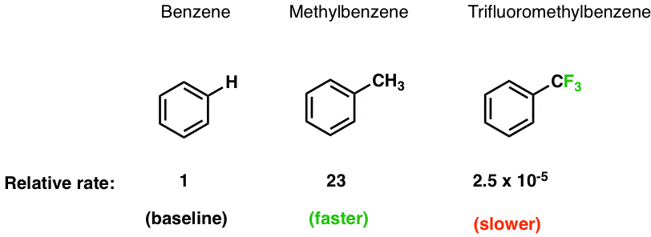
Electrophilic Aromatic Substitution Reactions; Substituted Benzene
What happens to the reaction rate if a substituent is added?
An electron-donating group (CH₃) results in a faster reaction than benzene itself.
An electron-withdrawing group (CF₃) results in a slower reaction than benzene itself.

Slide 26
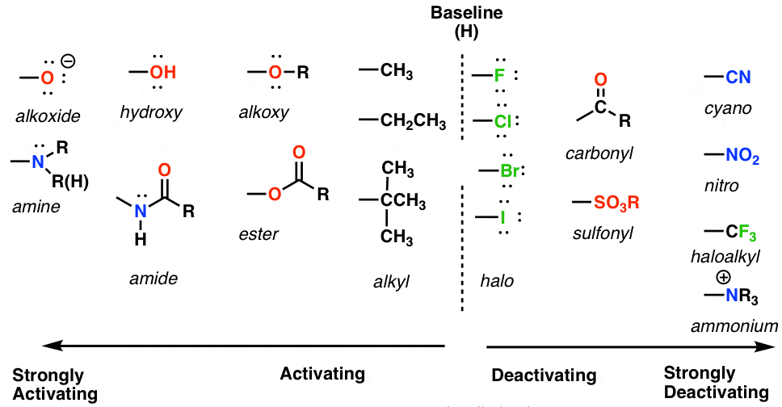
Electrophilic Aromatic Substitution Reactions; Substituted Benzene
Table of activating and deactivating groups

Slide 27
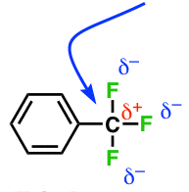
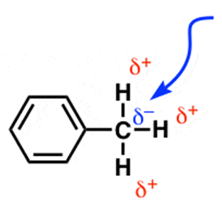
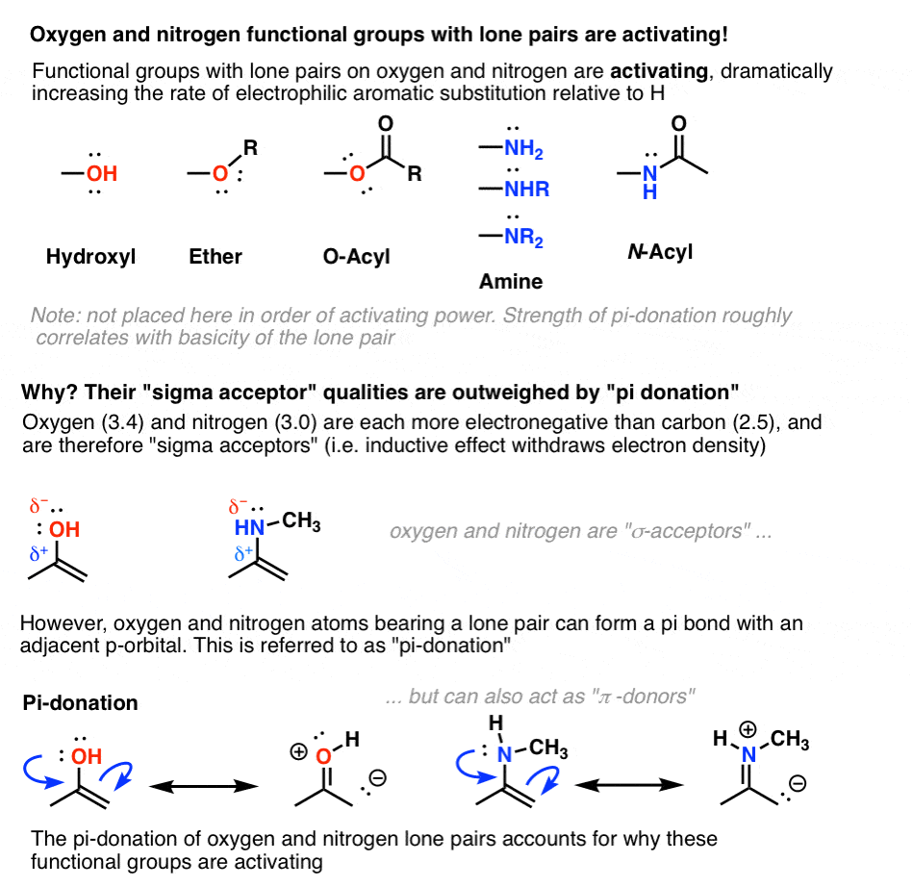
Electrophilic Aromatic Substitution Reactions; Substituted Benzene
When substituted benzene compounds undergo electrophilic substitution reactions, the following features must be considered: (1) Inductive Effect (2) Resonance Effect.
(1) Inductive Effect; “Sigma” (σ) donors and acceptors
Electron-donating group (e.g., Alkyl group)
Electron-withdrawing group (e.g., CF₃)
C is relatively electron-rich (δ-)
C donates electron density to the ring
C is relatively electron-donor (δ+)
C withdraws electron density from the ring
(2) Resonance Effect; Pi (π) donors and acceptors
Functional groups with lone pairs on oxygen and nitrogen are activating, dramatically increasing the rate of electrophilic aromatic substitution relative to H.

Slide 28
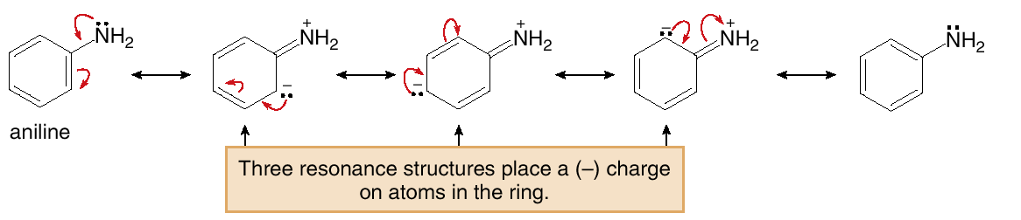
Electrophilic Aromatic Substitution Reactions; Substituted Benzene
A) π-donors groups are strongly activating
Inductive effect “σ-acceptors” withdraws electron density; Oxygen and nitrogen are more electronegative than carbon.
Oxygen and nitrogen are “σ-acceptors”
π-donor; oxygen and nitrogen bearing lone pairs and can form π–bond with adjacent p-orbital.
In this case; σ-acceptors < π-donor.
Example: An electron-donating resonance effect is observed whenever an atom having a lone pair of electrons is directly bonded to a benzene ring.

Slide 29
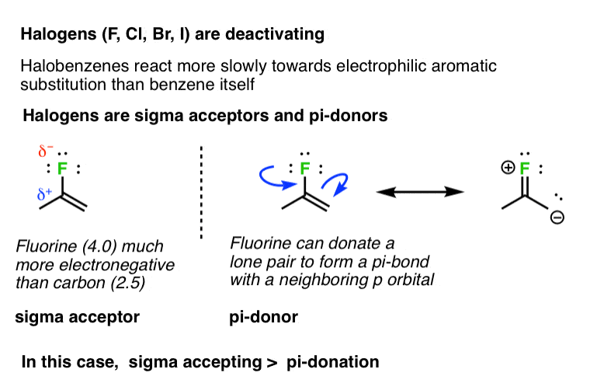
Electrophilic Aromatic Substitution Reactions; Substituted Benzene
B) Halogens (F, Cl, Br, I) are deactivating
Halobenzene react more slowly towards electrophilic aromatic substitution than benzene itself.
Inductive effect “σ-acceptors”; Fluorine much more electronegative than carbon.
π-donor; Fluorine can donate a lone pair to form π–bond with adjacent p-orbital.
In this case; σ-acceptors > π-donor.

Slide 30
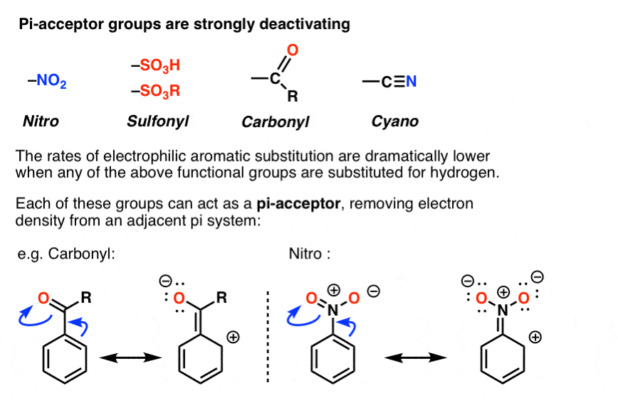
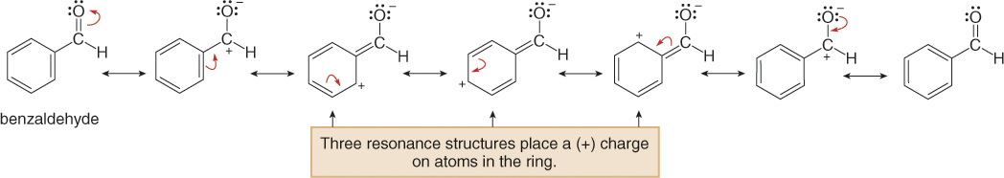
Electrophilic Aromatic Substitution Reactions; Substituted Benzene
C) π-acceptors groups are strongly deactivating
π-donor groups are strongly deactivating.
The rate of electrophilic aromatic substitution are lower than benzene itself.
Example: An electron-withdrawing resonance effect is observed in substituted benzenes having the general structure C₆H₅-Y=Z, where Z is more electronegative than Y.

Slide 31
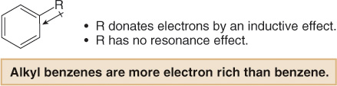
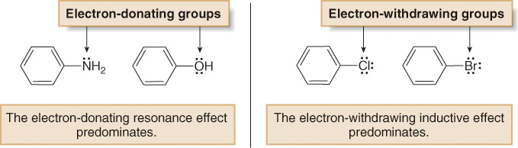
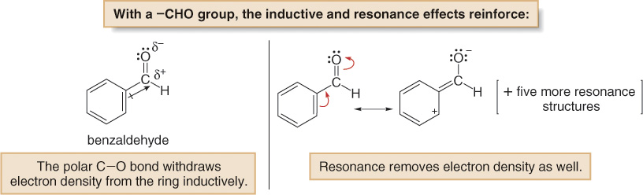
Electrophilic Aromatic Substitution Reactions; Substituted Benzene
We must consider the net balance of both the inductive and resonance effects.
Electron-donating groups
Electron-withdrawing groups
Activating groups-with no lone pairs, e.g., alkyl groups)
Deactivating groups-with lone pairs, e.g., halogens)
Activating groups-with lone pairs, e.g., OH, NH₂, …etc)
Deactivating groups-with lone pairs, e.g., general structure C₆H₅-Y=Z (with Z more electronegative than Y)

Slide 32
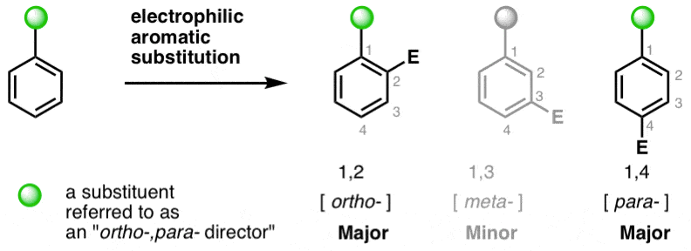
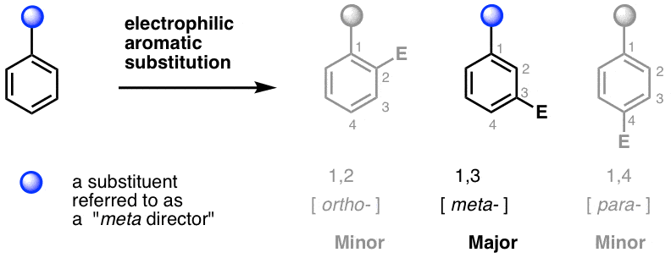
Electrophilic Aromatic Substitution Reactions; Substituted Benzene
A substituent affects two aspects of the electrophilic aromatic substitution reaction:
  1) The rate of the reaction
  A substituted benzene reacts faster or slower than benzene itself.
  Activating groups increase the rate of electrophilic aromatic substitution, relative to hydrogen.
  Deactivating groups decrease the rate of electrophilic aromatic substitution, relative to hydrogen.
  2) Orientation
  The new group is located either ortho, meta, or para to the existing substituent.
  The identity of the first substituent determines the position of the second incoming substituent.

Slide 33


Electrophilic Aromatic Substitution Reactions; Substituted Benzene
All substituents can be divided into three general types:
  1) ortho, para directors and activators
  3) meta directors
  Substituents that activate a benzene ring and direct substitution ortho and para
  Substituents that direct substitution meta.
  All meta directors deactivate the ring
  2) ortho, para deactivators
  Substituents that deactivate a benzene ring and direct substitution ortho and para

Slide 34


Electrophilic Aromatic Substitution Reactions; Substituted Benzene
Examples:
  Bromination of Toluene
Toluene reacts faster than benzene.
The electron-donating CH₃ group activates the benzene ring.
The CH₃ group is called an ortho, para director.
  Nitration of nitrobenzene
Nitrobenzene reacts more slowly than benzene.
The electron-withdrawing NO₂ group deactivates the benzene attack.
The NO₂ group is called a meta director.

Slide 35


Electrophilic Aromatic Substitution Reactions; Substituted Benzene
How substituents activate or deactivate the ring?
The first step involves addition of the electrophile (E⁺) to form a resonance stabilized carbocation.
The more stable the carbocation, the lower the energy of the transition state and the faster the reaction
The principles of inductive effects and resonance effects can now be used to predict carbocation stability.

Slide 36

Electrophilic Aromatic Substitution Reactions; Substituted Benzene
The energy diagrams

Slide 37

Electrophilic Aromatic Substitution Reactions; Substituted Benzene
Orientation Effects in Substituted Benzenes
There are two general types of ortho, para directors and one general type of meta director.
All ortho, para directors are R groups or have a non-bonded electron pair on the atom bonded to the benzene ring.
All meta directors have a full or partial positive charge on the atom bonded to the benzene ring.

Slide 38

Electrophilic Aromatic Substitution Reactions; Substituted Benzene
A CH₃ group directs electrophilic attack ortho and para to itself because an electron-donating inductive effect stabilizes the carbocation intermediate.

Slide 39

Electrophilic Aromatic Substitution Reactions; Substituted Benzene
With the NO₂ group (and all meta directors) meta-attack occurs because attack at the ortho and para position gives a destabilized carbocation intermediate.

Slide 40

Nucleophilic Aromatic Substitution Reactions of Aryl Halides
The carbon-halogen bonds of aryl halides are being much shorter and stronger than those of alkyl halides.
Aryl halides are resistant to attack by nucleophiles in either S_{N}¹ or S_{N}² reactions.
Aryl halides that have one or more nitro groups ortho or para to the halogen undergo nucleophilic substitution reactions under relatively mild conditions.

Slide 41


Nucleophilic Aromatic Substitution Reactions of Aryl Halides
Nucleophilic aromatic substitution reactions become quite rapid when
The aryl halide is activated by substitution with strongly electron-attracting groups such as NO₂,
Very strongly basic nucleophilic reagents are used.
General reaction:
Example:

Slide 42

Nucleophilic Aromatic Substitution Reactions of Aryl Halides
The reaction is faster when there are more nitro groups ortho and para to the halogen leaving group

Slide 43


Nucleophilic Aromatic Substitution Reactions of Aryl Halides
General Mechanism
Addition-Elimination Mechanism of Nucleophilic Substitution of Aryl Halides
Step 1: rate-determining step
The nucleophile reacts at the halide-bearing carbon to yield a resonance stabilized anion called a Meisenheimer complex.
Step 2:
Loss of the leaving group to reform the aromatic ring.

Slide 44


Nucleophilic Aromatic Substitution Reactions of Aryl Halides
Example
The nucleophile reacts at the halide-bearing carbon to yield a resonance stabilized anion called a Meisenheimer complex.
The negative charge in this complex is also delocalized into the nitro group.
The Meisenheimer complex breaks down to products by loss of the halide ion.

Slide 45





Nucleophilic Aromatic Substitution Reactions of Aryl Halides
Ortho and para nitro groups accelerate the reaction as they stabilize the intermediate by resonance (but not meta nitro groups).
Example: consider the displacement of bromine by methoxide (OCH₃) in the reaction of 4-bromonitrobenzene and methoxide ion:
The anionic intermediate formed by addition of methoxide ion to the aryl halide
Substituents in the meta positions have much less effect on the reactivity of an aryl halide because delocalization of electrons to the substituent is not possible.
The negative charges are both on atoms next to positive nitrogen and

Slide 46
Nucleophilic Aromatic Substitution Reactions of Aryl Halides
Nucleophilic aromatic substitution reaction vs. S_{N}² reactions of alkyl halides;
Nucleophilic aromatic substitution reaction of aryl halides
S_{N}² reactions of alkyl halides
There is an actual intermediate: Meisenheimer complex.
There is no evidence for an intermediate
Intermediate
Frontside substitution (it requires no inversion of configuration.
Backside substitution with inversion of configuration.
Configuration
Effect of the halogen on the reaction rate
Aryl fluorides react most rapidly
Alkyl fluorides react most slowly
Reagents
involve nucleophiles and leaving groups.
Rate of reaction
obey second-order rate laws. rate = k[aryl halide][nucleophile]
Polar effect of F, is greater than the other halogens.
Loss of halide is not rate-limiting, the basicity of the halide is not important in determining the reaction rate.

