Slide 1
Boolean Algebra and Digital Logic

Slide 2
Selecting
Selecting of data or information is a critical function in digital systems and computers
Circuits that perform selecting have:
A set of information inputs from which the selection is made
A single output
A set of control lines for making the selection
Logic circuits that perform selecting are called multiplexers
Selecting can also be done by three-state logic or transmission gates

Slide 3
Multiplexers
A multiplexer selects information from an input line and directs the information to an output line
A typical multiplexer has n control inputs (S_{n − 1}, … S₀) called selection inputs, 2^{n} information inputs (I₂^{n} ₋ ₁, … I₀), and one output Y
A multiplexer can be designed to have m information inputs with m < 2^{n} as well as n selection inputs

Slide 4
2-to-1-Line Multiplexer
Since 2 = 2¹, n = 1
The single selection variable S has two values:
S = 0 selects input I₀
S = 1 selects input I₁
The equation:
Y = I₀ + SI₁
The circuit:
S

Slide 5
2-to-1-Line Multiplexer (continued)
Note the regions of the multiplexer circuit shown:
1-to-2-line Decoder
2 Enabling circuits
2-input OR gate
To obtain a basis for multiplexer expansion, we combine the Enabling circuits and OR gate into a 2 × 2 AND-OR circuit:
1-to-2-line decoder
2 × 2 AND-OR
In general, for an 2^{n}-to-1-line multiplexer:
n-to-2^{n}-line decoder
2^{n} × 2 AND-OR

Slide 6
Example: 4-to-1-line Multiplexer
2-to-2²-line decoder
2² × 2 AND-OR

Slide 7
Multiplexer Width Expansion
Select “vectors of bits” instead of “bits”
Use multiple copies of 2^{n} × 2 AND-OR in parallel
Example: 4-to-1-line quad multi- plexer

Slide 8
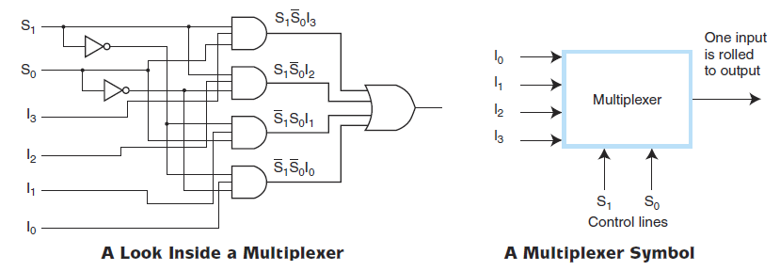
Typical Combinational Circuits – A Multiplexer (1/2)
Combinational Circuits
A multiplexer selects binary information from one of many input lines and directs it to a single output line.
Selection of the particular input line, to get data from, is controlled by a set of selection variables or control lines.

Slide 9
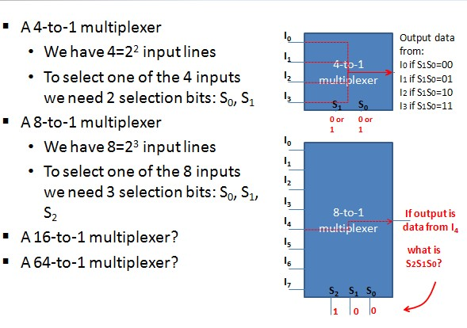
Typical Combinational Circuits – A Multiplexer (2/2)
Combinational Circuits

Slide 10
Sequential Circuits – Introduction
Sequential Circuits
Combinational circuits are memoryless, they do not have the concept of storage.
For some functions and operations we need to store past values and use them in future operations – we need sequential circuits.
The output of a sequential circuit is a function of its inputs at any given moment as well as its past inputs and states.
Thus sequential logic circuits must have a memory to remember values and store previous inputs and outputs.
In order to “remember” a past state, sequential circuits rely on feedback, where the output of a circuit is fed back as an input to the same circuit.

Slide 11
Sequential Circuits - Synchronization
Sequential Circuits
Timed “states”
There are two types of sequential circuits representing two ways to order events:
Asynchronous: they become active the moment any input value changes. Circuit output can change at any time (clockless)
Synchronous: Circuit output changes only at some discrete instants of time. Synchronization is achieved by using a timing signal called the “clock” to order events.
In this course we will study synchronous sequential circuits only

Slide 12
Flip-Flops (1/7)
Sequential Circuits
Clock: It is a circuit that emits a series of pulses
A clock is used to decide when to update the state of the circuit (when do “present” inputs become “past” inputs).
Clock speed: is generally measured in Megahertz (MHz), or millions of pulses per second.
Sequential circuits remember previous inputs by flip-flops.
If combinational circuits are generalizations of gates, sequential circuits are generalizations of flip-flops.
A simple example of this concept is shown below.
If Q is 0 it will always be 0, if it is 1, it will always be 1. Why?

Slide 13
Synchronous Sequential Circuits: Flip-flops as state memory (2/7)
Sequential Circuits
The flip-flops receive their inputs from the combinational circuit and also from a clock signal with pulses that occur at fixed intervals of time, as shown in the timing diagram.

Slide 14
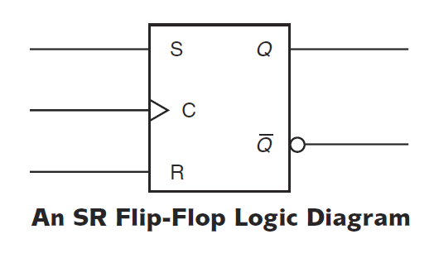
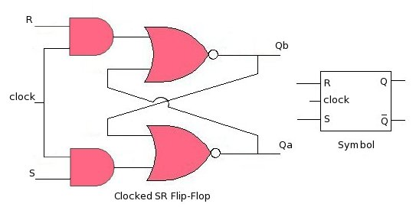
SR Flip-Flops (3/7)
Sequential Circuits
The most basic memory unit is called an SR flip-flop.
The “SR” stands for set/reset.
A clocked SR flip-flop. The output will change only when clock is '1', otherwise all inputs (S and R) will be ignored.

Slide 15
SR Flip-Flop Characteristics (4/7)
Sequential Circuits
How the feedback works?
Consider Q(t) as the value of the output Q at time t, and Q(t+1) as the new value of Q after a new clock pulse.
Note also that SR flip-flop has two additional inputs S and R, in addition to the fed-back output Q.
The behavior of an SR flip-flop is described by its characteristic table with the two inputs S and R.

Slide 16
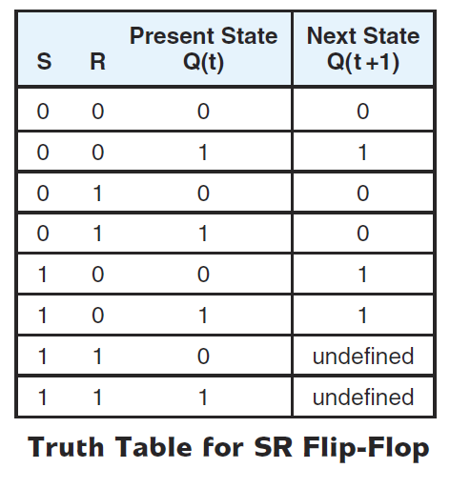
SR Flip-Flop Truth Table (5/7)
Sequential Circuits
Considering the three inputs: S, R, and Q, we can construct the truth table of an SR flip-flop
What happens when both S and R are 1?
The output is undefined
We say that the SR flip-flop is in an unstable state.

Slide 17
JK Flip-Flop (6/7)
Sequential Circuits
Jack Kilby modified the SR flip-flop to provide a stable state when both inputs are 1 – creating the JK flip-flop.
The characteristic table indicates that the flip-flop is stable for all inputs. When both inputs are 1 the present output is the complement (inverse) of the past output.
Try to draw the truth table of a JK flip-flop by considering the Q feedback as well.

Slide 18
D Flip-Flop (7/7)
Sequential Circuits
Another modification of the SR flip-flop is the D flip-flop (D stands for Data).
This sequential circuit stores one bit of information.
When the clock is pulsed:
If a 1 is asserted on the input line D the output line Q becomes a 1 (and remains 1 until the next clock pulse).
If a 0 is asserted on the input line the output becomes 0 (and remains 0 until the next clock pulse).

