Slide 1
Titration curve of amino acids
BCH 312 [PRACTICAL]

Slide 2
Objective:
-To study titration curves of amino acid.
-Determine the pKa values.
-Determine pI.
-Determine buffering regions.
-To understand the acid base behaviour of an amino acid.

Slide 3
Titration Curves:
Titration Curves are produced by monitoring the pH of a given volume of a sample solution after successive addition of acid or alkali. The curves are usually plots of pH against the volume of titrant added (acid or base).
Each dissociation group represent one stage in the titration curve.

Slide 4
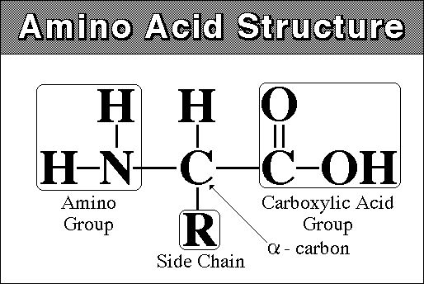
Amino acid general formula
Amino acids consist of:
1- a basic amino group ( —NH 2 )
2- an acidic carboxyl group ( —COOH)
3- a hydrogen atom ( —H)
4- a distinctive side chain ( —R).

Slide 5
Titration of amino acid:
-When an amino acid is dissolved in water it exists predominantly in the isoelectric form.
-( a compound that can act as either an acid or a base is known as an amphoteric compound).
-Upon titration with acid, it acts as a base (accept a proton).
-Upon titration with base, it acts as an acid (donate a proton)

Slide 6
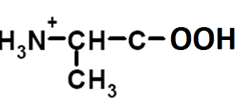
Titration of amino acid:
-Amino acids are example of weak acid which contain more than one dissociate group.
Example :
(1) Alanine, contain COOH (PKa1= 2.34) and NH₃⁺ (PKa2= 9.69) groups.
(it has one PI value=6.010)[Diprotic]
The COOH will dissociate first then NH₃⁺ dissociate later .
(Because PKa1<PKa2)
R-group = methyl-group
Full protonated alanine

Slide 7
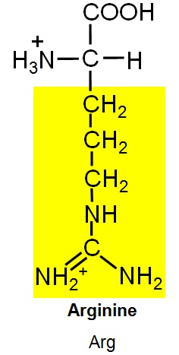
2)Arginine, contain COOH (PKa1= 2.34) , NH₃⁺ (PKa2= 9.69) groups and basic group(pKa3=12.5) (it has one pI value=11)[Triprotic]

Slide 8
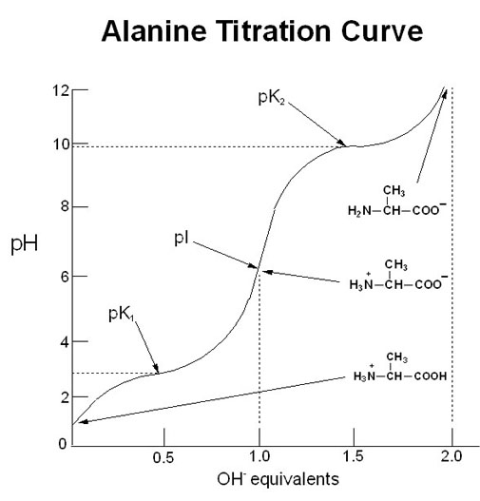
9X
7X
8X
6X
5X
4X
3X
2X
1X

Slide 9
Titration curve of alanine (or glycine) [diprotenation]
[1] starting point: Alanine, is full protonated [NH₃⁺-CH-CH₃-COOH].
[2] COOH will dissociate first:
- [NH₃⁺-CH-CH₃-COOH] > [NH3+-CH-CH3-COO⁻].
- PH<PKa1.
[3] In this point the component of alanine act as buffer:
- [NH₃⁺-CH-CH₃-COOH] = [NH₃⁺-CH-CH₃-COO⁻].
- PH=PKa1,
[4] In this point:
- [NH₃⁺-CH-CH₃-COOH] < [NH₃⁺-CH-CH₃-COO⁻ ].
-PH > PKa1

Slide 10
[5] Isoelectric point:
- The COOH full dissociate to COO- .
- [NH₃⁺-CH-CH₃-COO⁻] .
- The conc. Of negative charge = conc. Of positive charge.
- The amino acid present as Zwetter ion (neutral form) .
- PI (isoelectric point) : PH value at which the net charge of amino acid equal to zero.
- PI = (PKa1 + PKa2) /2 = (2.32+9.96)/2= 6.01

Slide 11
[6] The NH₃⁺ start dissociate ,
- [NH₃⁺-CH-CH₃-COO⁻] > [NH₂-CH-CH₃-COO⁻]
- PH <PKa2.
[7] In this point the component of alanine act as buffer:
- [NH₃⁺-CH-CH₃-COO⁻] = [NH₂-CH-CH₃-COO⁻].
- PH=PKa2.
[8] In this point: [NH₃⁺-CH-CH₃-COO⁻] < [NH₂-CH-CH₃-COO⁻].
- PH >PKa2
[9] End point:
- Alanine is full dissociated, [NH₂-CH-CH₃-COO⁻], (the NH3 group is full dissociate)
POH= (Pkb+P[A-])/2
PKb = PKw – PKa2

Slide 12
Note in calculation method:
The PH calculated by different way :
[1] at starting point PH= (Pka+ P[HA])/2
[2] At any point within the curve (before or in or after middle titration)
PH=Pka+log([A-]/[HA])
[3] At end point POH=(PKb+P[A-])/2
PH=PKw – POH

Slide 13
Method:
You are provided with 10 ml of a 0.1M alanine solution, titrate it with 0.1M NaOH adding the base drop wise mixing, and recording the pH after each 0.5 ml NaOH added until you reach a pH=11.
Take another 10 ml of a 0.1M alanine solution, titrate it with 0.1 M HCL adding the acid drop wise mixing, and recording the pH after each 0.5 ml HCL added until you reach a pH=2.17.
Measured pH value | Amount of 0.1M NaOH added [ml]
Measured pH value | Amount of 0.1M HCl added [ml]

Slide 14
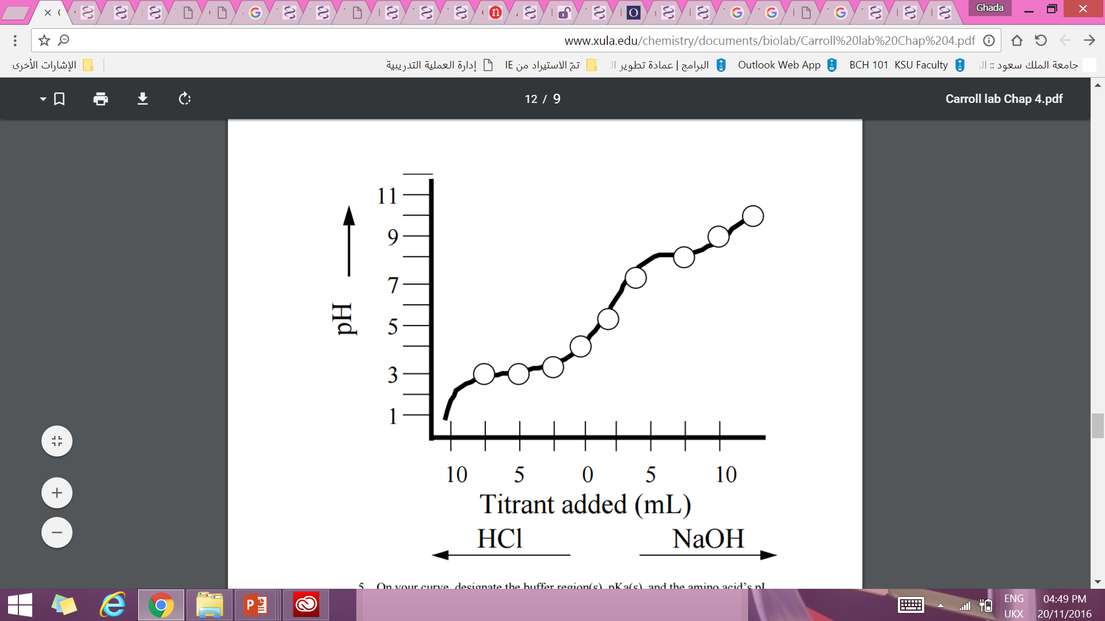
Results:
[1] record the titration table and Plot a Curve of pH versus ml of OH- added.
[2]Calculate the pH of the alanine solution after the addition of 0 ml, 5ml, of 0.2M NaOH. And calculate PH after addition of 0.5 ml , 2 ml of HCL
[3] determine the pKa of ionizable groups of amino acids
[4]Compare your calculated pH values with those obtained from Curve.
[5] determine the PI value from your result .

