Slide 1
chapter 3
Lecture
6
Fat as a Fuel for Exercise
Fat and Exercise
Dr. Iftikhar Alam
Author name here for Edited books

Slide 2
Introduction to Fat & Athletic Performance
Fat is important for athletic performance and good health
Primary fuels for exercise: fat & CHO
Both fuels are oxidized simultaneously
Proportion of each dependent on:
Meal prior to exercise
Energy fed during exercise
The duration, intensity, and type of exercise
Athlete’s fitness level
Fat becomes the primary source of fuel during endurance exercise

Slide 3
Introduction to Fat & Athletic Performance
20-35% of kcal from fat
Because of the role CHO plays in replenishing glycogen, athletes should consume less fat and more CHO than sedentary individuals
Endurance athletes: moderate-to-low-fat diets (20-25% of kcal from fat)
Ultralow-fat diets (<15% of kcal from fat) are not advantageous to health or performance and are difficult to follow

Slide 4
Table 7.1 Availability of Substrates in the Human Body
Substrate | Weight (kg) | Energy kJ (kcal)
Carbohydrates
Plasma glucose | 0.01 | 160 (40)
Liver glycogen | 0.1 | 1,600 (400)
Muscle glycogen | 0.4 | 6,400 (1,600)
Total (approximately) | 0.51 | 8,000 (2,000)
Fat
Plasma fatty acid | 0.0004 | 16 (4)
Plasma triacylglycerols | 0.004 | 160 (40)
Adipose tissue | 12.0 | 430,000 (108,000)
Intramuscular triacylglycerols | 0.3 | 11,000 (2,700)
Total (approximately) | 12.3 | 442,000 (111,000)

Slide 5
Function, Classification, and Dietary Sources of Fat

Slide 6
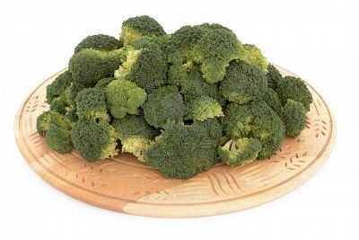
Important Roles of Fat
Fat is essential to life:
Primary source of energy at rest and during exercise
Efficient way to store extra energy in a small space
Fat is twice as energy dense as CHO and protein (9 kcal/ gram versus 4 kcal/ gram)
Provides essential FAs (linoleic and α-linolenic acid) and fat-soluble vitamins (A, D, E, K)

Slide 7
Important Roles of Fat
Fat is essential to life:
Part of the structural component of cell membranes and part of the brain and spinal cord tissue (Muscle structure for athletes)
Keeps the skin and other tissues soft & pliable (Movement during sports)
Pads the body and protects internal organs (Sports Injuries)
Tastes good; makes food more palatable by adding texture & flavour

Slide 8
Classification of Dietary Fats
Dietary fats can be classified based on their:
Structure or chain length
Level of saturation
Shape (i.e. cis vs. trans)
Commercial processing that the fat has undergone
Hydrogenation

Slide 9
Essential Fatty Acids
EFAs:
Linoleic acid (omega-6)
Food sources: vegetable oils (sunflower, safflower, corn, soy, peanut)
AI: ~5-10% of total energy
Males: 17 g/day, females: 12 g/day
α-linolenic acid (omega-3)
Food sources: leafy green vegetables, soy, seafood, canola oil, flaxseed, walnuts
AI: ~0.6-1.2% of total energy
Males: 1.6 g ALA/day, females 1.1 g ALA/day

Slide 10
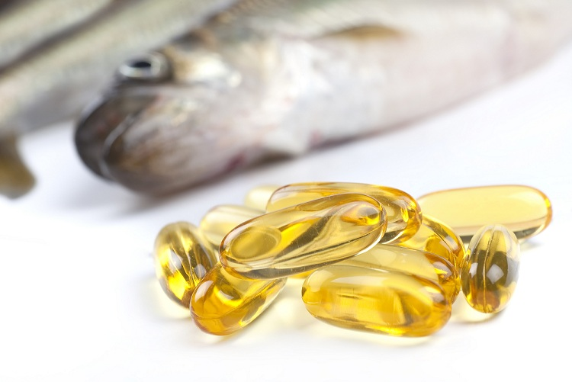
Omega-3 Fatty Acids
CFG: Aim to eat fish 2x/week (75 g per serving)
International Fish Oil Standards: http://www.nutrasource.ca/ifos/ConsumerReport.aspx

Slide 11
Fats in Foods
Triglycerides: dietary fat is found primarily in the form of triglycerides (triacylglycerols)
3 FAs attached to a glycerol backbone
Foods also contain other forms of lipids:
Cholesterol, phospholipids, sterols
Animal fats: provide ~40-60% of their energy as SFAs and 30-50% as MUFAs and PUFAs
Plant fats: provide ~10-20% of their energy as SFAs with the rest from MUFAs & PUFAs

Slide 12
Fats in Foods
Visible Fats
Obvious fats that are easy to spot in foods
E.g. oils, butter, cream, margarine, mayonnaise, fats on meats
Invisible Fats
Incorporated into prepared foods and are not as easily discernible
Majority of fat in most people’s diet comes from invisible fats
E.g. cookies, cakes, croissants, casseroles

Slide 13
Nutrition Labels: Fat Terminology
Fat free: less than 0.5 g of fat per serving
Low fat: 3 g or less of fat per serving
Reduced or less fat: at least 25% less fat as compared to a standard serving
Light: one-third fewer calories or 50% less fat as compared with a standard serving size

Slide 14
Fat Replacers
Carbohydrate-based fat replacers:
Dextrins, maltodextrins, tapioca dextrin, modified food starch
Oatrim
Z-Trim
Polydextrose
Microcrystalline cellulose
Gums

Slide 15
Fat Replacers
Protein-based fat replacers:
Simplesse
Fat-based fat replacers:
Olestra (Olean)
Salatrim (Benefat)

Slide 16
Body Fat Reserves and Dietary Fat Intake

Slide 17
Body Fat Reserves
Compared to protein & CHO stores, the body’s fat reserves are almost unlimited
Total amount of energy stored as fat varies with an individual’s size and body fat percentage

Slide 18
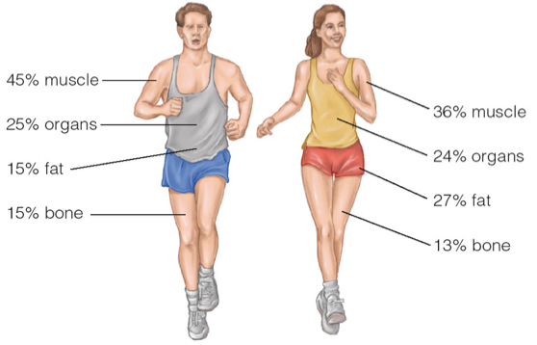
Average Body Composition
Women: greater fat tissue is normal & necessary for reproduction

Slide 19
Body Fat Percentage

Slide 20
Dietary Fat Guidelines
AMDR: aim for 20-35% of total energy intake coming from fat
Saturated fat: limit to <10% of total energy intake
Link between:
High dietary fat intake and risk of obesity, coronary heart disease, and some forms of cancer

Slide 21
Dietary Fat Intake of Active Individuals
Intake of fat is variable depending on the sport and gender of the athlete
Athletes typically report consuming about 35% of their energy from fat (Hawley et al. 1995)
Endurance sports:
E.g. running, cycling, x-country skiing
Report lower fat intakes and higher CHO intakes than sprinters and field event athletes
Athletes with weight concerns:
E.g. sports that have ‘weigh ins’, sub-clinical EDs
Lower fat intakes, esp. during periods of kcal restriction

Slide 22
Fat Metabolism During Exercise

Slide 23
Fat as a Fuel During Exercise
Fat is a major energy source during exercise
The ability to mobilize and use stored fat during exercise can improve exercise performance
Fat can be mobilized from the following sources:
Muscle fat
Adipose tissue fat
Blood lipoproteins
Fat consumed during exercise

Slide 24
Adipose Fat Tissue
Adipose fat tissue contains the largest reservoir of stored energy within the body
Steps involved to use fat during exercise:
Breakdown of TGs to FFAs and glycerol
Mobilization and transport of FFAs within the fat cell
Transport of the FFAs out of the fat cell to the blood
Transport of the FFAs in the blood
Transport of the FFAs into the muscle cell
Transport of the FFAs to the muscle mitochondria
Oxidation to energy via the tricarboxylic acid (TCA) cycle

Slide 25
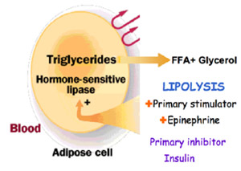
Lipolysis
Lypolysis: the breakdown of fat in the adipose or muscle tissue to FFAs and glycerol
Metabolic process is initiated when the sympathetic nervous system stimulates production of hormone-sensitive lipase (HSL) and epinephrine

Slide 26
Re-Esterification
Re-esterification: FAs released during the process of lipolysis are re-esterified if they are not needed for energy at that time
3FFAs + glycerol are transformed back into a TG
Intracellular recycling: re-esterification takes place within the adipose cell
Extracellular recycling: re-esterfication takes place outside of the adipose cell (e.g. in the liver)
During exercise, re-esterification is suppressed at the same time that the rate of lipolysis is accelerated

Slide 27
Hormonal Control of Lypolysis
Sympathetic nervous system
Strong stimulator of lipolysis
Hormones: epinephrine and norepinephrine rise dramatically upon the initiation of exercise
Signal the breakdown of stored fat (in adipose & muscle tissue) and carbohydrate (in liver & muscle glycogen), making these fuels available to the working muscles
Other hormones that stimulate lipolysis:
Growth hormone, cortisol, thyroid stimulating hormone

Slide 28
Hormonal Control of Lipolysis
Insulin:
Strongest inhibitor of lipolysis by decreasing the amount of active hormone-sensitive lipase (HSL)
During exercise or times of starvation, when the need for fat as an energy source is high, insulin levels are typically low and lipolysis is high
Blood glucose (BG) concentrations:
Independent of insulin, any increase in BG concentrations (i.e. feeding CHO during exercise) suppresses lipolysis, changing the mix of fuels used for energy during exercise

Slide 29
Intramuscular Fat
Fat stored within skeletal muscle appears to be an important energy source during exercise
Advantage: having TGs stored within muscle means that the fat is close to the mitochondria, the site of lipid oxidation and energy production, without requiring transport through the blood
Amount of intramuscular fat stored depends on:
Muscle fibre type
Nutritional status
Type of physical activity engaged in

Slide 30
Oxidation of Intramuscular Fat
Amount of intramuscular fat oxidized during exercise has not been well determined
Estimated that endurance exercise decreases intramuscular fat concentrations from 25% to 50%
The contribution of intramuscular fat breakdown to total fat oxidation during exercise may be 5% to 35%, depending on the study
Differences arise due to: subject fitness levels, exercise protocols, study methodology

Slide 31
Blood Lipids

Slide 32
Blood Lipids
Lipoproteins: transport fat in the blood, can be used for energy during exercise
2 lipoproteins highest in TGs: chylomicrons & VLDL
Lipoprotein lipase (LPL): the enzyme that is responsible for cleaving the FAs from the TG molecules in blood lipoproteins
Amount of energy obtained from blood lipids is generally small

Slide 33
Enhancement of Fat Oxidation

Slide 34
Fat Burning During Exercise
Exercise training:
Enables a person to work harder (higher oxygen uptake) while deriving more energy from fat and less from CHO
Physiological adaptations to exercise:
Increased # of mitochondria → enhances TCA cycle, FA oxidation, and the electron transport system
Increased TG storage intramuscularly
Increased capillary density of muscle, which improves blood flow and the exchange of FFAs and oxygen

Slide 35
Long-Chain Triglycerides vs. Medium-Chain Triglycerides

Slide 36
Long-Chain Triglycerides
Long-chain triglycerides (LCTs):
Slow gastric emptying, stay in the GI tract longer, and enter the blood stream more slowly
LCT consumption is generally not recommended during intense exercise lasting less than 4 hours
May be appropriate for long-lasting activity (i.e. ultramarathon, multiday event, all-day hike)

Slide 37
Medium-Chain Triglycerides
Medium-chain triglycerides (MCTs):
Glycerol backbone with 3 MCFAs (6-12 carbons)
Smaller size alters the way MCTs are digested, transported, & utilized for energy within the body
Rapidly exit the stomach and quickly diffuse across the gut (use less pancreatic lipase and bile salts)
Quickly enter the portal vein bound to albumin, where they are transported to the liver
Are oxidized rapidly for energy (vs. stored as adipose tissue)
MCFAs are not dependent on carnitine for transport into the mitochondria

Slide 38
Medium-Chain Triglycerides
MCTs & athletic performance:
MCTs do not significantly spare muscle glycogen
Total fat oxidation generally remains the same when MCTs are consumed either before or during exercise
MCTs may spare endogenous fat stores
MCTs have negative gastrointestinal side effects
MCTs are very expensive
Overall: MCT ingestion either before or during exercise does not appear to spare muscle glycogen or improve exercise performance

