Slide 1
For Loop

Slide 2
The for Statement
A for statement executes the body of a loop a fixed number of times.
Examples
  for (count = 1; count < 3; count++)
  System.out.println(count);

Slide 3
The for Statement
SYNTAX
for (initial expression; logical expression; update expression)
statement; //loop body: the statement to be repeated
Example
for (counter = 1; counter<=N; counter++)
sum += counter; //loop body
Execution:
  Initial statement(s) executes.
  Loop condition is evaluated.
  If loop condition is true,
    execute for loop statement (loop body)
    execute update statement(s).
    Go back to step 2
  If loop condition is false continue with remaining statements
Initial Expression
Update Expression
Logical Expression
True
Statement
False
Notes:
Mention that the initial expression can be more that one statement, they would be separated by commas.
Mention that the update expression can be more that one statement, they would be separated by commas.
Mention that often the loop counter is DECLARED and initialized right there. (more will be mentioned when we get to scoping)
Just to make them aware of the possibilities

Slide 4
Counter-controlled loops
The for loop is a specialized form of a while loop.
It’s primary purpose is to simplify the writing of counter-controlled loops.
The for loop is typically called a counted or indexed for loop.
If there’s more than one statement in the body, use a block {}
While loop
N = …
counter = 1
Loop while (counter<=N)
.
.
counter = counter + 1
End loop
N = …
For(counter = 1; counter <= N; counter=counter+ 1)
.
.
End For
Initialization
Condition
Increment \ Decrement

Slide 5
while vs for
while
for
int x = 0, i = 1;
while (i < 4)
{ x = x + i;
i++;
}
System.out.println(x);
System.out.println(i);
int x = 0, i;
for (i = 1; i < 4; i++)
{ x = x + i;
}
System.out.println(x);
System.out.println(i);

Slide 6
while vs for
while
for
int x = 0, i = 1;
while (i < 4)
{ x = x + i;
i++;
}
System.out.println(x);
System.out.println(i);
int x = 0, i;
for (i = 1; i < 4; i++)
{ x = x + i;
i++;
}
System.out.println(x);
System.out.println(i);
What would happen if we left this in here?
And what if we changed it to i--;?
Notes:
Note: As opposed to a while loop or a do-while loop you should avoid changing the loop counter inside the for loop body.

Slide 7
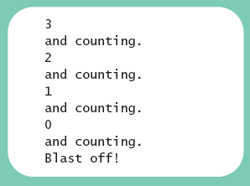
public class ForDemo
{
public static void main (String [] args)
{
int countDown;
for (countDown = 3 ; countDown >= 0 ; countDown--)
{
System.out.println (countDown);
System.out.println ("and counting.");
}
System.out.println ("Blast off!");
}
}
sample program, listing 4.5
Sample
screen output

Slide 8
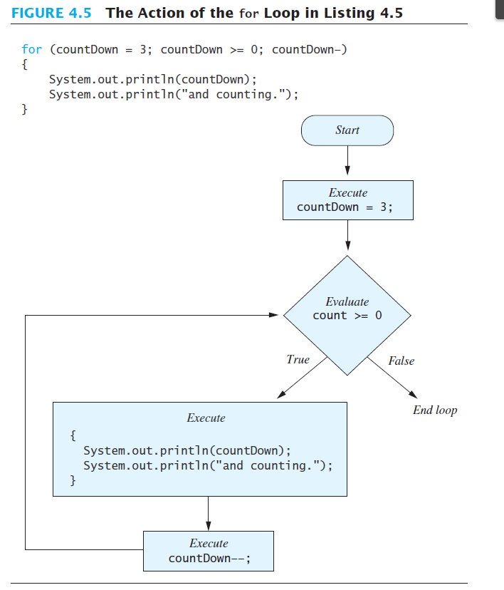
Notes:
Show sequence of execution

Slide 9
Example of while and equivalent for loop
Rewrite
The following while loop as a for loop
i = 0; //initialize
while (i <= 20) //condition
{
System.out.println(i + " ");
i = i + 5; //update
}
System.out.println();
Solution
// initialize condition update
for (i = 0; i <= 20; i = i + 5)
System.out.println(i + " ");
System.out.println();
Notes:
Point out the position of the semicolons again
One has to be careful where to update the loop counter.
For example, what would happen if the print statement contained (i-- + “ ”);

Slide 10
The for Statement
Simple Example
Print the first 10 nonnegative integers:
  for (i = 0; i < 10; i++)
  System.out.print(i + " ");

Slide 11
The for Statement
What is the difference between these two for loops?
for (i = 1; i <= 5; i++)
{ System.out.println("Hello");
System.out.println("*");
}
This for loop outputs the word Hello and a star (on separate lines) five times
for (i = 1; i <= 5; i++)
System.out.println("Hello");
This for loop outputs the word Hello five times and the star only once
System.out.println("*");

Slide 12
Programming Example: Square
Write a program that reads a set of 1000 integers and prints the square of each integer.
INPUT
A set of int numbers (variable: number, type: int)
N = 1000 (type: int)
OUTPUT
The square of each read number (variable: square, type: int)
PROCESS
Repeat N times:
read number
square = number * number
print square

Slide 13
Programming Example: Square
1
2
3
4
5
6
7
8
9
10
11
12
13
14
15
16
17
18
19
20
21
22
23
// import necessary libraries
import java.util.*;
public class forLoop
{
static final int N = 1000; //constant declaration
// instantiate the object read from the class Scanner
static Scanner read = new Scanner (System.in);
public static void main (String[] args)
{
// Declaration section: to declare needed variables
int number, square, counter;
for (counter = 0; counter < N; counter++)
{
// Input section: to enter values of used variables
System.out.println (“Enter an integer number”);
number = read.nextInt();
// Processing section: processing statements
square = number * number;
// Output section: display program output
System.out.println (“Square = “ + square);
} //end for loop
} // end main
} // end class
Modify the program to read from the user the number of integers
counter is int
Increasing step ➔ final value (N=1000) > initial value (0)

Slide 14
Programming Example: Classify Numbers
Input:
N integers (positive, negative, and zeros).
  int N = 20; //N easily modified
Output:
Number of 0s,
number of even integers,
number of odd integers.
Processing ??

Slide 15
Programming Example: Classify Numbers
int N = 20, number, evens = 0, odds=0, zeros = 0;
System.out.println("Enter " + N + " integers:");
for (int counter = 1; counter <= N; counter++)
{ number = console.nextInt();
switch (number % 2)
{ case 0: evens++;
if (number == 0)
zeros++;
break;
case 1:
case -1: odds++;
} //end switch
} //end for loop
System.out.printf("%d evens and %d odds and %d zeros\n",
evens, odds, zeros);
If we want to say what kind each number is. What do we need to add?

Slide 16
Programming Example: Classify Numbers
int N = 20, number, evens = 0, odds=0, zeros = 0;
System.out.println("Enter " + N + " integers:");
for (int counter = 1; counter <= N; counter++)
{ number = console.nextInt();
System.out.print(number);
switch (number % 2)
{ case 0: evens++;
System.out.print(" is even");
if (number == 0)
{ zeros++;
System.out.print(" and a zero");
}
break;
case 1:
case -1: odds++;
System.out.print(" is odd");
} //end switch
System.out.println();
} //end for loop
System.out.printf("%d evens and %d odds and %d zeros\n",
evens, odds, zeros);

Slide 17
Nested for - Syntax
SYNTAX
for (initial expression 1; logical expression 1; update expression 1)
{
statement i;
statement i+1;
for (initial expression 2; logical expression 2; update expression 2)
{
statement j;
statement j+1;
…
statement m;
}
statement i+k;
…
statement n;
}
// the inner loop.
NESTING
// the outer loop.
Each loop (inner and outer) has its own counter.

Slide 18
Initialize outCount
False
outCount < outFinal?
True
Statement(s) i
Initialize inCount
inCount < inFinal?
False
True
In statement(s) j
inCount++
Statement(s) i+k
outCount++

Slide 19
Nested for – Example 1
Example 1
1
2
3
4
5
6
7
8
9
10
11
int outCount, inCount = 0;
System.out.println (“Start the loops”);
for (outCount = 0; outCount < 2; outCount++)
{
System.out.printf (“Outer = %3d%n”, outCount);
for (inCount = 0; inCount < 3; inCount++)
System.out.printf (“\tInner = %3d ”, inCount);
System.out.println(“\n”);
} //end for outCount
System.out.printf (“After the outer loop ends, outCount = %d, inCount = %d”, outCount, inCount);
Output
1
2
3
4
5
6
7
8
Start the loops
Outer = ~~0
Inner = ~~0 Inner = ~~1 Inner = ~~2
Outer = ~~1
Inner = ~~0 Inner = ~~1 Inner = ~~2
After the outer loop ends, outCount = 2, inCount = 3

Slide 20
Nested for – Example 2 – analysis
Write a program that produces the following output:
*
**
***
****
*****
Line number Number of stars
1 1
2
3
4
5
If the line number (line) is the outer counter
➔ Initial value =1, final value: line <=5, step: line++
If the number of the stars (stars) is the inner counter
➔ Initial value = 1, final value: stars <= line, step: star++

Slide 21
Nested for – Example 2 – code
1
2
3
4
5
6
7
8
9
10
11
12
13
14
15
16
17
public class nestedFor
{
static final char ASTERISK = ‘*’;
public static void main (String[] args)
{
// Declaration section: to declare needed variables
int line, stars; //loop counters
// Processing section: processing statements
// Output section: display program output
for (line = 1; line <= 5; line++)
{
for (stars = 1; stars <= line; stars++)
System.out.print (ASTERISK);
System.out.print (“\n”);
} //end for (line =…
} // end main
} // end class

Slide 22
Nested for – Example 3
//What does this code do?
for (i = 1; i <= 5; i++)
{
for (j = 1; j <= 10; j++)
System.out.printf("%3d", i*j);
System.out.println();
}
Output
1 2 3 4 5 6 7 8 9 10
2 4 6 8 10 12 14 16 18 20
3 6 9 12 15 18 21 24 27 30
4 8 12 16 20 24 28 32 36 40
5 10 15 20 25 30 35 40 45 50

