Slide 1

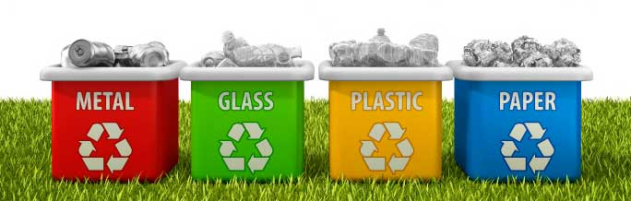
Solid and Liquid Waste
Lecture 6

Slide 2
Objectives
Define waste.
Define the different types of waste.
Outline the approaches to manage waste.
Describe sanitation procedures for different types of waste.
Describe the environmental impact of improper waste disposal.
Discuss food waste.

Slide 3
Introduction
What is waste?
Anything that lacks value.
Varies among people and cultures.
What is waste and how to deal with it
Laws and regulations for identification, storage, collection, transportation, treatment and disposal of waste.
Improper waste disposal can lead to environmental pollution and disease.
Industrialized countries divide waste in three main categories:
Municipal solid waste.
Hazardous waste.
Special waste.

Slide 4
Municipal Solid Waste (MSW)
What is MSW?
Trash or garbage generated by people in homes and businesses.
Discarded everyday household items. such as packaging materials, food scraps, furniture, clothing, glass, plastic, gardening waste, small appliances.

Slide 5
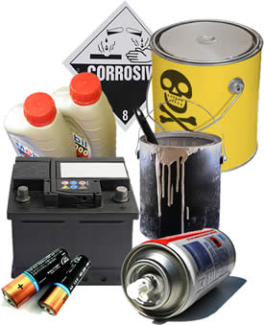
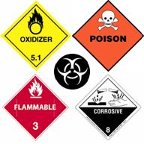
Hazardous waste
Contains substances harmful to human health and the environment when improperly managed or disposed.
Rules and regulations for disposal.
Specific industrial waste, such as petrochemicals.
Characteristics
Ignitability.
Corrosivity.
Reactivity.
Toxicity.

Slide 6
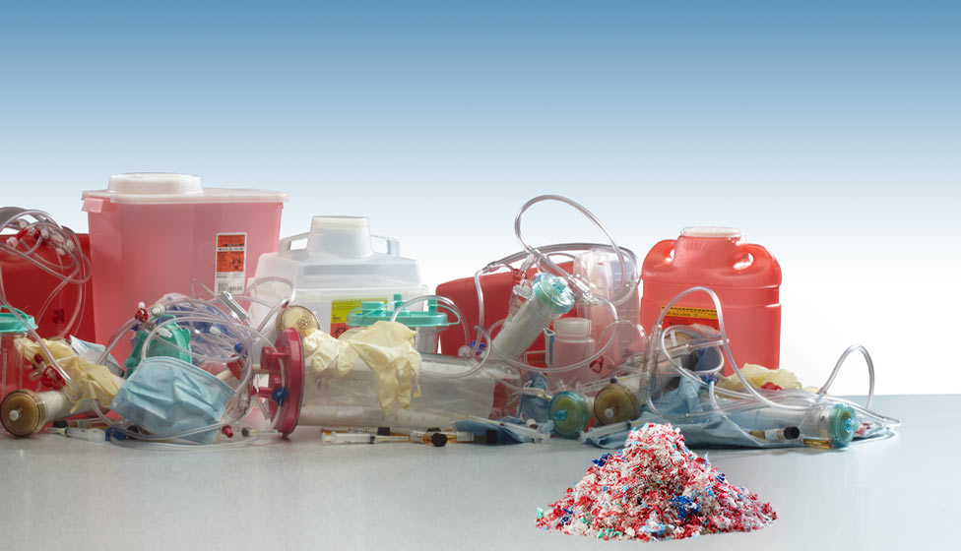
Special waste
Waste that is not MSW or hazardous waste (*).
Special designation, laws and regulations for it.
It can be treated or disposed in a way that do not pose a hazard to humans or the environment (*).
Radioactive waste
Low-level waste – used protective clothing.
High-level waste – spent fuel and waste from processing.
Medical waste
Materials contaminated with blood/bodily fluids and risk of transmission of blood borne pathogens.
Bandages and cleaning implements, glassware, used protective gear and supplies (needles), body fluids.

Slide 7
Special waste
Mining
Extraction of metals, coal and oil.
Agricultural
Animal waste from large scale food production
Nutrients, microbes, pathogens, antimicrobial and antibiotic drugs, and other veterinary drugs and chemicals like arsenic.
Construction
Asbestos, VOCs in paints.
Electronic waste
Old/broken electronic equipment.
Heavy metals – lead, mercury, cadmium.
Sewage sludge
Concentrated solid material from waste water treatment.
May or may not contain hazardous materials in it.

Slide 8
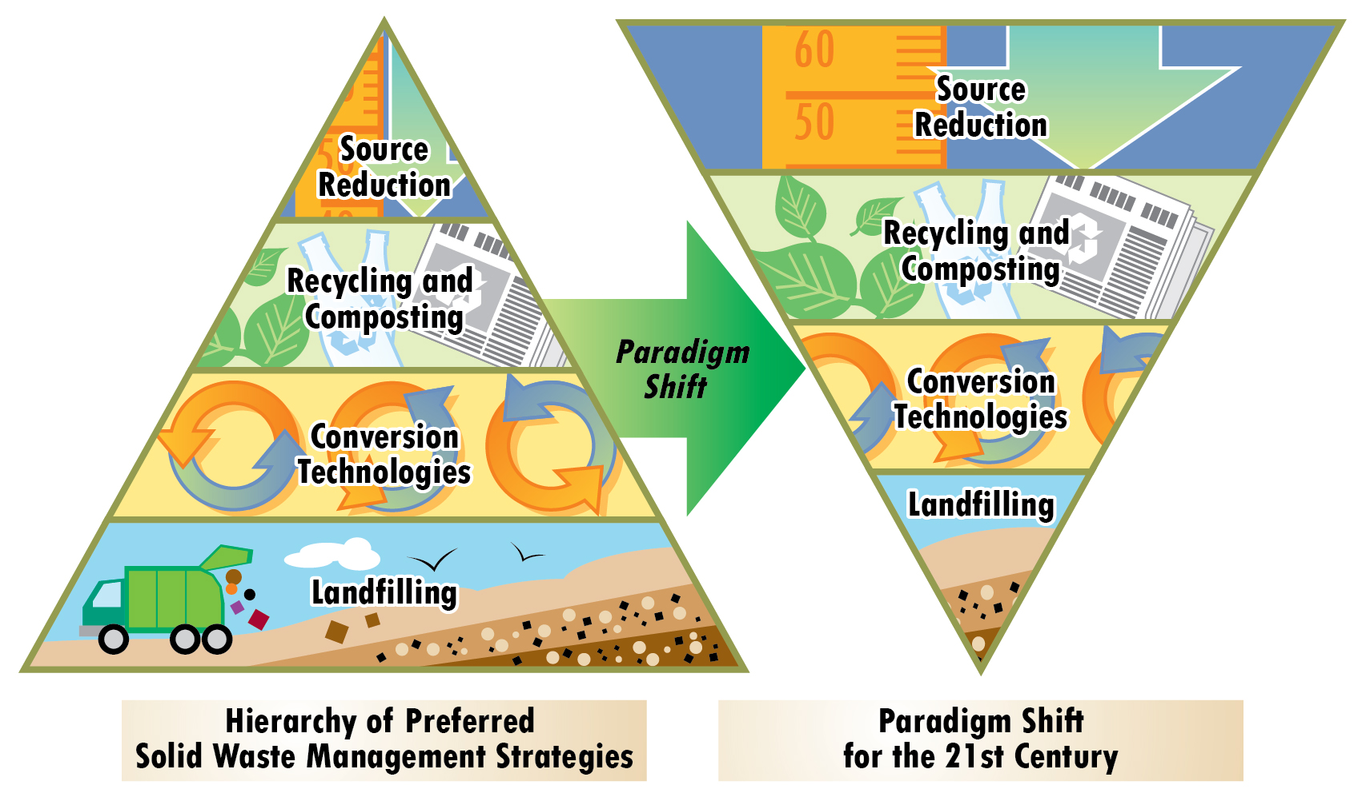
Solid Waste Management

Slide 9
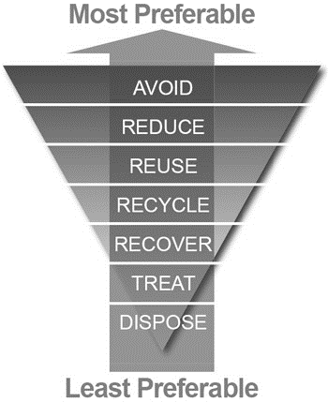
Solid Waste Management
Stage 1
Involves recycling, substitution of materials and changes in consumer habits.
Reduce – minimize use of raw materials and amount of waste created.
Reuse – find new uses for old items.
Recycle – use the waste material to produce more of the original product or to make something else, decreasing amount of waste going to landfills.

Slide 10
Solid Waste Management
Stage 2
Not all waste can be recycled, reused or avoided.
Proper handling of waste and its disposal to protect public health and the environment and reduce waste disposal.
Recover materials that can be destined for recycling, composting or incineration.
Treat by recycling, composting, incinerating or disposing.
Dispose
Landfills for municipal waste disposal.
Underground injection of hazardous waste.

Slide 11
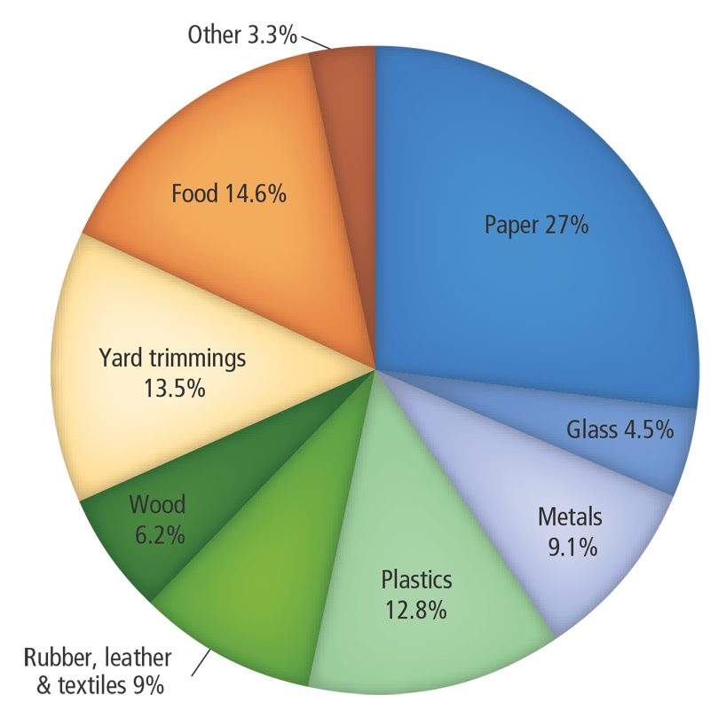
Recycling
Conserves resources and energy.
50-90% less energy needed than if making the same material from scratch.
Reduces levels of greenhouse and other air pollutants emissions.
Decreases amount of waste going to landfills.
Minimizes waste disposal by recovering and reprocessing usable materials.
Aluminum, paper, wood, glass, metals, plastics, rubber.
Waste from one industry is used by another as raw material.
Reuse and recycle energy and materials.

Slide 12
Recycling
Why people do not
recycle more?
What may be better than recycling?
No public policies in place.
Lack of consumer education.
Consumerism.
Use and throw away.
Consumers/Manufacturers.
Expensive.
Waste sorting and transport.
Plastics – new materials are cheaper than recycling.
Products made with recycled materials may not be cheaper.
Reduce waste
Use less material per product – food industry.
Minimize waste – increase efficiency.
Make products that last longer.
Do not promote consumerism.
Reuse
Use things multiple times.
Repair broken items.
Use old items in new ways.

Slide 13
Composting
Composting materials
Aerobic biological decomposition by microbes, nematodes, arthropods, earthworms of organic materials into humus.
Leaves, cotton, wool, paper, carton, food scraps, gardening and landscape waste.
Reduces amount of organic material going to landfills.
Reuse of humus by mixing with soil and use for planting.
Include | Exclude
Animal manure Leaves Wool rags Cotton rags Paper Carton Coffee grounds Egg shells Fruit and vegetable scraps and waste Tea bags Shredded newspaper Wood chips Sawdust Fireplace ashes | Dairy products Coal or charcoal ash Diseased or insect-infested plants Fats, grease or oils Meats, fish or bones Pet waste Plants treated with pesticides or herbicides

Slide 14
Incineration
Reduction in waste volume going to landfills ~ 80-90%.
Reduces waste to solid residues, gases and water vapor.
Solid residues disposed in landfills.
Why to incinerate waste?
Reduce the amount of waste to be disposed.
Reduce the hazardous properties of the waste.
Controlled burning of waste.
Municipal solid waste.
Sewage sludge.
Medical waste.
Industrial and hazardous waste.
Requires strict emission monitoring and control.
Incinerators can capture energy for reuse.

Slide 15
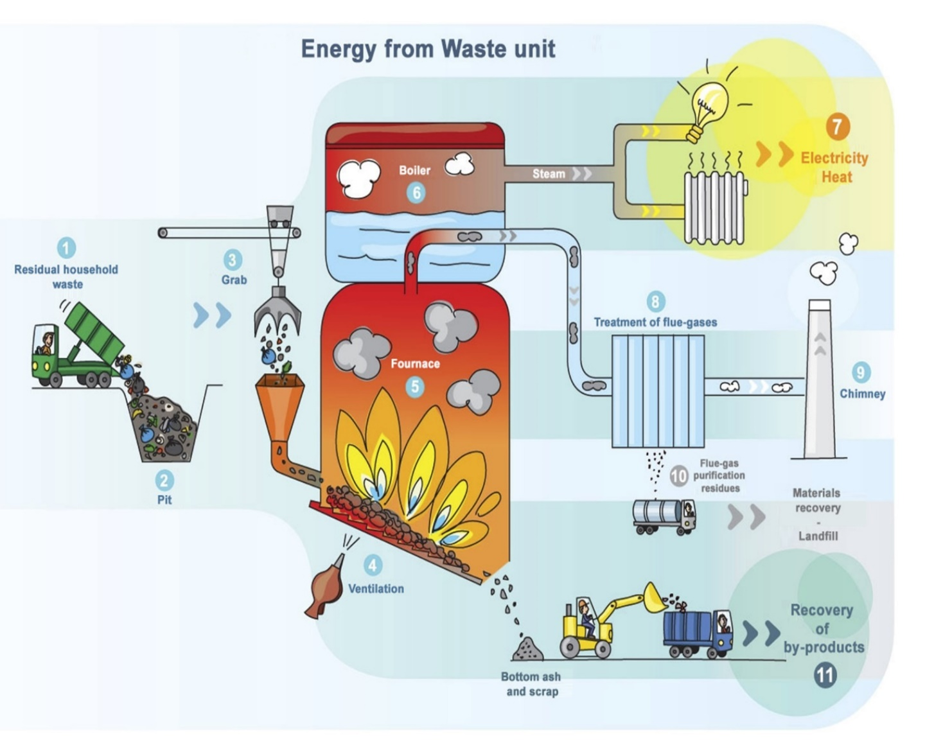
Incineration
Requirements
Enough time, high temperature, mixing and enough oxygen for combustion.
Strict air pollution control – air filtration.
Contaminants such as products of incomplete combustion, volatile compounds and particulates.
Heavy metal contaminants removal before incineration.

Slide 16
Sanitary Landfills
Landfills are sites were waste is buried.
Oldest form of waste management.
Four major parts of a landfill
Adequate location to minimize air, soil and water (surface and ground) contamination by materials released from the site.
Bottom liner
Leachate collection system
Cover

Slide 17
Sanitary Landfills
Landfill specifications
Large area to dispose of waste for a reasonable time.
Should not be located on floodplains, wetlands, earthquake zones, unstable land, or near airports (birds coming to the landfill).
Must monitor underground water for contamination.
Must have liners and a leachate collection system.
Liquid that contains dissolved solids and toxic compounds that form when rain moves down through the waste and that can contaminate groundwater.
Must cover daily with soil.
Must be monitored for up to 30 years after closing.

Slide 18
How long does trash last?

Slide 20
Sewage processing and disposal
Sewage is the waste and wastewater coming from homes and businesses that go into the sewers.
Piped to treatment plants were it is processed by microbial digestion, filtration, aeration and addition of chemicals.
Separation of waste water from drinking water to prevent contamination of drinking water and the spread of infectious diseases.
Vector borne – plague.
Waterborne – typhoid fever and cholera.

Slide 21
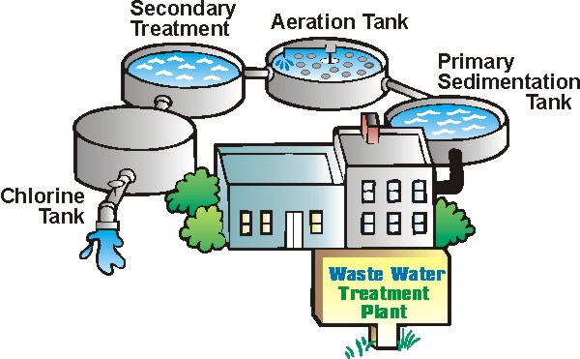
Sewage processing and disposal
Sewage treatment steps
Secondary – bacterial digestion of organic matter during aeration.
After this step, sewage is sometimes released into waterways (non-potable water reservoirs) or used for landscape irrigation.
Tertiary – filtration with sand/charcoal, membrane filtration, chemical and UV treatment.
Preliminary – removal of large solid debris.
Primary – Removal of suspended solids by sedimentation.
Sewage sludge goes to compost, incineration or landfills.
Wastewater cannot be used yet.

Slide 22
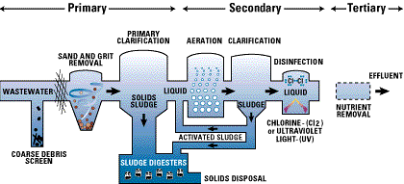
Sewage processing and disposal
Wastewater needs to have at least secondary treatment to be used for landscape irrigation (non-food crops).
After tertiary treatment, wastewater may be used for toilet flushing, car washing, landscape irrigation, food crop irrigation, discharge to potable waterways.

Slide 23
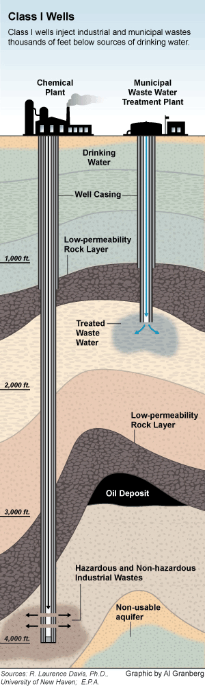
Deep well injection
What is deep well injection?
Type of waste
Injection of treated or untreated liquid waste into wells.
Geological formations that will not allow migration of contaminants into aquifers.
Need to avoid areas with earthquakes or volcanoes.
Waste not suitable for landfills.
Hydrocarbons.
Oil and gas drilling.
Radioactive.
Hazardous.

Slide 24
Health hazards of waste disposal
Leachate discharge of toxic chemicals in landfills can contaminate soil and water (surface and underground).
Microbial decomposition of organic matter reduces the pH of the leachate solubilizing heavy metals that can migrate and contaminate the soil and underground water.
Contamination of drinking water and soil and food by biological, chemical and industrial and mining waste.
Heavy metals may contaminate not only the soil, and water but also the air as fine particles are carried by wind.

Slide 25
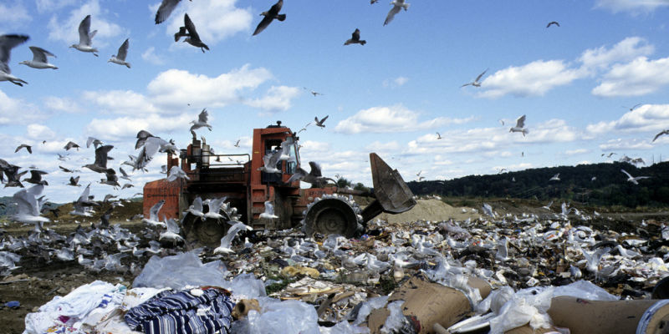
Health hazards of waste disposal
Infectious diseases from poorly managed solid waste in landfills.
Pests can find food, shelter, and a breeding ground.
Flies, mosquitoes, rodents – disease vectors as carriers of pathogens.
Covering landfills daily with clean soil reduces the spread of disease by vectors.
Landfills may be a source of air pollution.
Gases from decomposing waste affect health and quality of life.

Slide 26
Health hazards of waste disposal
Municipal and hazardous waste incinerators may release fine particulate matter and other pollutants into the air.
Polychlorinated biphenyls (PCBs), mercury, cadmium, lead, arsenic.
Bacterial transformation of mercury to methyl mercury – highly toxic.
Cerebral palsy-like symptoms in children exposed while in the womb.
Dioxins are persistent environmental pollutants that are resistant to degradation.
Accumulate in the food chain in the fat tissue of animals – meat, milk, fish, eggs.
Major source of exposure is by ingestion through food, followed by inhalation.

Slide 27
Solid waste management in KSA
High population growth (check), fast urbanization, rapid industrialization.
>75% of population in cities.
Increased pollution and waste.
> 15 million tons of solid waste/year.
1.5 – 2 kg waste/person/day.
> 6 million tons coming from the main three cities.
Waste disposal in landfills and dumpsites.
Lack of waste disposal facilities.
Capacity of most landfills will be reached within 10 years.
Sorting and recycling of 10-15% of waste is done by an informal sector.
Paper, plastic, metal.
Manual and labor-intensive.
Recycling, reuse and energy recovery not part of a formal program.?? Check
http://www.ecomena.org/solid-waste-management-in-saudi-arabia/

Slide 28
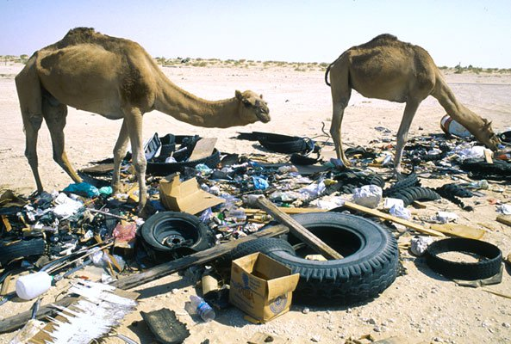
Solid waste management in KSA
Government investment
Water drainage and waste disposal projects.
Improving recycling and waste disposal.
SR29 billion in 2011 for municipal services.
The Ministry of Municipal and Rural Affairs is responsible for the solid waste management system.
Improve waste management through material recovery facilities, waste-to-energy systems and recycling infrastructure.
Public awareness and participation necessary for successful implementation of sustainable waste management
Legislation, financial support, technology.
http://www.ecomena.org/solid-waste-management-in-saudi-arabia/

Slide 29
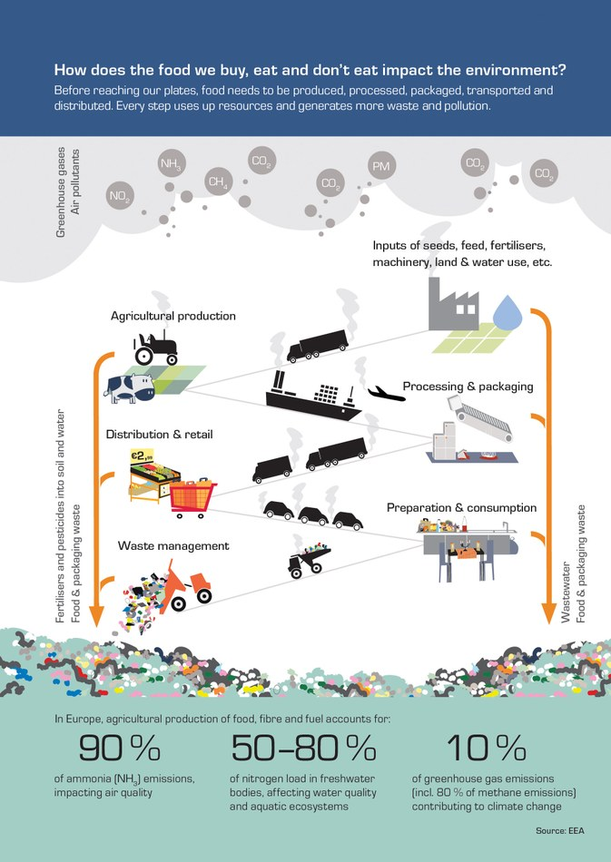
Food waste
One third of all the food produced in the world goes to waste.
~900 million people go hungry every day.
$750 billion/year wasted (not including fish and seafood).
Food waste means wasted resources used to produce that food.
Water, soil, fuel, seeds.

Slide 30
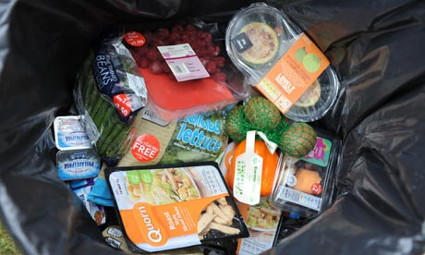
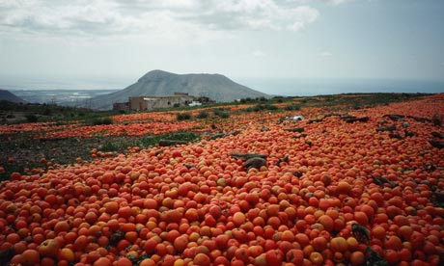
Food waste
Food loss is the unintentional decrease in quantity or quality of foods.
When crops go unharvested or produce is thrown out during processing, storage or transport.
Lack of technology, skills.
Developing countries.
Food waste is the intentional disposal of edible items, mainly by retailers and consumers, and is due to the behavior of businesses and individuals.
Developed countries.
Food wastage includes:
Food waste + food loss.

Slide 31
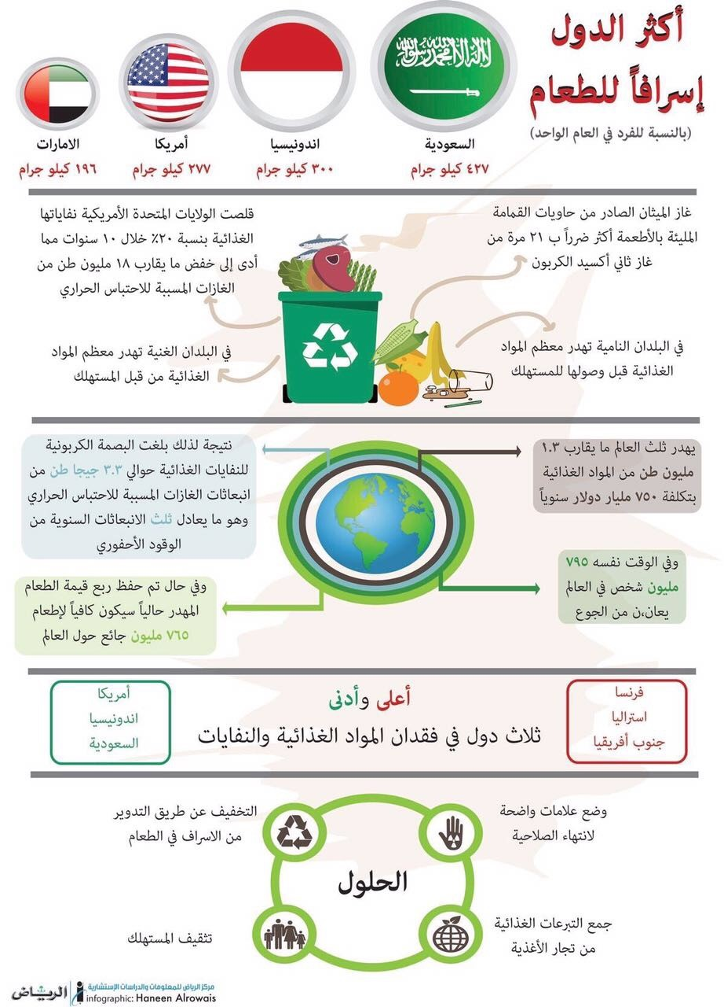

Slide 32
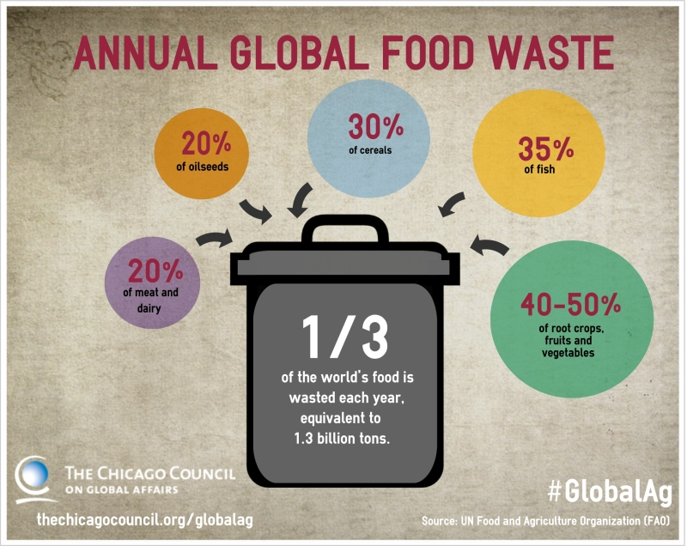
Food waste
Causes
In developing countries – higher losses because of food spoilage after harvesting.
Lack of proper technology for harvesting, storage and transport.
Unfavorable climate.
In developed countries – consumerism and food waste.
Cheap food – no incentive to avoid waste.
Food appearance – food gets rejected by both consumers and retailers if slightly blemished.
“Best-before-dates" = food good for consumption gets rejected.
“Super-size” and “buy-one-get-one-free”.
Laws that limit reuse of unwanted food.
http://www.fao.org/news/story/en/item/196220/icode/

Slide 33
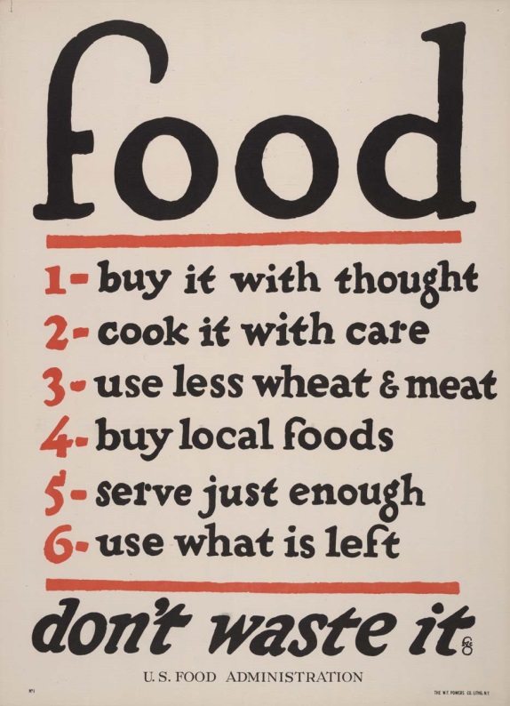
Food wastage
How to minimize food wastage
Reduce
In developing countries
Help to improve technology.
In developed countries
Do not produce/purchase more than needed.
Consumer education – buying, storing food.
Food waste is linked to individual behavior and cultural attitudes toward food.
Advocacy, education, and legislation may also reduce waste in the food service and retail sectors.
Review laws for sell-by dates (inadvertently increased food waste).
http://www.fao.org/news/story/en/item/196220/icode/

Slide 34
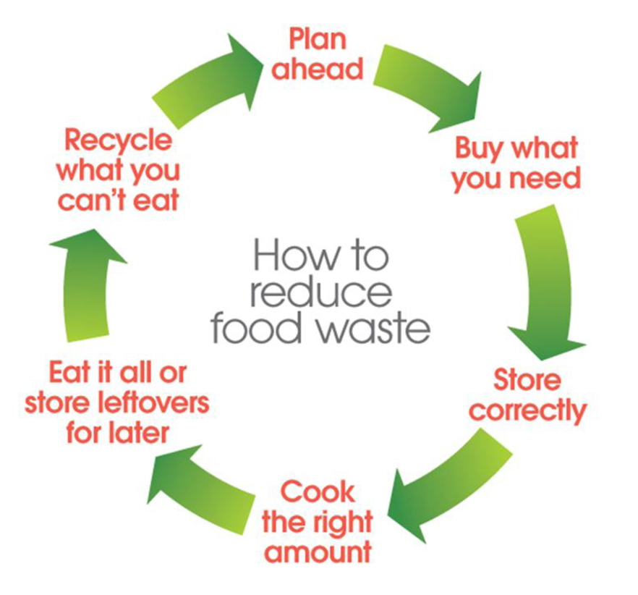
Food wastage
How to minimize food wastage
'Best before' date – food should have still best quality as long as it has been stored correctly.
Quality and appearance may have deteriorated, even if its still edible.
Frozen, dried or canned foods.
‘Use by' date –usually for refrigerated foods that need to be consumed within a shorter time. After that date, there is increased risk of food poisoning.

Slide 35
Food wastage
How to minimize food wastage
Reuse
When food is still edible.
Within the human food chain – donate extra food that is still good for human consumption to the hungry.
Within the animal food chain – food that is not fit for human consumption, use it for livestock feed to help conserve resources needed to produce animal feed (*).
Recycle and recover
When food cannot be reused.
Composting or incinerating with energy recovery.
Recover energy and nutrients from food waste – better than dumping it in landfills.
Rotting food in landfills produces large amounts of methane (greenhouse gas).
http://www.fao.org/news/story/en/item/196220/icode/

Slide 36
References
Food waste harms climate, water, land and biodiversity – new FAO report http://www.fao.org/news/story/en/item/196220/icode/
Godfray HC, et al. Food Security: The Challenge of Feeding 9 billion People. Science 327,812 (2010). doi: 10.1126/science.1185383
Zafar, S. 2015. Solid Waste Management in Saudi Arabia. http://www.ecomena.org/solid-waste-management-in-saudi-arabia/
Frumkin H. 2010. Environmental Health: From Global to Local> Second Edition. Wiley.
Moore GS. 2007. Living with the Earth: Concepts in Environmental Science. Third Edition. Taylor and Francis.
'Best Before' and 'Use By' Dates. http://www.elmbridge.gov.uk/envhealth/food/useby.htm
http://www.fda.gov/AboutFDA/Transparency/Basics/ucm210073.htm

