Slide 1
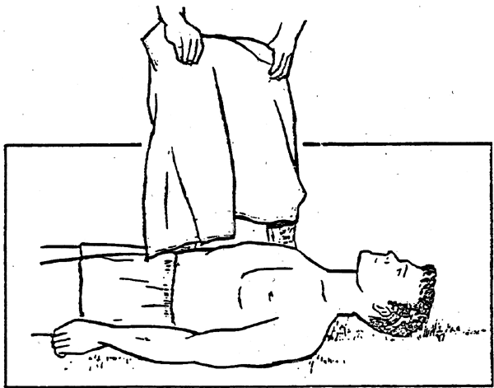
Shock

Slide 2
Outlines
Definitions
Signs and symptoms of shock
Classification
General principles of management
Specific types of shock

Slide 3
Definitions
Shock: is a disturbance of circulation leading to inadequate perfusion of vital tissues and with a wide variation of systemic effects.
Normal tissue perfusion: requires three intact mechanisms:
1- A functioning pump (heart)
2- Adequate volume (blood and plasma)
3- An intact vascular system

Slide 4
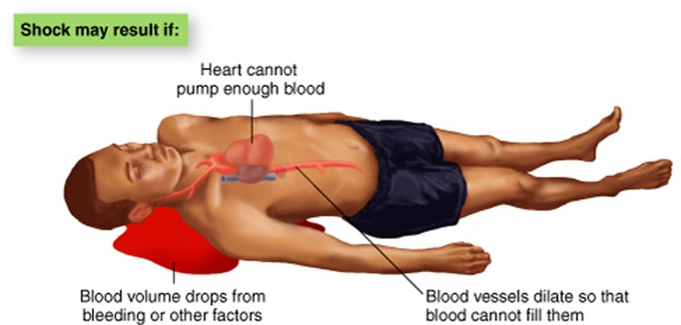

Slide 5
Signs and symptoms
1- confusion and delirium.
2- scared appearance.
3- rapid and shallow respiration.
4- rapid and weak pulse.
5- cold and pale skin.
6- nausea and vomiting.
7- reduced blood pressure.

Slide 6
Classification of
Shock by cause

Slide 7
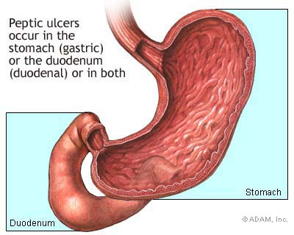
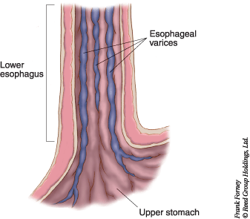
1- Hypovolemic shock
Caused by blood or plasma loss due to:
A- Burns.
B- Bleeding peptic ulcer.
C- Ruptured varices.
D- Extensive fractures.
E- Crushing accidents.
F- External or internal injuries.

Slide 8
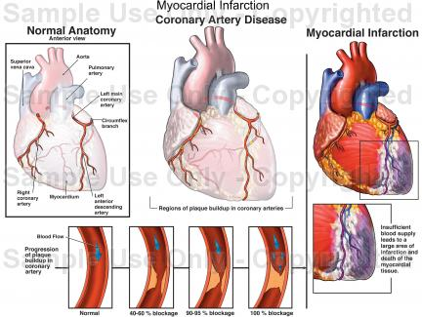
2- Cardiogenic shock
Inability of heart to pump needed blood:
Causes:
1- myocardial infarction.
2- cardiac arrhythmia.
3- pulmonary embolism.
4- myocardial contusion.

Slide 9
3- Neurogenic shock
Caused by failure of nervous system to control diameter of blood vessels.
Causes:
1- severe pain.
2- spinal injury.

Slide 10
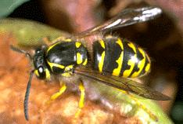
4- Anaphylactic shock
Allergic shock.
Functioning blood vessels is disturbed by sensitivity to injection of a foreign substance.
Causes:
1- insect stings.
2- certain medicines (antibiotics)

Slide 11
5- Septic shock
Occurs in severe infections.
Exotoxins of gram +ve bacteria
(staph aureus)
Endotoxins of gram –ve bacteria
(E coli)
Exotoxin (cell-protein-heat liable)
Endotoxin (cell wall – lipid – heat stable)

Slide 12
General principles of management

Slide 13
1- Carry standard CPR first aid to maintain an open airway, monitor breathing, and prevent further blood loss.
2- oxygen to assist respiration.
3- position: depending on problem
Lower extremity elevation (improve circulation).
Supine position in fracture of extremities

Slide 14
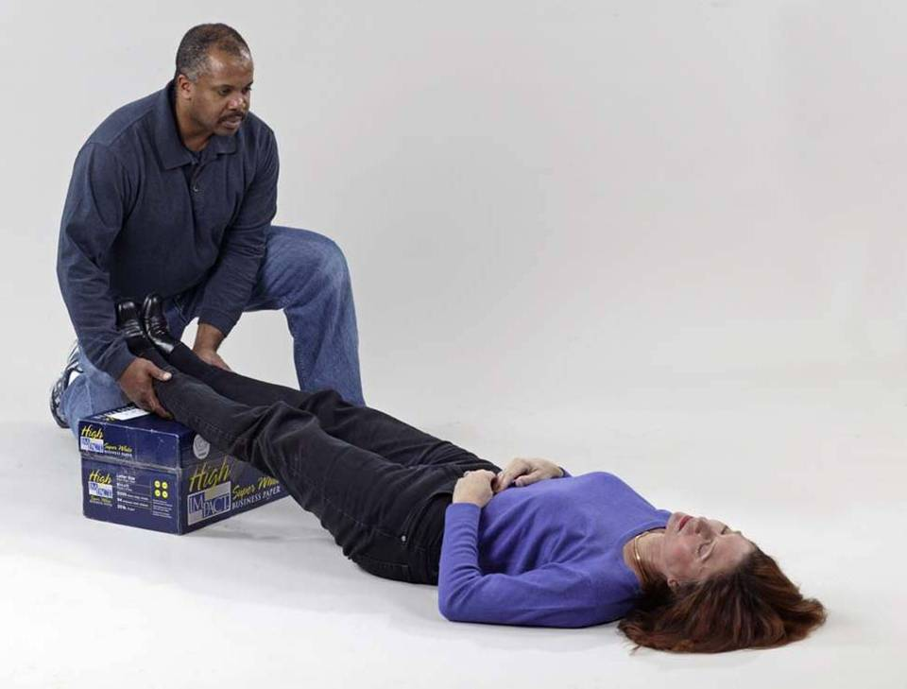

Slide 15
Position an unconscious casualty Semi prone Position on his side with his head turned so fluids can drain from his mouth. Maintains airways open and provide best drainage of vomiting.

Slide 16
Cont.
4- control bleeding.
5- keep normal temperature: cover patient with blanket, remove wet clothings.
6- start I.V line.
7- drug therapy according to physician’s order.
8- monitor all vital signs.
9- avoid movement (head , spine, neck injury)

Slide 17
Specific types of shock
Hypovolemic shock:
Replace volume therapy by I.V fluids
In massive hemorrhage, more than one I.V line is required.

Slide 18
Cardiogenic shock
Continuous oxygen to combat hypoxia.
Correct hypovolemia.
Appropriate therapy.
Measure urine volume (catheter).
Monitor arterial blood gases.

Slide 19
Septic shock
I.V antibiotic therapy.
Continue appropriate therapy after culture and sensitivity results.
Anaphylactic shock
Ensure open airways.
Oxygen administration.
Monitor blood pressure.
Start I.V line.
Hydrocortisone administration.
Antihistaminic.

Slide 20
THANK YOU

