Slide 1
Microbial Growth
CLS 212: Medical Microbiology

Slide 2
Factors Affecting Microbial Growth
There are some factors that affect and control the growth of microorganisms around us, in hospitals, in the laboratory, and in industrial settings. These factors are:
Nutritional factor
Water availability
Temperature
pH
Atmospheric Pressure
Oxygen requirment

Slide 3
Nutritional factor
Nutrients are crucial for microorganisms to survive in the environment.
These nutrients are chemicals that can be broken into essential elements like: carbon, oxygen, hydrogen, nitrogen, sodium, potassium, calcium, iron, ext... which are required for growth.

Slide 4
Enable to synthesis the cell wall – cell membrane – nuclic acid .
These component are made up of building blocks such as fatty acid – sugar – amino acids and nucleotide
These block is made up of variety of elements include carbon+ nitrogen

Slide 5
Element that make up cell constituents called Major element such as [carbon – oxygen – hydrogen- nitrogen – sulfur – phosphours - potassium – magnesium – calcium and iron]
Hetrotropic use organic carbon source (glucose) as source of carbon
Autotrophic use inorganic carbon source (C02) as source of carbon
Autotrophic organism:
They play critical role in the cycling of carbon in the environment because they can convert inorganic carbon (C02) to organic form, in a process called carbon fixation .

Slide 6
Some prokaryotic use Nitrogen gas (N2) in process called Nitrogen fixation, this process Unique to prokaryotic.
It require Phousphours and iron in a low concentration for a maximum level of growth, but it is limiting nutrient.
Trace elements : require a vary minute amount by all cells ( zinc – copper – manganese –cobalt and molybdenum ). Which are required for enzyme function .

Slide 7
Growth factors :
Low molecular weight compounds required by a particular bacteria that can not synthesize their cell constituents' (amino acids – vitamins –pyrimidines )example Nisseria spp. (fastidious )
Energy source :
Phototrophs: Organisms that harvest the energy of sunlight (algea –plants –photo synthetic bacteria)
Chemotrophs: Orgasnisms that obtain energy by oxidizing chemical compound (mamalian cells- fungi- many type of bacteria)

Slide 8
Water availability
All organisms on planet need water for their metabolic processes and most will die if moisture is too little.
Some bacteria and parasites can stay dormant in spores and cysts until moisture is available for their growth.
NacL , sugar interact with water , make the water not available for the cell.

Slide 9
Osmotic Pressure and Salinity
Most microorganisms prefer to live in isotonic solutions
isotonic solutions : where the concentration of the solute out side the cell is equal to concentration of the solute inside the cell .
Hypotonic solutions: where the concentration of the solute out side the cell is less than the concentration of the solute inside the cell , that cause microbial cells to swell then burst (die).
Hypertonic solutions: where the concentration of the solute out side the cell is greater than concentration of the solute inside the cell, that cause microbial cells to shrink plasmolysis(inhibiting growth).
Some bacteria can tolerate the high salt concentration 10% NaCL halotolerant EX. Staphylococcus in a dry salty skin .
Some microorganisms are halophilic require 3% i.e prefer salt environment to grow (salt lovers) e.g marine bacteria
Some bacteria extreme halophiles require 9% e.g. microorganisms living in the Dead Sea.

Slide 10
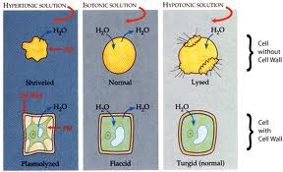
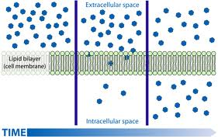

Slide 11
Temperature
Microorganisms have optimum temperature required for growth, this temperature depends on their enzymes.
The temperature (which ranges from minimum to maximum growth temp.) is different from one organism to another.
Microorganisms can be classified according to their preferred temp. into:
Thermophiles: microorganisms that grow best at high temp. 45-80°C (heat lover) e.g. organisms living in hot springs, archaea,...
Mesophiles: microorganisms that grow best at moderate temp. 15-40°C e.g. Normal Flora, most bacteria.
Psychrophiles: microorganisms that grow best at low temp.
-5_ 10°C (cold lover) e.g Bread Mold.

Slide 12
pH
Most microorganisms prefer a neutral or slightly alkaline growth medium pH 7-7.4. ( neutrophiles)
Some bacteria adopt special mechanisms to enable them to grow al low PH Ex . Helicobacter pylori that grow in the stomach causing ulcer .
The H. Pylori produce urease enzyme that neutralize the surrounding area by splitting urea in stomach into CO2 and ammonia the ammonia will neutralize the surrounding media of the bacteria
Some microorganisms like acidic or alkaline environments so are classified into:
Acidophiles: microorganisms that grow best in acidic media pH 2-5 e.g. Fungi.
Alkaliphiles: microorganisms that grow best in alkaline media pH 8.5-11 e.g. Vibrio cholera (the only alkaliphilic human pathogen).

Slide 13
Atmospheric Pressure
Most bacteria live at normal atmospheric pressure (14.7 psi) and are not affected by minor changes in it.
Some like very high atmospheric pressure (Barophiles) like in oil wells and deep oceans.

Slide 14
Oxygen requirment
Microorganisms can be classified according to the requirement of oxygen to survive into:
Obligate aerobes: have absolute requirement of 20-22% O2 aerobic respiration.
Obligate anaerobes: cannot multiply in in the presence of O2. killed by toxic derivatives . Ex. Clostridium botulinum use fermintation anaerobic respiration.
Microaerophiles: require 2%- 10% only of O2. for aerobic respiration; higher concentration are inhibitory H. Pylori.
Facultative anaerobic : grow better in the presence of O2 use fermentation or anaerobic respiration in absence of o2 , in the presence of o2 aerobic respiration . Ex Ecoli
O2 can be converted into number of compound highly toxic as superoxide - superoxide dismutase enzyme that convert superoxide into non toxic derivative.

Slide 15
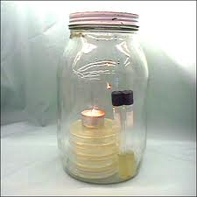
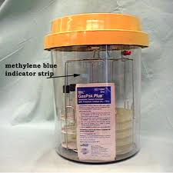
Some microorganisms are Capnophiles i.e. require 5-10% of CO2 for their growth. Nisseria – haemophilus
Using a candle jar consume O2 providing CO2 + H2O.
for microaerophilic we use special packet holds chemical that react with O2 to be reduced to 5-15 % O2 .

Slide 16
Bacterial Growth In Vitro
In order for bacteria to grow in the laboratory it need appropriate growth medium and special environmental conditions like temperature, pH, O2,.. to multiply.
Bacteria can be cultured on many different culture media according to its nutritional needs such as Nutrient Agar, Blood Agar, Mac Conkey Agar, CLED,..
After inoculation of media, they should be incubated in chambers to maintain appropriate environment. Temperature and time of incubation differ for each type of bacteria to grow.

Slide 17
Bacterial Count
Microbiologists tend to measure the number of bacteria present in a liquid for quality control purposes in FDA (Food and Drug Administration) monitored fields e.g. dairy farms, drinking water supply, drug industry...
This is done by measuring:
The total number of bacteria present in the sample (dead and alive bacteria) counting chamber
Coulter counter instrument that count cell in a suspension as they pass through a minute aperture
Flow cytometer similar to coulter counter except it measure the light scattering of light by cells as they pass by a laser.

Slide 18
The Viable Plate Count Method
Serial dilutions of the sample are prepared.
From each dilution, 1ml or 0.1ml is inoculated on Nutrient Agar media.
All the plates are incubated for 24hours at 37°C.
After incubation, the bacterial colonies are counted from the plates. Then the number is multiplied by the dilution factor to get the number of bacteria in the original sample.

Slide 19
Pour plate method 0.1 ml -1ml
Spread plat 1ml-2ml
Count expressed as colony forming units

Slide 20
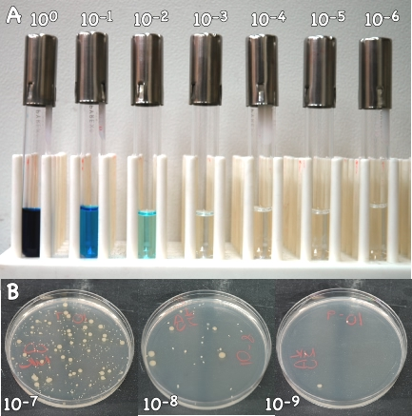
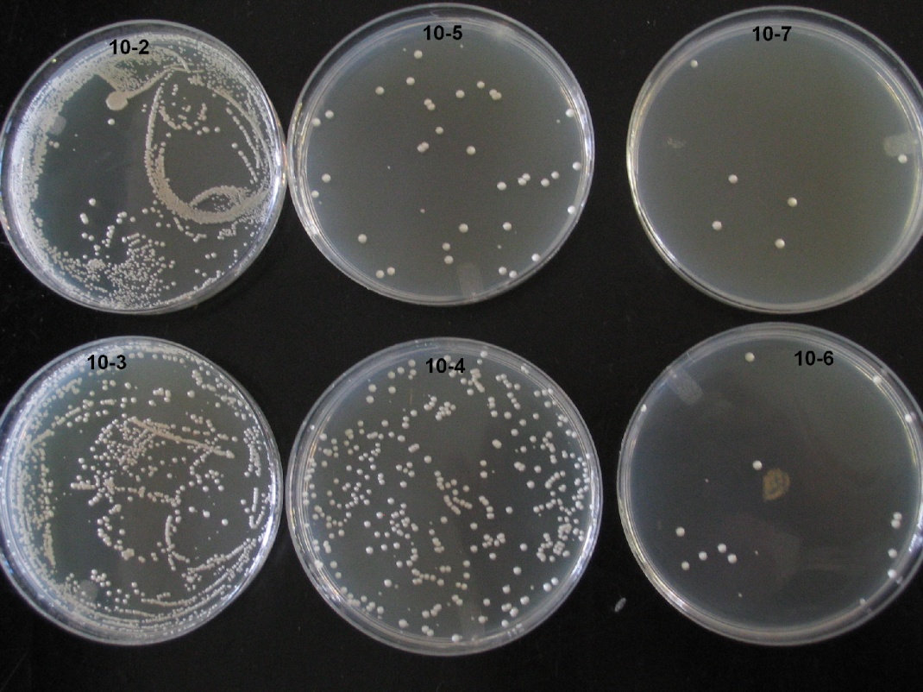

Slide 21
Bacterial Growth Curve
In order to plot a growth curve for a certain bacteria, a pure bacterial broth is to be prepared and incubated. Then a sample is collected from the broth every 30 minutes and a viable plate count is done on each sample.
The data is then plotted on a logarithmic graph paper where the x-axis represent the incubation time and the y-axis represent the log10 of the number of viable bacteria.

Slide 22
4 Phases in a Bacterial Growth Curve
Lag Phase: where the bacteria absorb nutrients, synthesize enzymes, and prepare for division. There is no increase in bacterial number in this phase.
2. Log Phase ( exponential phase): where rapid multiplication occur causing very high increase in the number of bacteria.
Stationary Phase: where the nutrients in the media decrease and the toxic waste resulting from bacterial metabolism increase. As a result, the multiplication is slowing down. The number of dividing bacteria equals the number of dead bacteria.
Death Phase: where overcrowding occurs and the bacteria are dying very rapidly because of lack of nutrients and accumulation of toxic waste. Very few bacteria will remain alive in this stage.

Slide 24
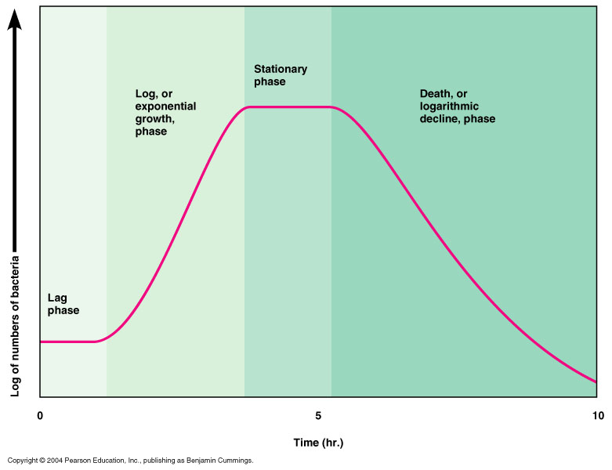

Slide 25
Cultivation of prokaryotic in the lab.
1. complex media:
1.Pepton: amino acids and short peptide with enzyme, acid or alkaline.
2. Extract: water soluble component of substance ex. Beef extract+ vitamins + mineral and other .
3. nutrient broth : pepton + beef extract .
4. nutrient agar : nutrient broth + agar.

Slide 26

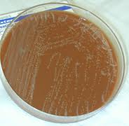
2. Enriched media
1.blood agar : nutrient agar with 5% sheep red blood cell. Fastidious organism
2. chocolate agar : lysed red blood and additional nutrition more fastidious organism.

Slide 27
3. selective media : to isolate or detect a bacteria of mixed population we use this type of media.
1. Thayer martin agar : Nisseria gonorrhoae
chocolate agar with 3 antimicrobial agent
( fungi , gram +ve bacteria , gram –ve bacteria )
2. macConkey agar: to isolate gram –ve rod
peptone +crystal violte inhibit gram positive bacteria and bile salt inhibit non intestinal bacteria

Slide 28
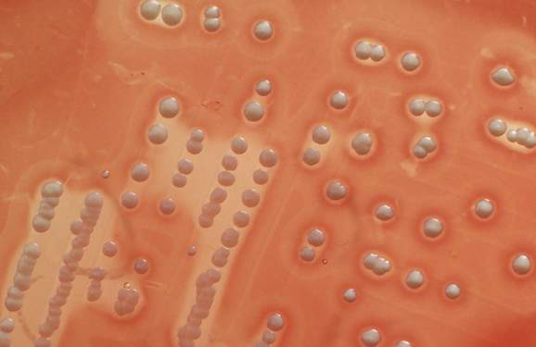
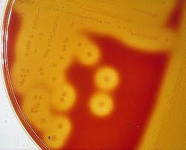
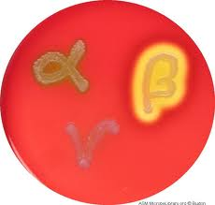
4. Differential media :
nutritional and differential media
Blood agar: haemolysis α haemolysis in complete haemolysis green color streptococcus sp.
β haemolysis complete haemolysis transparent colorless streptococcus pyogenes

Slide 29
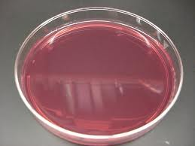
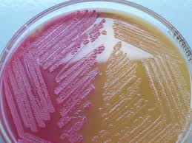
macConkey: lactose fermenting colony Ecoli

